Slide 1

4 bit multiplier Circuit
Lisa Jacklin

Slide 2
Planned Attack
VHDL
C++/C
Assembly

Slide 3
Starting with VHDL

Slide 4
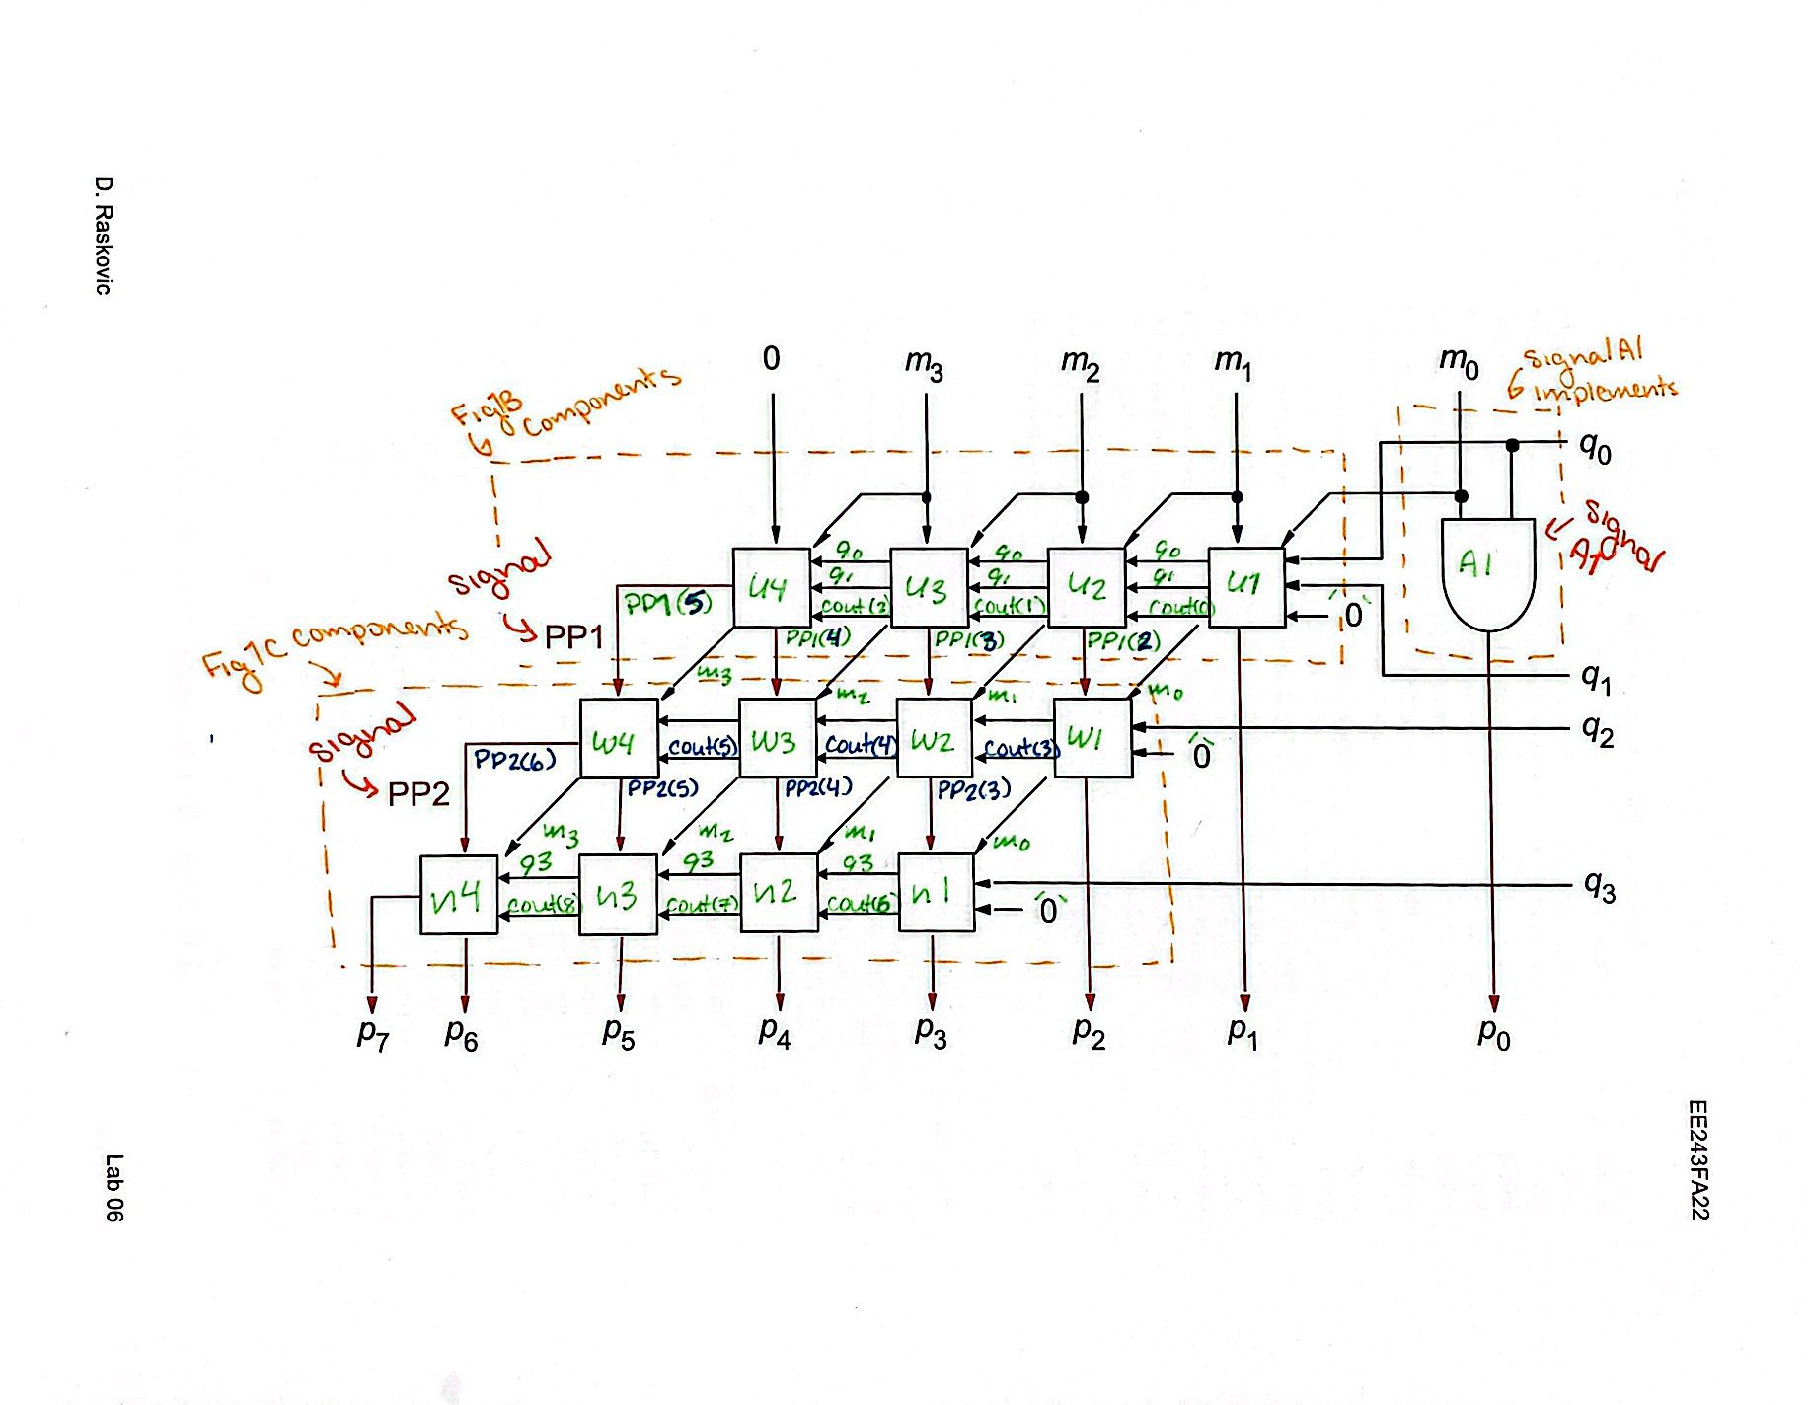
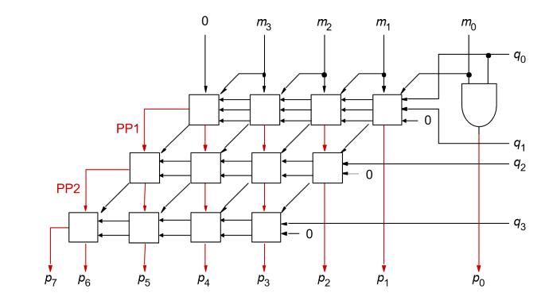
VHDL Code and Circuits

Slide 5
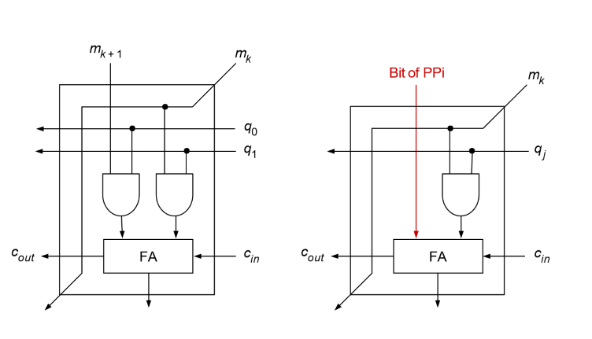
VHDL Subcircuits
Top Row Boxes
Second and Third Row Boxes

Slide 6
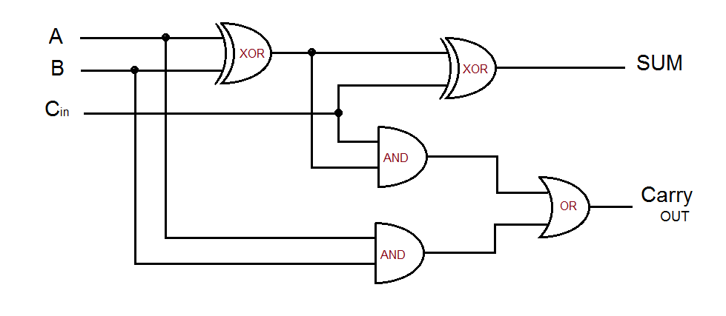
VHDL Full Adder Subcircuit

Slide 7
Code Slide

Slide 8
C++ Conversion

Slide 9
Started with Functions for each subcircuit:
Inlcude an image of the VHDL circuit and the attempted code for each one….Might only begin with the Adder and one of the subcircuits.

Slide 10
Preliminary Issues
Display the main circuit image and discuss how the prelimilary values ( and zoom into the interior arrow between the boxes) and explain the issues I had with figuring out how to display this in a way that would work in all cases and still act as buffers or in VHDL terms, “Signals”

Slide 11
Attempting Assembly

Slide 12
Assembly Code

Slide 13

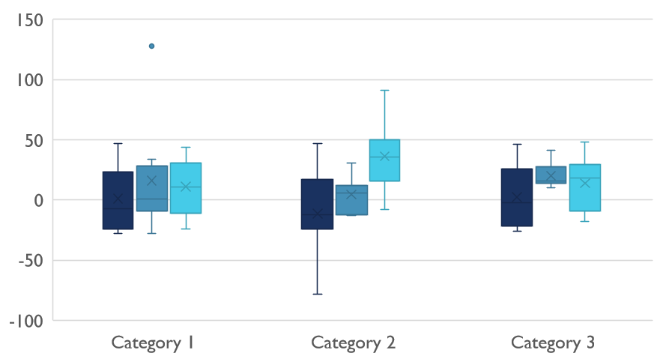
Struggles and Learning things

Slide 14

Thank You
Github Link:

