Slide 1

ProgLLM: Building a Tutoring Platform with LLM-powered programming Lisa Rebecca Schmidt 12. Apr. 2024

Slide 2
Research Question
How well can large language models create a study-assistant platform?

Slide 3
Approach
Experiment
We want to create a study advisor platform which helps students in three specific areas:
AI Tutor
Studying for the exam with comprehensive questions
Done by Lisa
AI Counsellor
Talking about your stress and feelings
Done by David
AI Semester Planner
Planning which courses you want to take
Done by Jeta
Evaluation of each Experiment
Number of prompts needed
Number of syntax errors occurred
Number of semantic errors occurred
Only evaluate for Design Time

Slide 4
Demo Time ☺ ../Create_Course.webm ../Study_Session.webm

Slide 5
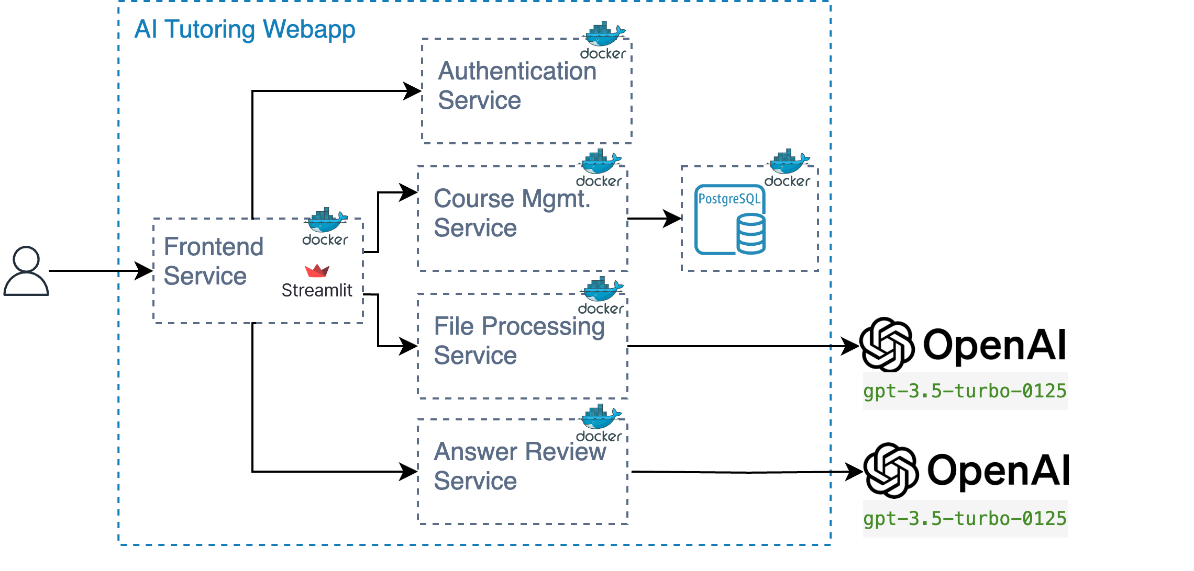
Architecture Overview
A complex architecture allows to evaluate LLMs for enterprise use-cases.

Slide 6
Quick Metrics
Prompts Needed | Syntax Errors/Compatibility | Code did not fit Requirements
92 | 8 | 11
Authentication and frontend needed most, file storage in single prompt | Mainly obsolete libraries or incompatible configurations | Code not production-ready, only method stubs
Overall, app development was significantly sped up (ca. 40hrs).

Slide 7





Five Great Use-Cases for LLMs in SoftwareDev
User Personas | Dummy Data | Tests | Translation of Instructions | Troubleshooting
Understand user needs and preferences. | Generate placeholder data for your database. | Quickly cover many different test cases. | Ex. transform CURL to python. | Get friendly help without describing the problem in technical terms.

Slide 8

Common Problems and Remedies
How can I get the LLM to do its job?
 | Obstacle |  | Remedy
 | "This task would require a team of developers ..." / "I can provide a basic implementation …" |  | Prompt: "You are a team of experienced [XYZ-] engineers"
 | “This is not for production setup, you should use XX" |  | Prompt: “Design it to be production-ready”
 | Incompatible or obsolete interfaces in libraries/dependencies |  | Ask for the version pip install XXX==V.V
 | Identical configuration across services (ex. Everything on port 5000) |  | Prompt: “Provide a configuration file with environment variables for all ports”
 | Terms like "OpenAI Function Calling" refer to a specific concept, but are not recognized as such |  | Provide example/ few shot

Slide 9
Impact of LLM depending on developer skill
Not to scale; higly indicative
Developer Productivity
Limited applicability for SW Architects
Productivity Gains largest for experienced Users
Enablement of “unskilled” workers
Developer Skill & Experience

Slide 10
Research Question & Answer
How well can large language models create a study-assistant platform?
With applicable prior experience, a shippable assistant platform can be developed in 40hrs and 90 prompts.

Slide 11
Thank you for listening! ☺

