Slide 1
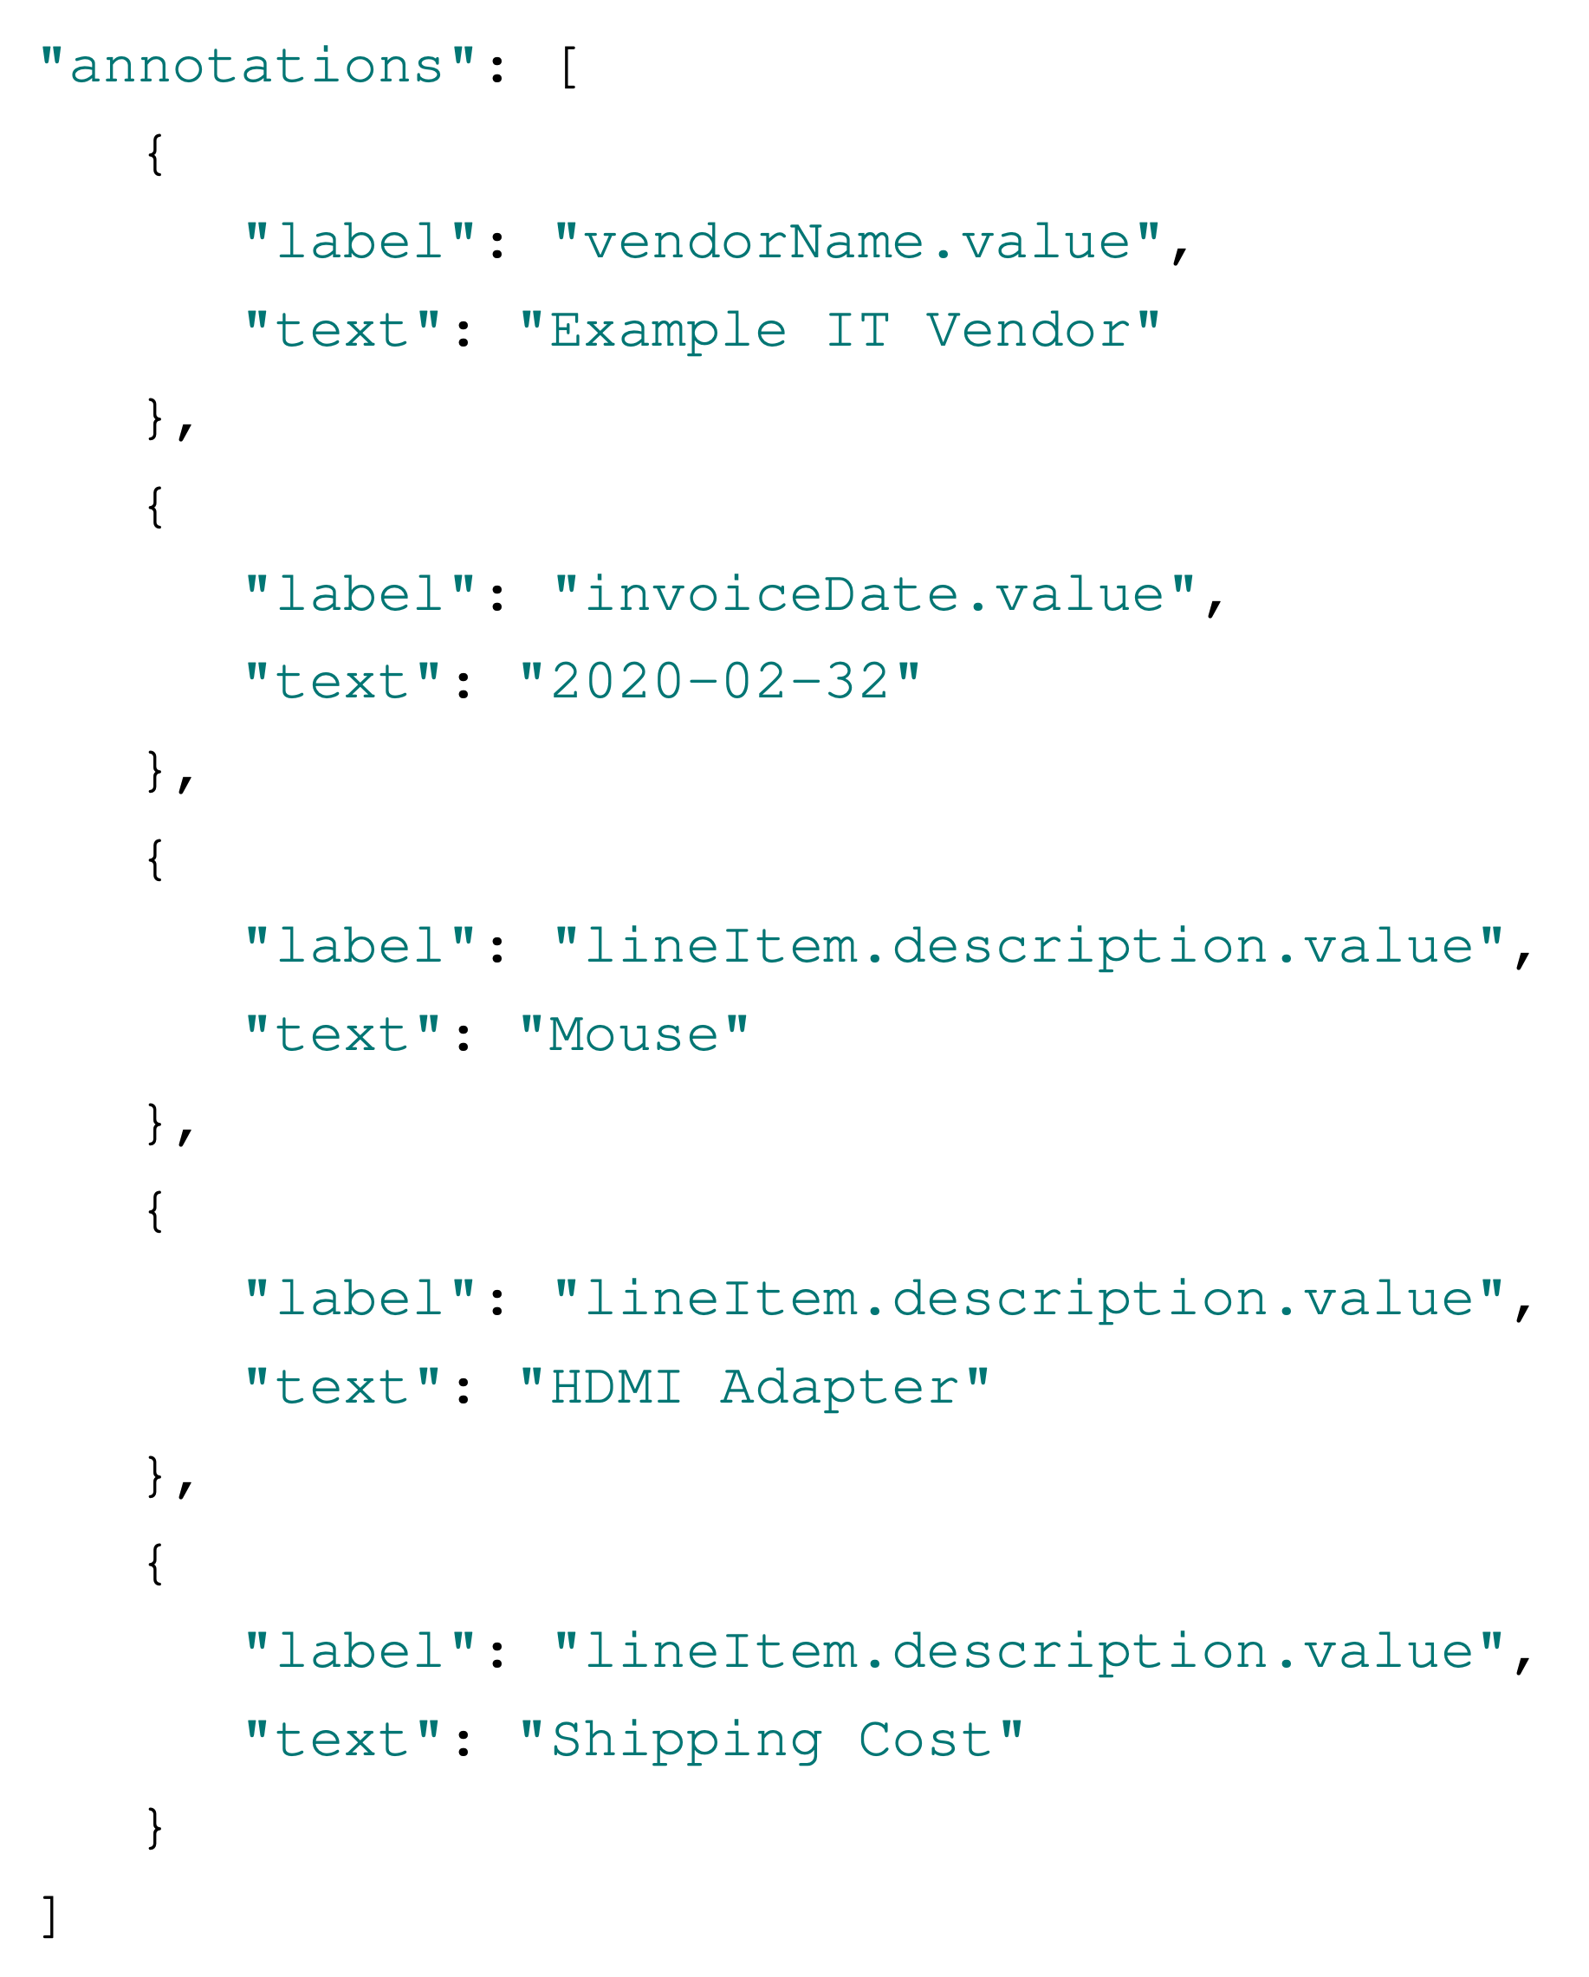
DataFrame invoices
invoice | vendorName.value | invoiceDate.value
1 | Example IT Vendor | 2020-02-32
DataFrame line items
line item | lineItem.description.value
1 | Mouse
2 | HDMI Adapter
3 | Shipping Cost

Slide 3
𝜽

Slide 4
Whole sum spent
Bubble Chart of Spending Categories
Timeline spending over the years

