Slide 1
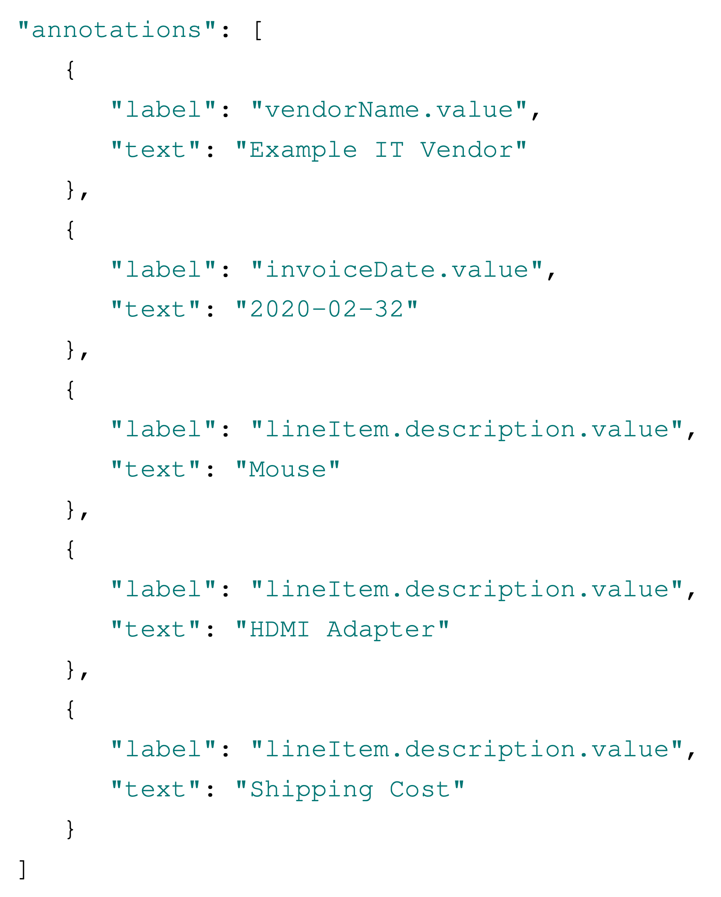
DataFrame invoices
invoice | vendorName.value | invoiceDate.value
1 | Example IT Vendor | 2020-02-32
DataFrame line items
line item | lineItem.description.value
1 | Mouse
2 | HDMI Adapter
3 | Shipping Cost

Slide 3
𝜽

Slide 4
Whole sum spent
Bubble Chart of Spending Categories
Timeline spending over the years

Slide 5
Input
Bob | is | taller | than | Alice
Random Masking
Bob | is | [?] | than | Alice
Generate Embeddings
BERT
0.0020%
…
16%
…
0.0018%
Aardvark
…
taller
…
Zyzzyva
Predict the masked Word

