Slide 1
Parameter | GCReW Marsh | Housatonic River/ Wheeler Marsh
Characterized vegetation | Spartina patens, Distichlis spicata, Schoenoplectus americanus, Iva frutescens and Phragmites australis (Source: Pat Megonigal, personal communication) | Wheeler: “Low marsh” classified as sparse Spartina alterniflora and mudflat. “Mid marsh” classified as dense Spartina alterniflora. “High marsh” representative of Spartina patens and Distichlis spicata (Source: Lamb et al., 2021)
Wetland Area (hectare) | 22 (high marsh) (Source: Tzortziou et al., 2008) | 223 (total) (Source: Long Island Sound Study)
Tidal range (m) | 0.44 (Source: Pat Megonigal, personal communication) | > 2 (Source: Lamb et al., 2021)
Salinity range (PSU) | 0 – 16 (Source: Menendez et al., submitted) | 0 – 33 (Source: Tzortziou lab)
[DOC] (mg L⁻¹) measured range | 3.6 – 14.8 (Source: Menendez et al., submitted) | 1.1 – 6.9 (Source: Tzortziou lab)
aCDOM (300 nm) (m⁻¹) range | 6.1 – 80.9 (Source: NASA C Cycle ISCO data, SERC) | 3.0 – 37.4 (Source: Tzortziou lab)
S275-295 (nm¹) range | 0.0128 – 0.0233 (Source: NASA C Cycle ISCO data, SERC) | 0.0127 – 0.0223 (Source: Tzortziou lab)
S350-400 (nm¹) range | 0.0137 – 0.0218 (Source: NASA C Cycle ISCO data, SERC) | 0.0144 – 0.0183 (Source: Tzortziou lab)
S_{R} range | 0.700 – 1.521 (Source: NASA C Cycle ISCO data, SERC) | 0.752 – 1.337 (Source: Tzortziou lab)
a*CDOM (300 nm) (m² g⁻¹) range | 1.41 – 6.74 (Source: NASA C Cycle ISCO data, SERC) | 1.78 – 5.44 (Source: Tzortziou lab)
Average [DOC] (mg L⁻¹) | 6.97 | 2.71
NDOC (mg L⁻¹) using aCDOM (300 nm) | 3.33 | 1.03
Average NDOC percent | 48% | 38%

Slide 2
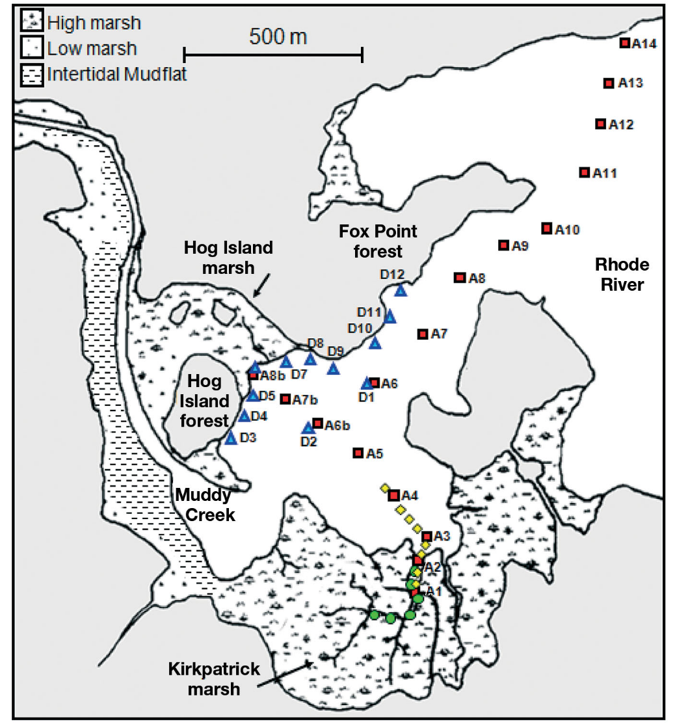
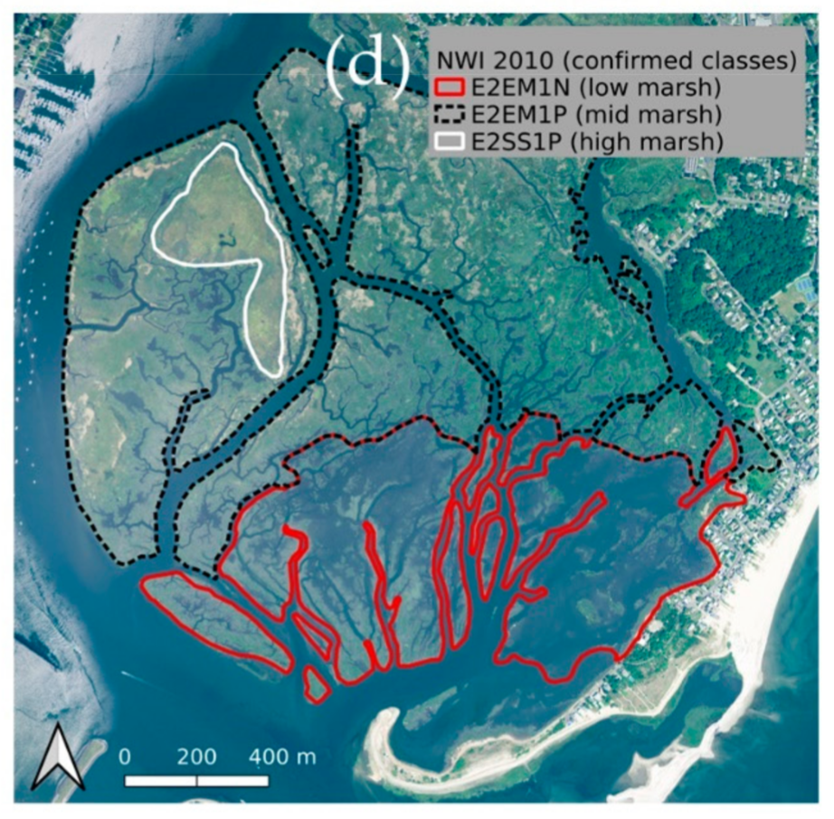
Marsh Delineations
(Tzortziou et al., 2011)
(Lamb et al., 2021)

Slide 3
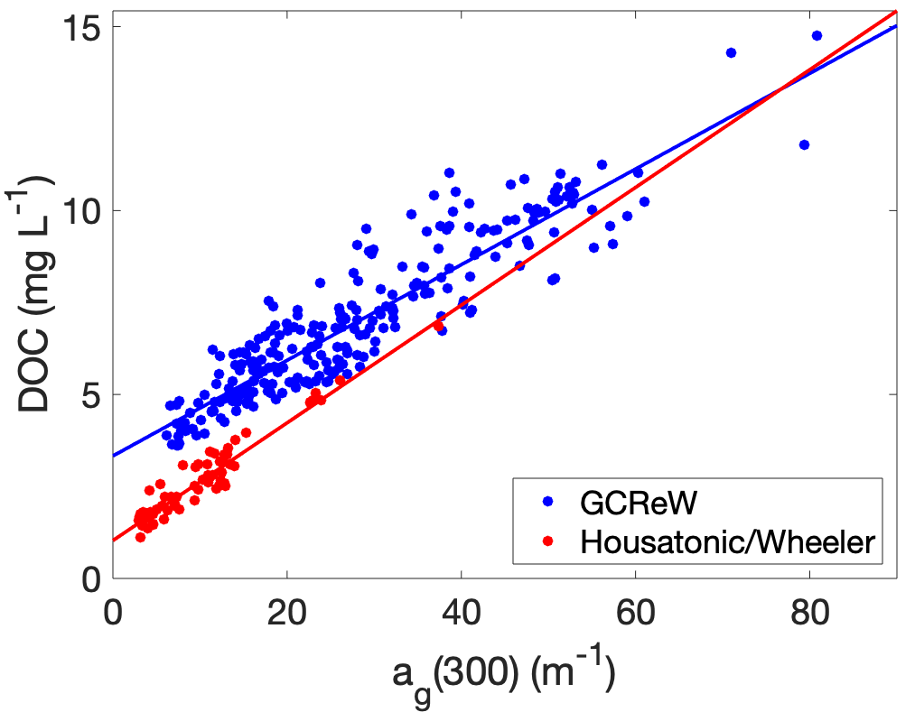
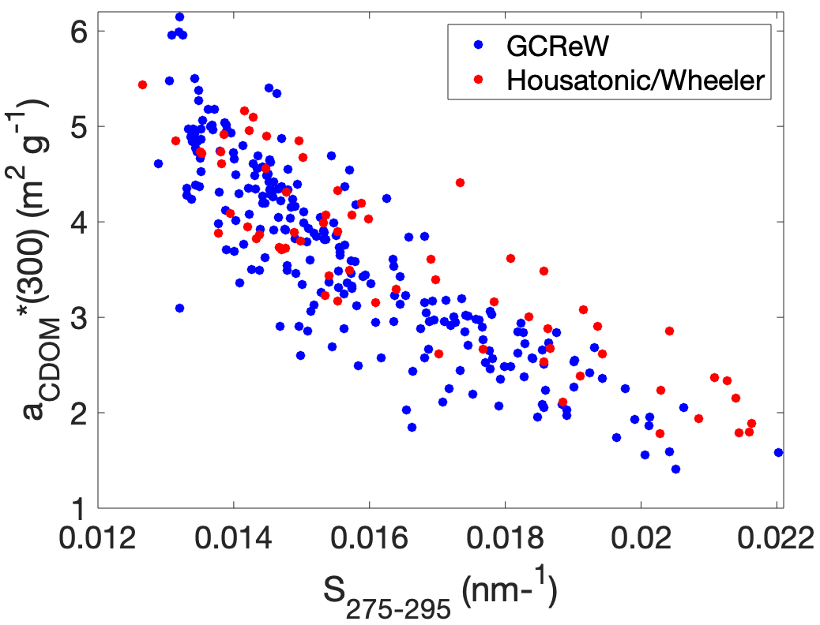
System Comparisons of [DOC], aCDOM, DOC-specific CDOM absorption, and S275-295
NDOC was estimated from the y-intercept of linear fit.
Data from GCReW is from all tidal stages and seasons. GCReW DOC used in this relationship had flagged samples excluded (samples were flagged when there was > 10% half-difference between duplicate measurements or DOC values proved to be outliers beyond observed seasonal and or tidal variability in the DOC-a_{g}(300 nm) relationship). S275-295 nm data was flagged for GCReW from May and June 2015 because of anomalously low values. Housatonic and Wheeler data is from all tidal stages and extends from the Housatonic River, through the Wheeler Marsh channels, extending to the Housatonic plume-region within the estuary.

Slide 4
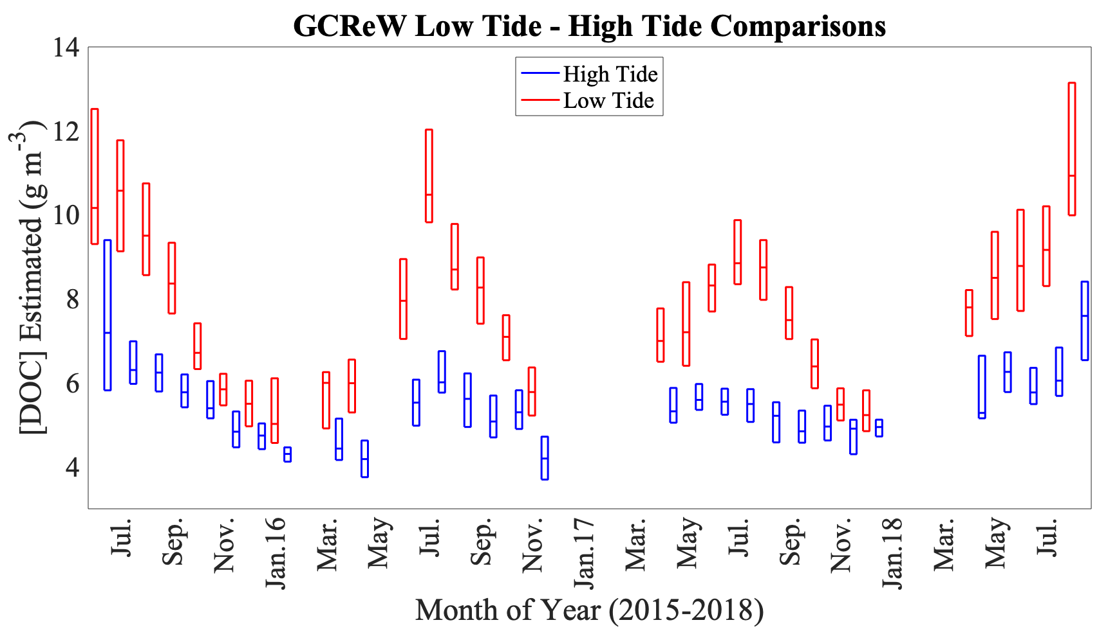
This figure is from our submitted GCReW paper on lateral fluxes and is shown here to emphasize the tidal and seasonal controls on [DOC] within the GCReW tidal creek. We don’t have this extent of tidal and seasonal data for the Housatonic River mouth.

Slide 5
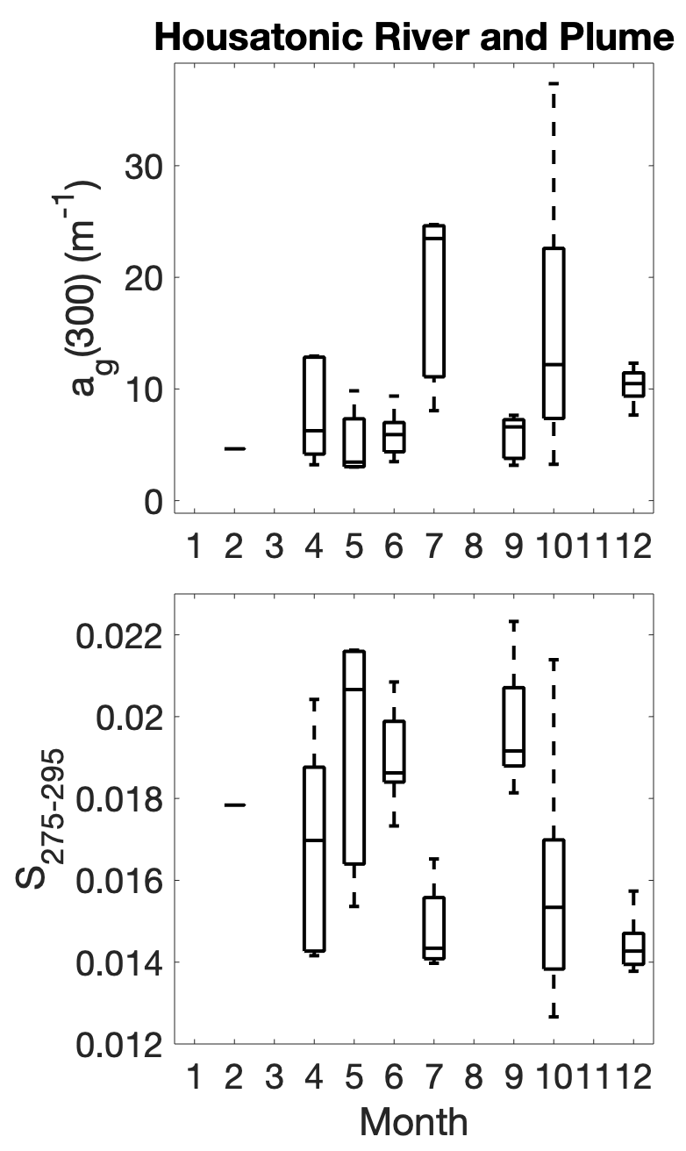
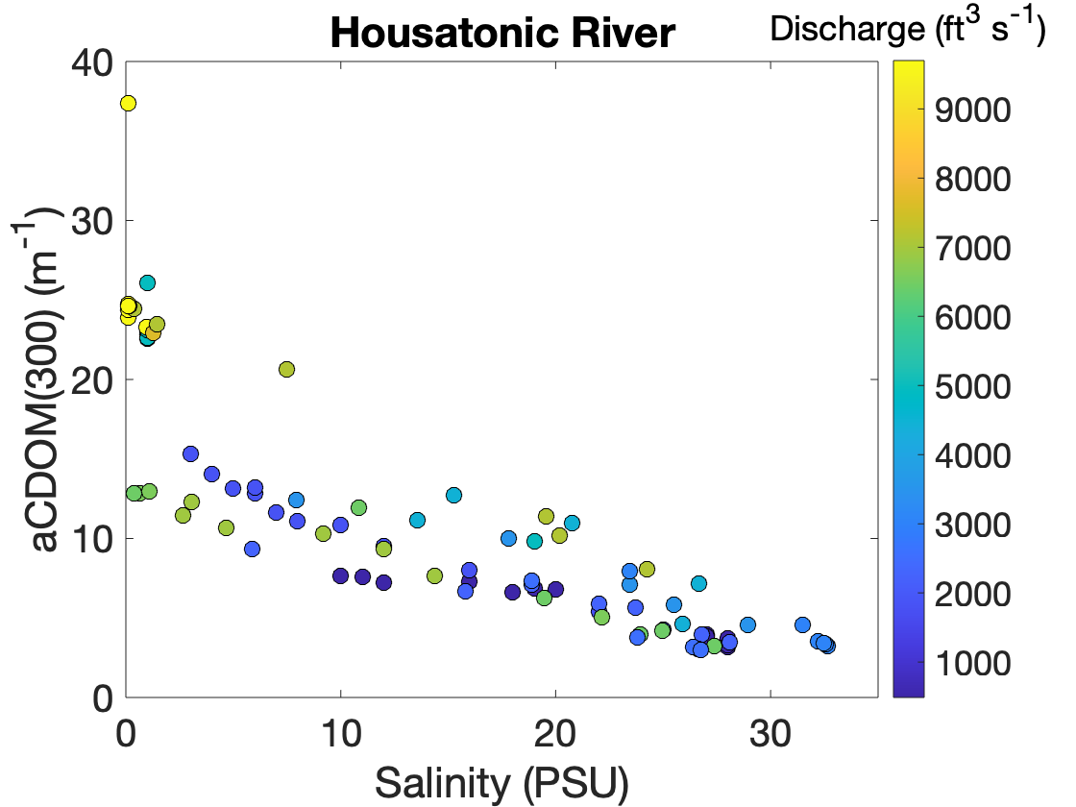
This highest aCDOM point is from a wetland channel up-river, not from the main stem of the Housatonic River.
Mean daily discharge from the USGS Stevenson Dam site.
The high range of aCDOM and S275-295 shown to the left for Housatonic/Wheeler can be attributed to capturing different tidal phases and mixing across the river-estuary continuum. We do not have even distributions of data for all months over different tidal phases to speak much to seasonal trends for the Housatonic/Wheeler system (PARAFAC components could possibly shed some light on seasonal trends for the Housatonic River seasonality in DOM composition).

Slide 6
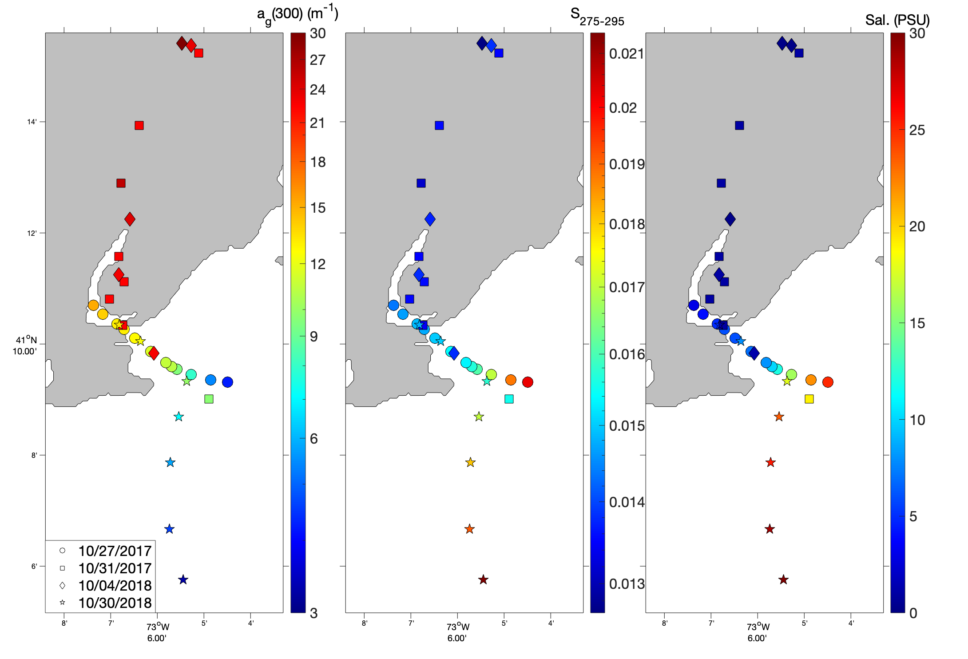
October
Housatonic
Transects

Slide 7
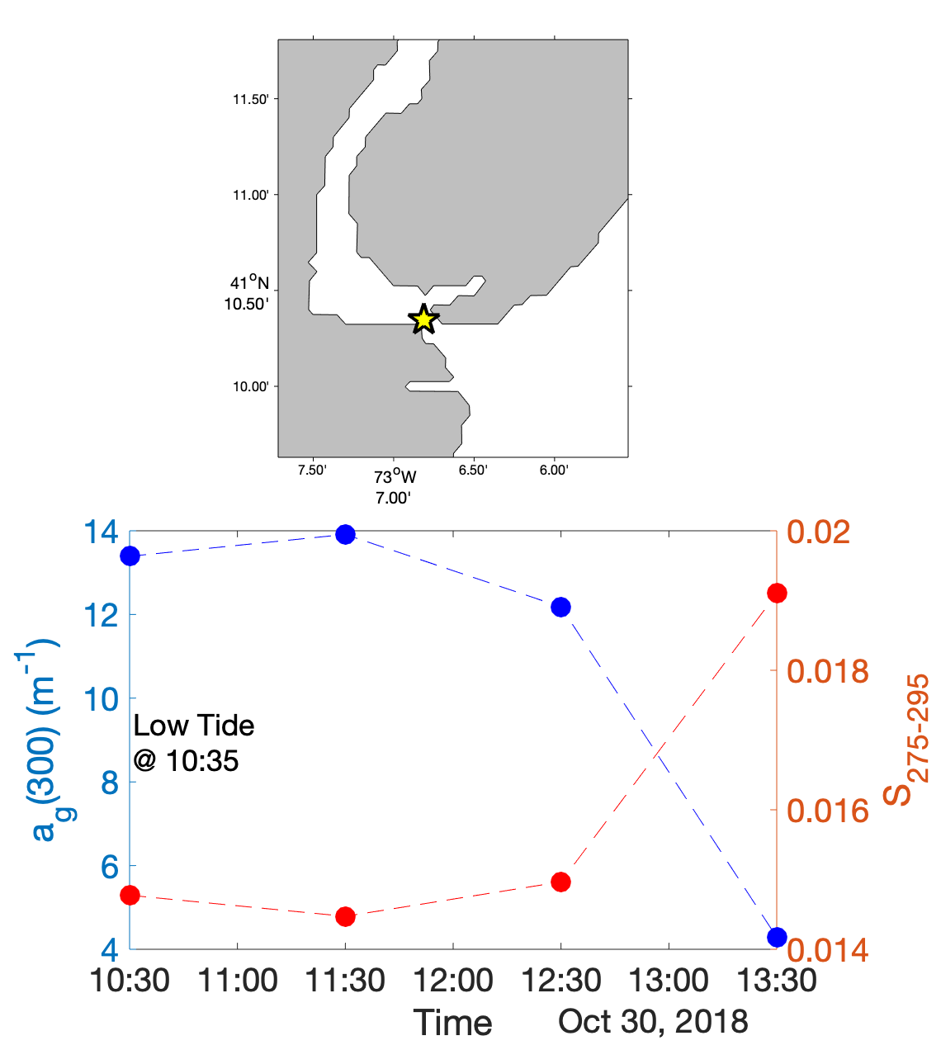
Stationary sampling at one location within the Housatonic River mouth at low tide + 3 hours
Strong changes are observed between hours 2 and 3
More tidal sampling needed?

Slide 8
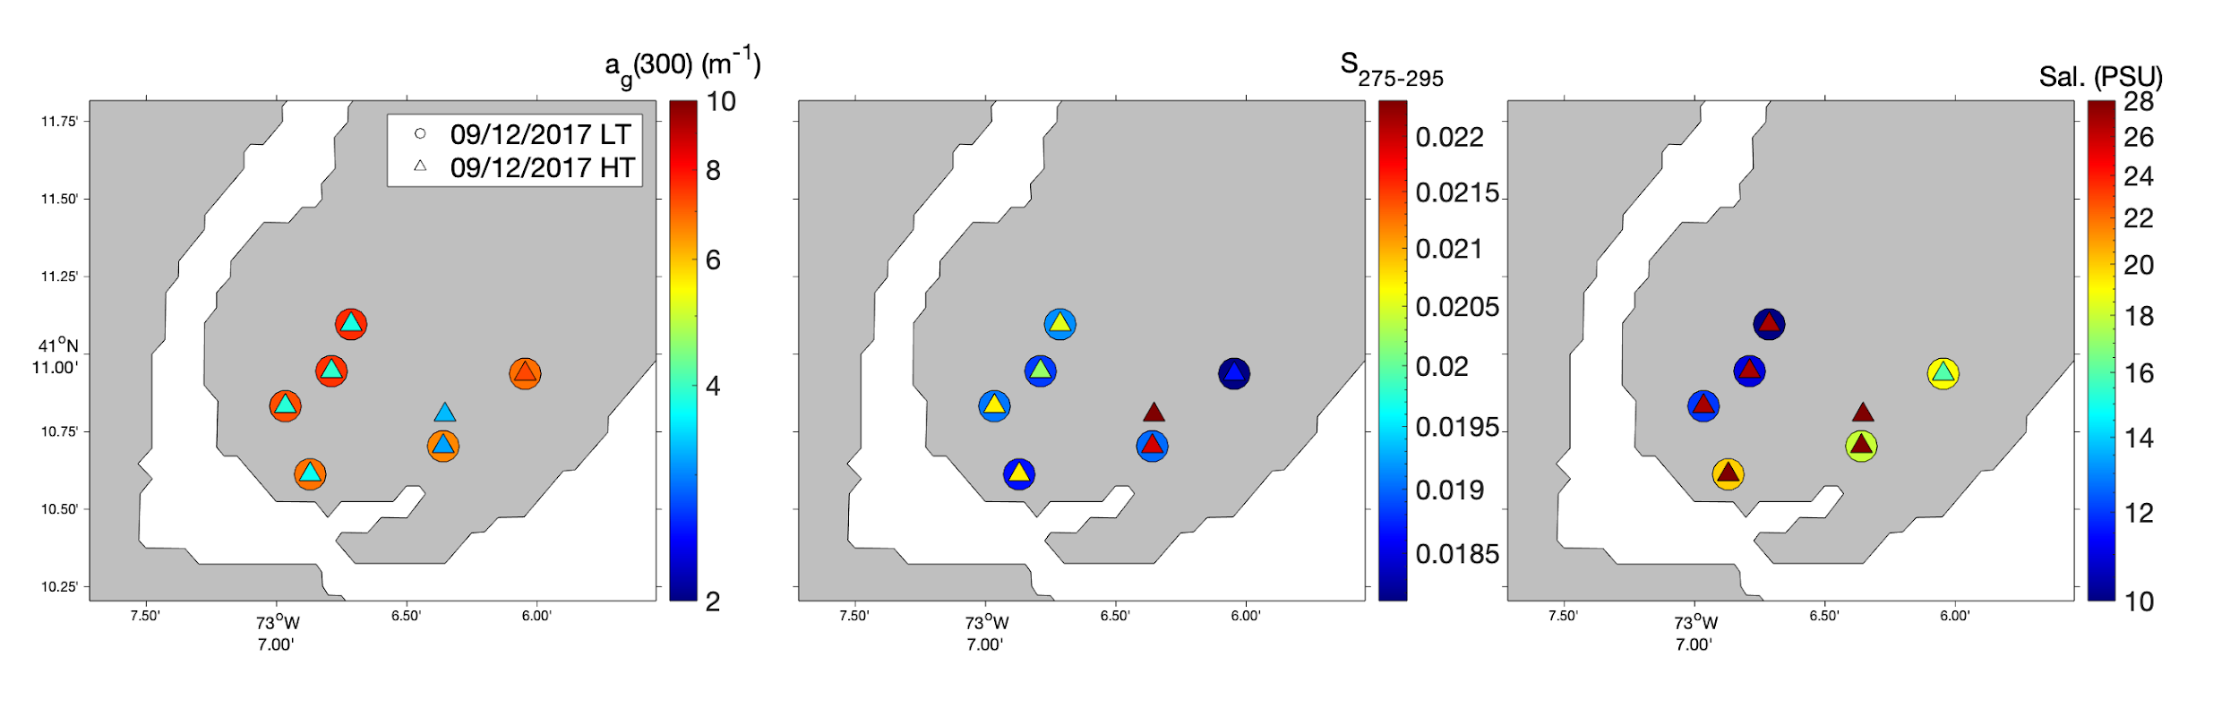
Sampling within Wheeler Marsh Channels: Low Tide versus High Tide

Slide 9
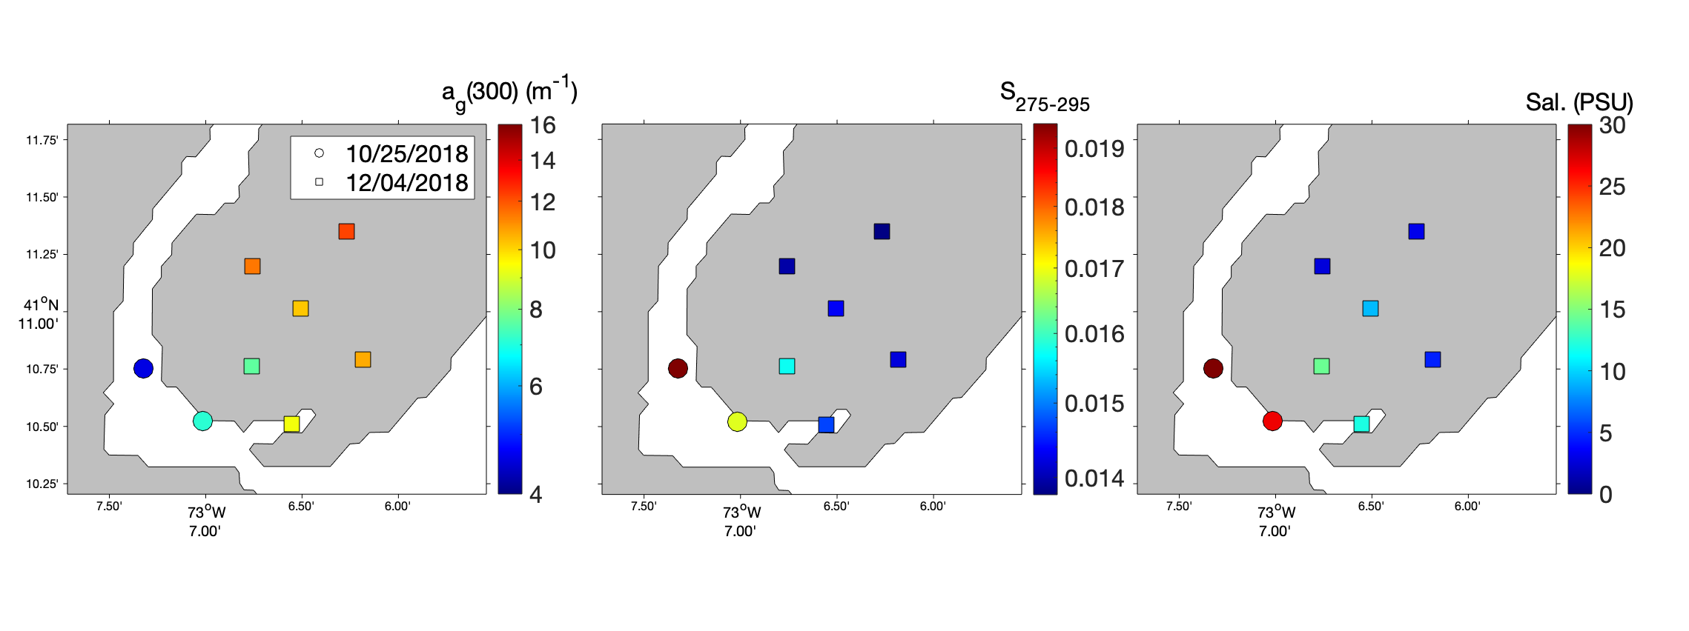

Slide 10
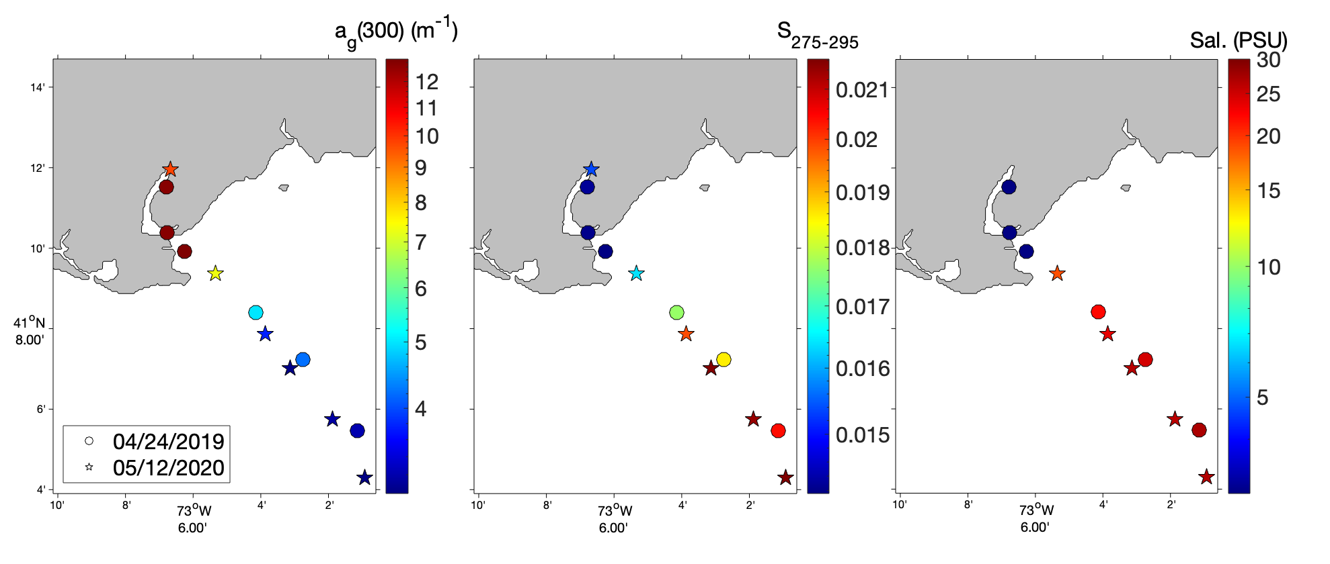
We are missing salinity data for the 05/12/2020 most up-river sample.

Slide 11
