Slide 1


MSIT3820-01-F25 IT Business Intelligence
Final Project
United Healthcare Dataset
Group 3:
Richa Cristina Podakkal,
Swapna Alampally,
Lisa Roman Foss

Slide 2
The Contents
01
Company Overview
02
Problems & Goals
03
ETL, SQL, Python, Tableau
04
Charts & Dashboards
05
Insights, Recommendations, Future Improvements

Slide 3
Company Overview
Multi-hospital healthcare provider.
Handles admissions, treatments, billing, and insurance.
Large volumes of operational and financial data.
Currently lacking centralized analytics capabilities.

Slide 4
Project Dataset
Synthetic healthcare dataset sourced from Kaggle
Contains 55,501 patient records.
Includes details on:
Patient demographics (age, gender, blood type, condition), Providers (doctor, hospital), Insurance information, Admission & discharge dates, Medication and test results, Billing amounts and room numbers.

Slide 5
Current Problems
Data scattered across separate files and systems.
Manual, slow, Excel-based reporting.
No unified patient or billing visibility.
Hard to identify cost drivers and inefficiencies.
No automated dashboards or KPIs.

Slide 6
Company Goals
Improve patient care.
Reduce unnecessary billing.
Track patient patterns.
Improve hospital & provider performance.
Support management with data-driven insights.

Slide 7
Why BI?
Turns raw data into actionable insights.
Improves operational visibility.
Helps reduce cost.
Supports automated dashboards.
Gives leaders accurate information.

Slide 8
BI Approach
Clean and organize the dataset.
Build a structured database (star schema).
Run SQL queries for analysis.
Use Python for data exploration.
Build dashboards in Tableau.
Present insights for decision makers

Slide 9

ETL Process
Raw data
Cleaned data
SQL Star Schema
Python EDA
Tableau Dashboards

Slide 10
Tools & Technologies
Python → Cleaning & EDA
SQL / SQLite → Data modelling
Tableau → Visual dashboards
Excel/CSV → Raw inputs

Slide 11
Star Schema
Fact Table: Billing, Dates, Keys to all dimensions.
Dimensions: Patient, Provider, Service, Payer, Time.
Benefits: Faster querying, Clear relationships, Standardized analytics structure.

Slide 12
Python EDA
Cleaned dataset: fixed types, dates, missing values.
Generated Length of Stay (LOS) feature.
Analyzed patient ages and condition distribution.
Identified billing patterns across groups.
Explored trends in admissions over time.

Slide 13
Feature Engineering
Length of Stay = discharge − admission.
Created age bins (5-year & 10-year groups).
Extracted admission month/year.
Standardized categorical fields.
Improved dataset consistency.

Slide 14
Dashboard 1: Patient Demographics & Clinical Patterns
Age Distribution - Most patients fall between 20–80 years (~4K each), with very few at 10 and 85+.
Age Group Billing Share - Billing is evenly spread, with ages 20–70 each contributing ~14–15%.
Treatment Duration Over Time - All conditions show stable treatment durations from 2019–2024.
Length of Stay by Admission Type - Emergency stays are longest (15.6 days), slightly above elective and urgent.
Patients by Condition & Gender - Conditions have balanced gender counts, roughly 4.6K male/female each.
Billing Distribution Across Age Groups - Billing ranges are consistent across all age groups, peaking around $50K.

Slide 15
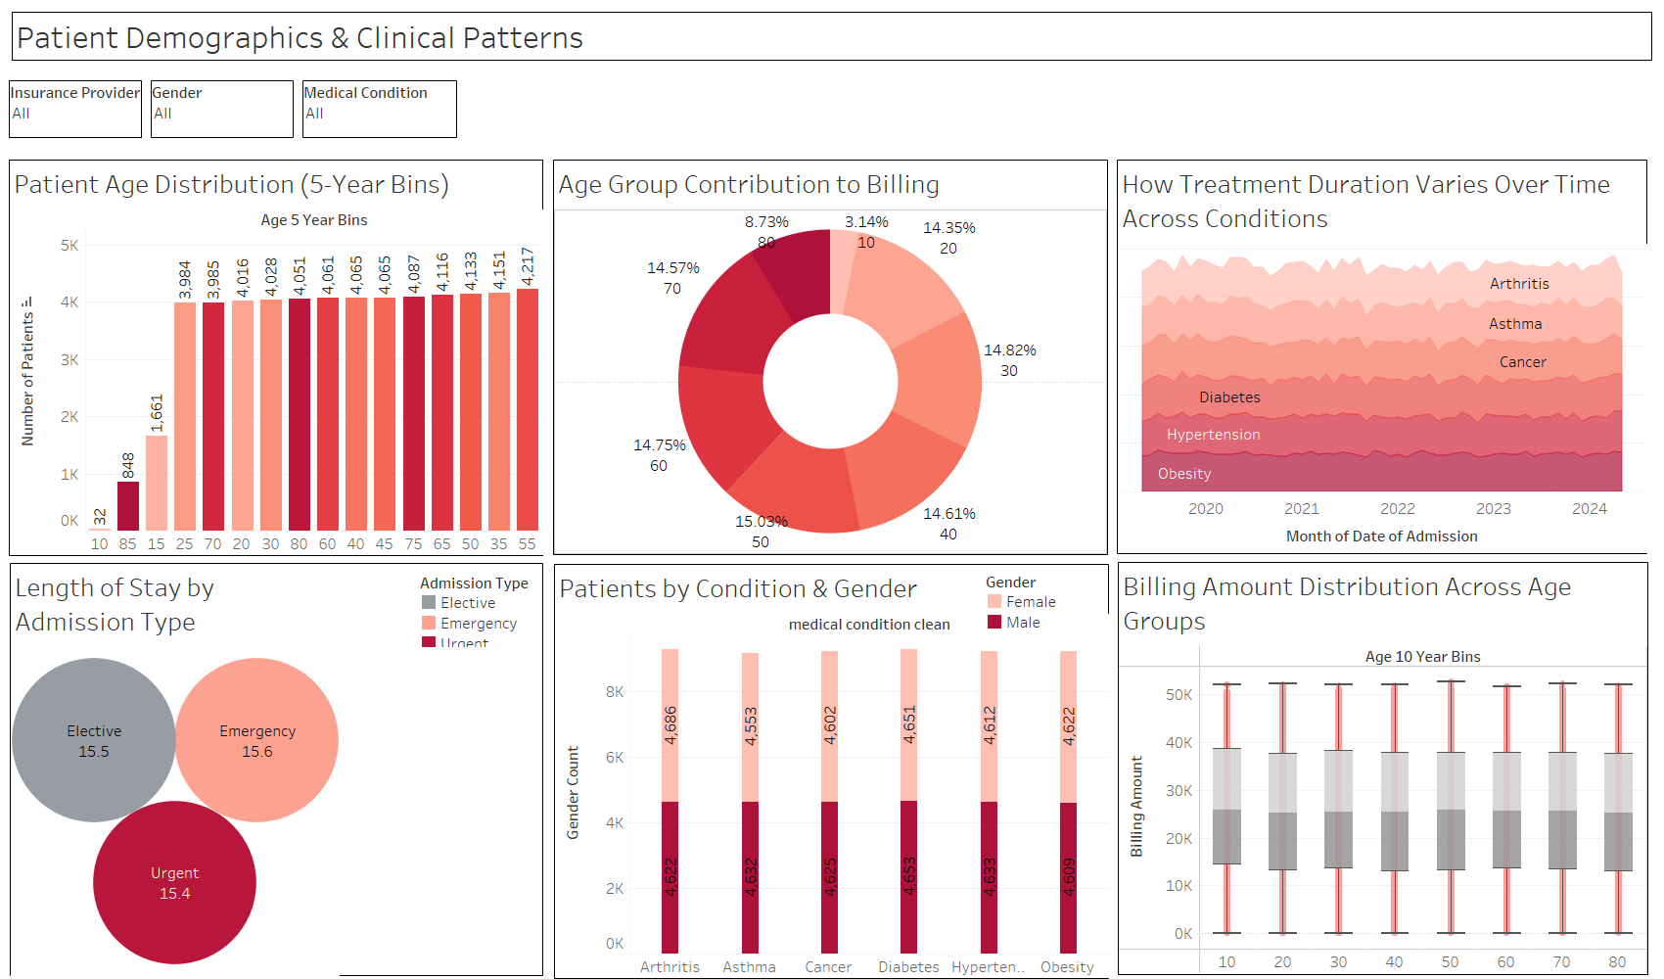

Slide 16
Dashboard 2: Hospital Performance & Financial Insights
Top 10 Costliest Hospitals - Smith Hospital leads all hospitals with $8.72M billing, followed by Johnson at $7.20M.
Hospital Billing vs Patient Volume - Billing strongly rises with patient volume, top-volume hospitals generate $6M–$9M.
Monthly Billing vs Discharges Trend - Monthly discharges consistently stay around 900–1,050, while billing remains stable.
Admissions vs Avg Billing Over Time - Annual admissions decline from 7.4K (2019) to 3.9K (2024), but avg billing stays steady.
Insurance Provider Revenue Contribution - Medicare, Aetna, Cigna, Blue Cross, and UnitedHealthcare all show similar avg billing ($25.3K–$25.6K) with volumes around 9K+ patients.
Top 10 Doctors by Billing Contribution - Michael Smith is the top contributor with $785K across 24 patients; other top doctors bill $446K–$635K.

Slide 17
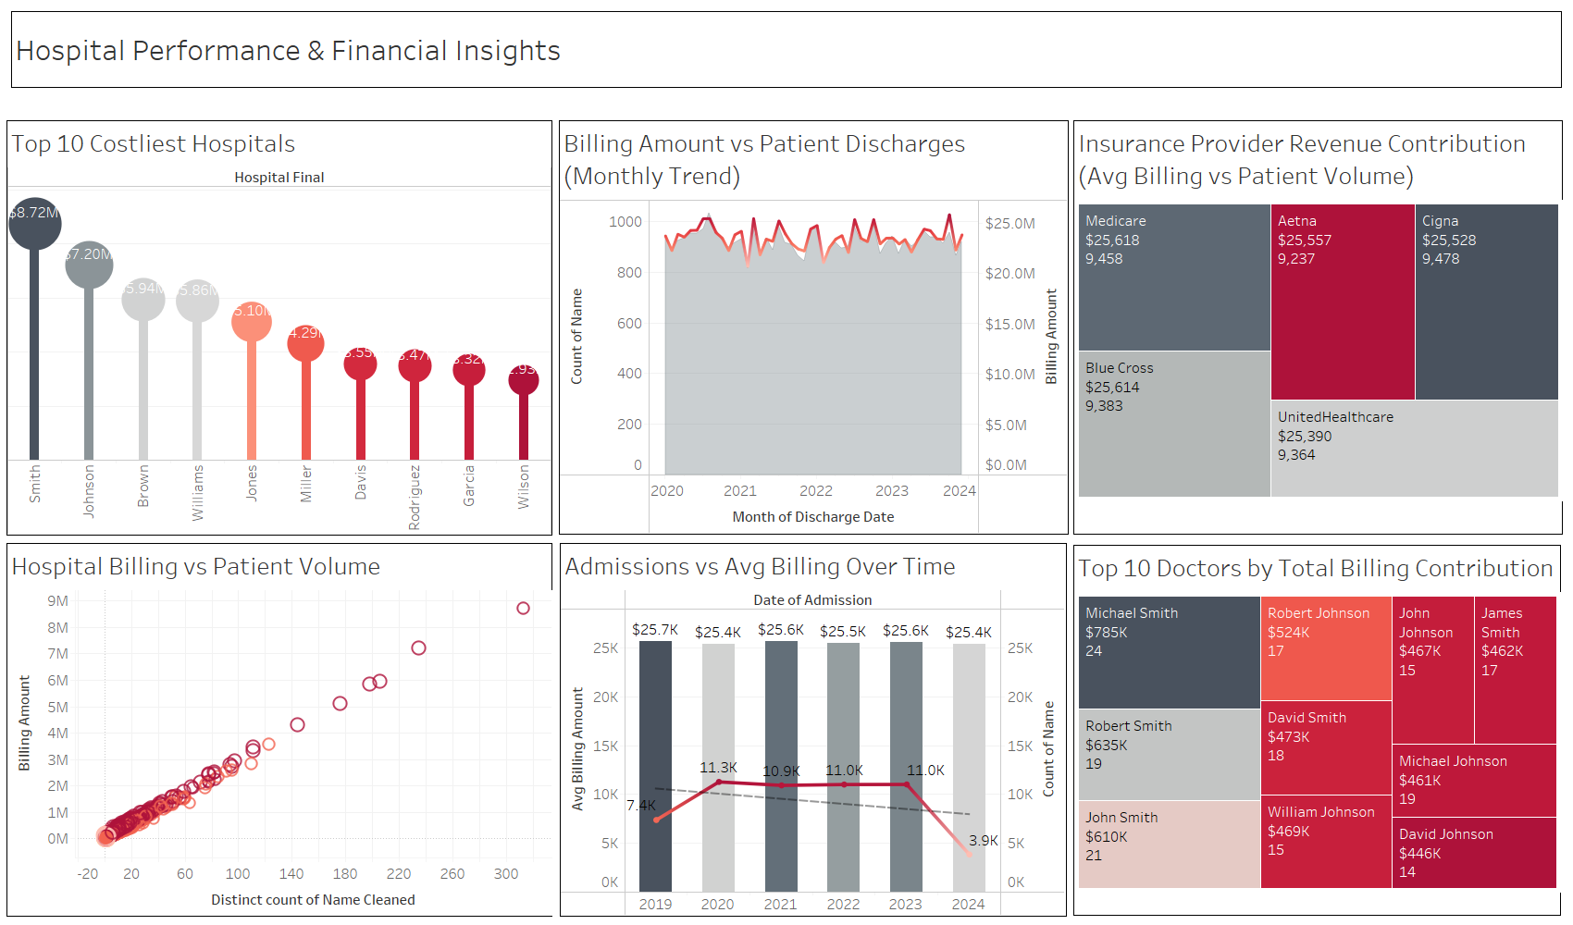

Slide 18
BI Stakeholders
Claims teams
Fraud analytics teams
Executives & Finance
Quality & compliance teams

Slide 19
Key Insights
Patient base mostly ages 20–60.
Some hospitals and doctors drive significantly higher costs.
Insurance revenue varies widely across providers.
Length of Stay is generally short but varies per condition.
Admissions follow seasonal/monthly trends.

Slide 20
Recommendations
Implement automated dashboards for departments.
Regular data quality checks and validation rules.
Build centralized SQL-based BI pipelines.
Strengthen insurance contracting using revenue insights.
Track KPIs like LOS, billing, patient volume continuously.

Slide 21
Future Improvements
Transition to cloud BI platforms for scalability.
Add real-time data ingestion.
Integrate predictive analytics for forecasting.
Improve connectivity with hospital EMR/EHR systems.

Slide 22

Conclusion
BI provides clarity into patients, costs, and operations.
Supports data-driven decision-making.
Enhances financial and clinical performance.

Slide 23

Thank You

