Slide 1
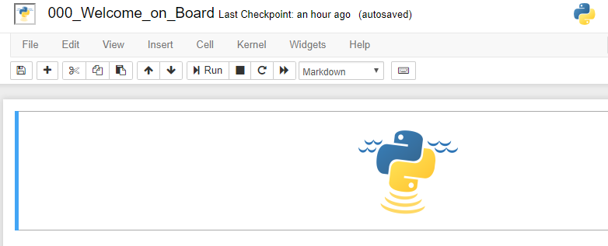
Notebook name
Menu bar
Toolbar
Cell

Slide 2
Congratulations !

