Slide 1
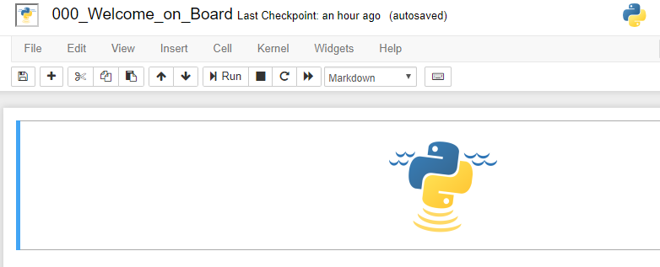
Notebook name
Menu bar
Toolbar
Cell

