Slide 1
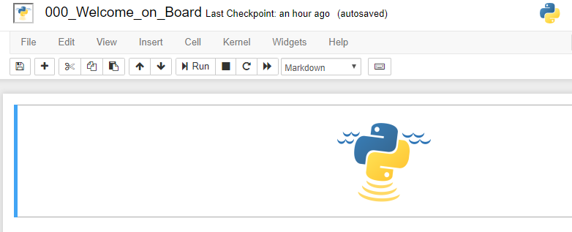
Notebook name
Menu bar
Toolbar
Active Cell

Slide 2
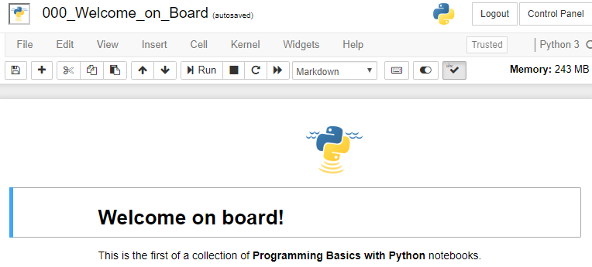
Notebook name
Menu bar
Toolbar
Cell
Active Cell
Cell

Slide 3
Congratulations !

