Slide 1
Introduction to the TypeScript Collections Framework
Larry Diamond ldiamond at ldiamond dot com
for OpenCamps November 2017

Slide 2
I was writing JSPs & Java and now I’m using TypeScript with AngularJS. Where did all my Collections go?
We “kinda sorta but not really” have some of the functionality
There is an Array class, new Array<MyType>()
Every JavaScript object can be accessed like it’s kind of a HashMap myobject [‘myfield’]
Sorting requires explicit sorting of elements which requires manual calls and wasn’t necessary in Java. myArray.sort(compareFunction)

Slide 3
Ick. What about the nice consistent APIs from the Java Collections Framework?
TypeScript is a Microsoft sponsored language, and Microsoft hasn’t yet made their own Framework. They’d port a C# API not an Oracle API.
Google hasn’t ported Google Guava to TypeScript (not from a lack of requests)
Lodash and other JavaScript libraries have done some pieces but hasn’t created a consistent Collections Framework

Slide 4
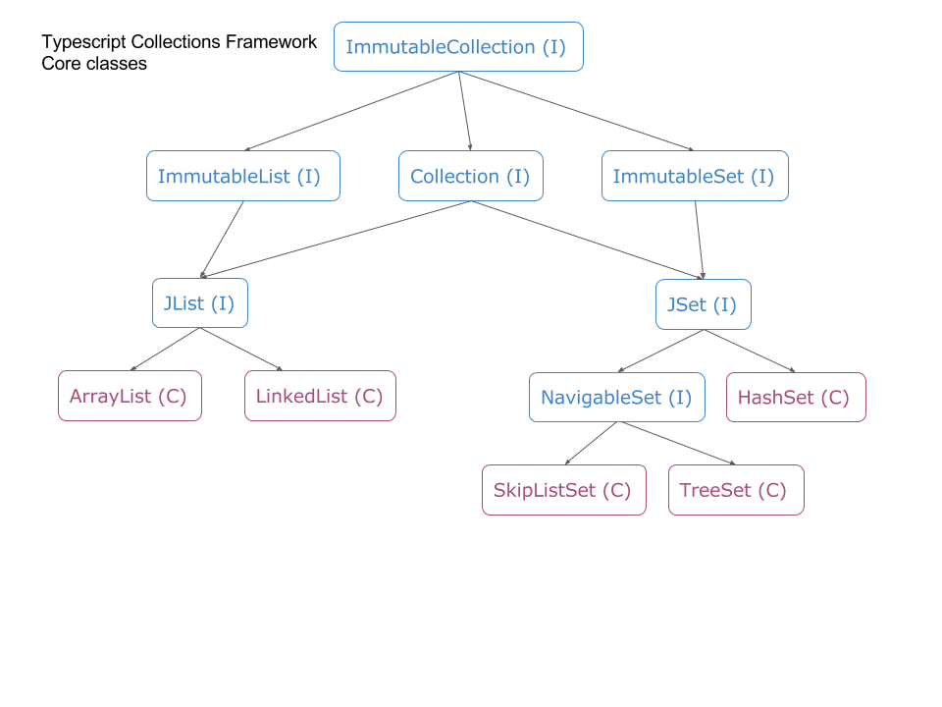
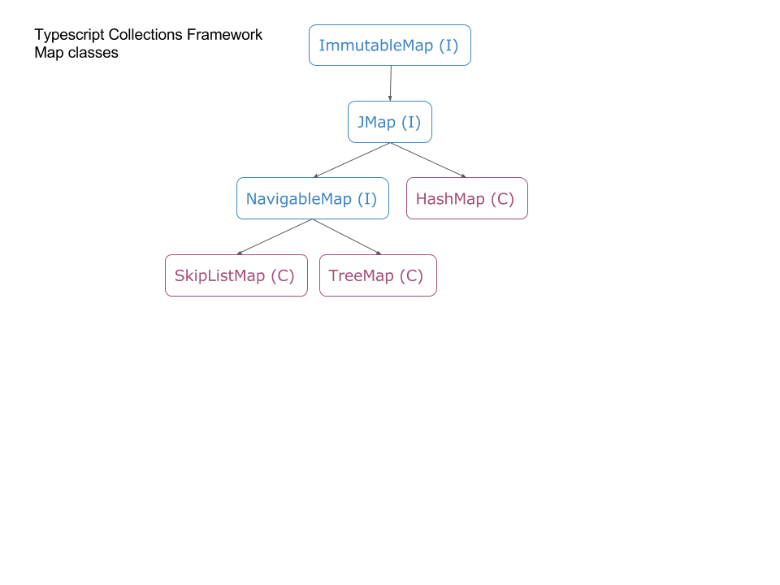
That’s where the TypeScript Collections Framework comes in.
npm install typescriptcollectionsframework --save
( C ) means this is a class
( I ) means this is an interface

Slide 5
What’s all those Immutable Interfaces?
Collections.unmodifiable<whatever> methods are a FAIL.
Always prefer compile time failures versus run time exceptions.
“Hey why did you change my map? That caused a bug!”
If a method accepts an Immutable<whatever> then it guarantees it won’t change your object.
If you pass in an Immutable<whatever> then you protect yourself by not allowing the method to change your object.
Methods that exist to pass in an Immutable image of your Collection
.immutableCollection()
.immutableList()
.immutableSet()
.immutableMap()

Slide 6
How do you compare object? .equals(), .hashCode() and natural ordering?
Java insisted that every object implement .equals and .hashCode.
They could, they owned the language. Me not so much. ☺
Lists require a Collectable object that provides the equals method (and I provide an AllFieldCollectable object)
HashMaps require a Hashable object that provides the equals and hashCode methods (and I provide an AllFieldHashable object)
Sorted objects require a Comparator object (and I provide a stringComparator and a numberComparator)

Slide 7
You can put native objects into Collections and objects that aren’t written with support for the TypeScript Collection Framework.
tsData:TreeSet<string> = new TreeSet<string>(Collections.getStringComparator()); this.tsData.add ("Cat"); this.tsData.add ("Squirrel"); this.tsData.add ("Dog"); this.tsData.remove ("OtherElement"); for (let iter:JIterator<string> = this.tsData.iterator(); iter.hasNext(); ) { let ostr:string = iter.next(); console.log (ostr); }
<li *ngFor="let str of tsData"> <button (click)="removeTreeSetEntry(str);"> </button> </li>

