Slide 1
Introduction to the TypeScript Collections Framework
By Larry Diamond - ldiamond at ldiamond dot com
for OpenCamps November 2017
Project: | https://github.com/larrydiamond/typescriptcollectionsframework
Demo and Sample Code: | https://larrydiamond.github.io/typescriptcollectionsframework-Demo-For-Angular5/dist/
How to install: | npm install typescriptcollectionsframework --save

Slide 2
Why did I create the Framework?
I’m an architect for a team of Java developers who previously coded web sites using JSPs or JSF.
Our organization switched to AngularJS (1.x originally)
We recognized quickly (2.0 RC3) that TypeScript was the right way forward to produce better quality code more quickly.
We have a Java background, not a JavaScript background mostly.
This framework is designed to get Java developers productive using AngularJS 2+ quickly.

Slide 3
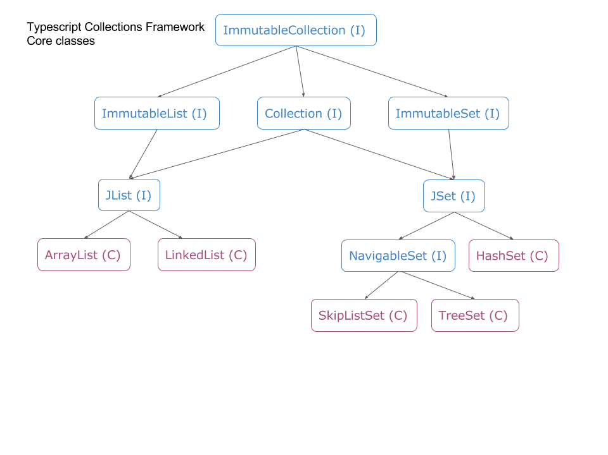
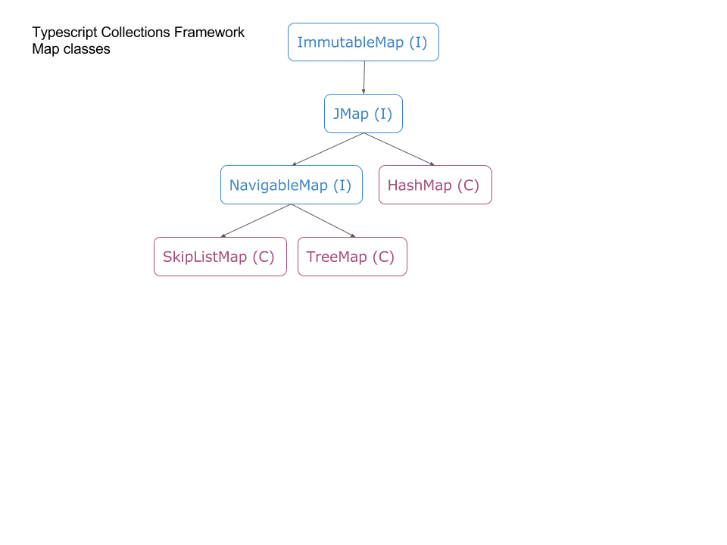
Most Java Collections are available today in the TypeScript Collections Framework
( C ) means this is a class
( I ) means this is an interface
TypeScript Collections Framework by Larry Diamond
npm install typescriptcollectionsframework --save
https://github.com/larrydiamond/typescriptcollectionsframework

Slide 4
If you know Java, you already know the TypeScript Collections Framework
Java Code
TypeScript Code
package com.ldiamond; import java.util.*; public class Main { public static void main(String[] args) { ArrayList<Integer> stuff = new ArrayList<Integer> (); for (int loop = 0; loop < 10; loop++) { stuff.add (loop); } for (Iterator i = stuff.iterator(); i.hasNext(); ) { System.out.println (i.next()); } } }
import { ArrayList, AllFieldCollectable, JIterator }
from 'typescriptcollectionsframework';
const stuff:ArrayList<number> = new ArrayList<number>(
new AllFieldCollectable<number>());
for (let loop:number = 0; loop < 10; loop++) {
stuff.add (loop);
}
for (const i:JIterator<number> = stuff.iterator(); i.hasNext(); ) {
console.log (i.next());
}
<li *ngFor="let x of stuff">{{x}}</li>
TypeScript Collections Framework by Larry Diamond npm install typescriptcollectionsframework --save
https://github.com/larrydiamond/typescriptcollectionsframework

Slide 5
What about Java .equals() & .hashCode()?
Java Code
TypeScript Code
public class Employee {
long employeeId;
String firstName;
String lastName;
public boolean equals (Object o) {
if (o == null) return false;
if (!(o instanceof) Employee) return false;
Employee other = (Employee) o;
if (this.employeeId != other.employeeId) return false;
if (! this.firstName.equals (other.firstName)) return false;
if (! this.lastName.equals (other.lastName)) return false;
return true;
}
public int hashCode() {
return (int) employeeId * firstName.hashCode() * lastName.hashCode();
}
}
export class Employee {
employeeId:number;
firstName:string;
lastName:string;
}
const stuff:HashSet<Employee> = new HashSet<Employee>(
new AllFieldHashable<Employee>());
AllFieldHashable uses JSON.stringify when it needs to compare instances and will build a hash code off of the JSON.stringify results.
This all means that you can build collections off of anybody’s code – they don’t need to support the framework.
<li *ngFor="let emp of stuff">{{emp.firstName}}</li>
Anybody ever find a bug in somebody’s equals method? Tedious, huh?
TypeScript Collections Framework by Larry Diamond npm install typescriptcollectionsframework --save
https://github.com/larrydiamond/typescriptcollectionsframework

Slide 6
SkipListSet and TreeSet (NavigableSet)
Java Code
TypeScript Code
public class Employee {
long employeeId;
String firstName;
String lastName;
}
Comparator<Employee> byId = new Comparator<Employee>() {
public int compare (Employee o1, Employee o2) {
if (o1 == o2) return 0;
if (o1 == null) return -1;
if (o2 == null) return 1;
if (o1.employeeId == o2.employeeId) return 0;
if (o1.employeeId < o2.employeeId) return -1;
return 1;
}
}
TreeSet<Employee> employees = new TreeSet<Employee>(byId);
export class Employee {
employeeId:number;
firstName:string;
lastName:string;
}
const byId:Comparator<Employee> = {
compare(o1: Employee, o2: Employee) : number {
if (o1 === o2) return 0;
if (o1 === undefined) return -1;
if (o1 === null) return -1;
if (o2 === undefined) return 1;
if (o2 === null) return 1;
if (o1.employeeId === o2.employeeId) return 0;
if (o1.employeeId < o2.employeeId) return -1;
return 1;
}
};
const employees:TreeSet<Employee> = new TreeSet<Employee>(byId);
<li *ngFor="let emp of employees">{{emp.firstName}} </li>
TypeScript Collections Framework by Larry Diamond npm install typescriptcollectionsframework --save
https://github.com/larrydiamond/typescriptcollectionsframework

Slide 7
Why use the TypeScript Collections Framework?
Arent there other really good libraries in JavaScript?
There are other really good choices in JavaScript.
Lodash, Immutable.js, Collections.js, and others.
The Framework provides two big benefits that the other choices don’t:
Method for method and Class for Class compatibility with Java. Your know this API because you’ve been using it.
Type Safety. One big reason AngularJS migrated to TypeScript was Type Safety and the big drop in defects you get by having a compiler validate your code. The Framework is built in TypeScript.
TypeScript Collections Framework by Larry Diamond npm install typescriptcollectionsframework --save
https://github.com/larrydiamond/typescriptcollectionsframework

Slide 8
Future of the TypeScript Collections Framework
Queue, Stack, Deque
MultiSet & MultiMap from Google Guava
Ease of use / fewer keystrokes to use
LinkedHashMap, NavigableHashMap
TypeScript Collections Framework by Larry Diamond npm install typescriptcollectionsframework --save
https://github.com/larrydiamond/typescriptcollectionsframework

Slide 9
What’s all those Immutable Interfaces?
Collections.unmodifiable<whatever> methods are a FAIL.
Always prefer compile time failures versus run time exceptions.
“Hey why did you change my map? That caused a bug!”
If a method accepts an Immutable<whatever> then it guarantees it won’t change your object.
If you pass in an Immutable<whatever> then you protect yourself by not allowing the method to change your object.
Methods to obtain an Immutable image of your Collection:
.immutableCollection()
.immutableList()
.immutableSet()
.immutableMap()
Google Guava understood this a long time ago and implemented this already in Java.
https://github.com/google/guava/wiki/ImmutableCollectionsExplained
TypeScript Collections Framework by Larry Diamond npm install typescriptcollectionsframework --save
https://github.com/larrydiamond/typescriptcollectionsframework

Slide 10
Open Source resources without which the TypeScript Collections Framework would not exist
Github.com for free source code hosting
Npmjs.org for free distribution hosting
Travis-ci for free automatic builds
Codcov.io for free code coverage analysis and UI
David-dm.org for free dependency analysis
Nodesecurity.io for free security analysis
All of the people who are using the TypeScript Collections Framework
OpenCamps 2017 for allowing me to present (and the recommendations!)
You for sitting through my presentation!
A very big thank you to all of these people and organizations
TypeScript Collections Framework by Larry Diamond npm install typescriptcollectionsframework --save
https://github.com/larrydiamond/typescriptcollectionsframework

