Slide 1
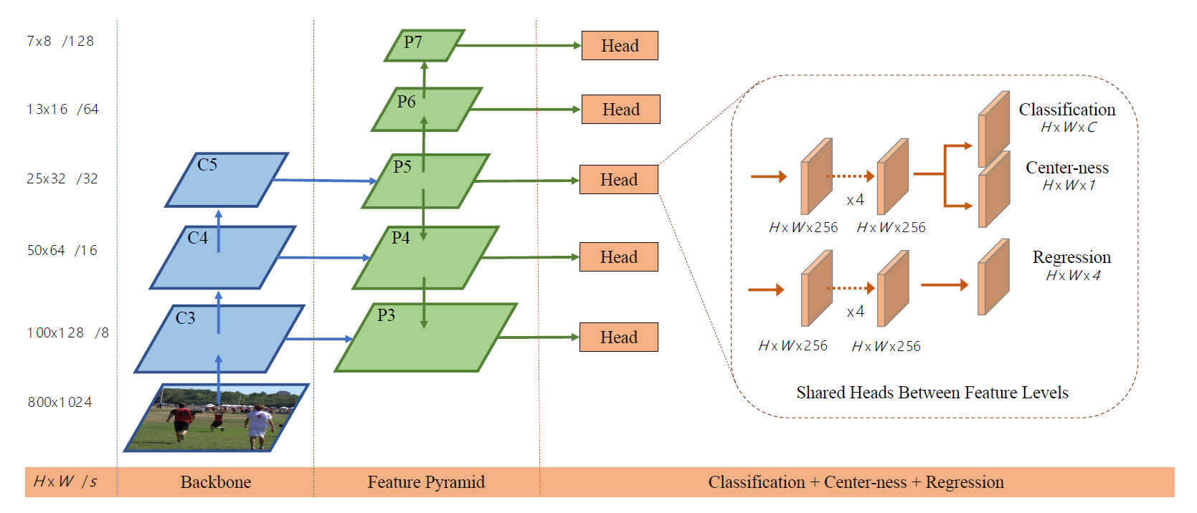

Slide 2
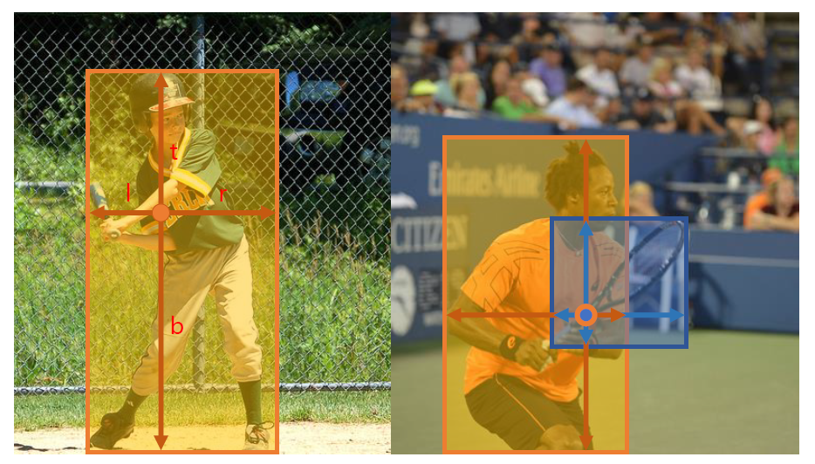


Slide 3



Slide 4

head预测三个值：
Classification Loss：RetinaNet的FocalLoss
Center-ness Loss：BCE
Regression Loss：IoULoss

Slide 5
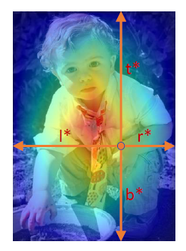



Slide 6


