Slide 1
Exploring opportunities to decrease the future healthcare burden of cardiovascular diseases for women
Lisette de Schipper
15-12-2022

Slide 2
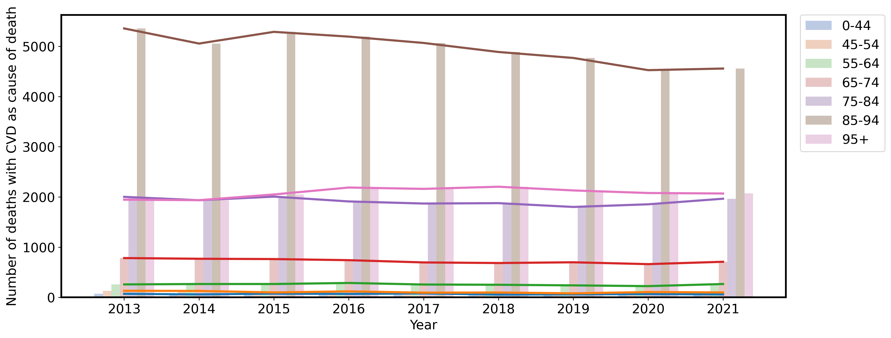
Problem
adapted from CBS

Slide 3

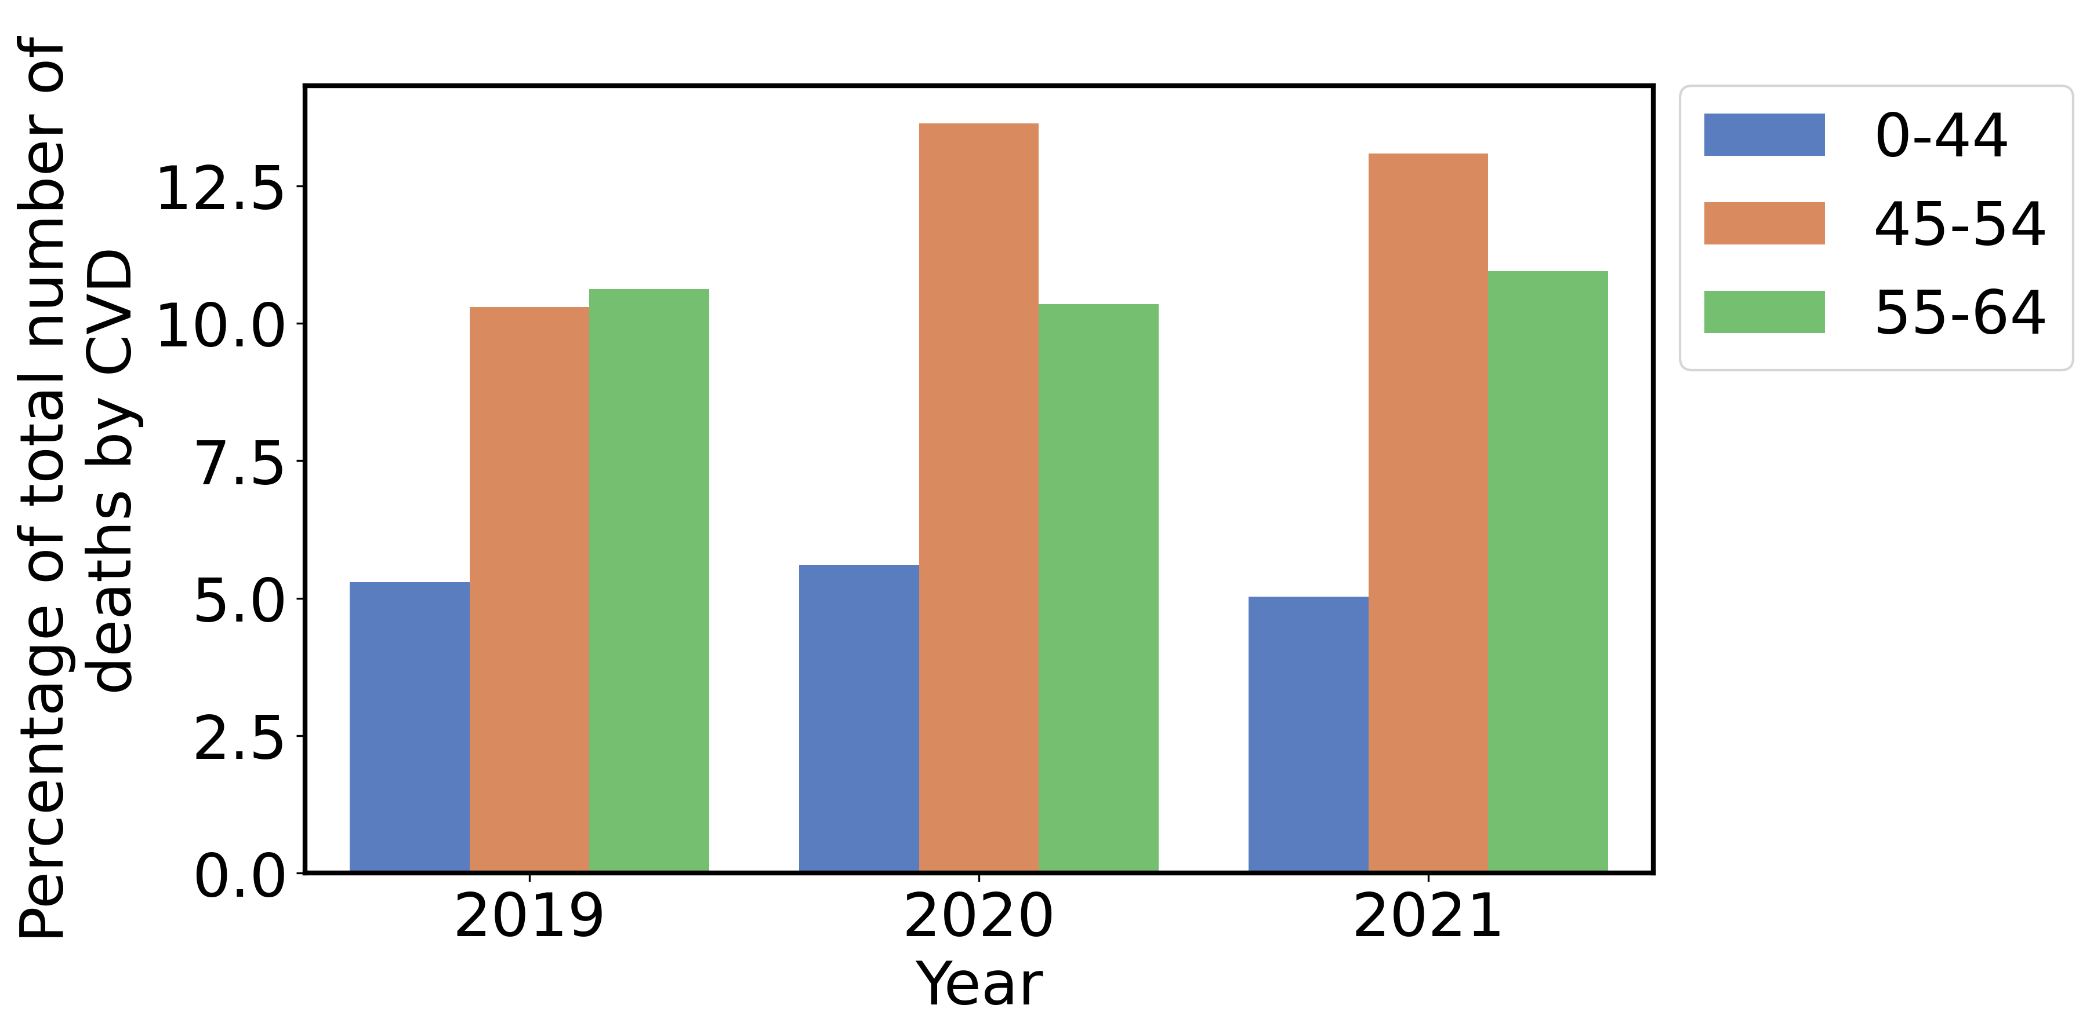
Problem
18%
Of total deaths in the Netherlands
from CBS
Under-represented group
Pregnancy complications
Studies are rarely long-term
adapted from CBS

Slide 4
Research Question
How can behavioural interventions decrease the healthcare burden of cardiovascular diseases among women in The Hague?
Case study: The Hague
Cardiovascular diseases (CVD).
Main KPI: MACEs – major adverse cardiovascular event
(non-fatal) myocardial infarction
(non-fatal) stroke
Cardiovascular mortality

Slide 5
Methodology
SQ1: Risk factors
SQ2: Intervention entry points
Hypothesis
Data analysis
SQ3: Agent-based model
RQ

Slide 6
Results literature study
SQ 1
SQ 2
Risk factors
Intervention entry points
Interaction between risk factors often unclear
Not all risk-factors are modifiable
Often understudied
Complicates interpretation
Smoking
Diet
Exercise
Alcohol
Stress management
Interventions also understudied

Slide 7
Hypothesis
How can recurring interventions targeting diet, exercise or smoking behaviours decrease the healthcare burden of cardiovascular diseases among women in The Hague?
Experimental design
Four interventions
Smoking
School
Targeted
Immediate
Three scenarios (will only look at one in this presentation)

Slide 8



SQ 3
Multidisciplined microsimulation model
Interaction
Social circle
Maternal
External
Ethnicity
Age
Socioeconomic status
Pregnancies
Risk factors
Looks at the entire life cycle (long-term effects)
Stochasticity
50 years

Slide 9
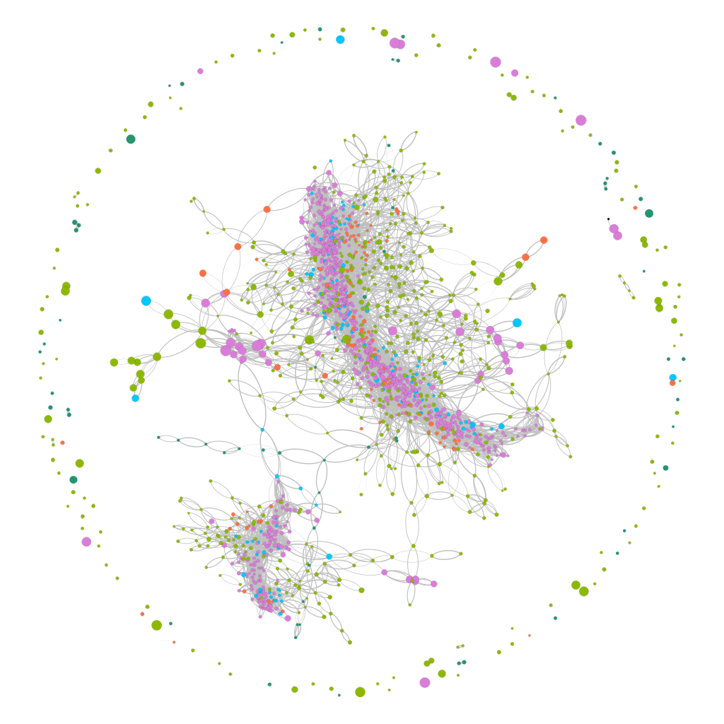

Slide 10
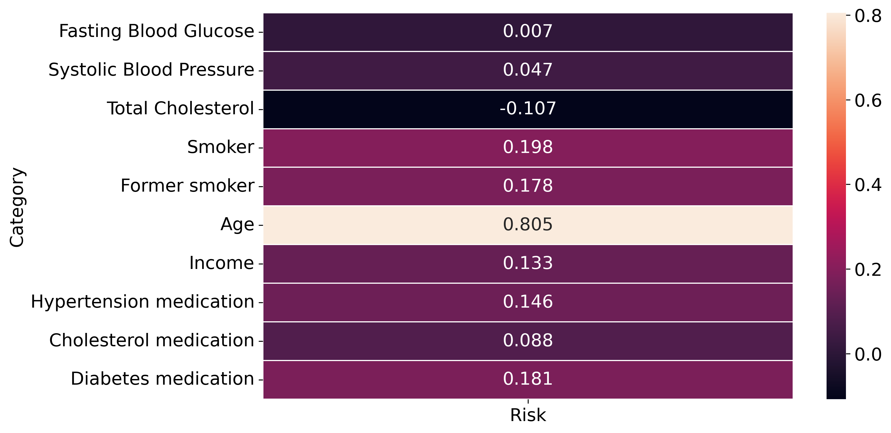
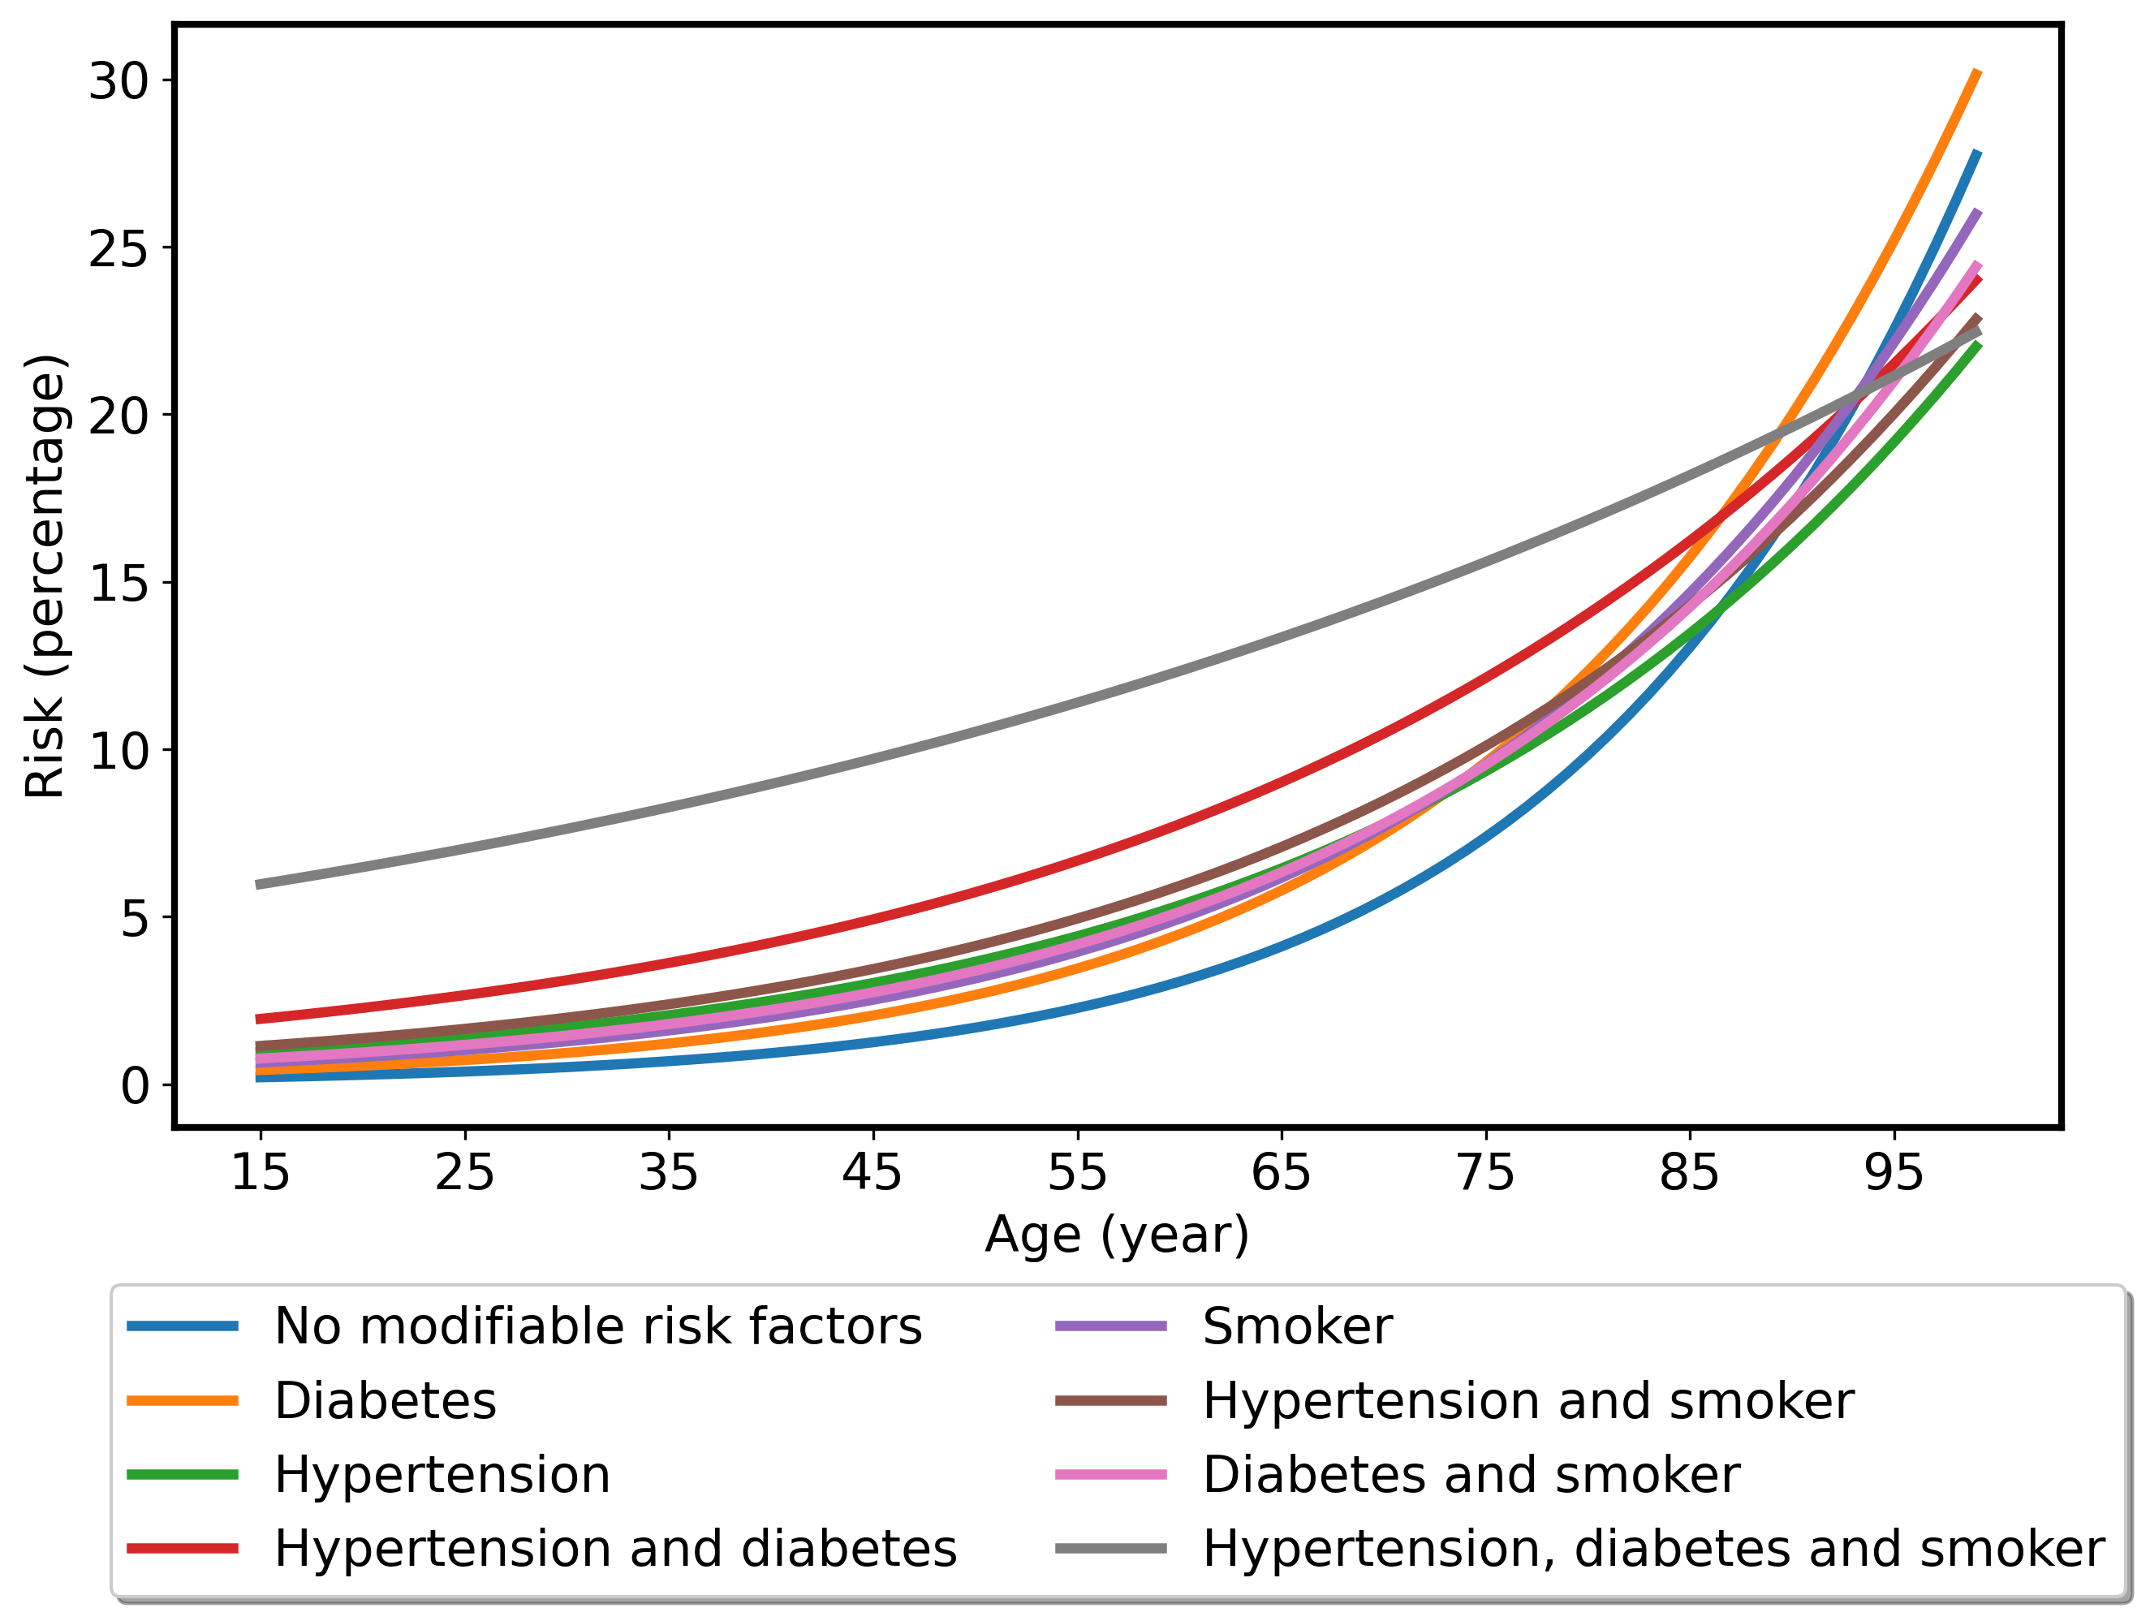
Results data analysis
Dominance of the variables for the 10-year first-ever MACE risk model
Example of an agent with different risk factors

Slide 11
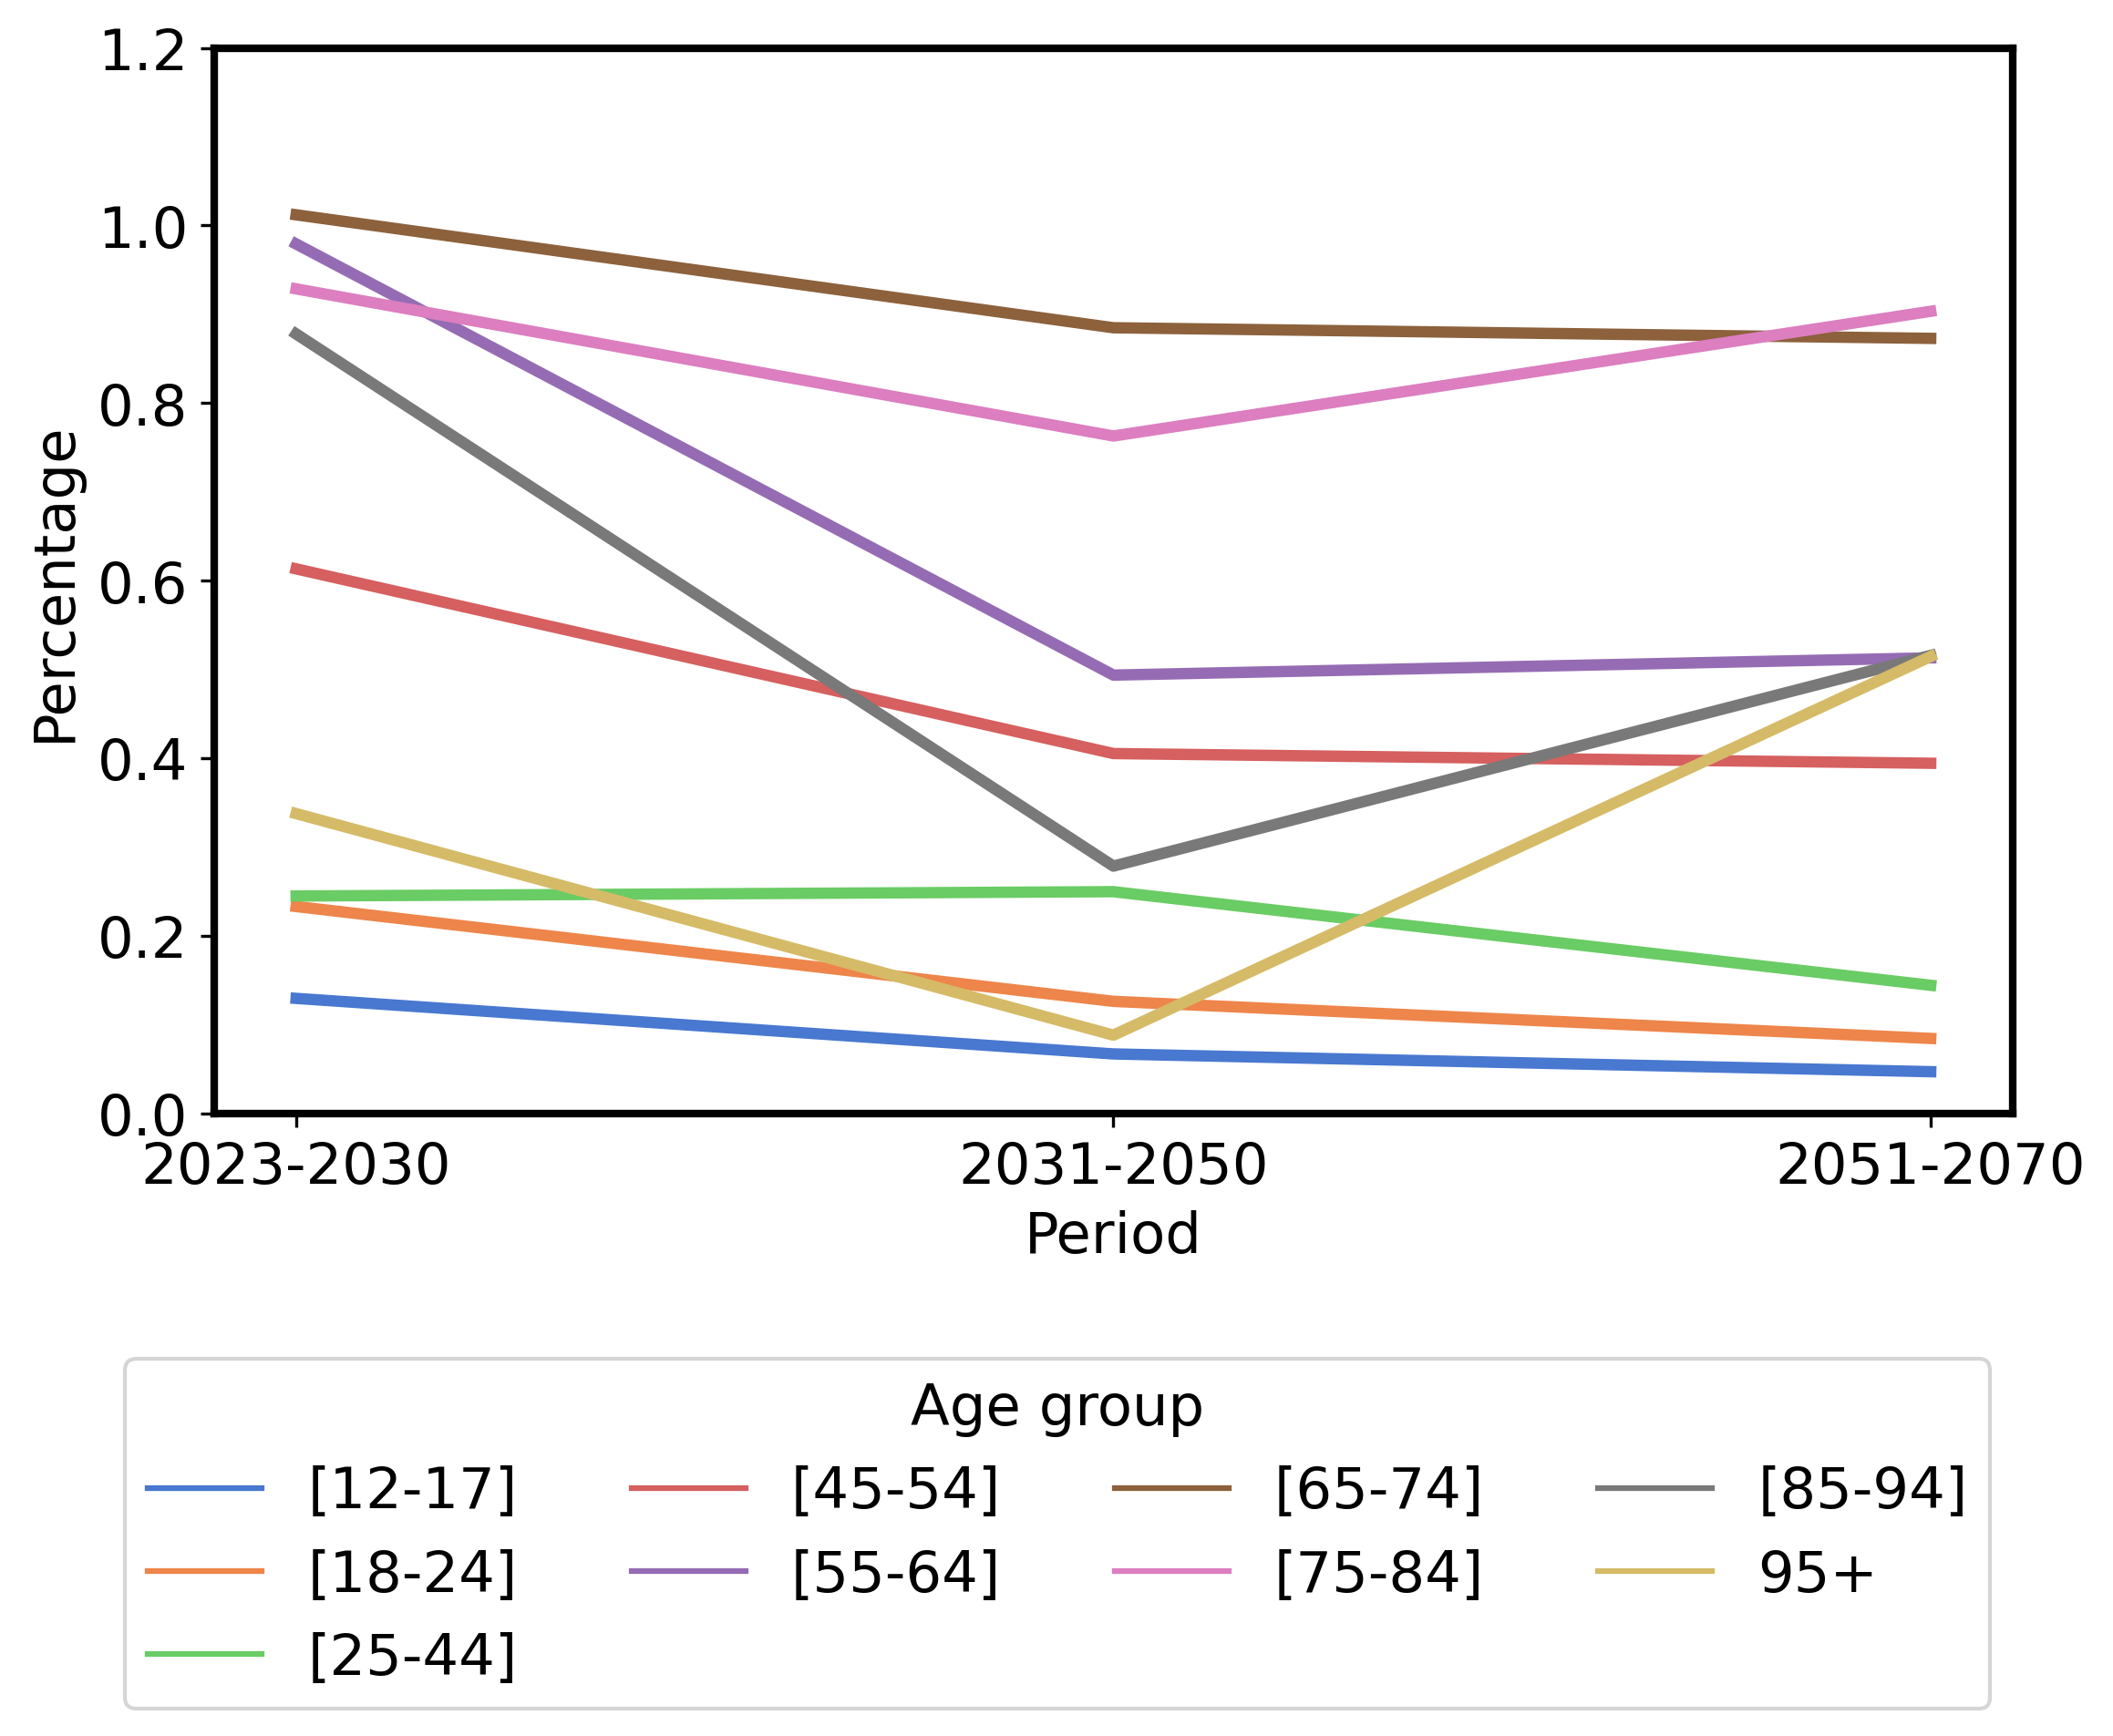
Results simulations: base case
SQ 4
Plausible
future
Percentage of the population getting a MACE

Slide 12
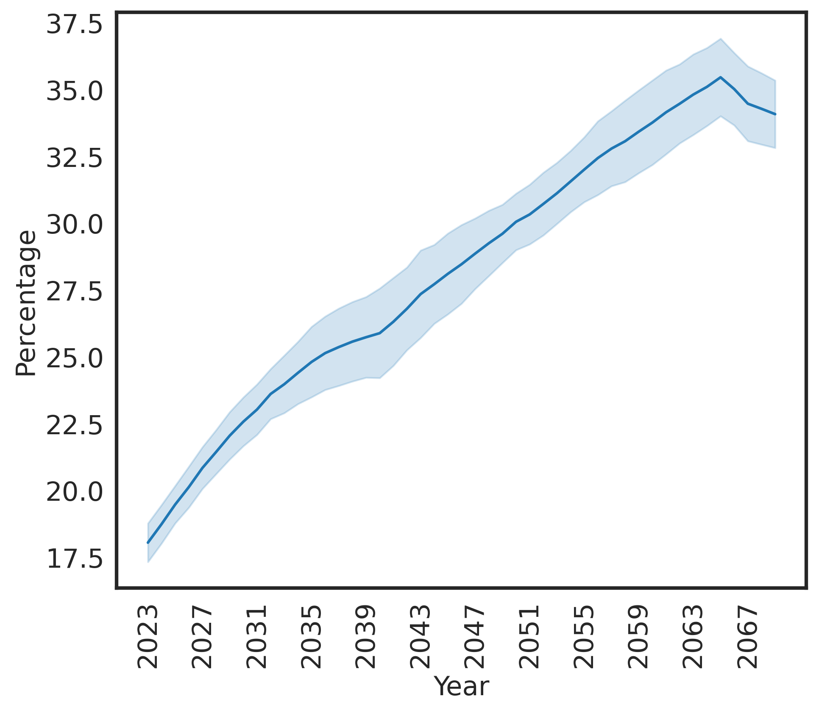
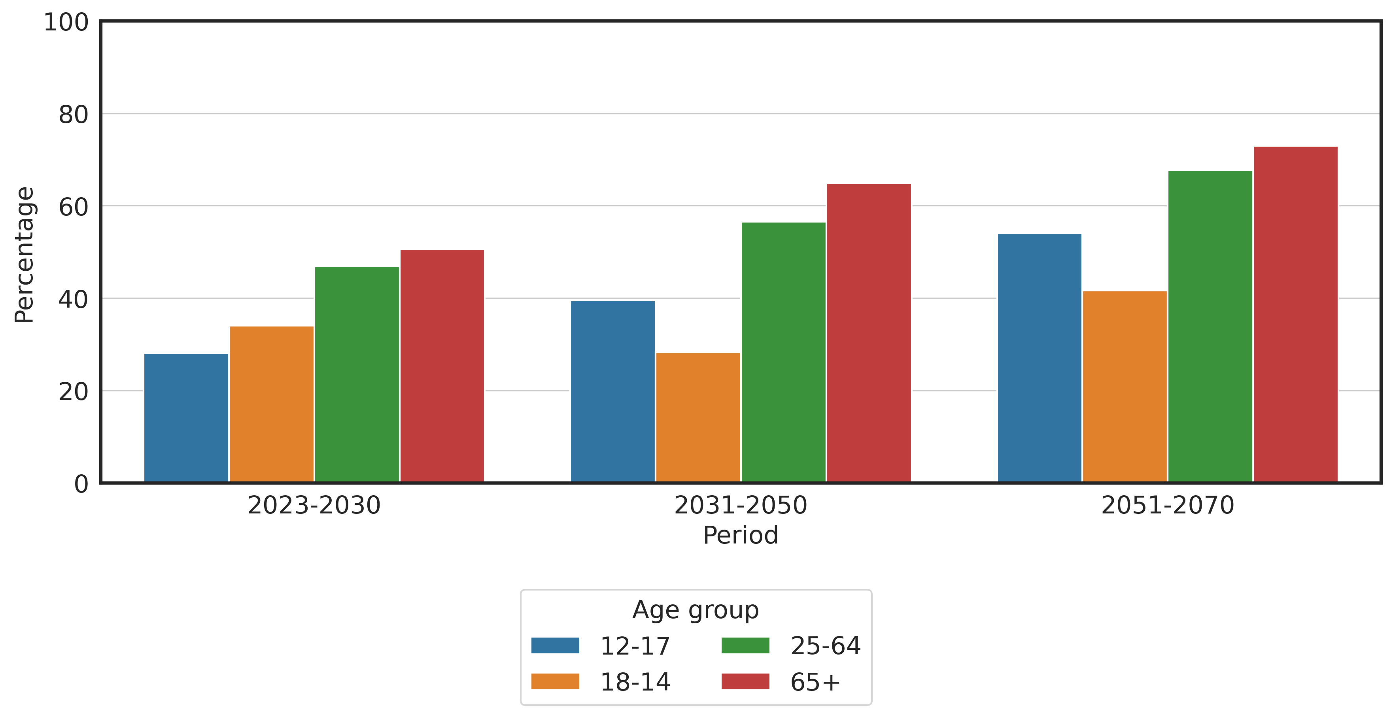
Results simulations: base case
Percentage of the population aged ≥ 65
Percentage of the population with a BMI ≥ 25

Slide 13
SQ 4
Plausible future
Grim CVD outlook
Bad behaviours will be propagated
The ageing of the population

Slide 14
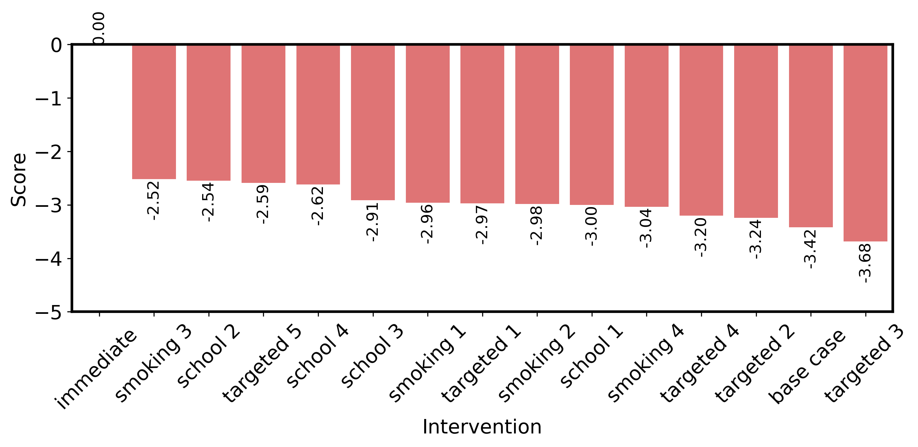
Results simulations: interventions
Scores of the interventions

Slide 15
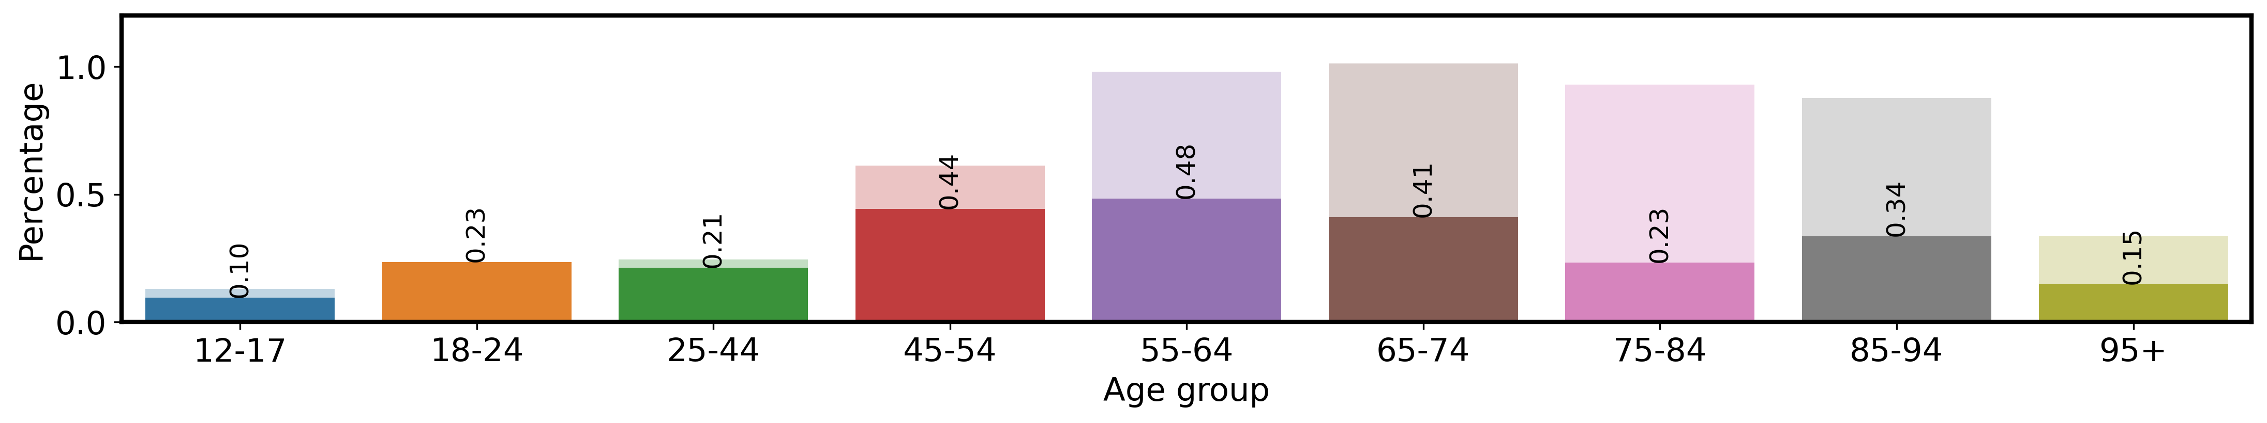
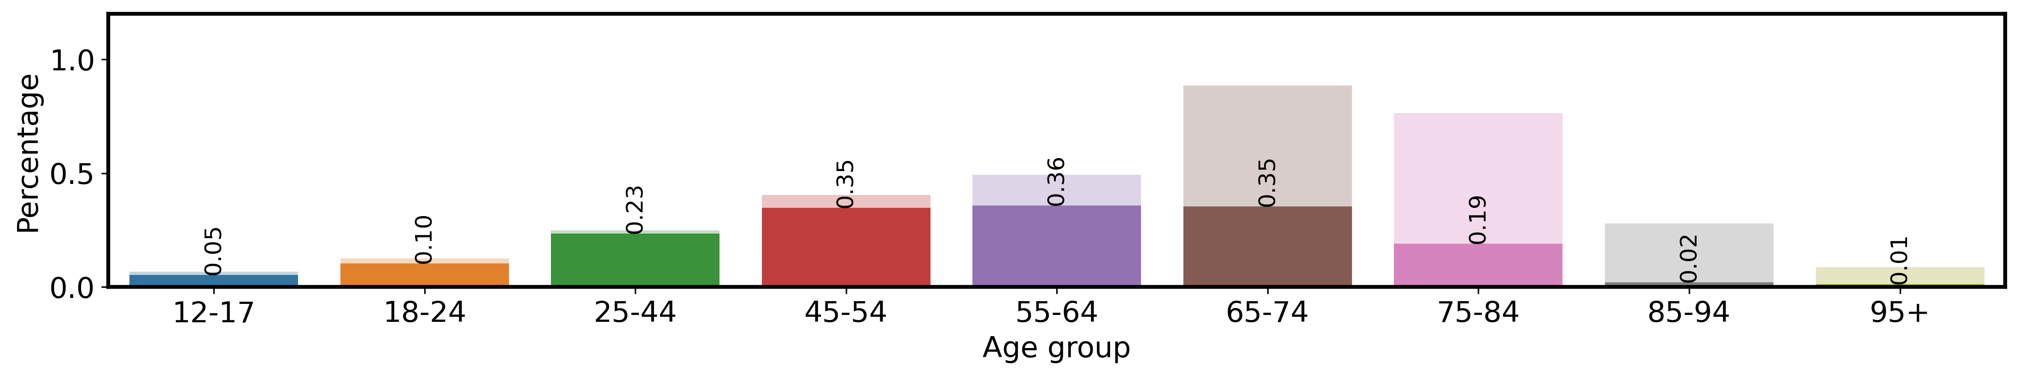
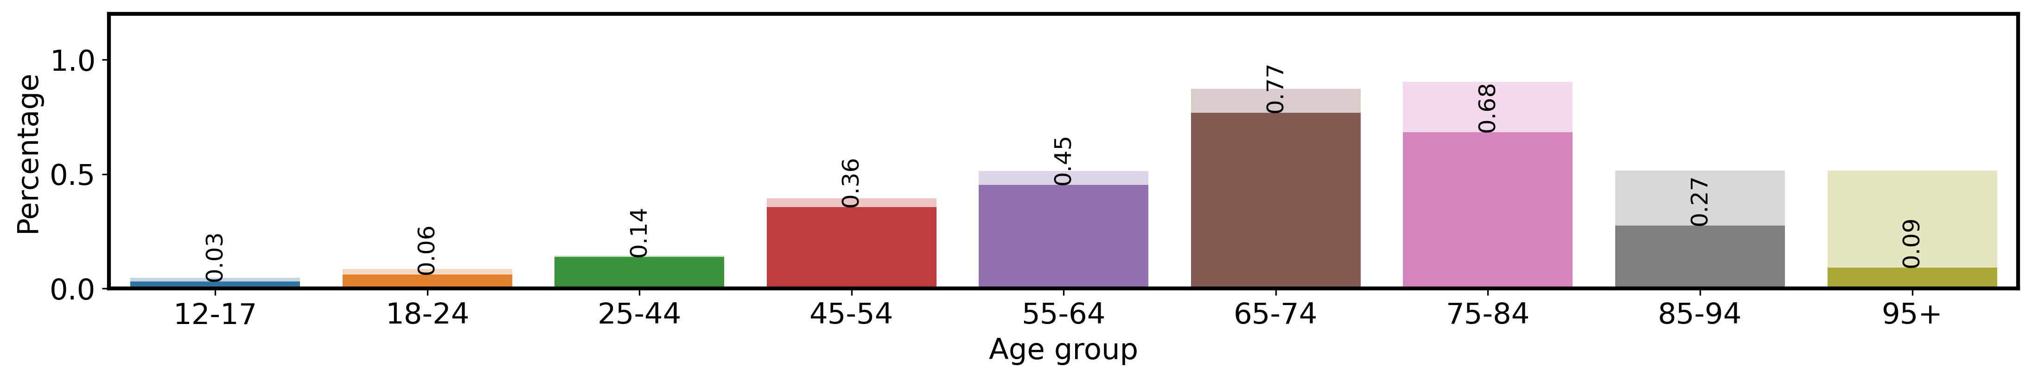
Results simulations: interventions
Reduction in MACEs
2023-2030
2031-2050
2051-2070

Slide 16
Discussion
How can recurring interventions targeting diet, exercise or smoking behaviours decrease the healthcare burden of cardiovascular diseases among women in The Hague?
Regular interventions may not be adequate (anymore)
Our social networks seem saturated with unhealthy behaviours → intensive interventions are needed

Slide 17
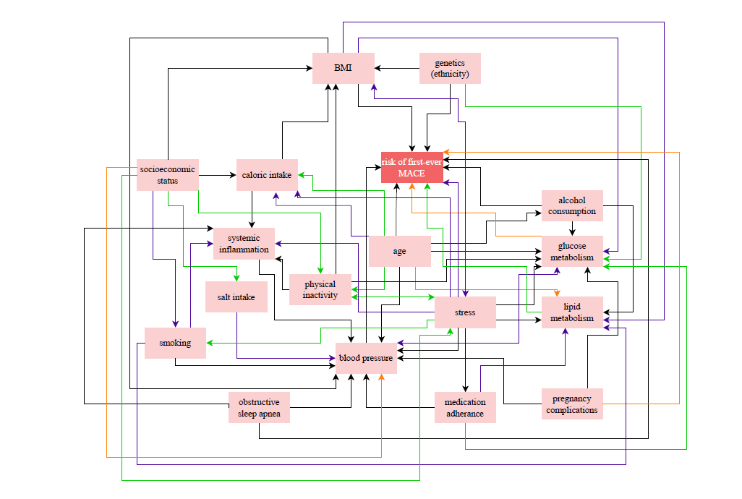
Discussion
The model is a simplification of the real
world.
Proof of concept
Certain uncertainties have been
excluded. Only one combination of risk
factors was explored.
Novel combination of simulation computation model and regression methods used for health

Slide 18
Implications
We need to act quickly (and quite intensely)
Given results from the model, and;
The fact that there will not be enough personnel in healthcare if this keeps going
Prevent the youth from getting multiple risk factors
Keep incentivising smoking cessation among the youth
Will also reduce the risks of other non-communicable diseases

Slide 19
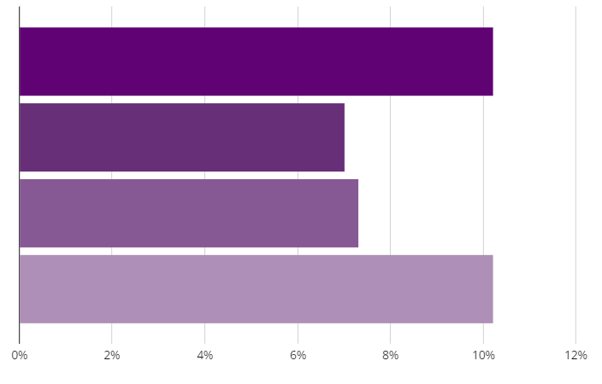

Percentage of women aged 12 to 16 who have smoked in the past month
27.5%
Of children aged 12 to 16 have used an e-pen
from Trimbos-instituut (2017)
from Independer

Slide 20
Thank you

Slide 21
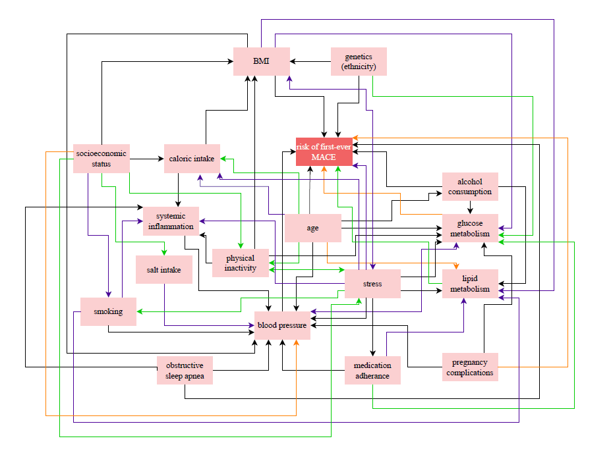

Slide 23
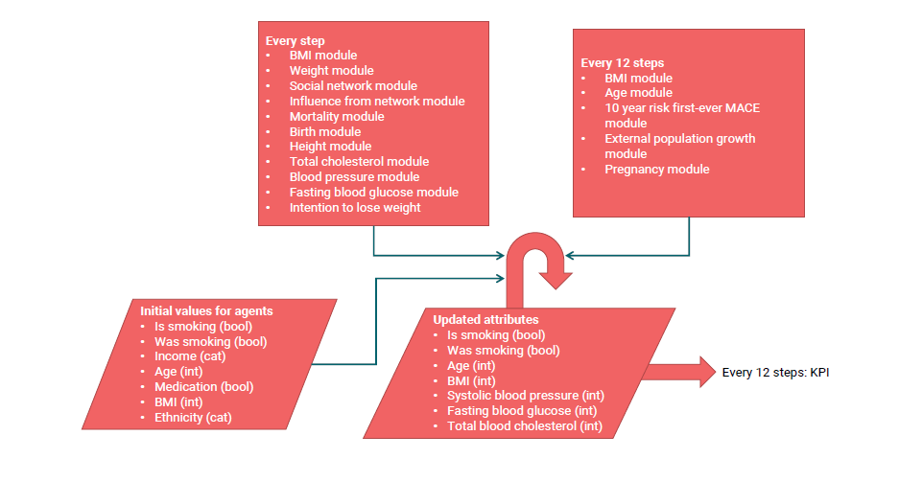

Slide 24
