Slide 1
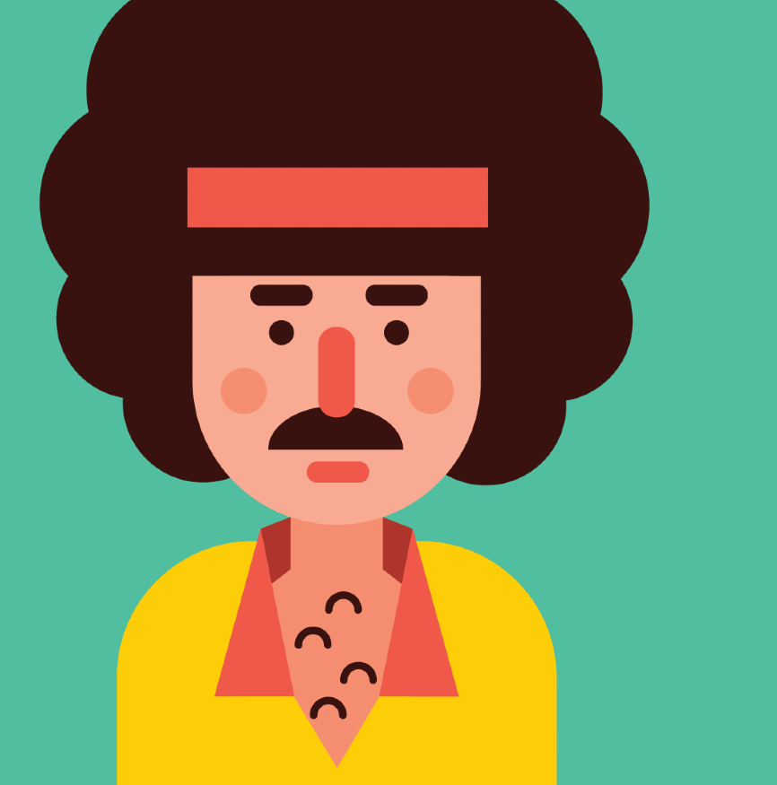
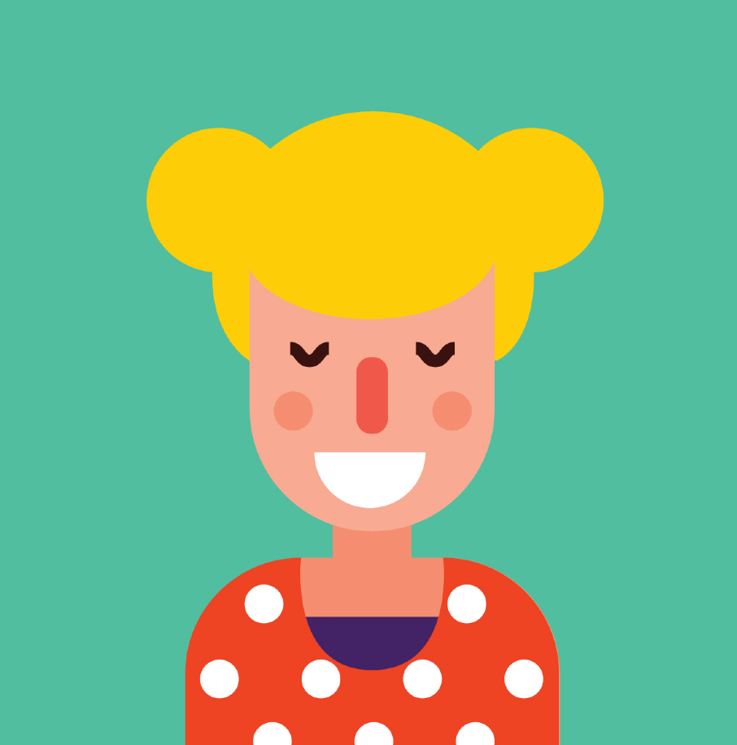
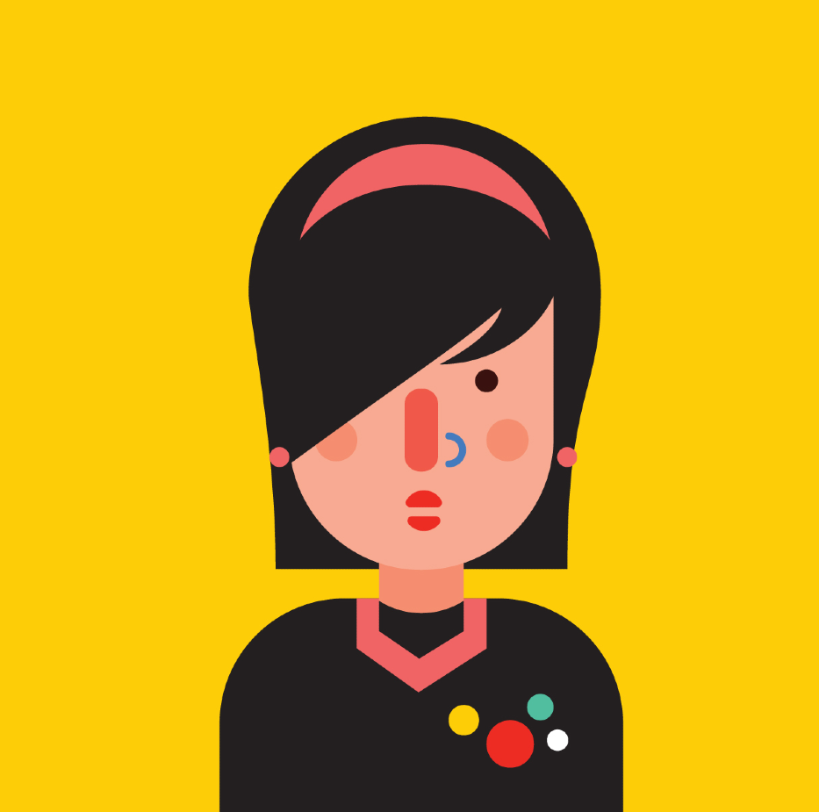
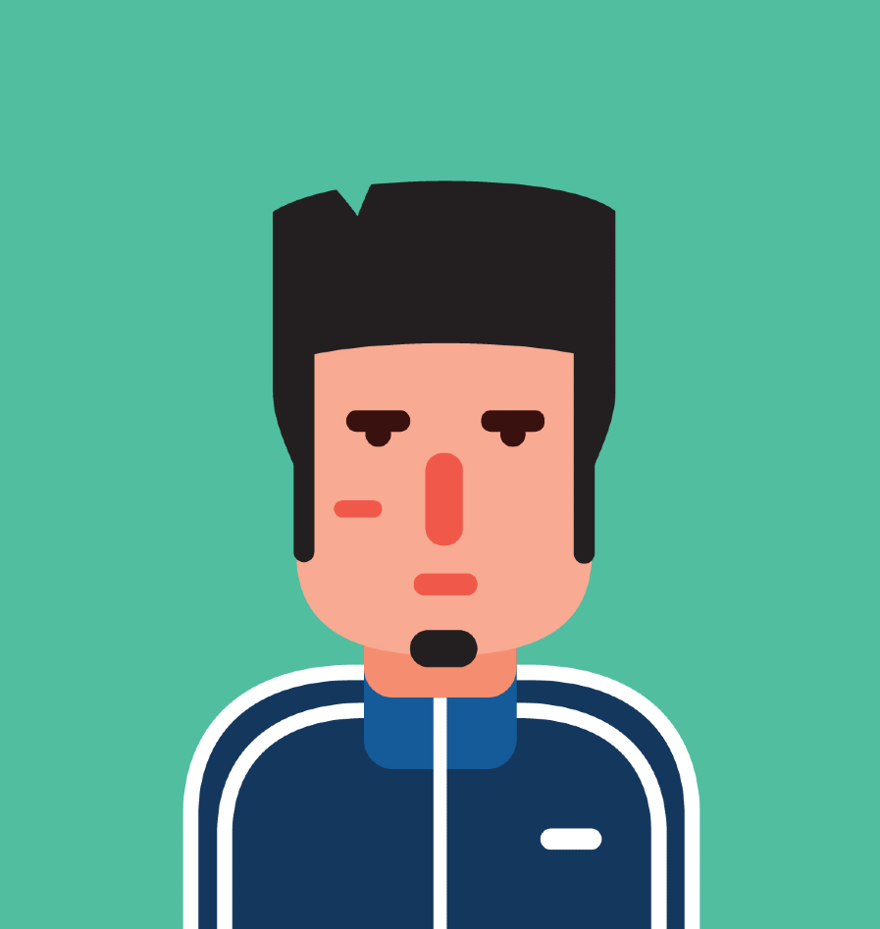
Home My profile Sign up | login
Name: Toby
Address: MA
Name: Kate
Address: FL
Match
Match
Name: Grace
Address: LA
Name: Jerry
Address: PA
Match
Match

Slide 2
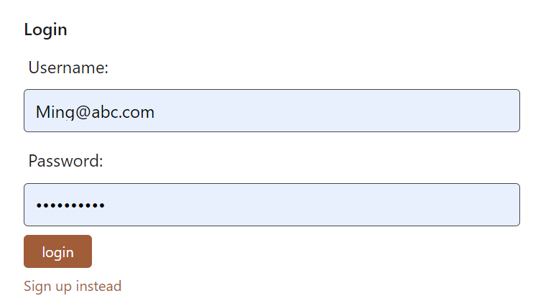
Home My profile Sign up | login

Slide 3
Home My profile Welcome, Grace | Logout
Name: Grace
Address: LA
Name: Jerry
Address: PA
Do you want to know if you are matching him?
Let’s find out!
Get started

Slide 4
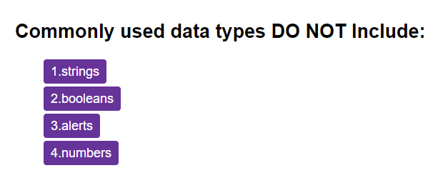
Home My profile Welcome, Grace | Logout
Name: Grace
Address: LA
Next >

Slide 5

Home My profile Welcome, Grace | Logout
Name: Grace
Address: LA
Name: Jerry
Address: PA
Congratulations! You are a perfect match!
Chat with him

Slide 6

Home My profile Welcome, Grace | Logout
Name: Grace
Address: LA
Name: Jerry
Address: PA
Sorry! You don’t match.

Slide 7
Home My profile Welcome, Grace | Logout
Do you want to make friends?
Let’s find out who matches you!
Name: Grace
Address: LA
Get started

Slide 8
Home My profile Welcome, Grace | Logout
Name: Grace
Address: LA
Next >

Slide 9
Home My profile Welcome, Grace | Logout
People who matches you:
Name: Kate
Address: FL
Name: Grace
Address: LA
Chat
Name: Jerry
Address: PA
Chat

