Slide 1
PERFORMANCE ANALYSIS OF DECISION TREES, RANDOM FOREST, XGBOOST TREES AND SVM CLASSIFIER
Subhadeep Dash – S20160010021 V. Sai Rathan – S20160010104

Slide 2
DECISION TREES
Passenger Class
Logic seems easy to visualize.
Doesn’t require normalization of data, removal of blank values or dummy variables.
Cost of construction is quite less.
1
2
Age
Gender
Male
Female
>=35
<35
Yes
No
Yes
No

Slide 3
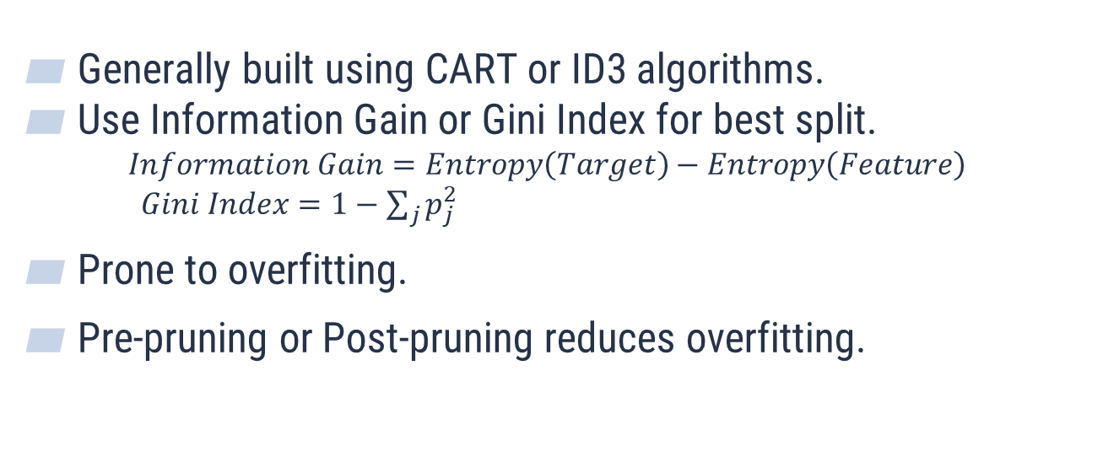
DECISION TREES(Contd..)
Generally built using CART or ID3 algorithms.
Use Information Gain or Gini Index for best split.
$$Information Gain=Entropy\left(Target\right)−Entropy\left(Feature\right)$$
$Gini Index=1−\sum_{j}{p_{j}^{2}}$
Prone to overfitting.
Pre-pruning or Post-pruning reduces overfitting.

Slide 4
RANDOM FOREST
Consists of many decision trees.
More the decision trees, more the accuracy.
Average output of all the Decision Trees is considered the final output.
m out of n attributes are considered for recursive split while building a tree.

Slide 5
RANDOM FOREST(Contd..)
Overfitting is still an issue.
Hyperparameters, namely no. of attributes needed to be considered and no. of decision trees to be constructed, should be provided.
Computational cost is higher than Decision Trees.
Takes relatively more time to build.
Each tree is constructed parallelly and independently.

Slide 6
XGBOOST TREES
More than 50% of award winning solutions in Machine Learning challenges hosted in Kaggle adopt XGBoost.
Involves Gradient Boosting implementation.
Unlike Random Forest, these are constructed sequentially.
For every tree built, the error caused in the constructed tree is tried to be rectified in the next tree.

Slide 7
XGBOOST TREES(Contd..)
An additional hyperparameter i.e. learning rate is required while training.
Harder to tune when compared to Random Forest.
Logic or rules can’t be easily interpreted or visualized.
Training takes more time since trees are built one after the other.
More sensitive to over-fitting if the data is noisy.

Slide 8


SVM CLASSIFIER
$$x_{2}$$
Considered one of the best options for unsupervised learning.
Generally resistant to overfitting.
Works great even when the number of features is large.
Powerful when an appropriate kernel is used.
Margin
Linear SVM Classifier
$$x_{1}$$

Slide 9
SVM CLASSIFIER(Contd..)
Selection of an appropriate kernel is a difficult task.
Usage of inappropriate kernel leads to large errors.
The final model is difficult to visualize or interpret.
It’s algorithmic complexity is high which may result in slower testing phase.

Slide 10
RESULTS ON TITANIC DATASET
 | ACCURACY ON TRAINING SET(%) | ACCURACY ON TESTING SET(%)
Decision Trees | 84.43 | 79.10
Random Forest | 96.63 | 84.70
XGBoost Trees | 88.44 | 85.07
SVM Classifier | 78.97 | 77.99

