Slide 1
Python Final Assignment
Lishen Amaraweera
Student ID:PCPP/11/300/24
25.05.2024

Slide 2
Section 1

Slide 3
Variables, Builtin Functions
Declare a variable is_married and assign a value to it
Declare a variable is_true and assign a value to it
Use the built-in input function to get first name, last name, country and age from a user and store the value to their corresponding variable names
Run help(&#39;keywords&#39;) in Python shell or in your file to check for the Python reserved words or keywords

Slide 4
Strings
Concatenate the string &#39;Thirty&#39;, &#39;Days&#39;, &#39;Of&#39;, &#39;Python&#39; to a single string, &#39;Thirty Days Of Python&#39;.
Use index or find to find the position of the first occurrence of the word &#39;because&#39; in the following sentence: &#39;You cannot end a sentence with because because because is a conjunction&#39;
Slice out the phrase &#39;because because because&#39; in the following sentence: &#39;You cannot end a sentence with because because because is a conjunction&#39;
Does &#39;&#39;Coding For All&#39; start with a substring Coding?

Slide 5
Lists
The following is a list of 10 students ages:
ages = [19, 22, 19, 24, 20, 25, 26, 24, 25, 24
Sort the list and find the min and max age
Add the min age and the max age again to the list
Find the median age (one middle item or two middle items divided by two)

Slide 6
Tuples
Create an empty tuple
Create a tuple containing names of your sisters and your brothers (imaginary siblings are fine)
Join brothers and sisters tuples and assign it to siblings
How many siblings do you have?
Modify the siblings tuple and add the name of your father and mother and assign it to family_members

Slide 7
Dictionaries
Create an empty dictionary called dog
Add name, color, breed, legs, age to the dog dictionary
Create a student dictionary and add first_name, last_name, gender, age, marital status, skills, country, city and address as keys for the dictionary
Get the length of the student dictionary
Get the value of skills and check the data type, it should be a list
Modify the skills values by adding one or two skills

Slide 8
Operators
Write a script that prompts the user to enter base and height of the triangle and calculate an area of this triangle (area = 0.5 x b x h).
Write a script that prompts the user to enter side a, side b, and side c of the triangle. Calculate the perimeter of the triangle (perimeter = a + b + c).
Write a script that prompts the user to enter number of years. Calculate the number of seconds a person can live. Assume a person can live hundred year
Write a Python script that displays the following table
1 1 1 1 1
2 1 2 4 8
3 1 3 9 27
4 1 4 16 64
5 1 5 25 125
5. I hope this course is not full of jargon. Use in operator to check if jargon is in the sentence

Slide 9
Conditional
1. Write a code which gives grade to students according to theirs scores:
80-100, A70-89, B60-69, C50-59, D0-49, F
2. The following list contains some fruits:
fruits = ['banana', 'orange', 'mango', 'lemon'
If a fruit doesn't exist in the list add the fruit to the list and print the modified list. If the fruit exists print('That fruit already exist in the list’)
3. Here we have a person dictionary. Feel free to modify it!
person={ 'first_name': 'Tharaka', 'last_name': 'Mahabage', 'age': 250, 'country': 'Sri Lanka', 'is_marred': True, 'skills': ['JavaScript', 'React', 'Node', 'MongoDB', 'Python'], 'address': { 'street': 'Space street', 'zipcode': '02210' } }
4. Check if the person dictionary has skills key, if so print out the middle skill in the skills list.
5. Check if the person dictionary has skills key, if so check if the person has 'Python' skill and print out the result.

Slide 10
Functions
Declare a function add_two_numbers. It takes two parameters and it returns a sum.
Area of a circle is calculated as follows: area = π x r x r. Write a function that calculates area_of_circle.
Write a function called is_prime, which checks if a number is prime.

Slide 11
Loops
Write a loop that makes seven calls to print(), so we get on the output the following triangle:
#
##
###
####
#####
######
#######
2. Use nested loops to create the following:
# # # # # # # #
# # # # # # # #
# # # # # # # #
# # # # # # # #
# # # # # # # #
# # # # # # # #
# # # # # # # #
# # # # # # # #
3. Print the following pattern:
0 x 0 = 0
1 x 1 = 1
2 x 2 = 4
3 x 3 = 9
4 x 4 = 16
5 x 5 = 25
6 x 6 = 36
7 x 7 = 49
8 x 8 = 64
9 x 9 = 81
10 x 10 = 100
4. Iterate through the list, ['Python', 'Numpy','Pandas','Django', 'Flask'] using a for loop and print out the items.
5. Use for loop to iterate from 0 to 100 and print only even numbers

Slide 12
Section 2 Python Flask Blog Project

Slide 13
Introduction
- Simple blog application built with Flask
- Demonstrates basic CRUD(Create, Read, Update & Delete) operations and user authentication
- Allows users to view, add, edit, and delete blog posts

Slide 14
Technologies and Tools
- Python
- Flask (Web Framework)
- HTML/CSS/JavaScript (Frontend)
- SQLite (Database)
- Jinja2 (Flask Templating)
- Werkzeug ( Flask Security)

Slide 15
Project Structure
- blog.py: Main application file
- templates/: HTML templates
- static/: CSS, JavaScript files
- blogs.db: SQLite database file

Slide 16
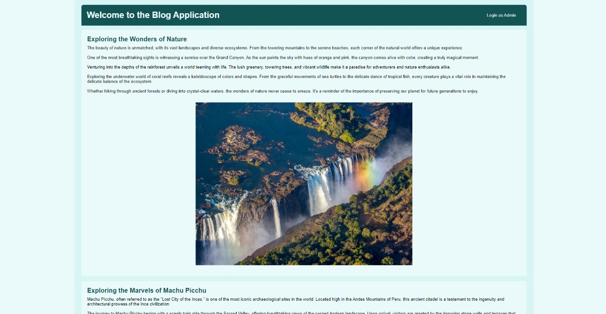
Home Page
@app.route('/')
def index():
conn = sqlite3.connect('blogs.db')
cursor = conn.cursor()
cursor.execute('SELECT id, title, content FROM blogs')
blogs = cursor.fetchall()
conn.close()
return render_template('index.html', blogs=blogs, role=session.get('role'))
- Displays all blog posts
- Publicly accessible
- Admins see additional options to edit or delete posts

Slide 17
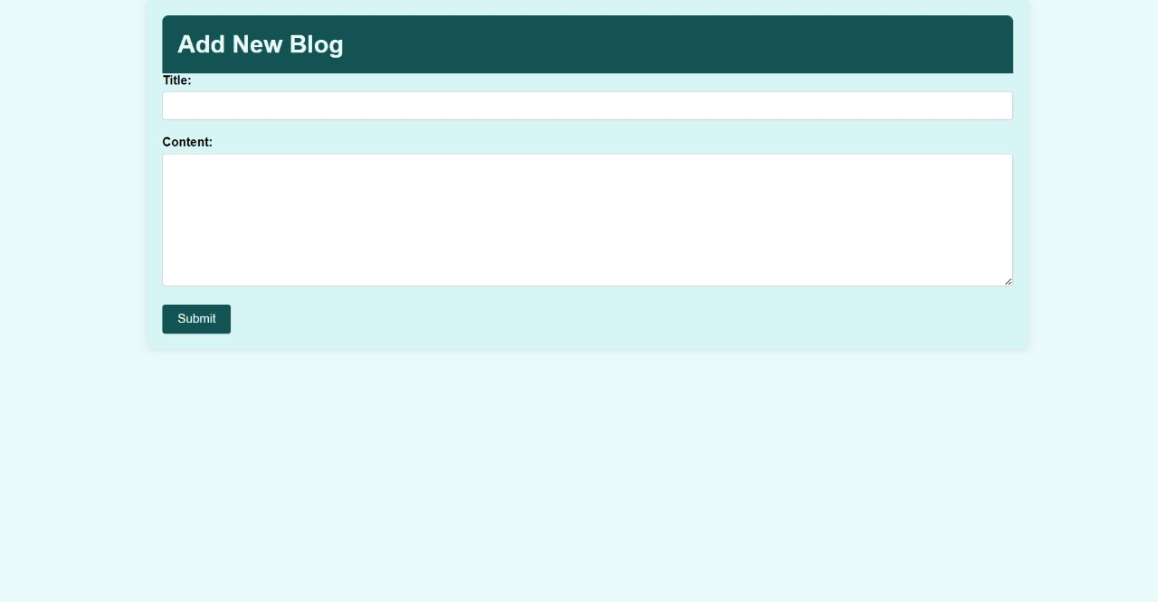
Add Blog Page
@app.route('/add', methods=['GET', 'POST'])
def add_blog():
if 'username' not in session or session['role'] != 'admin':
return redirect(url_for('login'))
if request.method == 'POST':
title = request.form['title']
content = request.form['content']
conn = sqlite3.connect('blogs.db')
cursor = conn.cursor()
cursor.execute('INSERT INTO blogs (title, content) VALUES (?, ?)', (title, content))
conn.commit()
conn.close()
return redirect(url_for('index'))
return render_template('add_blog.html')
- Admins can add new blog posts
- Includes form fields for title and content

Slide 18
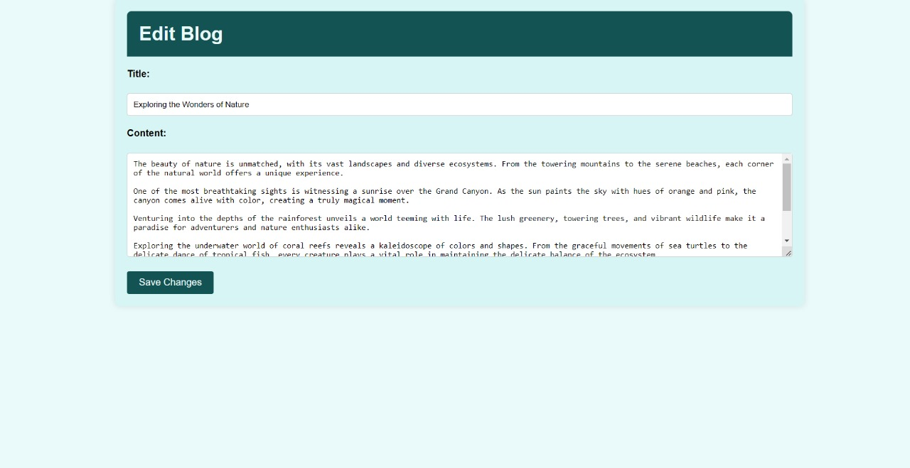
Edit Blog Page
conn = sqlite3.connect('blogs.db')
cursor = conn.cursor()
cursor.execute('SELECT title, content FROM blogs WHERE id=?', (blog_id,))
blog = cursor.fetchone()
conn.close()
if not blog:
return 'Blog not found', 404
return render_template('edit_blog.html', blog=blog)
@app.route('/edit/<int:blog_id>', methods=['GET', 'POST'])
def edit_blog(blog_id):
if 'username' not in session or session['role'] != 'admin':
return redirect(url_for('login'))
if request.method == 'POST':
title = request.form['title']
content = request.form['content']
conn = sqlite3.connect('blogs.db')
cursor = conn.cursor()
cursor.execute('UPDATE blogs SET title=?, content=? WHERE id=?', (title, content, blog_id))
conn.commit()
conn.close()
return redirect(url_for('index'))
- Admins can edit existing blog posts
- Pre-filled form with current title and content

Slide 19
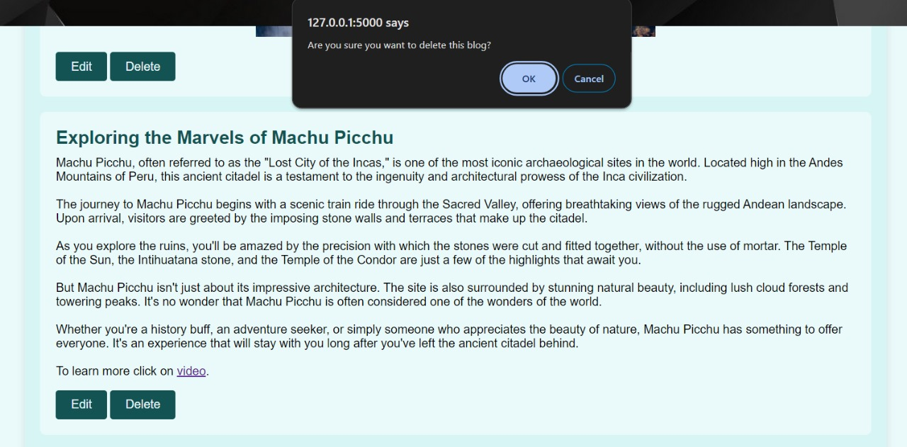
Delete Blog Page
@app.route('/delete/<int:blog_id>')
def delete_blog(blog_id):
if 'username' not in session or session['role'] != 'admin':
return redirect(url_for('login'))
conn = sqlite3.connect('blogs.db')
cursor = conn.cursor()
cursor.execute('DELETE FROM blogs WHERE id=?', (blog_id,))
conn.commit()
conn.close()
return redirect(url_for('index'))
- Admins can delete existing blog posts
- Confirmation dialog before deleting a post

Slide 20
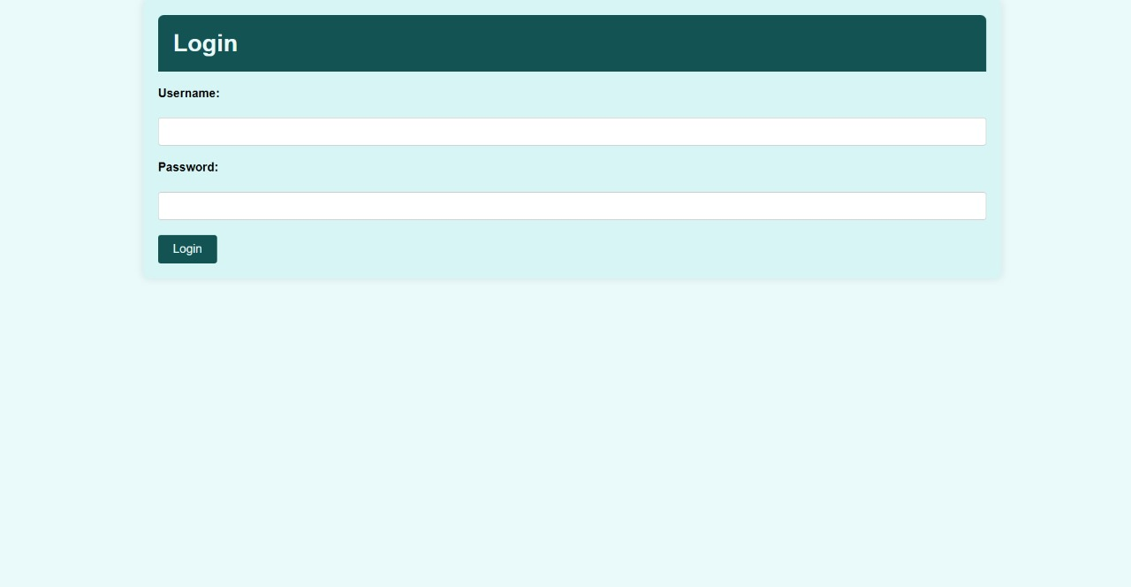
Login Page
@app.route('/login', methods=['GET', 'POST'])
def login():
if request.method == 'POST':
username = request.form['username']
password = request.form['password']
if username == 'admin' and password == 'admin123':
session['username'] = username
session['role'] = 'admin'
return redirect(url_for('index'))
else:
return render_template('login.html', error='Incorrect username or password')
return render_template('login.html')
- Admin login page
- Requires username and password

Slide 21
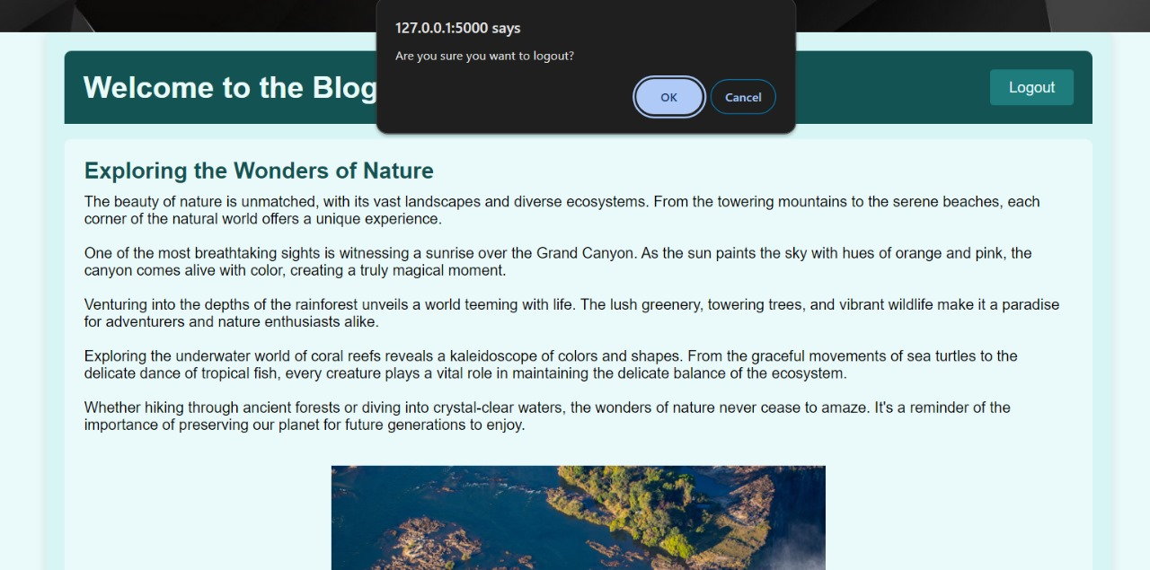
Logout Confirmation
# Logout route
@app.route('/logout')
def logout():
session.pop('username', None)
session.pop('role', None)
return redirect(url_for('index'))
- Displays confirmation dialog before logging out
- Allows users to confirm or cancel logout action

Slide 22
Thank You!

