Slide 1
Break the Xilence
Elliot Rosen | Jacob Nelson | Stephanie Mao

Slide 2
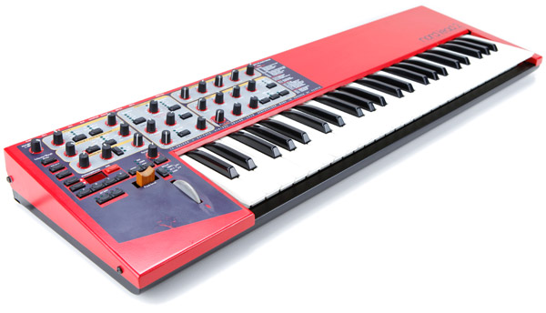
Project idea and Motivation
Build a hardware digital synthesizer
Amplitude envelope
Instant feedback
Out of the ordinary, fun, and interactive project

Slide 3
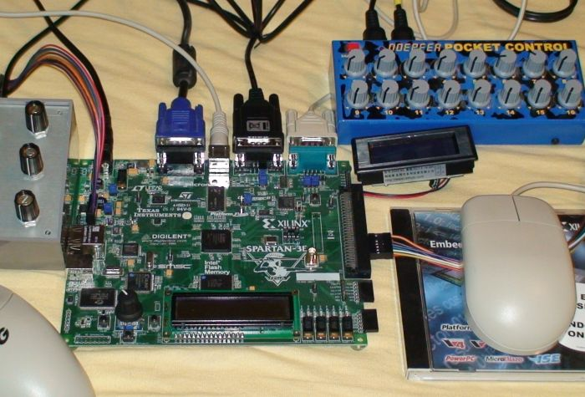
Project Goals
Functional
Flexible and responsive (maximum latency < 25ms)
User-friendly

Slide 4

Where are we now?

Slide 5
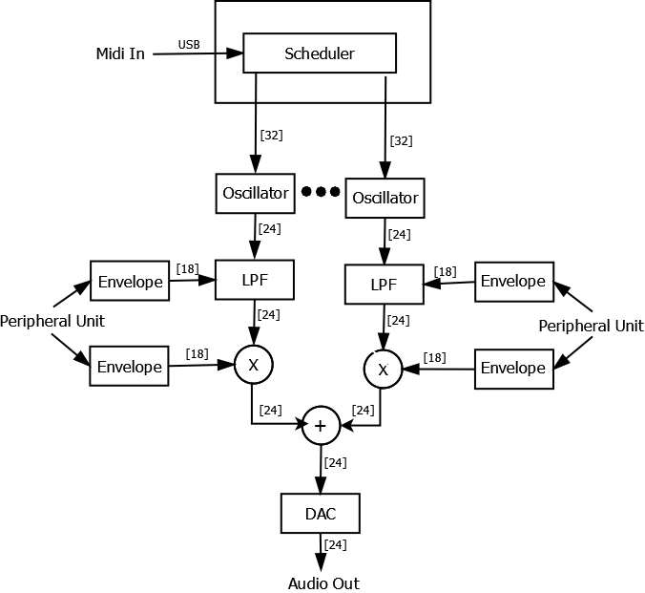
Block Diagram
Software
Scheduler
Hardware
Oscillators
Low Pass Filters
Multipliers
Adder
Digital to Analog Converter

Slide 6
software
Scheduler
Receives bytecode from midi controller
Receives which oscillators are available from hardware
Interprets bytecode
Keeps track of unused note banks
Maps note events to note banks
Monophonic and Polyphonic?

Slide 7
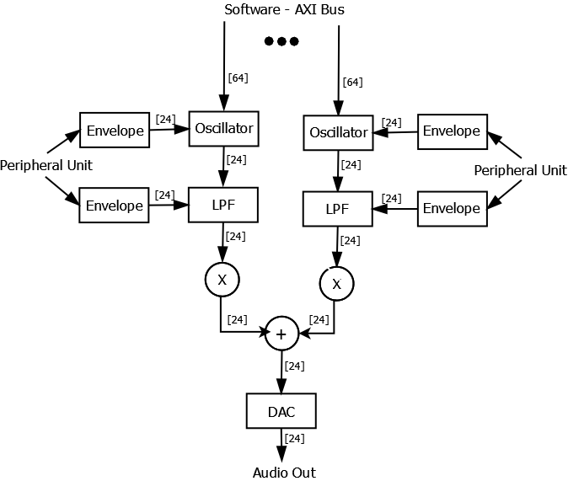
Hardware
Implement ADSR envelope
Peripheral control unit control parameters for changes in envelopes which causes varying sounds
Use adder for polyphony

Slide 8
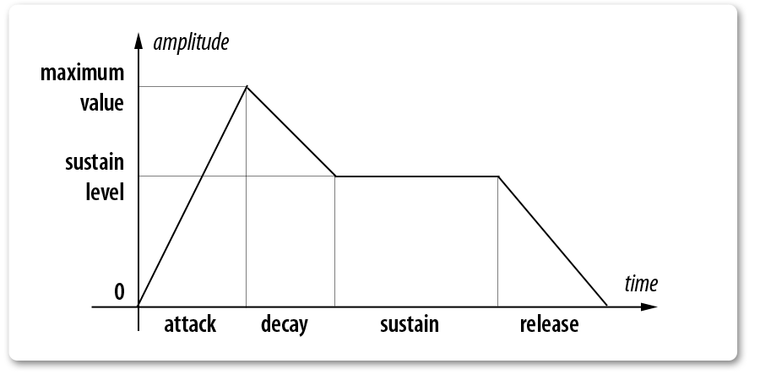
ADSR envelope
The attack phase starts when a key is pressed
The decay phase follows
The sustain phase lasts as long as the key is pressed
The release phase starts when the key is released
Length of phases determined by peripheral control unit

Slide 9
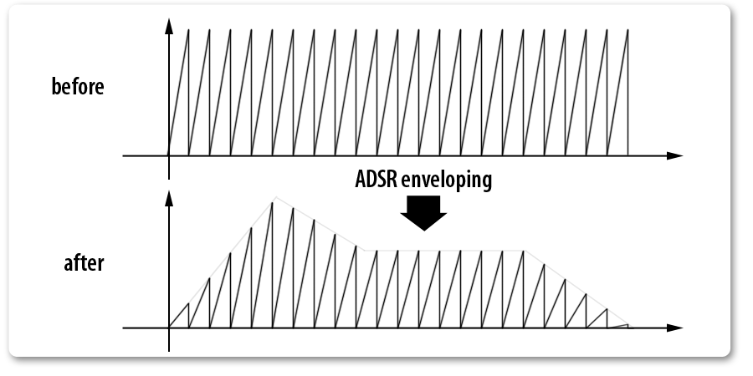
Adsr envelope

Slide 10
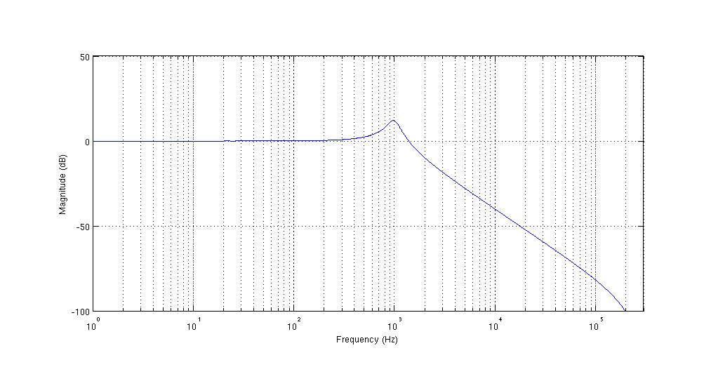

Matlab filter simulations
$$H\left(s\right)=\frac{{ω_{0}}_{}^{2}}{s^{2}+{ω_{0}}/Q+{ω_{0}}_{}^{2}}$$

Slide 11
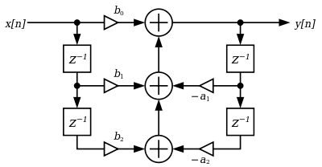

Digital filter realization
$$H\left(z\right)=\frac{b_{0}+b_{1}z^{−1}+b_{2}z^{−2}}{1+a_{1}z^{−1}+a_{2}z^{−2}}$$
Notes:
Digital realization of a direct form 1 digital biquad filter
-z^-1 unit time
-a’s and b’s coefficients

Slide 12
Where are we really now
Scheduler complete and tested
Oscillators completed and tested
Envelopes complete and being debugged
Filters complete and being debugged
Peripheral controls complete and tested
Note banks almost complete

Slide 13
What we learned
What not to do:
Work separately
All work on the same piece
Relax too much
What to do:
Share progress updates with each other
Divide labor
Keep common goal specified and in mind

Slide 14
Our thoughts
Affirmations
Suggestions
Thank you for pushing us early on in the semester
The freedom we were given allowed us to do a cross-disciplinary project
More clear/detailed directions for labs, especially the first one, would’ve been really helpful

Slide 15
Questions?

