Slide 1
SG-Farmer伐木伐木
Tianfu He
Tianfu.D.He@outlook.com
Harbin Institute of Technology

Slide 2
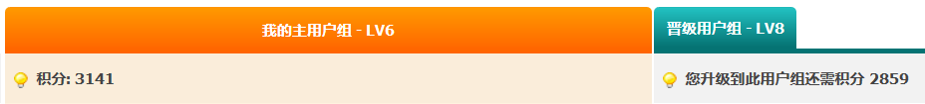
It’s a hard time farming!
We Sgers are farming for LV10
Publishing voting in LV5
Stack-like commenting in LV8
Evaluating, praising in LV10
I need LV8!
I spent two years to get my LV6
Now scored 3141 points
Still 2589 points’ way to go

Slide 3
Solution
Challenge: non-trivial in http request method
The cookie sent is too complex
Authentication info’s
Last action, last time of posting
Something more to be figure out
Most of them change over posts!
Hard to track back to find all relevant “Set-cookies”
What I choose
Actions simulation in JavaScript!
Are there something new?
Focusing on the simulation of farming, making it really human alike.

Slide 4
Design
N
Start
Scan
board
Pick one topic
Visited?
Check in
Intelij
reply
Straight ahead
Intelligent waiting (reading alike)

Slide 5
Reply Strategy
复制粘贴文本
随机复制点评
复制2楼
复制楼主节选
innerText.split(‘\n’)中选取一部分
复制标题
复制图片
随机选头像复制
固定文本
伐木伐木|不明伐木
来了来了
如果有roll字样
如果能搜到“来了来了”
有点评？
任选1点评回复
任选1点评回复

Slide 6
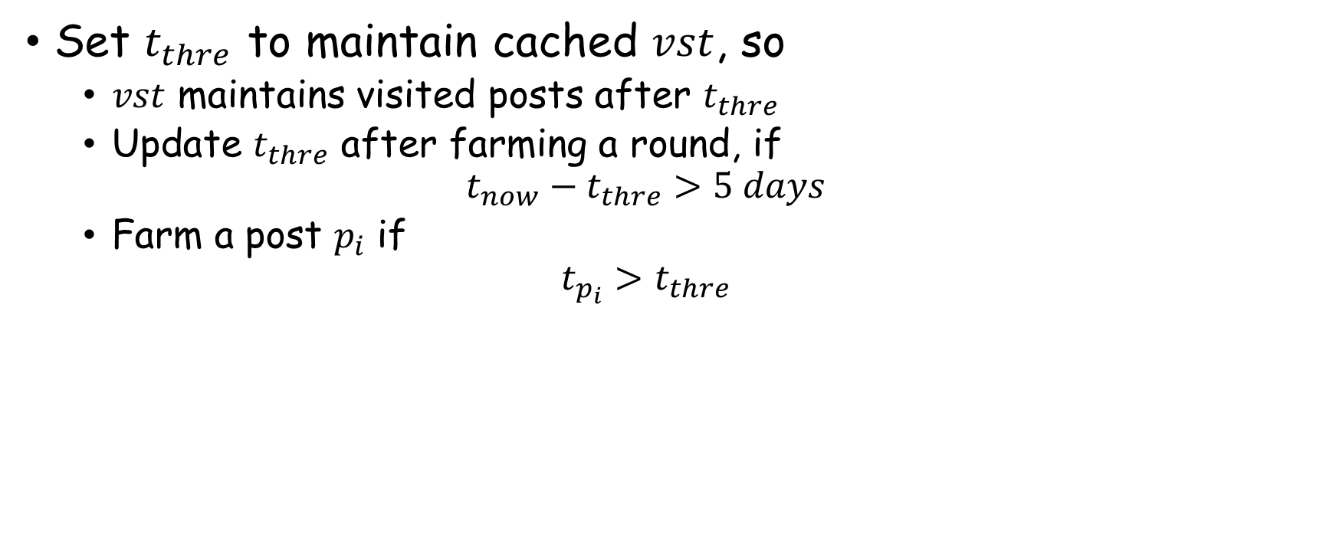
Cache Cleaning Strategy
Set $t_{thre}$ to maintain cached $vst$, so
$vst$ maintains visited posts after $t_{thre}$
Update $t_{thre}$ after farming a round, if
$$t_{now}−t_{thre}>5 days$$
Farm a post $p_{i}$ if
$$t_{p_{i}}>t_{thre}$$

