Slide 1


暑期汇报
GPGPU并行线程调度算法
姓 名
杨伟光
时 间
2014.08.20

Slide 2

目录
1
Background
2
Round-robin policy
3
Two-level policy
4
CALSO

Slide 3
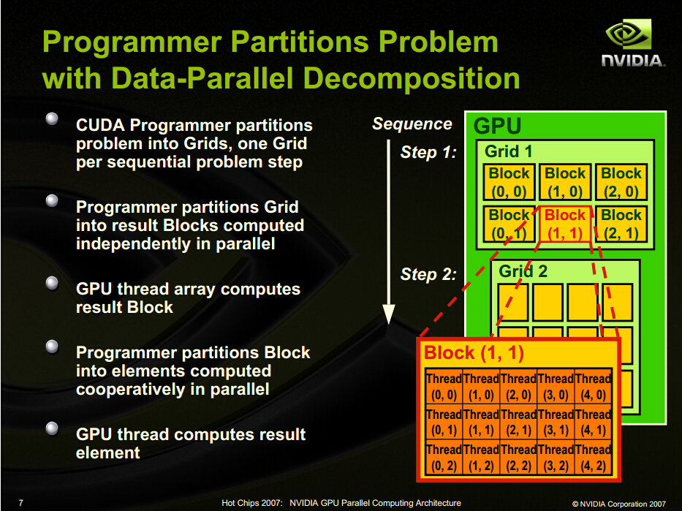
1
Introduction

Slide 4
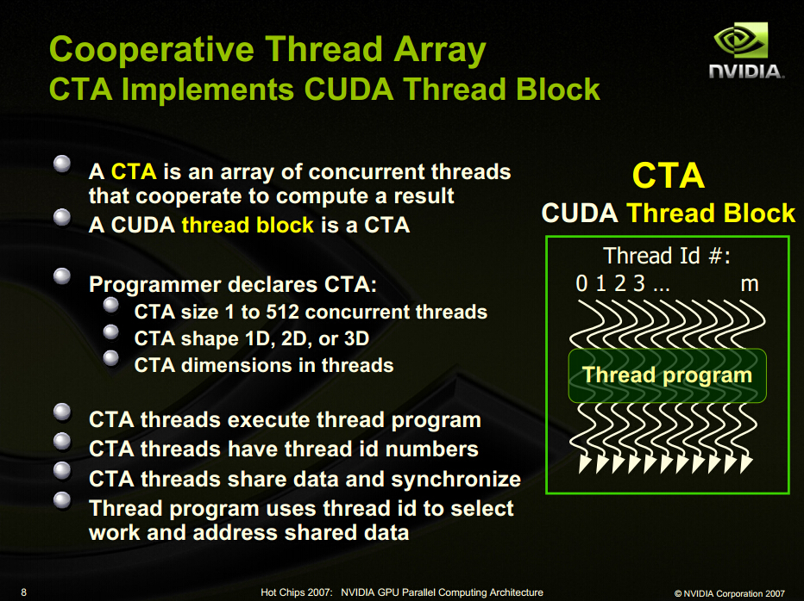

Slide 5
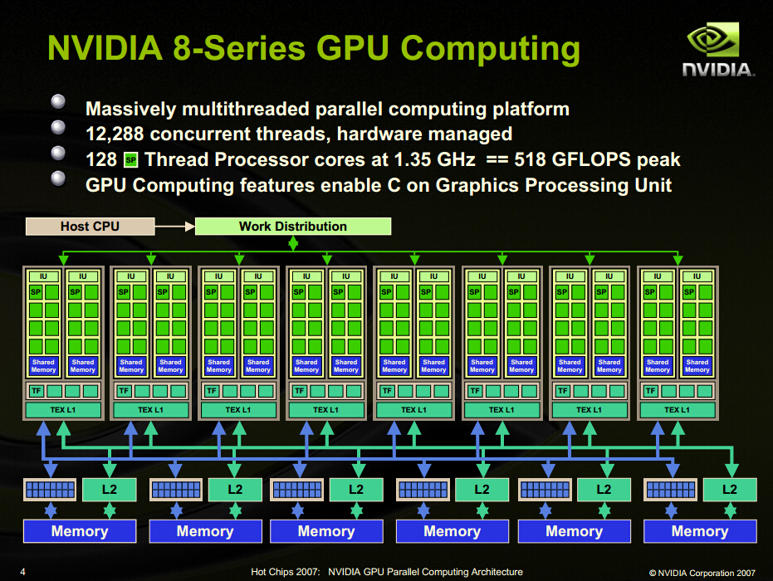

Slide 6
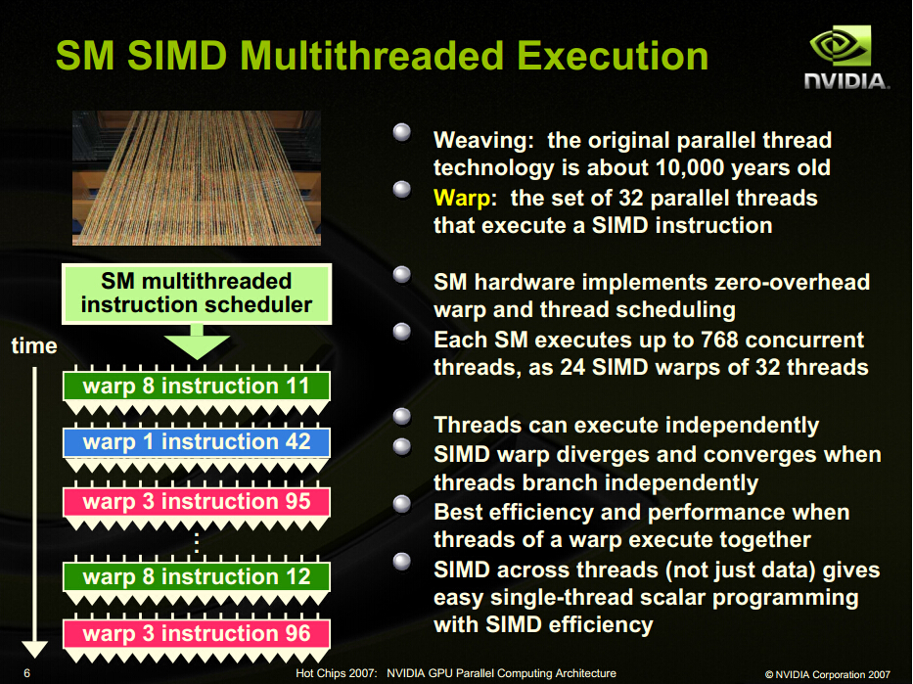

Slide 7
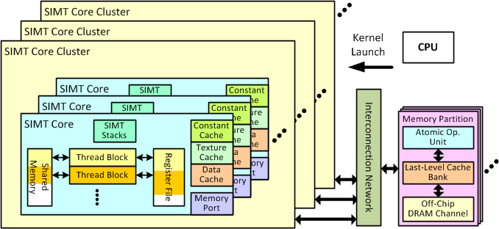
Overall GPU Architecture Modeled by GPGPU-Sim

Slide 8
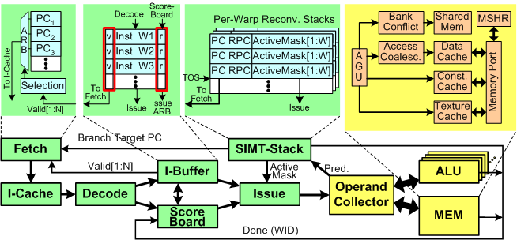
Detailed Microarchitecture Model of SIMT Core

Slide 9
2
Round-robin policy
The commonly-used round-robin (RR) policy schedules consecutive warps in consecutive cycles, assigning all warps equal commonly-used round-robin (RR) policy schedules consecu- tive warps1 in consecutive cycles, assigning all warps equal priority in scheduling.
Advantage: easy
Disadvantage:most of the warps arrive at a long-latency memory operation roughly at the same time

Slide 10
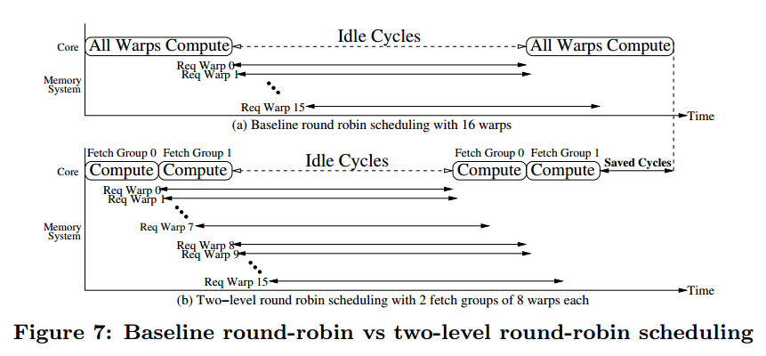
2
Two-level policy
Advantage: when warps in one fetch group are stalled on memory, warps in another fetch group can continue to execute
Disadvantage:

Slide 11
3
CLASO
A Credit-Based Load-Balance-Aware Scheduling Optimization Scheme (CLASO)

Slide 12
3
下周计划
1、Cache-Conscious Wavefront Scheduling
2、继续看量化方法
3、

Slide 13




4
进度安排及完成情况
2014.06
2014.10
2013.08
2013.12
2015.03
2013.10
请输入您要的内容请输入您要的内容请输入您要的内容请输入您要的内容请输入您要的内容请输入您要的内容

Slide 14
LOGO
Qijiayebing 作品
谢谢您的聆听

