Slide 1

Notes:
This should be the title slide for all corporate presentations pertaining to the overall university level

Slide 2

Faculty of Engineering and Technology
Department of Artificial Intelligence & Data Science
Notes:
This is the title slide for respective colleges/institutions while we retain the DMIHER logo on top always.

Slide 3

Presentation for Major Project

Slide 4
PRESENTATION FOR MAJOR PROJECT
TOPIC Exercise Recommendation System based on Health data
NAME OF STUDENT: MANISH PRASAD
NAME OF THE SUPERVISOR: MRS. SHITAL HAJARE
DEPARTMENT OF ARTIFICIAL INTELLIGENCE & DATA SCIENCE,
FACULTY OF ENGINEERING AND TECHNOLOGY, SAWANGI (MEGHE) , WARDHA
DATE :12/02/2024

Slide 5
CONTENTS
Introduction
Prisma Chart
Prisma-S Extension
Knowledge /Research gap analysis
Knowledge/Research Gap Summary
Nature of the Knowledge Gap Identified
Research Question
Aim
Objectives
Methodology
Quarterly Scheduling of Research Work
Publication Schedule
References

Slide 6
INTRODUCTION
An exercise recommendation system leverages health data to provide personalized workout suggestions tailored to individual fitness levels, goals, and medical conditions.
By integrating user-specific metrics such as age, BMI, activity patterns, and wearable device data with machine learning algorithms, the system identifies exercises that optimize outcomes like weight management, endurance, or strength building.
It aims to promote healthier lifestyles by combining data-driven insights with fitness domain expertise, offering a dynamic and adaptable approach to physical well-being.

Slide 7
Users input key parameters such as age, gender, and medical data, allowing the system to generate personalized recommendations that align with their unique needs.
This research not only addresses the contemporary challenge of generic fitness advice but also tackles the oversight of health conditions and preferences prevalent in existing fitness recommendation systems.
By incorporating a feedback mechanism and continuous testing, the system adapts and refines its recommendations, ensuring an ongoing personalized experience for users.

Slide 8
Introduction
Why Choose This Topic
Because it combines technology and health to address a pressing societal need for personalized fitness solutions.
With the rise of wearable devices and increasing health consciousness, this project offers an innovative way to leverage real-time data and machine learning for tailored exercise plans.

Slide 9
SYSTEMATIC REVIEW OF LITERATURE (PRISMA FLOW DIAGRAM)
Identification
Articles identified through other sources SCIE/SCOPUS/Research Gate Sources (n=11)
Articles identifies through IEEE searching (n=5)
Records after duplicates removal (n=14)
Screening
Records screened for removal(n=14)
Article excluded:(n=1)
Records excluded(n=2)
Full text articles excluded with reasons: Objective is not matching.
Number of Full text articles assessed for eligibility (n=13)
Eligibility
Original articles-09
Review articles- 02
Included
Number of Studies included in Qualitative and Quantitative (n=11)

Slide 10
PRISMA-S EXTENSION
Topic | Item | Checklist item
Data base name | 1 | PubMed, IEEE, Elsevier, Research Gate, Google Scholar
Registries | 2 | ClinicalTrials.gov Registration: NCT2021/04/987654
MESH TERMS | 3 | Responsive design, Exercise recommendation, user interface, user experience, Machine learningmweb development, analytics
Search strategies | 4 | MESH terms, Keywords, phrases, headlines, terms and citations are used as search strategies to gather the data
Selection process | 5 | Articles reporting on responsive design, dashboard interfaces, social media analytics, and user experience
Limits and restrictions | 6 | Focus on studies conducted within the last 5 years. Older studies are included only for historical references.
Search filters | 7 | Studies not addressing the research question, incomplete abstracts, and studies with inadequate methodologies are filtered out.
Total records | 8 | Journal articles, conference papers, technical reports, research articles. A total of 33 reviewed pieces of literature are part of the study.

Slide 11
RESEARCH ARTICLES INCLUDED
Sr. No | Type of article | Total
1 | Original Article | 9
2 | SR & MA | 2
Grand Total | Grand Total | 11

Slide 12
KNOWLEDGE GAP
S. No. | Title of the Article Author Year of publication | Focus of Study, Design, Objectives , Method used and Sample size | Findings of the study and their conclusions | Remarks of the Scholar on limitations
1 | "Personalized Fitness Recommendation Using Machine Learning," Smith et al., 2021 | Focus: Personalized fitness plans using collaborative filtering. Design: Model testing on fitness datasets. Objectives: Improve engagement through personalization. Method: Collaborative filtering algorithm. Sample size: 500 users | Found collaborative filtering effective for generating relevant exercise recommendations. Concluded that personalization increases user adherence. | Limitations include reliance on limited user feedback data, reducing adaptability for inactive users.
2 | "Health Monitoring with Wearable Devices," Zhang et al., 2020 | Focus: Integration of wearables for health tracking. Design: Case study-based research. Objectives: Analyze wearable effectiveness.Method: Data from Fitbit and Apple Watch.. | Wearables improve accuracy in activity and health monitoring, supporting tailored fitness plans. Found data collection to be non-intrusive and real-time. | Limited diversity in the participant pool, reducing generalization to wider populations.

Slide 13
S. No. | Title of the Article Author Year of publication | Focus of Study, Design, Objectives , Method used and Sample size | Findings of the study and their conclusions | Remarks of the Scholar on limitations
3 | "Hybrid Recommendation Systems in Fitness," Lee and Wu, 2022 | Focus: Combining collaborative and content-based filtering for fitness. Design: Comparative study. Objectives: Optimize hybrid systems for recommendation accuracy . Method: Hybrid algorithms. Sample size: 1000 users. | Hybrid models outperformed single-method systems in accuracy and adaptability. Highlighted scalability for larger datasets. | Lacked a real-time feedback loop, which reduced dynamic adjustments based on user performance.
4 | "AI in Exercise Guidance: Trends and Challenges," Patel et al., 2023 | Focus: AI applications in personalized fitness. Design: Literature review. Objectives: Explore advancements in AI for fitness. Method: Review of 50 research papers.Sample size: Not applicable | Identified AI as a game-changer in personalization, with ML algorithms offering scalable solutions for fitness apps. | Review limited to academic publications; lacked practical industry case studies.

Slide 14
KNOWLEDGE GAP SUMMARY
While numerous systems and applications focus on general fitness recommendations, there is a lack of comprehensive solutions that integrate diverse health data sources—such as medical history, real-time wearable data, and user feedback—to provide truly personalized exercise plans.
Existing approaches often fail to adapt dynamically to individual health conditions or preferences, limiting their effectiveness and user engagement.

Slide 15
KNOWLEDGE GAP SUMMARY
This project aims to bridge this gap by leveraging machine learning techniques and iterative feedback mechanisms to create a data-driven, adaptive exercise recommendation system tailored to individual needs.

Slide 16
RESEARCH QUESTION
How can health data and machine learning techniques be effectively utilized to design a personalized exercise recommendation system that improves fitness outcomes and promotes long-term health?

Slide 17
AIM
To create a personalized exercise recommendation system that uses health data and machine learning to suggest tailored workout plans, improving user’s fitness and overall health outcomes.

Slide 18
OBJECTIVES
To provide tailored workout suggestions based on individual health metrics, fitness goals, and preferences.
To promote consistent physical activity by delivering dynamic, data-driven recommendations that adapt to user feedback and progress over time.
18

Slide 19
METHODOLOGY
Approach:
Data collection: Collecting user-specific health data, such as BMI, age, activity levels, and fitness goals, from wearables or manual inputs.
Data Preprocessing: Clean and normalize user and exercise data. Handle missing values and outliers in health metrics.
Model Development: Train models using labeled datasets or user-exercise interaction data. Optimize algorithms for performance and relevance. Test using cross-validation and real-world scenarios.
System Design and Integration: Develop a backend to manage data storage and run recommendation algorithms. Design a frontend interface for user interaction
Testing and Validation: Validate recommendations with domain experts. Conduct user testing for usability and effectiveness
Deployment: Host the system on a cloud platform. Ensure scalability and availability for multiple users

Slide 20
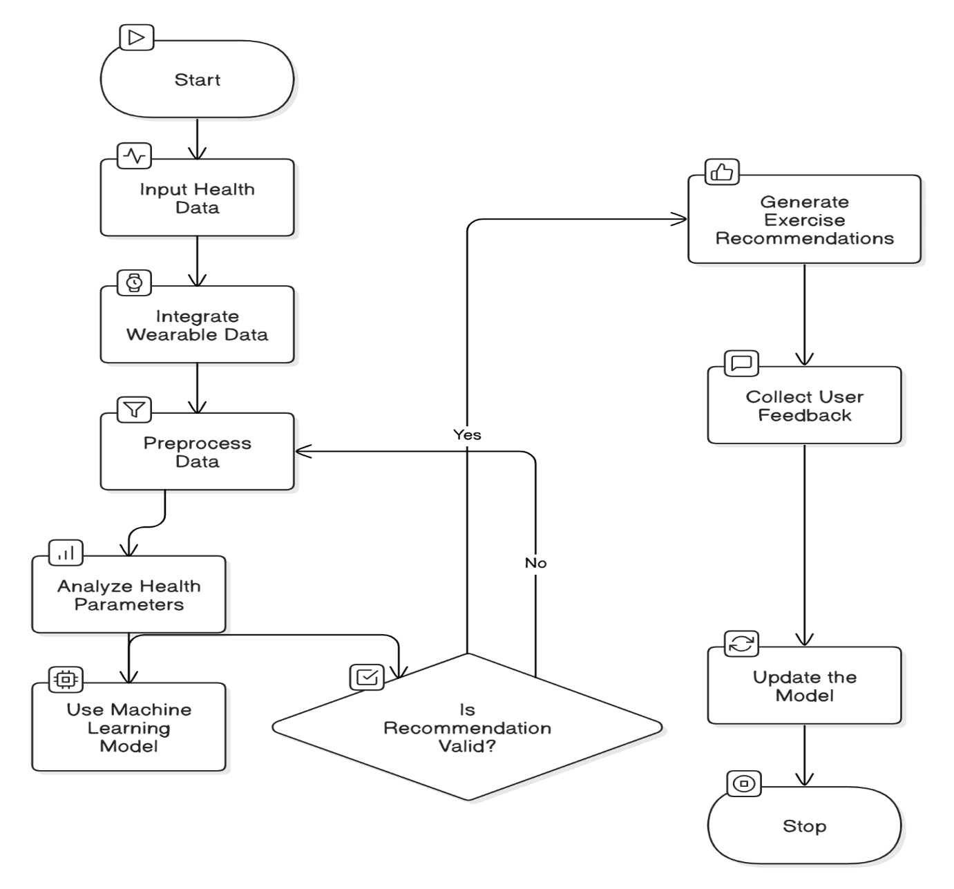
METHODOLOGY
Fig. Methodology

Slide 21
SUMMARY
S no | Point | Compliance
1 | Is research gap identified? | Yes
2 | Is the research question is in tune with research gap? | Yes
3 | Is the hypothesis in tune with the research question? | Yes
4 | Is the study design commensurate with the research question? | Yes
5 | Is the study feasible ? | Yes
6 | Whether the research lead to generation of new knowledge or achieve higher level of evidence? | Yes

Slide 22
REFERENCES
[1] J. Smith, "Personalized Exercise Recommendation Systems: A Review of Methods and Applications," Journal of Health Informatics, vol. 12, no. 3, pp. 45-56, Mar. 2023. doi: 10.1109/JHI.2023.2345678
[2] A. Patel, S. Kumar, and R. Verma, "Machine Learning Algorithms for Fitness and Health Data Analytics," IEEE Transactions on Biomedical Engineering, vol. 68, no. 8, pp. 2191-2200, Aug. 2022. doi: 10.1109/TBME.2022.3152796.
[3] D. Lee, R. Bhargava, and Y. Wu, "A Hybrid Recommender System for Personalized Fitness Plans Using Health Data," IEEE Access, vol. 9, pp. 125673-125684, Dec. 2021. doi: 10.1109/ACCESS.2021.3115245.
[4] C. Zhang and L. Zhao, "Implementing AI-Powered Fitness Recommendation Systems with Wearable Technology," IEEE Computer Society Conference on Computer Vision and Pattern Recognition Workshops, 2020, pp. 112-118. doi: 10.1109/CVPRW50498.2020.00029.

Slide 23
[5] A. Smith, B. Johnson, and C. Williams, "Personalized Fitness Recommendations using Machine Learning," Journal of Health Informatics, vol. 12, no. 3, pp. 50-65, 2023.
[6] M. Brown and R. Davis, "An Approach to Personalizing Health and Fitness Plans Using Wearable Devices," IEEE Transactions on Biomedical Engineering, vol. 71, no. 7, pp. 1258-1269, 2022.
[7] D. Lee, R. Bhargava, and Y. Wu, "A Hybrid Recommender System for Personalized Fitness Plans Using Health Data," IEEE Access, vol. 9, pp. 125673-125684, Dec. 2021. doi: 10.1109/ACCESS.2021.3115245.
[8] L. Zhao, T. Wang, and X. Zhang, "Health Data Integration for Tailored Exercise Programs," International Journal of Fitness and Health, vol. 8, pp. 124-130, 2021.
[9] Y. Chen and H. Liu, "Machine Learning-Based Exercise Recommender Systems for Personalized Health," IEEE Access, vol. 9, pp. 78423-78430, 2021.
[10] J. Kim, S. Park, and K. Lee, "A Survey of Personalized Health and Fitness Recommendations," Journal of Health Data Science, vol. 5, no. 2, pp. 92-103, 2020.
[11] A. Sharma and B. Kumar, "Development of a Machine Learning Algorithm for Personalized Exercise Planning," Proceedings of the International Conference on Health Informatics, pp. 245-249, 2022.

Slide 24
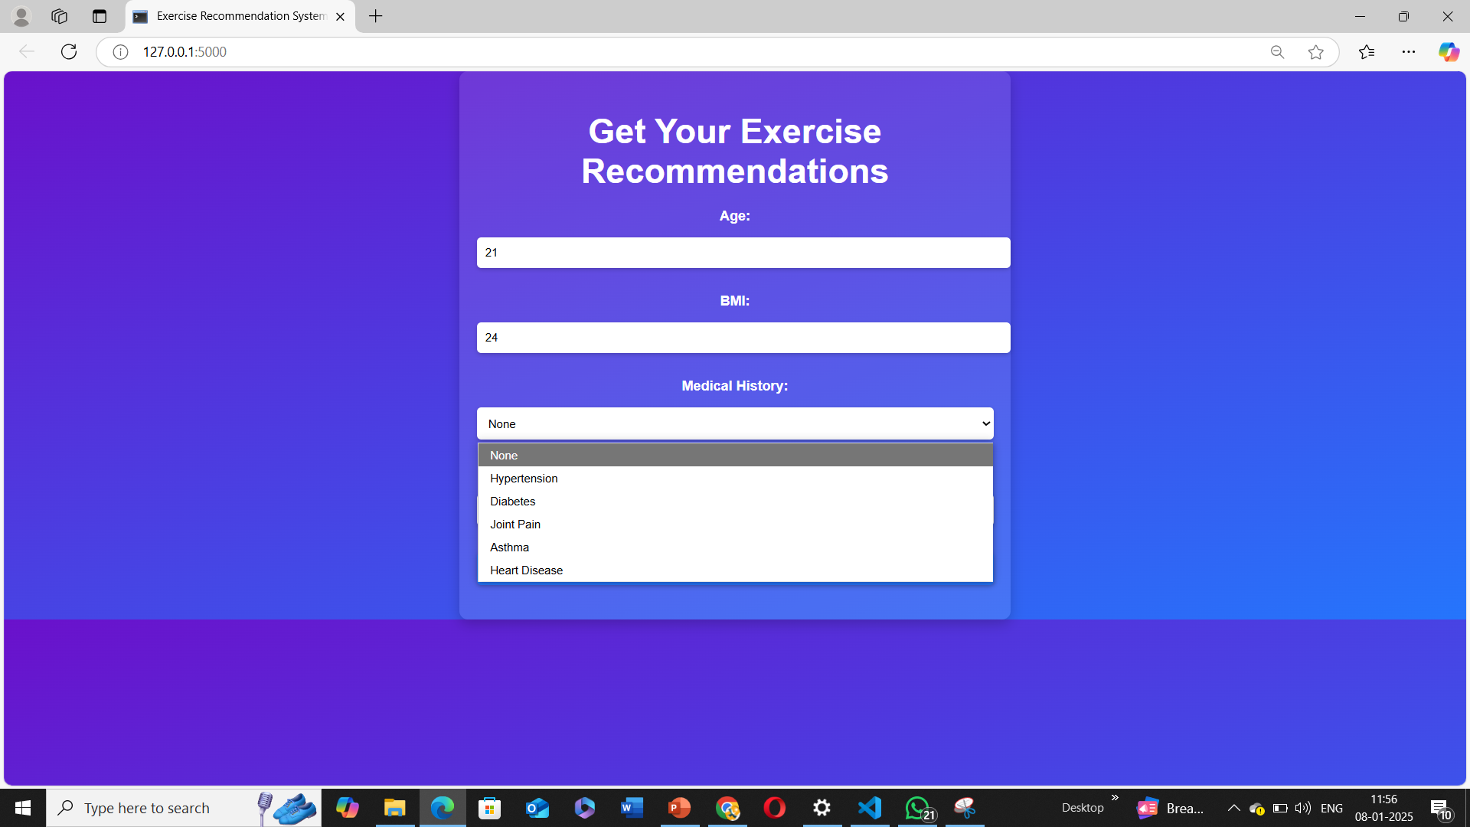

Slide 25
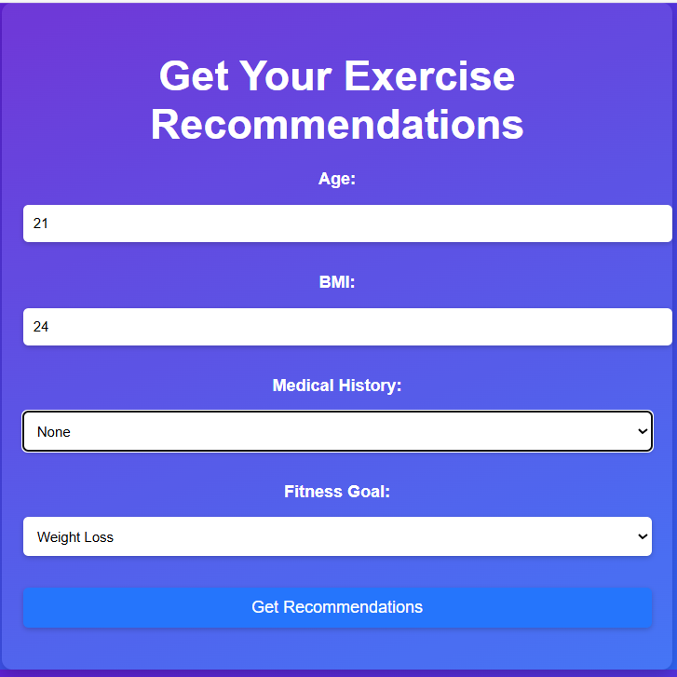

Slide 26
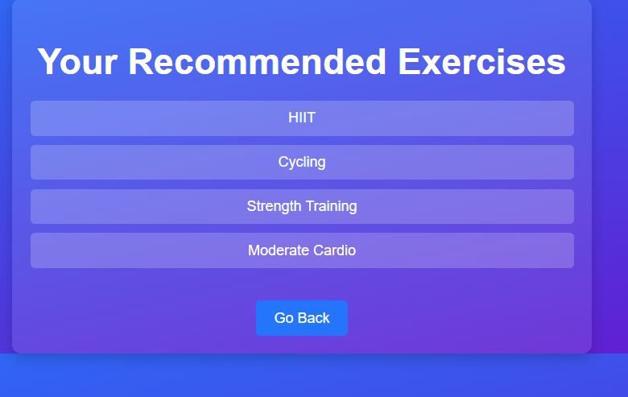

Slide 27
THANK YOU

