Slide 1
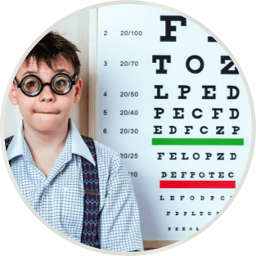
Myopia Study
Statistics for BA II
By Eva Giannatou

Slide 2
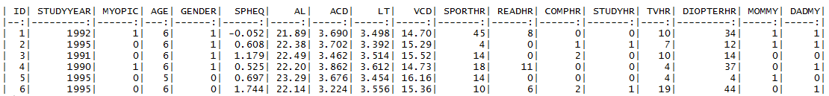
The Dataset
Data from the Orinda Longitudinal Study of Myopia (OLSM), a cohort study of ocular
component development and risk factors for the onset of myopia in children.
Dataset included
Eye measurements, family history of myopia & various visual activities
Data subjects
Your Great Idea 2
618 children who had at least five years of follow-up and were not myopic when they entered the study.
Project purpose
is to examine which variables contribute to the development of Myopia

Slide 3
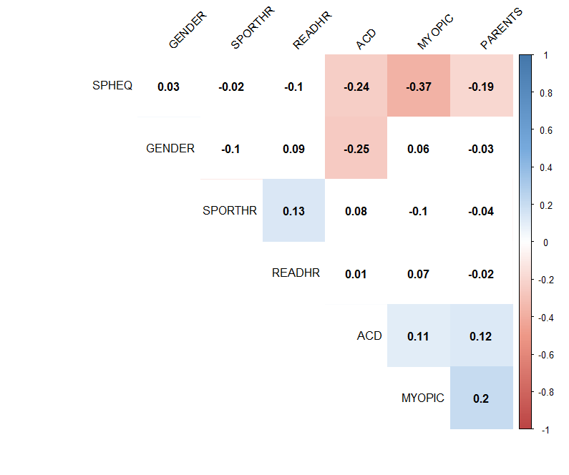
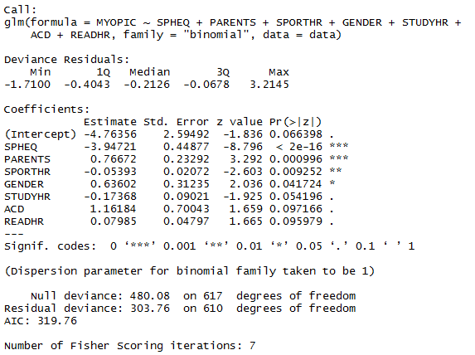
Important Variables
Which variables contribute to
the development of myopia?
01
SPHEQ
02
PARENTS
03
SPORTHR
04
GENDER
05
STUDYHR
06
ACD
07
READHR

Slide 4

GLM Model Evaluation
Binomial logistic regression
1
Confusion Matrix
TP = true positive (declare H1 when, in truth, H1)
FN = false negative (declare H0 when, in truth, H1)
FP = false positive
TN = true negative
=525
=50
=12
=31
2
Precision
3
Recall
= 31/(31+12) = 0.72
= 31/(31+50) = 0.38
4
F-Score
5
Accuracy
= 2x (0.38 x 0.72) / (0.38 + 0.72) = 0.50
= 556/618 = 0.90

Slide 5
Conclusions
01
The dataset is imbalanced. Only 15% of the dataset’s subjects are myopic students.
02
Model’s accuracy is high (approx. 90%). However, the model is unable to successfully predict myopic students.
Lower accuracy levels may have better predictive power, better precision, recall and F score.
03
04
This statistic analysis provides insights concerning the correlation between the studied variables and the existence of myopia in children, but the fitted model does not have strong predictive power.

