Slide 1

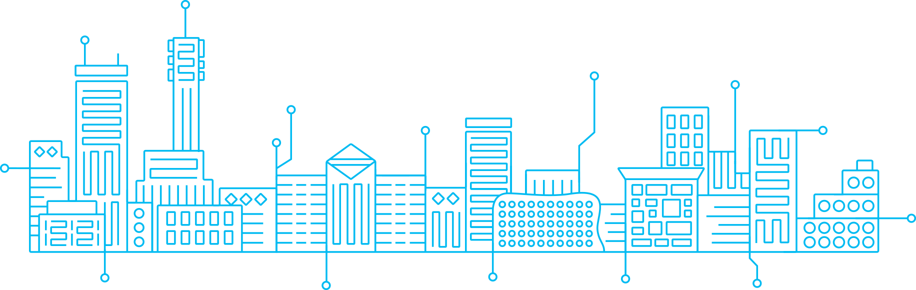
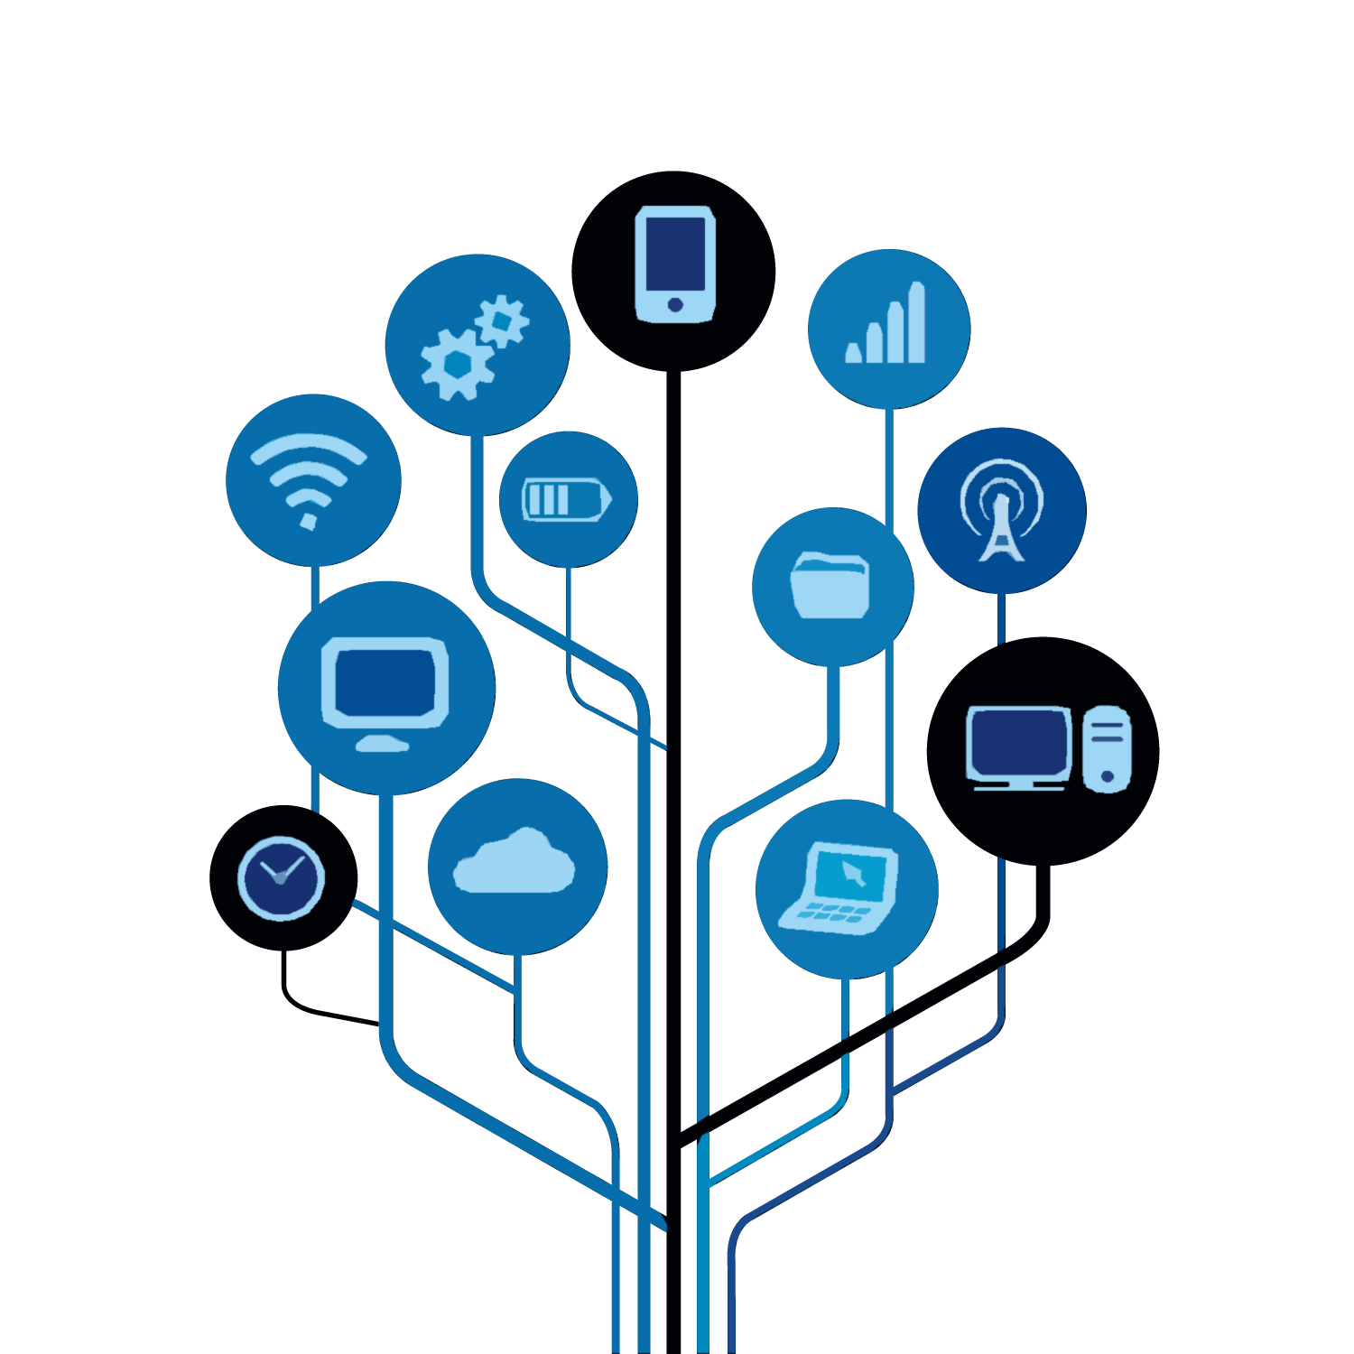
KG COLLEGE OF ARTS AND SCIENCE
A MOBILE WASTE-TO-ENERGY SYSTEM THAT CONVERTS WASTE TO BIOGAS AND USES IOT FOR REMOTE MONITORING.

Slide 2
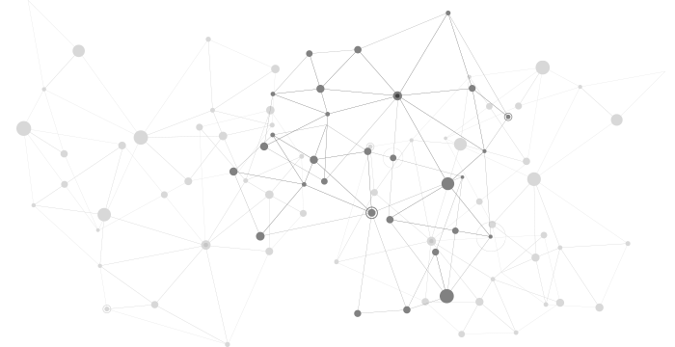
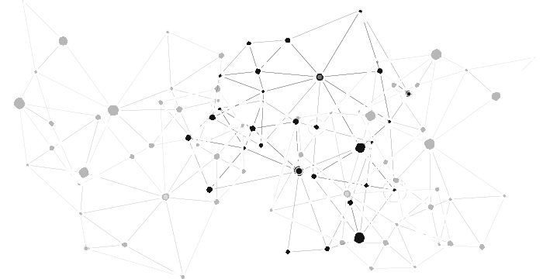

INTRODUCTION
OBJECTIVES:
To develop a sustainable, mobile waste-to-energy solution that converts organic waste into biogas and integrates smart energy storage and IoT for efficient, off-grid energy access.
IMPORTANCE:
This system addresses energy poverty, promotes sustainable waste management, and offers a reliable power source for remote areas, reducing reliance on traditional energy grids while ensuring environmental sustainability.

Slide 3
PROPOSED SOLUTION:
Mobile Waste-to-Energy System: Produces organic waste into biogas to generate sustainable energy.
Smart Energy Storage: Keeps energy stored in self-sustaining Li-ion batteries with continuous use.
IoT & AI Integration: Environment monitoring in real-time while optimizing the system for efficient energy utilization.
Sustainable & Off-Grid: This provides a reliable source of power for off-grid areas due to poor power access.
Modular Design: Ensures scalability and easy deployment, allowing customization based on specific energy and waste requirements.

Slide 4
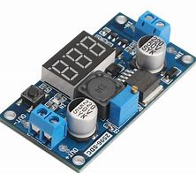
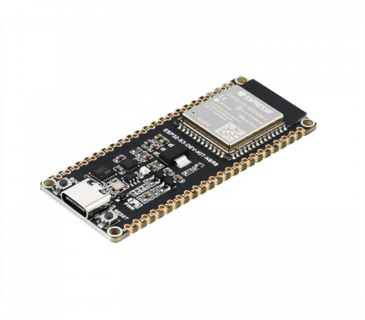
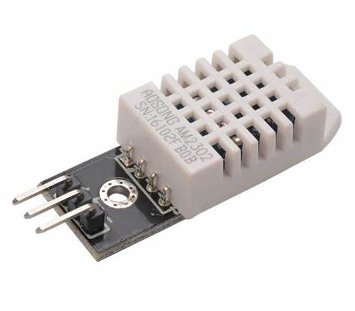
TECHNICAL APPROACH:
HARDWARE:
SOFTWARE:
Biogas Digester PVC Pipes Gas Storage (Balloons/Small Tank) Mini Fan/Pump Li-ion Battery (18650 Cells)
ESP32 Firmware
IoT Platform (e.g., Blynk, ThingSpeak)
Wi-Fi/Bluetooth Protocols
Sensor Data Processing Algorithms
Mobile App/Interface
LM2596 Buck Converter
ESP32 Microcontroller
DHT22 Sensor
Compact Frame (Acrylic/3D Printed)
METHODOLOGY:
Convert organic waste into biogas to power a fan/pump and store energy in a Li-ion battery, regulated by a Buck Converter And Integrate IoT-enabled ESP32 for real-time monitoring and control via a mobile app, with optional solar charging for portability.

Slide 5
FEASIBILITY AND VIABILITY:
TECHNICAL:
The system is technically feasible because it uses available components such as biogas digesters, Li-ion batteries, ESP32 microcontrollers, and IoT platforms.
COST EFFECTIVE:
The use of low-cost materials such as PVC pipes, 18650 cells, and mini fan ensures that the system is affordable for remote communities.
SCALABILITY:
The use of low-cost materials such as PVC pipes, 18650 cells, and mini fan ensures that the system is affordable for remote communities.
VIABILITY:
SCALABILITY:
The system will promote a circular economy, reduce waste, and give the benefit of renewable energy because it harnesses waste to create energy
The inclusion of solar charging and IoT will ensure that the system is self-sustaining and can operate in remote areas, Energy shortages, waste management, and environmental sustainability in underserved and remote regions can be addressed by this solution as a long-term value.

Slide 6
IMPACTS AND BENEFITS:
ECONOMIC BENEFITS:
It generates low-cost energy and saves the nation from dependency on external power Local job opportunities and boosts the community's development.
SOCIAL BENEFITS:
Increases the living standards through the generation of clean energy in remote areas Empowers the community through sustainable waste management.
ENVIRONMENTAL BENEFITS:
Reduces waste and pollution by converting organic material into biogas Supports sustainable energy and reduces greenhouse gas emissions.
IMPACTS:
ECONOMIC IMPACT:
Offers low-cost, renewable energy that can lower energy costs in remote region economic development by creating employment and energy self-sufficiency.
SOCIAL IMPACT:
Enhances living standards by providing access to clean, reliable energy Increases community health and hygiene through proper management of waste.

Slide 7
THANK YOU.

