Slide 1
WELCOME YOU ALL

Slide 2
TITLE Uploading videos/files in social media
Team Members
Praveenchidambaram . V , B.E ECE
Manojkumar . K , B.TECH AI&DS
Lokeshwaran . K , B.E CSE
Lithikhaa . K , B.TECH AI&DS
1
2
3
4

Slide 3
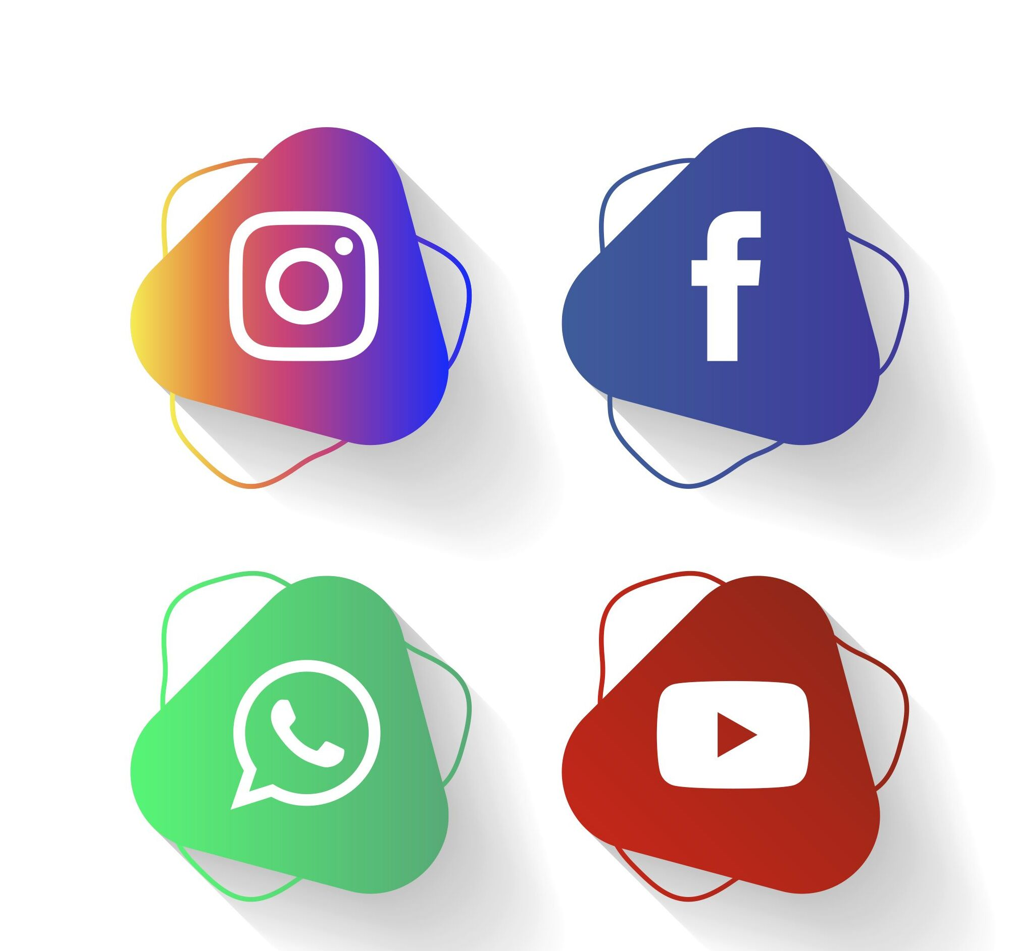
ABSTRACT
The purpose of the project is to upload the video/files in social media apps such as Instagram , Youtube , Whatsapp , Facebook by using python language. Along with these we used some Python packages and its process to upload the files or videos in social media.

Slide 4

PACKAGES
1
Tkinter to create a graphical user interface(GUIs)
Instabot not only used for instagram api but also used in some functions.
facebook-sdk A secure and convenient way for people to log into your app or website by using facebook credentials.
Pywhatkit Send WhatsApp messages.
Googleapiclient to access the Google APIs .
google_auth_oauthlid construct an instance of this flow using from_client_secrets_file() get from the Google API Console. ...
2
3
4
5
6

Slide 5
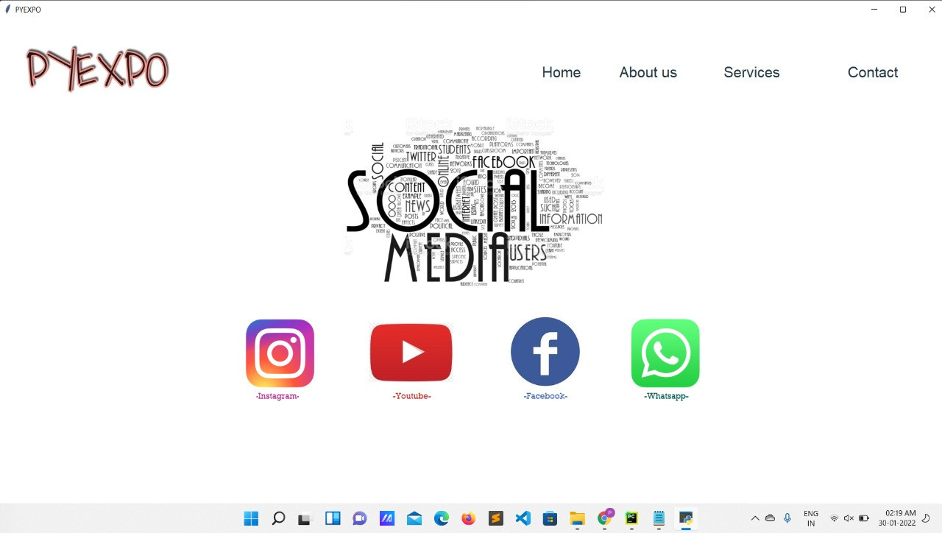
PROCEDURE
How it works:
1
Click the social media you want to Upload
2
Enter the required data given in interface
Note : You need to be online when you add a picture.
3
Browse the image / video
4
Click upload and the file will be uploaded

Slide 6
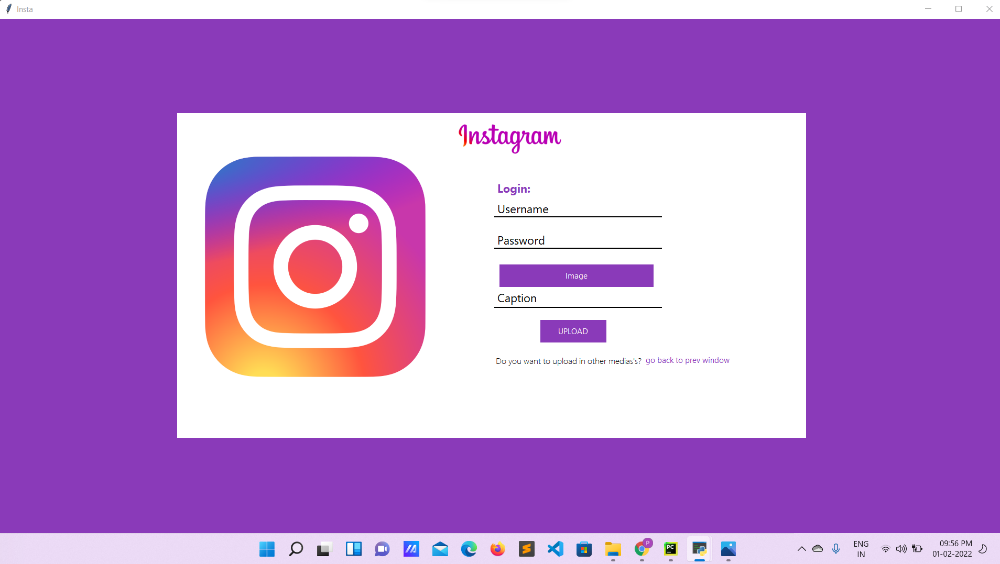
INSTAGRAM
How it looks:

Slide 7
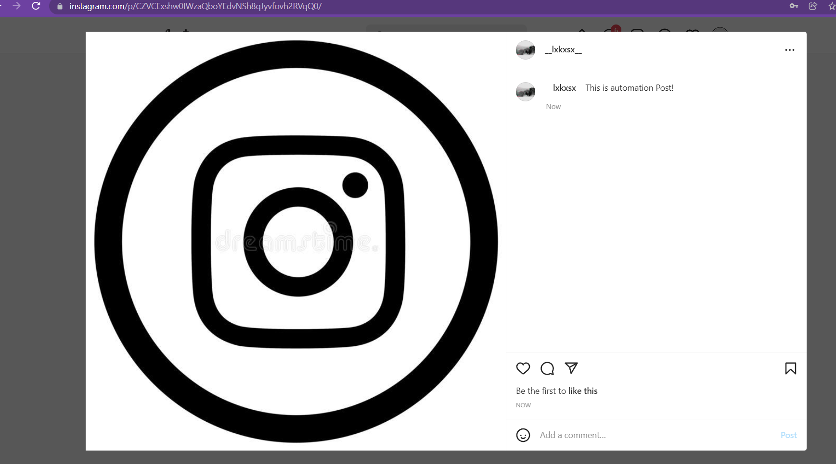
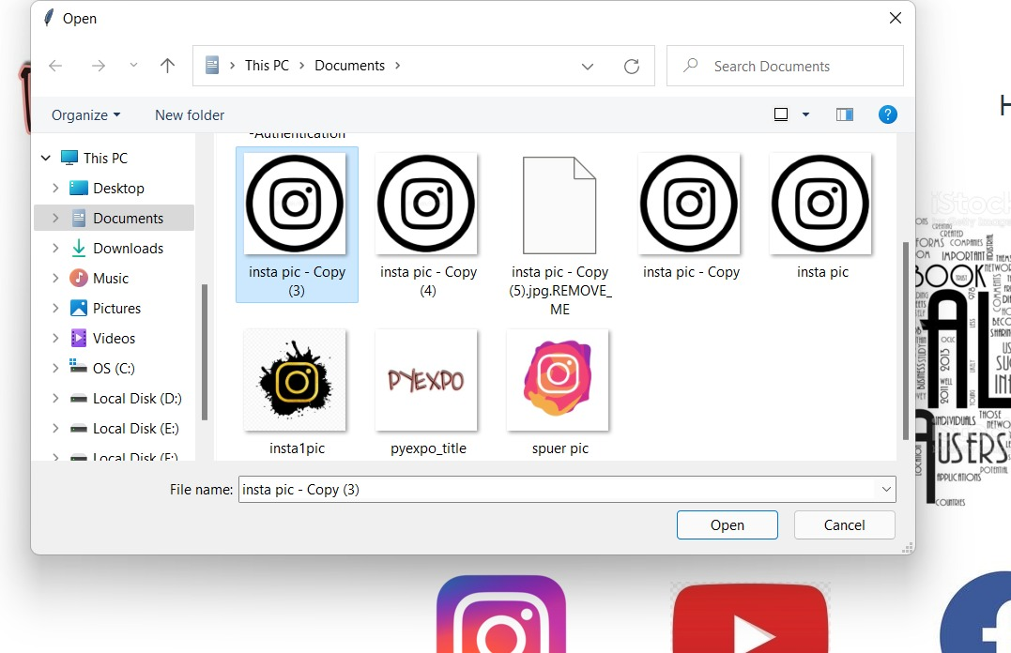
UPLOADING PROCESS
2
The post will be uploaded
Select the picture you want to upload
1

Slide 8
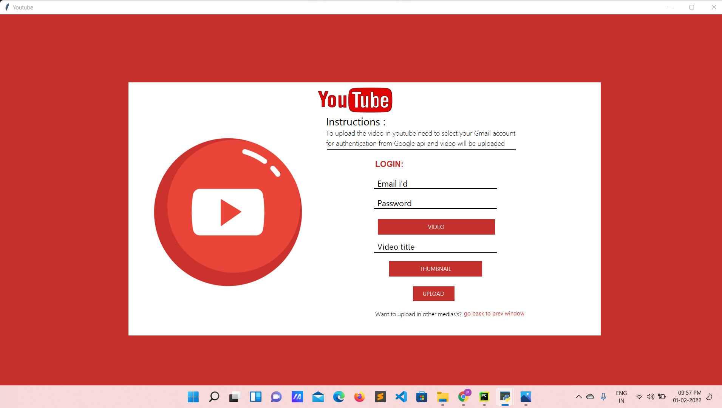
YOUTUBE
How it looks:

Slide 9
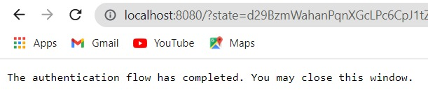
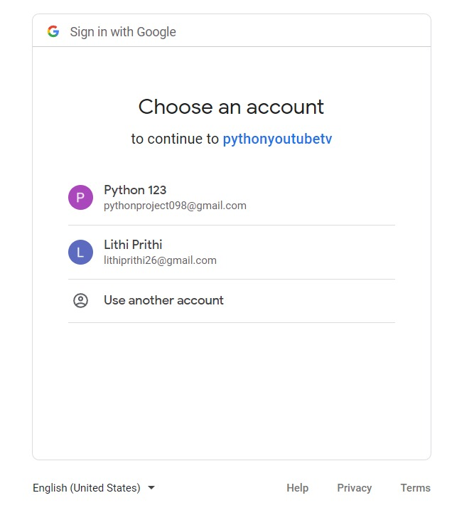
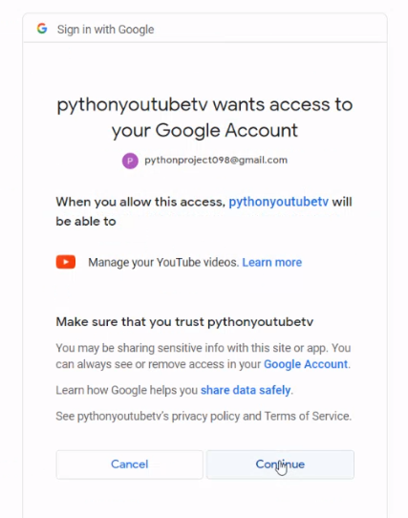
AUTHENTICATION PROCESS
3)
3
1
2

Slide 10
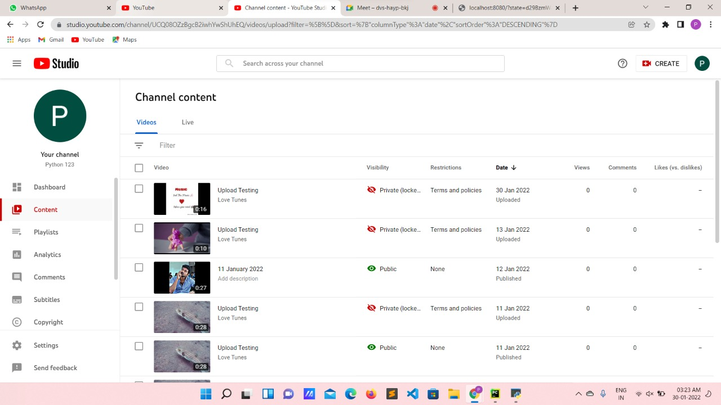
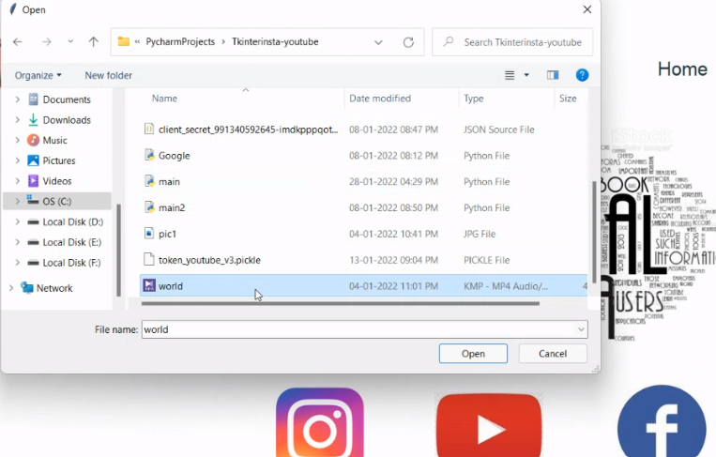
UPLOADING PROCESS
2
The post will be uploaded
1
Select the video you want
to upload

Slide 11
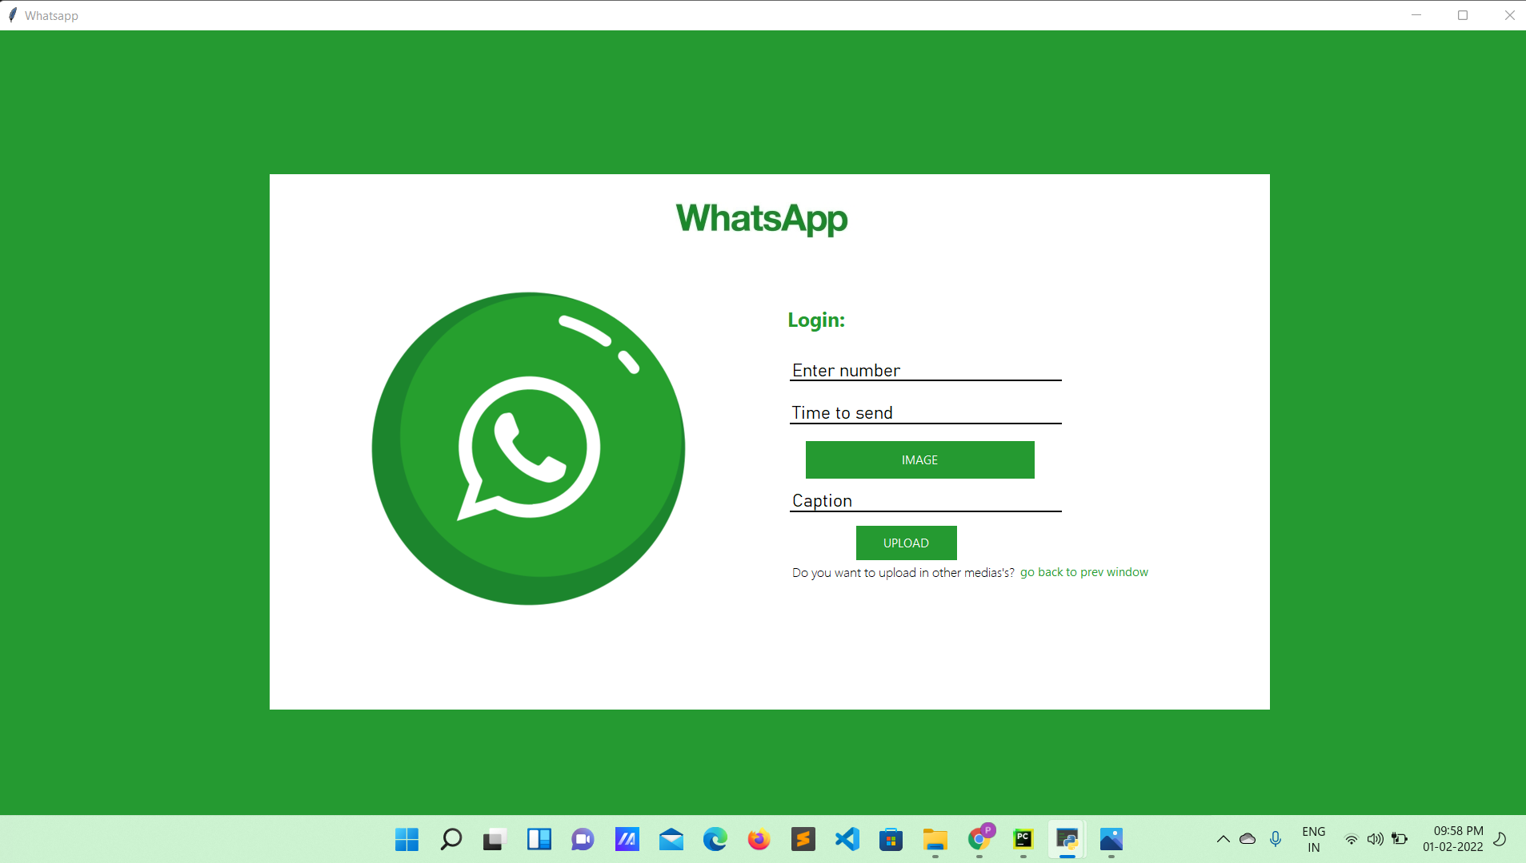
WHATSAPP
How it looks:

Slide 12
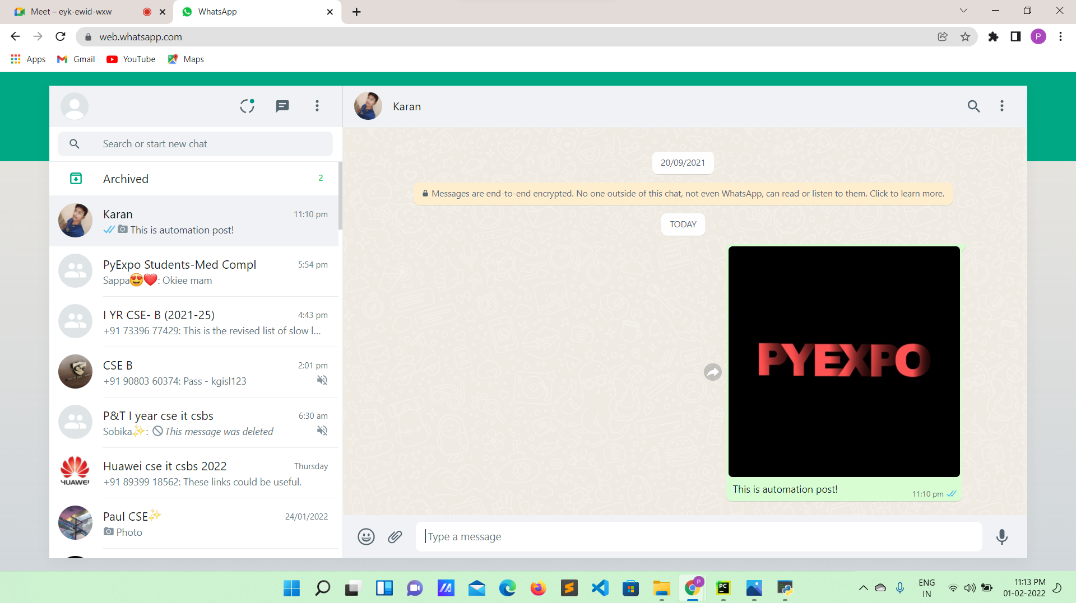
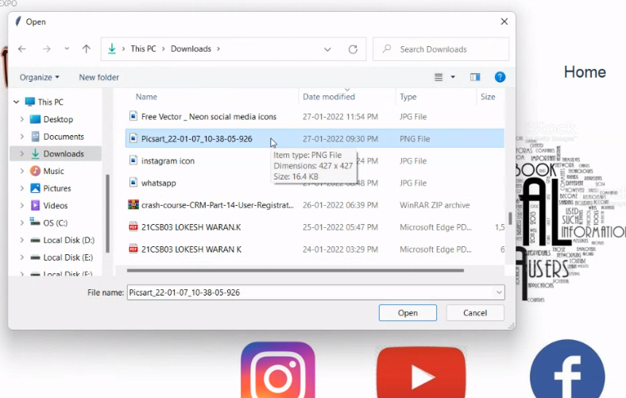
UPLOADING PROCESS
2
The post will be sended
1
Select the picture you want
to send

Slide 13
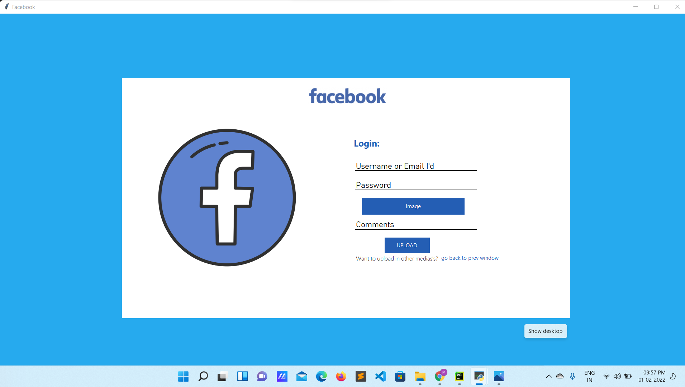
FACEBOOK
How it looks:

Slide 14
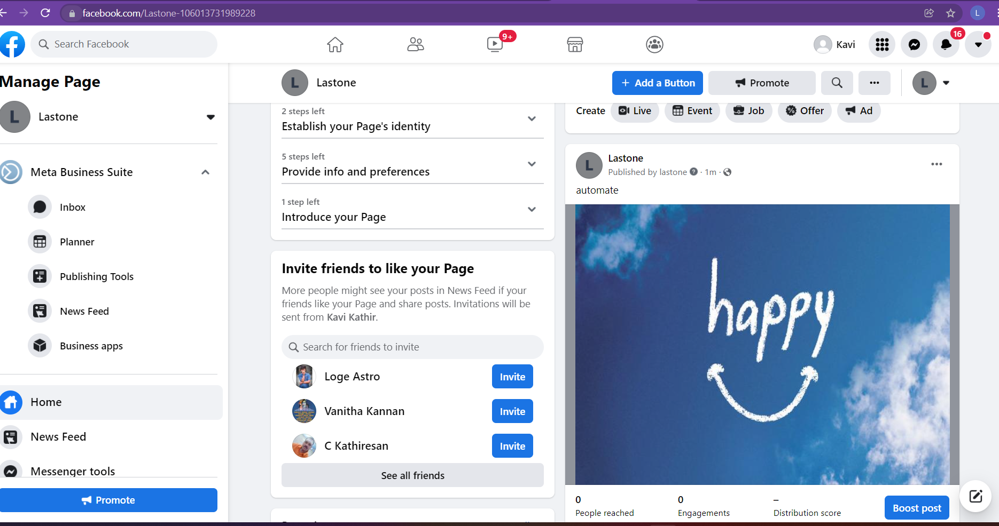
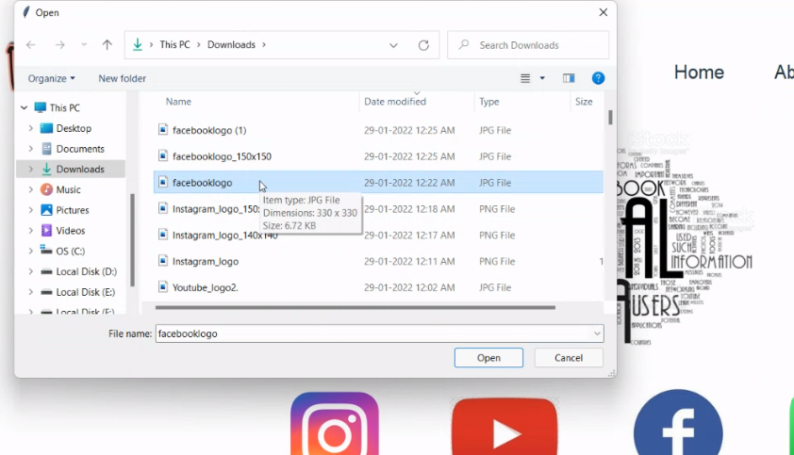
UPLOADING PROCESS
2
The post will be uploaded
1
Select the picture you want
to upload

Slide 15

Let us get into the demo!

Slide 16
REFERENCE
https://github.com/Lithikhaa/socialmedia.git
https://github.com/lokeshwaran26/-socialmedia-upload
https://docs.python.org/3/library/tkinter.html

Slide 17
FUTURE ENHANCEMENT
In future enchancement this desktop app can developed as web application
It is planned to include more social media apps like snapchat,twitter…etc
In future it is determined to upload 10+ post at a time
1
2
3

Slide 18

Ask if any query

Slide 19
THANK YOU

