Slide 1
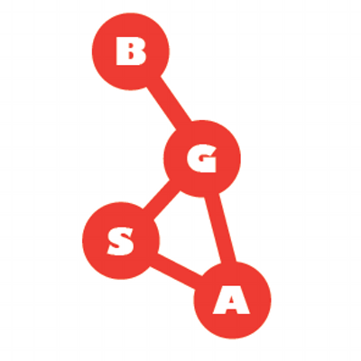
The Biology Department & You

Slide 2

Student associations
University associations
PGSS (post-graduate student society)
Thomson House
ALL GRADUATE
STUDENTS
GPS (graduate and post-doctoral studies)
BGSA (Biology graduate student association)
Me
BIOLOGY
GTC (biology graduate training committee)
YOU

Slide 3
The Biology Graduate Student Association
Made up of all of you (MSc, PhD, Post Doc)
Execs
Councilors
Representatives
President
VP
Finance officer Secretary
16 BGSA members
PGSS
AGSEM (TA union), seminar series
etc
Two first year reps
GA: Sep 27th

Slide 4
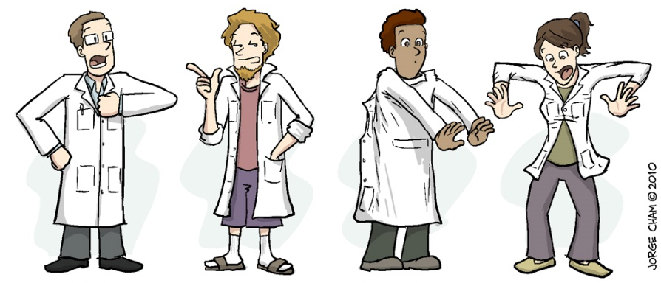


Where we get our money to do things

Slide 5
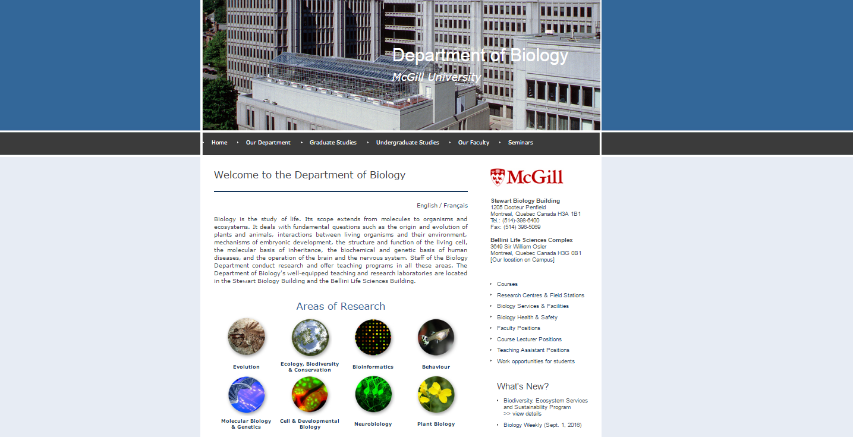
Being a grad student

Slide 6
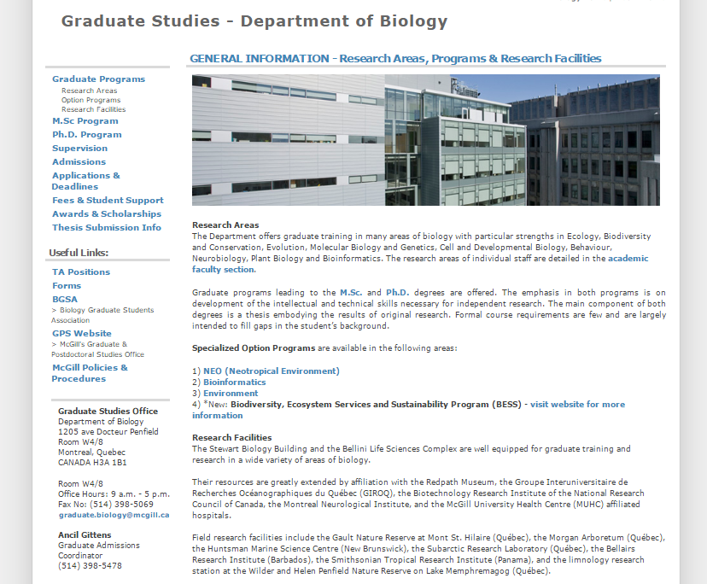
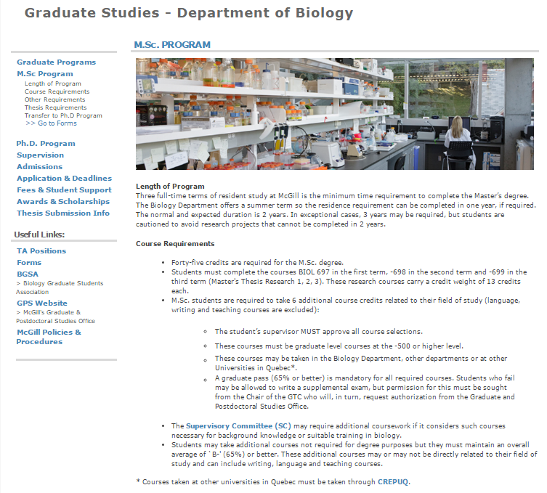
Being a grad student

Slide 7
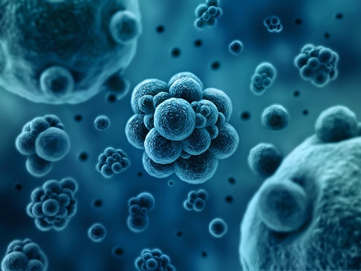
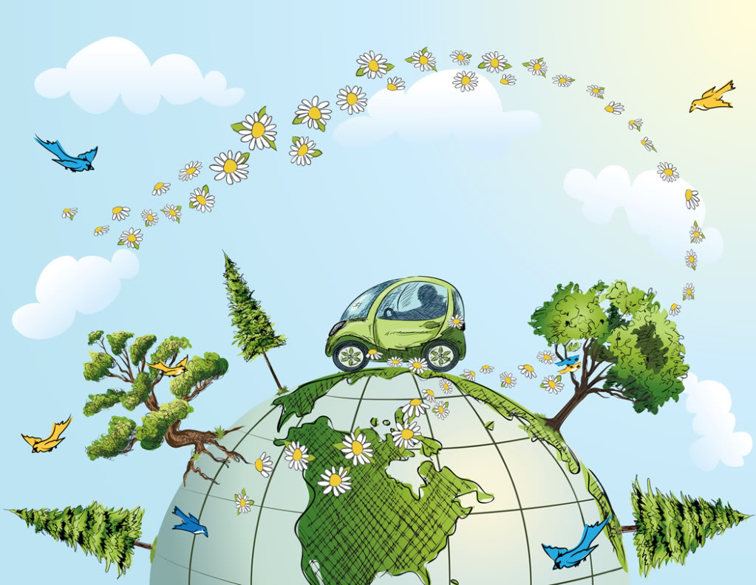
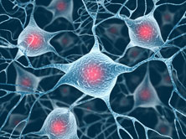
Biology department subdivisions
INTERNAL SEMINARS:
Molecular
Conservation, Ecology & Evolution
Neurobiology
Molecular WIPS
EELs
Neurobiology and behaviour seminars

Slide 8
Biology department subdivisions
EXTERNAL SEMINARS:
Molecular
Conservation, Ecology & Evolution
Neurobiology
Molecular Seminars
Stewart biology N2/2: Mondays @ 4:00pm
Organismal Seminars
Redpath Museum: Thursdays @ 3:00pm

Slide 9
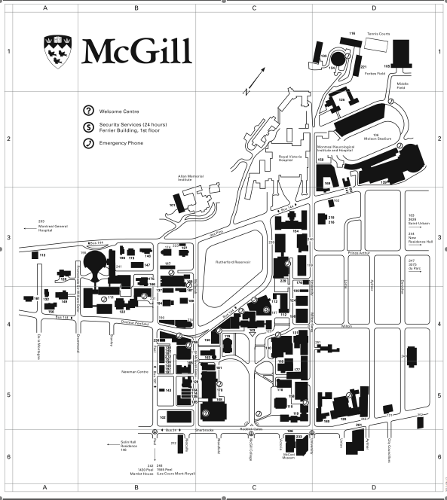
Biology department Buildings
For important building people and information on safety, keys, room access, and room bookings for each building, check out the BGSA website (http://mcgillbgsa.com/)
Bellini
Redpath Museum
Stewart Biology

Slide 10
Other Buildings
Samosas!
3 for $2
McIntyre Cafeteria
Law Cafeteria
Thomson House
Stewart Biology
Bellini
Vinh’s Banh Mi
Second Cup
Subway
Redpath Museum
SSMU
Quesada
Super sandwich
Hipster coffee (Humble Lion)

Slide 11
IMPOSTER SYNDROME
This is a real thing
Feeling like a “fake” or “fraud”
Feeling like your success is due to luck
Worried people will “find you out”

Slide 12
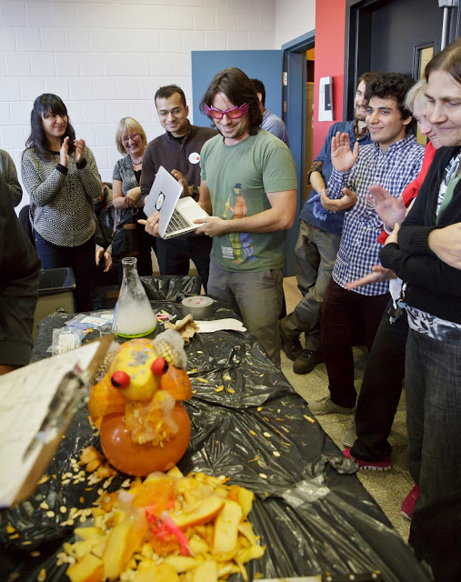
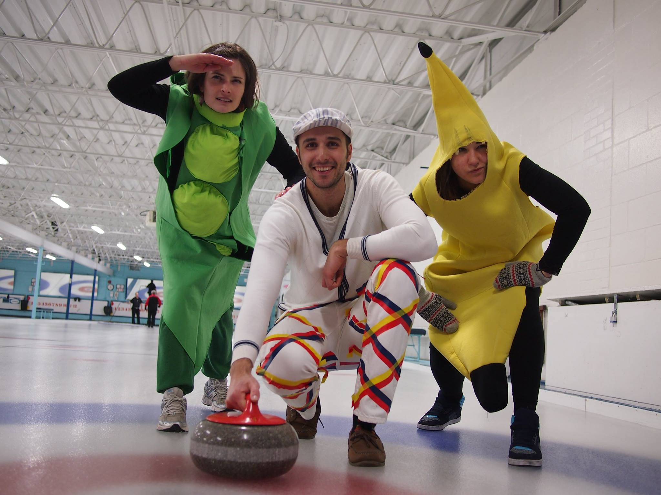
Other grad student things
AVOID ISOLATION! SOCIAL LIFE:
Monthly social events
Camping trip (this weekend)
Cabin trip (winter)
BGSA weekly newsletter
BGSAjiji
Intramurals
Trivia night
BGSA room: SB N2/5 (COFFEE HOUR)
Get involved! Available positions

Slide 13

BGSA newsletter
You’ve been added!
BGSA Weekly
BGSAjiji

Slide 14
Links
Biology department: http://biology.mcgill.ca
GPS: http://www.mcgill.ca/gps/
GPS Policies: http://www.mcgill.ca/gps/policies/
McGill Policies-Secretariat: http://www.mcgill.ca/secretariat/policies/
Supervisor-supervisee website: http://www.mcgill.ca/gradsupervision/
Environmental Health and Safety: https://www.mcgill.ca/ehs/training

Slide 15
Thanks!
BGSA Room: N2/5
mcgillbgsa.com
mcgillbgsa@gmail.com
Twitter: @McGillBGSA
Instagram: mcgillbgsa
Facebook: McGill BGSA

