Slide 1

Capstone Project-Retail Analysis
Hachibul Islam

Slide 2
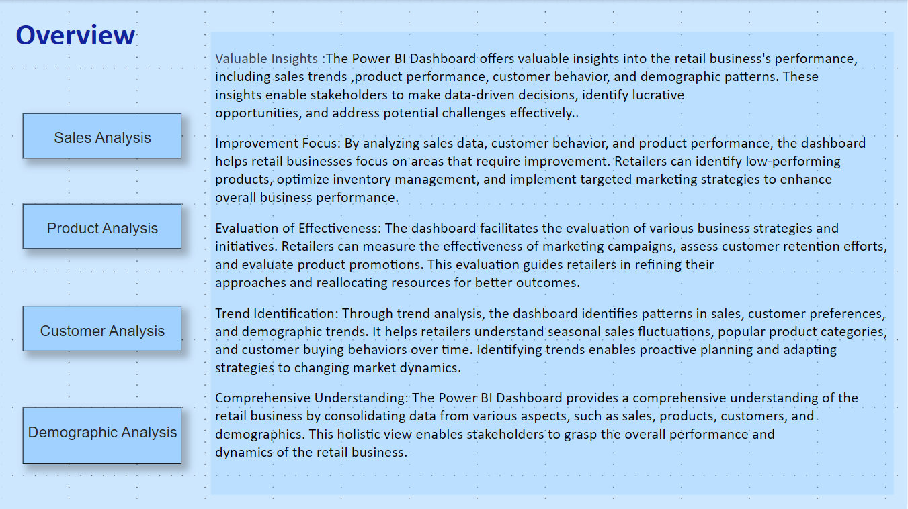

Slide 3
Objective : The objective of this project is to develop a Power BI dashboard using the Retail Database that provides comprehensive insights into the retail business's performance. The dashboard aims to facilitate data-driven decision-making, optimize sales strategies, and enhance customer experiences.
Analysis Scope : The analysis will focus on four key areas: Sales Analysis, Product Analysis, Customer Analysis, and Demographic Analysis. It will cover sales trends, product performance, customer behaviour, and customer demographics to offer a comprehensive understanding of the retail business
Goal : The primary goal of the Power BI dashboard is to empower retail stakeholders with actionable insights. The dashboard will help identify top-selling products, peak sales periods, customer preferences, and target demographics. It will enable retailers to make informed decisions to boost sales, optimize inventory, and tailor marketing strategies.

Slide 4
Insights & Recommendations: The Power BI dashboard will provide valuable insights into sales performance, product trends, customer behaviour, and demographic patterns. It will identify high-performing products, low-performing items, customer preferences, and opportunities for customer engagement and retention. Based on the analysis, the dashboard will recommend targeted marketing strategies, inventory optimization, and personalized customer experiences.
Report & Presentation: The final deliverables will include a comprehensive report detailing the data sources, data modeling, and data cleaning processes used to create the Power BI dashboard. The report will describe the key insights derived from the dashboard's analysis and outline the actionable recommendations for business improvement. The presentation will showcase the dashboard's visualizations, the significance of the findings, and how stakeholders can utilize the dashboard for effective decision-making.
The Power BI Dashboard for the Retail Database is a comprehensive and insightful tool designed to analyze various aspects of the retail business. It focuses on four key areas: Sales Analysis, Product Analysis, Customer Analysis, and Demographic Analysis. By leveraging data from the retail database, the dashboard offers valuable visualizations and analytics to support data-driven decision-making and strategic planning.

Slide 5
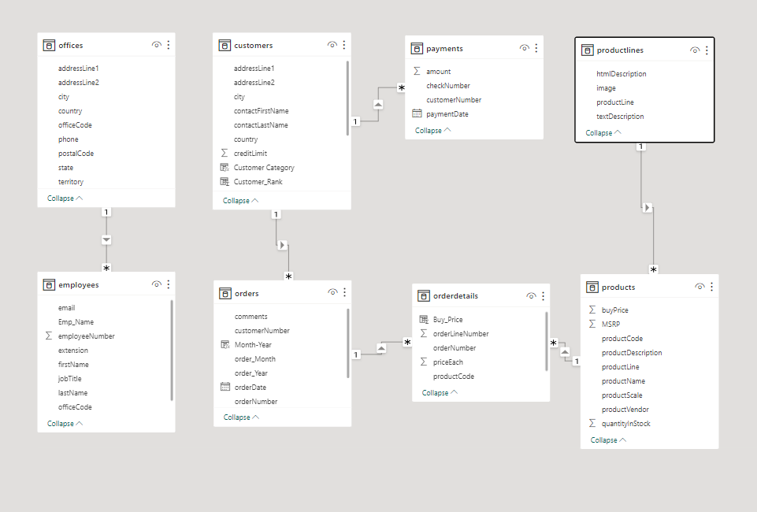
ER Diagram

Slide 6
Power BI Problem Statements

Slide 7
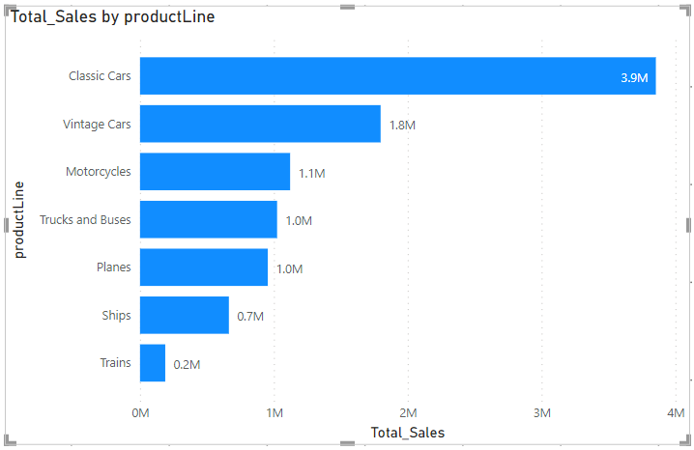
Sales Analysis
To visualize the highest sales in terms of product line in PowerBI , we create a visual that shows total sales by product line. By creating this visual we easily identify and analyze the highest sale in terms of product line .Here we see which product line contribute the most in terms of sales and we can use this information to make business decisions.

Slide 8
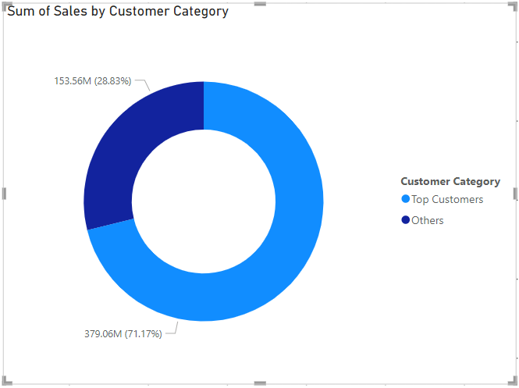
Sales Analysis
This Donut Chat shows the sale performance of top customer compare the other customers, making it easy to see how the top customers are performing in relation to the over all customer base. We can also adjust the number of “top-customer” by changing the threshold in the DAX formula used to categorize customers.

Slide 9
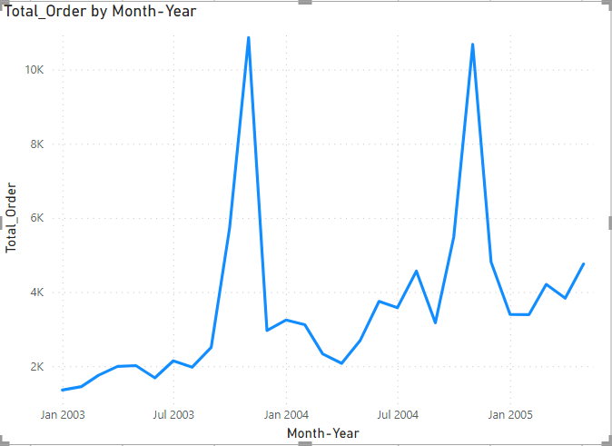
Product Analysis
This trend clearly shows the customer order volume over the past year.

Slide 10
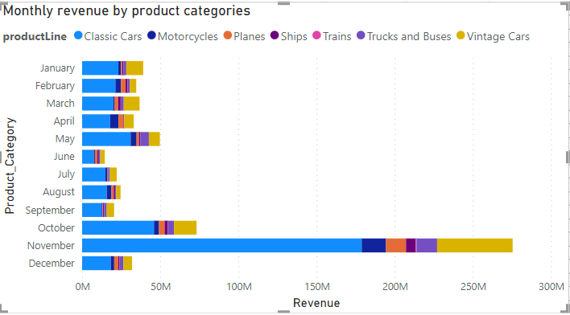
Product Analysis
This is how monthly revenue vary according
Different product categories. Here we clearly
see that in the month of November ,the
monthly revenue is high as compare to
other month as well as the revenue generated by classic cars is higher as compare to all the other product line.

Slide 11
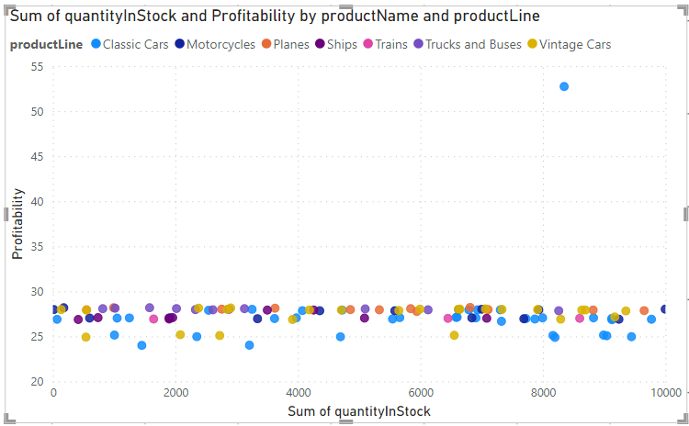
Product Analysis
To compare the Profitability of different products based on their quantity on stock in PowerBI ,we create a visual that shows the relationship between product profitability and quantity in stock and this visual allowing us to identify which products are more profitable relative to their stock level.

Slide 12
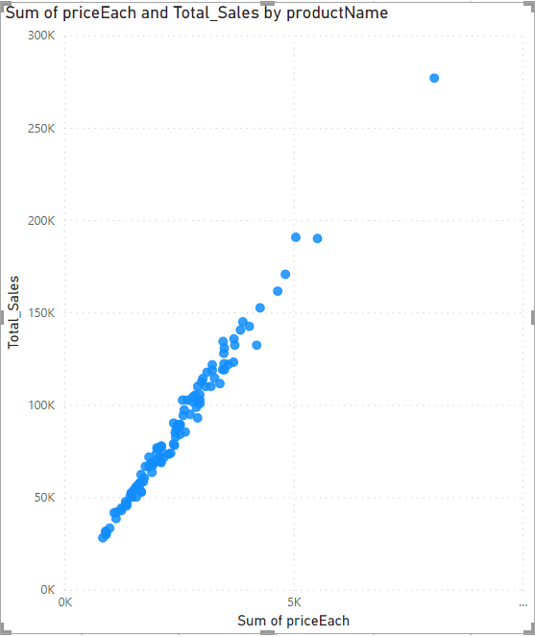
Product Analysis
To analyze how product pricing impacts sales volume in PowerBI we can create a visual that shows the relationship between product price and sales volume.
By creating this visual we gain insights that help us to make informed decision to optimize our sales and revenue

Slide 13
Customer Analysis
This Donut Chat shows the sale performance of top customer compare the other customers, making it easy to see how the top customers are performing in relation to the over all customer base. We can also adjust the number of “top-customer” by changing the threshold in the DAX formula used to categorize customers.

Slide 14
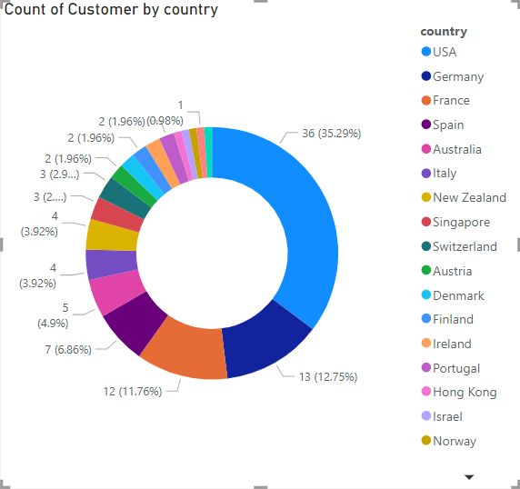
Customer Analysis
To visualize the distribution of customers across different demographic segments in PowerBI we create a visual that shows customer segmentation by demographics.
By creating these visuals, we can easily visualize and analyze the distribution of customer across different demographic segments, helping us gain insights into customer base and make data-driven decisions related to marketing, product development and any other aspects of business.

Slide 15
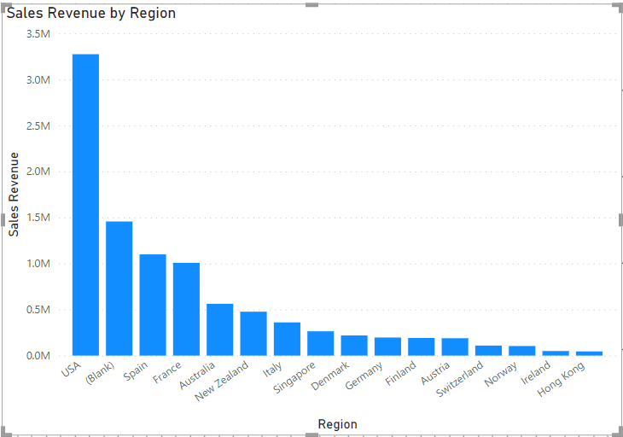
Demographic Analysis
To visualize the top regions in terms of sales revenue in PowerBI, we create a visual that shows sales revenue by region.By creating this visual we easily identify and analyze the top regions in terms of sales revenue.Here we see which regions contribute the most in terms of sales ,we can use this information to make business decisions.

Slide 16
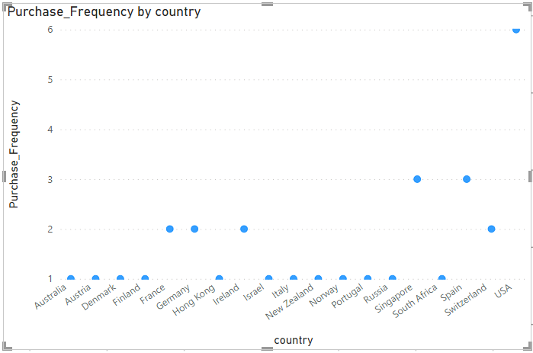
Demographic Analysis
To visualize the correlation between customer demographics and purchase frequency in PowerBI ,we create a visual that shows the relationship between customer demographics and purchase frequency and this visual allowing us to identify in which country the purchase frequency is higher as compare to the rest.

Slide 17
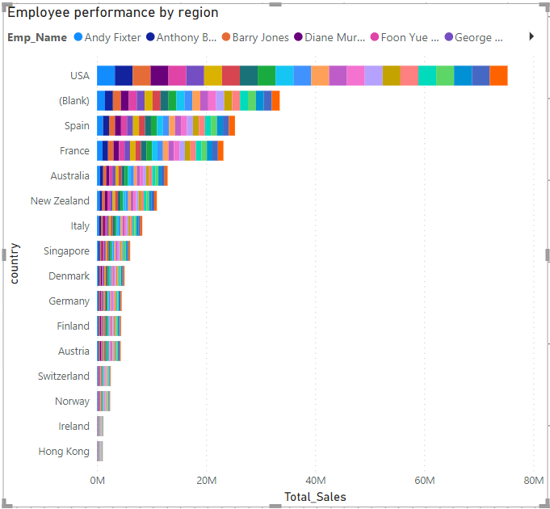
Demographic Analysis
To analyze how the performance of sales employees varies across diferrent regions in PowerBI, we create a visual that shows employee performance in terms of sales by region. By creating this visual we can easily identify top-performing employees in each regions and assess which regions may need additional support or improvement

Slide 18
EDA Problem Statements

Slide 19
EDA questions
Which factors contribute to the highest sales in a particular region?
How can customer purchasing patterns be influenced to increase average order value?
What are the key drivers of sales growth, and how can they be leveraged for future success?
Which product features or attributes are most appealing to customers?
How can the product mix be optimized to cater to changing market demands?
Are there any specific market segments where a particular product is underperforming, and how can it be improved?
What are the main factors that influence customer loyalty and repeat purchases?
How do customer preferences differ based on geographic location, and how can marketing campaigns be customized accordingly?
What are the characteristics of high-value customers, and how can similar customers be targeted for acquisition?
How can marketing strategies be tailored to target specific demographic segments in different regions?
What are the potential untapped markets based on demographic indicators, and how can market penetration be increased?
How do customer preferences and behavior differ based on demographic factors, and how can they be leveraged for personalized marketing campaigns?

Slide 20
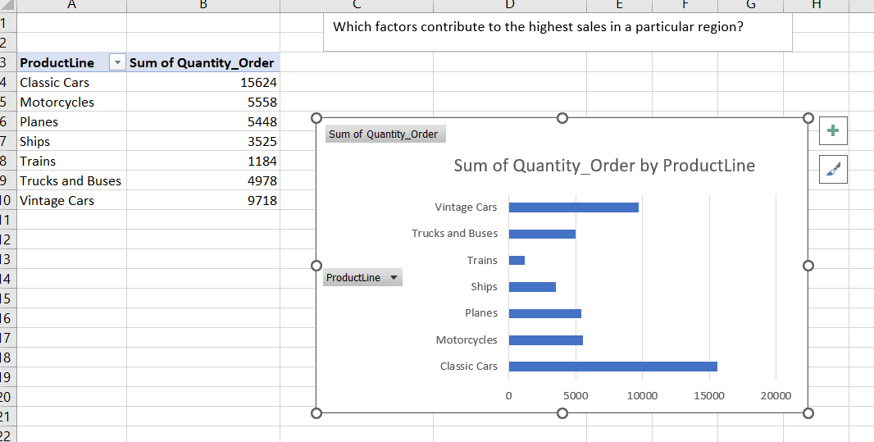
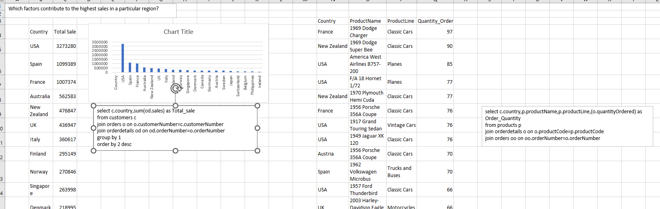
Which factors contribute to the highest sales in a particular region?

Slide 21
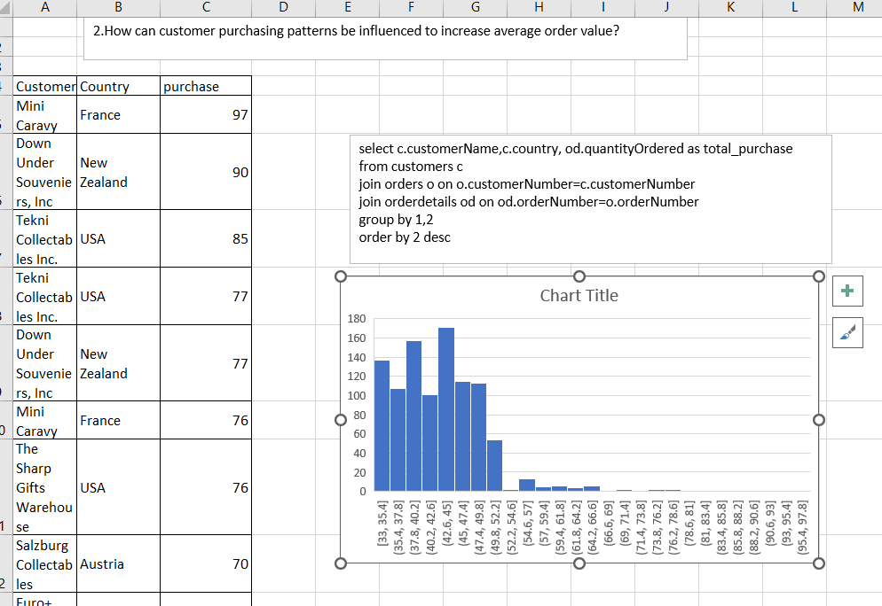
2.How can customer purchasing patterns be influenced to increase average order value?

Slide 22
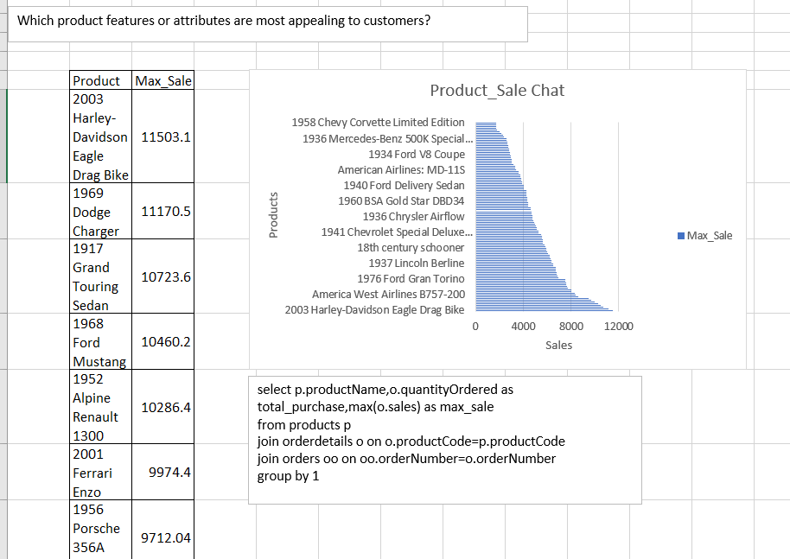
Which product features or attributes are most appealing to customers?

Slide 23
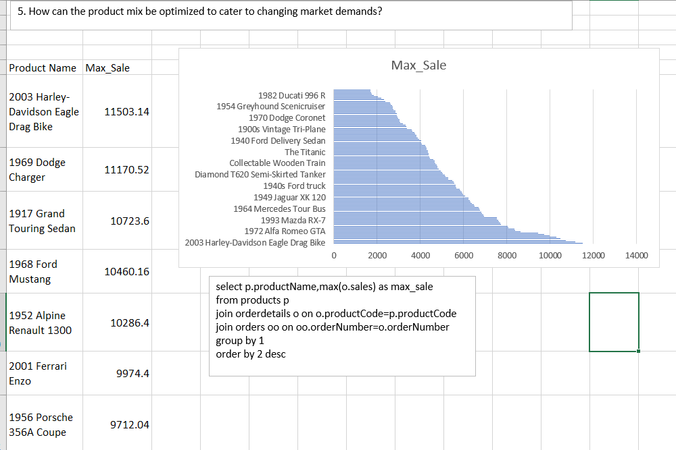
How can the product mix be optimized to cater to changing market demands?

Slide 24
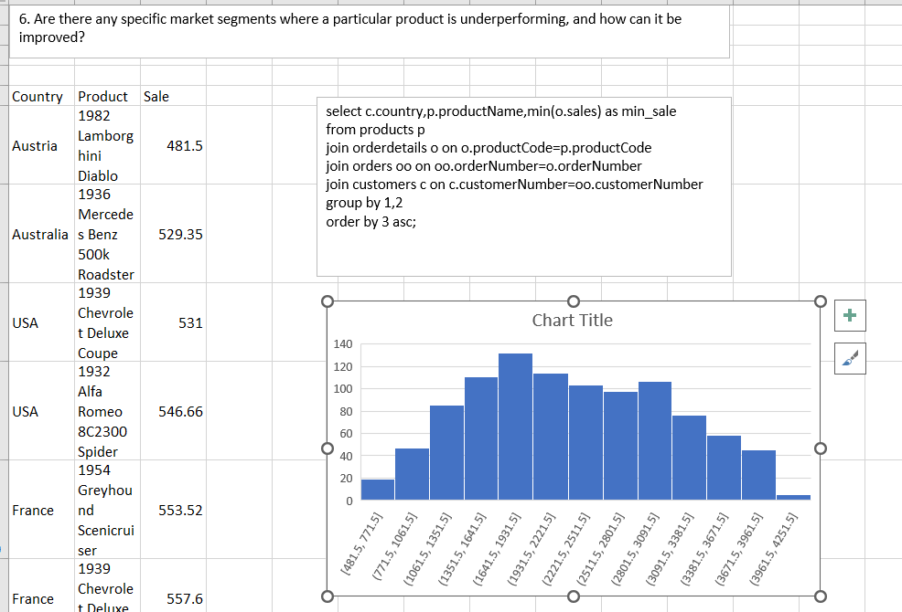
Are there any specific market segments where a particular product is underperforming, and how can it be improved?

Slide 25
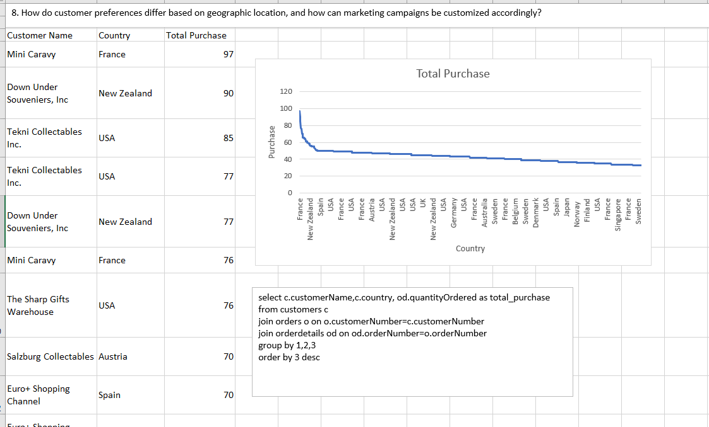
How do customer preferences differ based on geographic location, and how can marketing campaigns be customized accordingly?

Slide 26
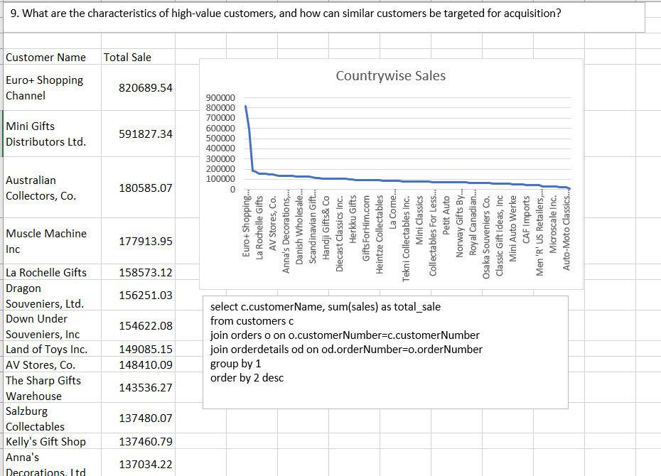
What are the characteristics of high-value customers, and how can similar customers be targeted for acquisition?

Slide 27
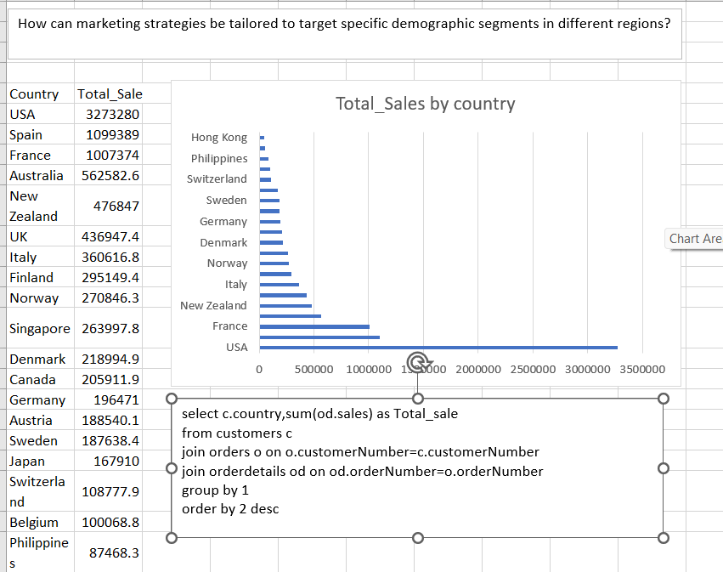
How can marketing strategies be tailored to target specific demographic segments in different regions?

Slide 28
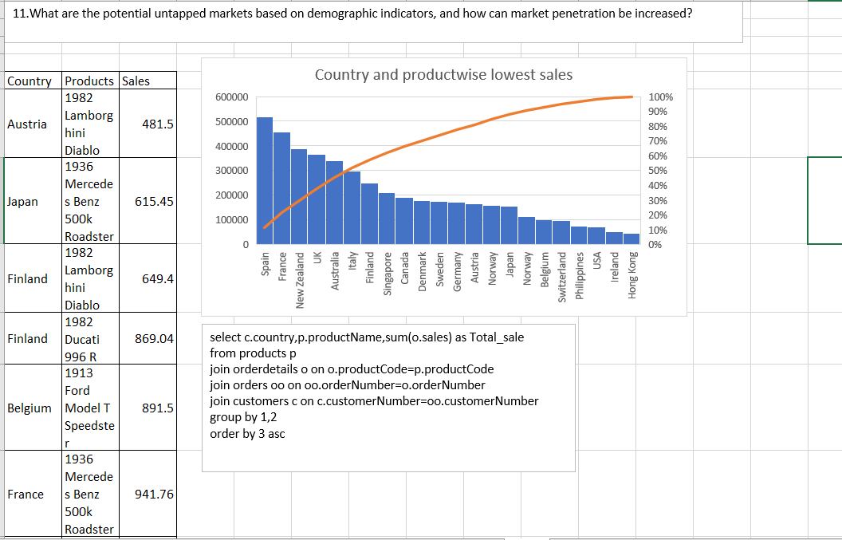
What are the potential untapped markets based on demographic indicators, and how can market penetration be increased?

Slide 29
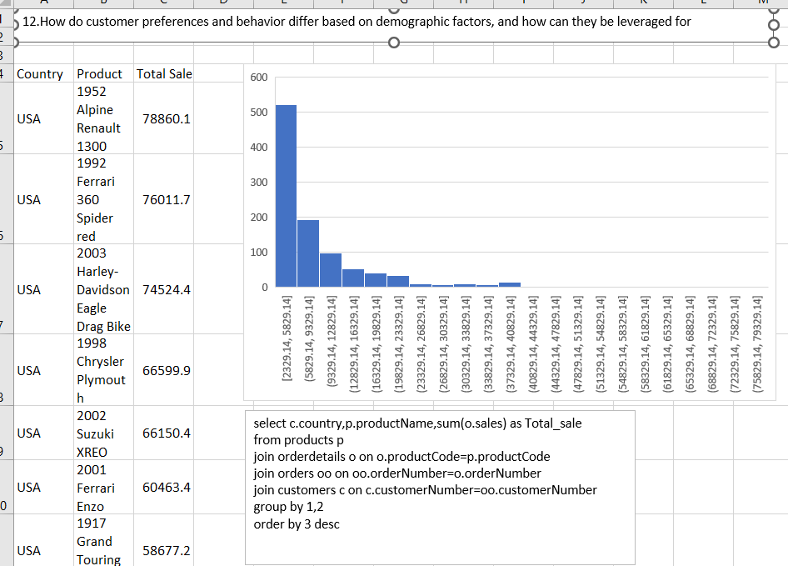
How do customer preferences and behavior differ based on demographic factors, and how can they be leveraged for personalized marketing campaigns?

