Slide 1
Python编程 ——从数据分析到数据科学
朝乐门
中国人民大学
chaolemen@ruc.edu.cn

Slide 2
37. Series
朝乐门
中国人民大学
chaolemen@ruc.edu.cn

Slide 3
本章内容提要
▼第四篇 数据加工
► 37. Series
37.1 Series的主要特点
37.2 Series的定义方法
37.3 Series的操作方法

Slide 4
37.2 Series的定义方法
▼第四篇 数据加工
► 37. Series
In[2]:
import pandas as pd
mySeries1=pd.Series(data = [11,12,13,14,15,16,17],index=["a","b","c","d","e","f","g"])
mySeries1
Out[2]:
a 11
b 12
c 13
d 14
e 15
f 16
g 17
dtype: int64

Slide 5
37.2 Series的定义方法
▼第四篇 数据加工
► 37. Series
In[3]:
import pandas as pd
mySeries1=pd.Series([11,12,13,14,15,16,17], index=[a,b,c,d,e,f,g])
mySeries1
---------------------------------------------------------------------------
NameError Traceback (most recent call last)
<ipython-input-3-88cdcb222886> in <module>()
1 import pandas as pd
----> 2 mySeries1=pd.Series([11,12,13,14,15,16,17], index=[a,b,c,d,e,f,g])
3 mySeries1
NameError: name 'a' is not defined

Slide 6
37.2 Series的定义方法
▼第四篇 数据加工
► 37. Series
In[4]:
mySeries2=pd.Series([10], index=["a","b","c","d","e","f","g"])
mySeries2
Out[4]:
a 10
b 10
c 10
d 10
e 10
f 10
g 10
dtype: int64

Slide 7
37.2 Series的定义方法
▼第四篇 数据加工
► 37. Series
In[5]:
mySeries3=pd.Series([1,2,3,4,5], index=["a","b","c"])
mySeries3
---------------------------------------------------------------------------
ValueError Traceback (most recent call last)
<ipython-input-5-e8a37d3e2b30> in <module>()
----> 1 mySeries3=pd.Series([1,2,3,4,5], index=["a","b","c"])
2 mySeries3
……
---> 90 len(self.mgr_locs)))
91
92 @property
ValueError: Wrong number of items passed 5, placement implies 3

Slide 8
37.3 Series的操作方法
▼第四篇 数据加工
► 37. Series
In[6]:
import pandas as pd
mySeries4=pd.Series([21,22,23,24,25,26,27], index=["a","b","c","d","e","f","g"])
mySeries4.index
Out[6]:
Index(['a', 'b', 'c', 'd', 'e', 'f', 'g'], dtype='object')
In[7]:
mySeries4.values
Out[7]:
array([21, 22, 23, 24, 25, 26, 27], dtype=int64)
In[8]:
mySeries4['b']
Out[8]:
22

Slide 9
37.3 Series的操作方法
▼第四篇 数据加工
► 37. Series
In[9]:
mySeries4["b"]
Out[9]:
22
In[10]:
mySeries4[["a","b","c"]]
Out[10]:
a 21
b 22
c 23
dtype: int64

Slide 10
37.3 Series的操作方法
▼第四篇 数据加工
► 37. Series
In[11]:
mySeries4["a":"d"]
Out[11]:
a 21
b 22
c 23
d 24
dtype: int64
In[12]:
mySeries4[1:4:2]
Out[12]:
b 22
d 24
dtype: int64

Slide 11
37.3 Series的操作方法
▼第四篇 数据加工
► 37. Series
In[13]:
mySeries4
a 21
b 22
c 23
d 24
e 25
f 26
g 27
dtype: int64
Out[13]:

Slide 12
37.3 Series的操作方法
▼第四篇 数据加工
► 37. Series
In[14]:
"c" in mySeries4
Out[14]:
True
In[15]:
"h" in mySeries4
Out[15]:
False

Slide 13
37.3 Series的操作方法
▼第四篇 数据加工
► 37. Series
In[16]:
import pandas as pd
mySeries4=pd.Series([21,22,23,24,25,26,27], index=["a","b","c","d","e","f","g"])
mySeries5=mySeries4.reindex(index=["b","c","a","d","e","g","f"])
mySeries5
Out[16]:
b 22
c 23
a 21
d 24
e 25
g 27
f 26
dtype: int64

Slide 14
37.3 Series的操作方法
▼第四篇 数据加工
► 37. Series
In[17]:
mySeries5=mySeries4.reindex(index=["b","c","a","d","e","g","f"])
mySeries4
Out[17]:
a 21
b 22
c 23
d 24
e 25
f 26
g 27
dtype: int64

Slide 15
37.3 Series的操作方法
▼第四篇 数据加工
► 37. Series
In[18]:
mySeries5=mySeries4.reindex(index=["new1","c","a","new2","e","g","new3"])
mySeries5
Out[18]:
new1 NaN
c 23.0
a 21.0
new2 NaN
e 25.0
g 27.0
new3 NaN
dtype: float64

Slide 16
37.3 Series的操作方法
▼第四篇 数据加工
► 37. Series
In[19]:
mySeries4
Out[19]:
a 21
b 22
c 23
d 24
e 25
f 26
g 27
dtype: int64

Slide 17

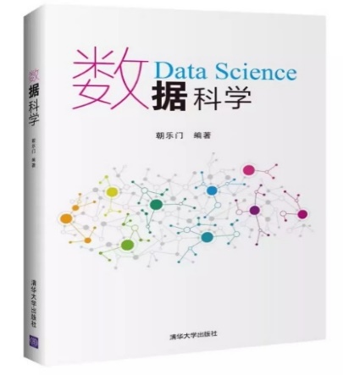



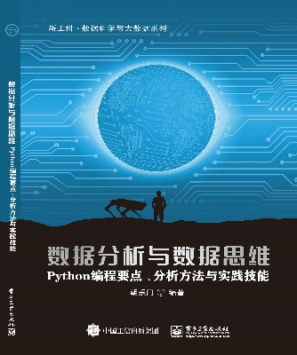
▼第四篇 数据加工
► 37. Series
chaolemen
@
ruc.edu.cn
参考书目
微信公众号
主讲人联系方式
主讲人微信

