Slide 1
RocketRFP
AI-Powered Proposal Response, From Days to Hours
Win more bids without growing the team.
Customer Briefing

Slide 2
THE PROBLEM
Monday morning, your proposal team is buried.
⏱️
Days lost per response
📄
Format chaos
A single RFP eats 3–7 days of senior time, copy-pasted from old win files.
PDFs, Word docs, web portals with character limits — no single tool handles them all.
🔍
Knowledge scattered
📉
Bids left on the table
Past projects, certs, bios, and pricing live in Slack, email, and someone's desktop.
Most teams respond to under 20% of qualified opportunities — pure capacity loss.
RocketRFP
Confidential · 2 / 13

Slide 3
THE MATH
What it actually costs you.
$5K–$25K
3–7 days
<20%
Labor cost per RFP response
Senior time per response
Of qualified bids your team can answer
If your team could answer 3× more RFPs with the same headcount,
what would that do to your pipeline?
RocketRFP
Confidential · 3 / 13

Slide 4
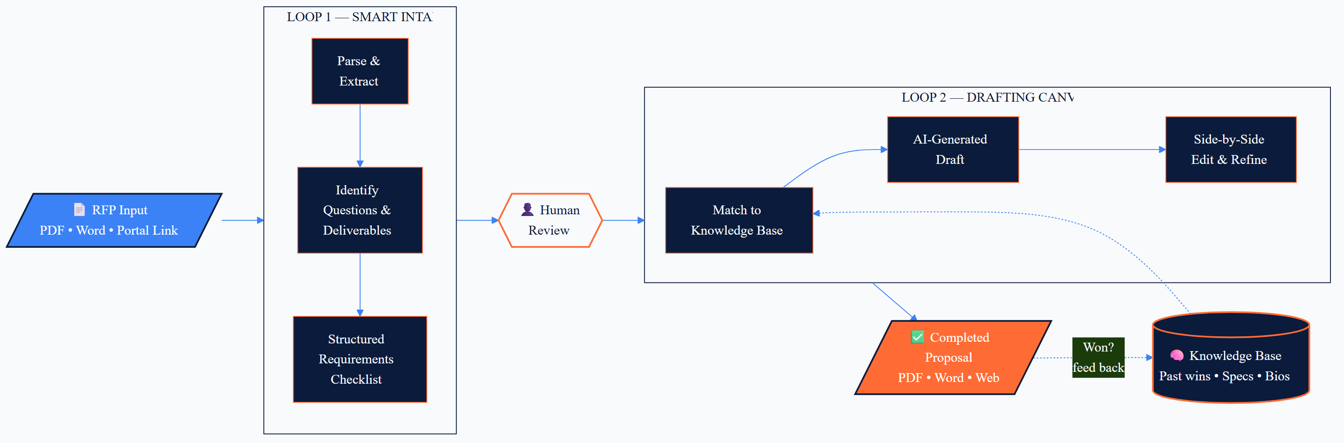
HOW IT WORKS
Two loops. One smarter proposal every time.
Your services are standardized. Customer RFPs are variable. RocketRFP is the intelligent mapping in between.
RocketRFP
Confidential · 4 / 13

Slide 5
TURN 50 PAGES INTO A CHECKLIST
Loop 1 — Smart Intake
BEFORE
AFTER · ~2 MIN
📄 A 50-page PDF.
🌐 A web portal with questions buried in tabs.
📋 Hours of reading just to know what's being asked.
❓ Easy to miss a required cert, deliverable, or page-limit rule.
✅ 27 questions extracted and tagged
✅ 6 required deliverables flagged
✅ Submission rules captured (page limits, format, due date)
✅ Human reviews the RFP profile before any drafting starts
RocketRFP
Confidential · 5 / 13

Slide 6
WHERE THE WORK ACTUALLY HAPPENS
Loop 2 — The Drafting Canvas
Side-by-side editor. AI proposes. You approve, edit, or chat with your knowledge base.
RFP QUESTION
AI DRAFT · EDITABLE
"Describe your firm's experience delivering similar projects for public-sector clients in the last 5 years. Include outcomes and references."
Over the last 5 years, our firm has delivered 14 comparable engagements for public-sector clients, including the City of St. Peters water modernization (2024) and the STLCC facilities program (2023)…
[Pulled from: 3 case studies, 2 references]
💬 Chat sidecar: "Find outcomes from our 2024 healthcare project in Missouri." — answer in seconds.
▶ Implement
RocketRFP
Confidential · 6 / 13

Slide 7
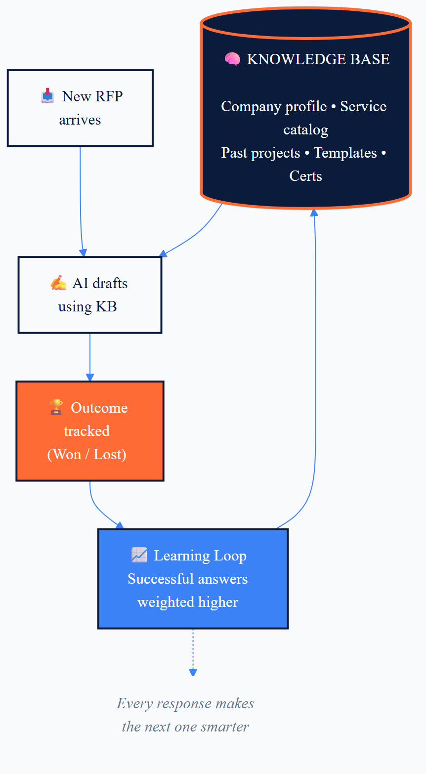
THE COMPOUNDING ASSET
Build your knowledge base once. Reuse it forever.
WHAT GOES IN
📊
Company profile
History, certs, bios, mission
🛠️
Service catalog
Pricing, SLAs, technical specs
📁
Past projects
Outcomes, testimonials, references
📝
Template library
Proven "why us" answers
Secure & redacted. You control what gets ingested.
RocketRFP
Confidential · 7 / 13

Slide 8
BEFORE / AFTER
What changes for your team.
TODAY
WITH ROCKETRFP
Mon · Read the 60-page RFP, build a Q checklist by hand
Tue · Hunt through Slack and old proposals
Wed · First draft, then chase SMEs for missing answers
Thu · Reformat to match the customer's template
Fri · Review, sign-off, submit — late afternoon
Mon AM · Upload RFP, review extracted checklist (15 min)
Mon AM · AI drafts 60–80% from your knowledge base
Mon PM · SMEs review the flagged gaps in the canvas
Mon PM · Export in original format, route for approval
Tue · Submitted. The rest of the week is new pipeline.
RocketRFP
Confidential · 8 / 13

Slide 9
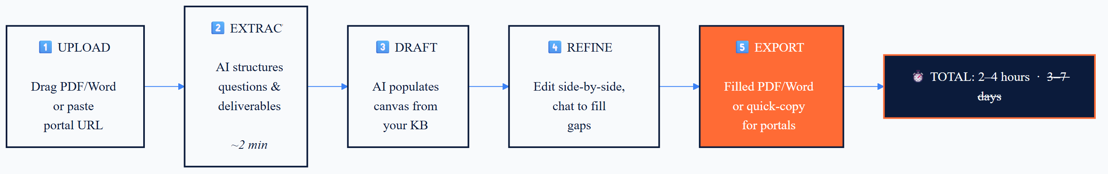
THE USER FLOW
End to end, in five steps.
Total time per response: 2–4 hours instead of 3–7 days.
RocketRFP
Confidential · 9 / 13

Slide 10
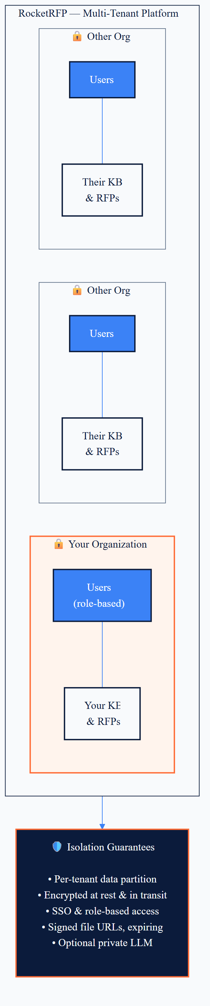
SECURITY & ISOLATION
Your data stays yours.
WHY IT MATTERS
▸
Per-tenant isolation — your KB never touches another customer's
▸
Encrypted at rest and in transit
▸
SSO + role-based access (admin / reviewer / contributor)
▸
Signed, expiring file URLs
▸
Optional private/local LLM for sensitive sectors
RocketRFP
Confidential · 10 / 13

Slide 11
COMMON QUESTIONS
What customers ask first.
Does this replace my proposal team?
How accurate is the AI-generated content?
No. It removes the copy-paste tax so they spend their time on strategy, win themes, and customer relationships — the work that actually wins bids.
Every answer is sourced from your own knowledge base and tagged with confidence. Low-confidence items are flagged for human review before export.
What about confidentiality and our IP?
How long until we see value?
Per-tenant data isolation, encryption, signed URLs, and an optional private LLM mode for regulated industries. You decide what's ingested.
First completed RFP typically inside week one. The knowledge base — and the speed — compounds with every response after that.
RocketRFP
Confidential · 11 / 13

Slide 12
THE PATH TO VALUE
What changes in your first 30 days.
WEEK 1
WEEK 2
WEEKS 3–4
Stand up
Switch on
Scale up
Connect your first knowledge sources. Run RocketRFP against a live RFP alongside your normal process. Compare outputs.
Your team drafts inside the canvas. SMEs review flagged gaps. First proposal submitted from RocketRFP.
Multiple proposals in flight in parallel. Won outcomes feed back into the KB. Time-to-first-draft drops measurably.
Outcome: more bids answered, less senior time burned, a knowledge asset that grows.
RocketRFP
Confidential · 12 / 13

Slide 13
RocketRFP
Let's run RocketRFP against one of your live RFPs.
30-minute working session. We'll show you the draft your team would have spent three days producing.
NEXT STEPS
1. Pick one in-flight RFP to use as the test.
2. We connect a starter set of your knowledge base materials.
3. Working session — first draft on screen, end of meeting.
[ Austin's contact details — name, title, email, phone ]

