Slide 1

Intent Classification
SPOKEN LANGUAGE UNDERSTANDING
Lv Rongrong
Notes:
Intent classification is critical pre-processing steps for Spoken language understanding (SLU) .

Slide 2

Contents
01
Motivation
02
Introduction
03
Method
04
Reference

Slide 3
01
Motivation

Slide 4
Intent Classification in Single-turn SLU
Issues
In single-turn spoken language understanding(SLU), some intentions can be classified, but some intent classification are difficult to be accomplished.
There is a dependency between intentions, we cannot accurately identify the intention of a sentence.
We need more historical information.

Slide 5
User 1: Hello
(greeting)
Chatbot 1: Hello
(greeting)
User 2: what’s the weather like today?
(query_weather(time=today))
Chatbot 1:it’s rainy day
(reply_weather(time=today, type= rainy ))
User 3: and for the weekend?
(query_weather(time= weekend))
Chatbot 3: There is a beautiful weather.
(reply_weather(time= weekend, type= beautiful weather ))

Slide 6
Intent Classification in Multi-turn SLU
Core Challenges
In single-turn spoken language understanding(SLU), some intentions can be classified, but some intent classification are difficult to be accomplished.
There is a dependency between intentions, we cannot accurately identify the intention of a sentence.
How do we tell
if we need
historical information
How do we save
historical information

Slide 7





PRODUCT
百度度秘
三角兽
Siri
Cortana
Not Multi-turn SLU
Not Multi-turn SLU
Not Multi-turn SLU
Multi-turn SLU

Slide 8
02
Introduction

Slide 9
Introduction
Traditionally
Domain detection and intent prediction are framed as classification problems, where several classifiers such as support vector machines and maximum entropy are employed[1,2,3].
1
Recently
With the advances on deep learning, deep belief networks(DBNs) with deep neural networks (DNNs) have been applied to for domain and intent classification[4,5,6].
2
3

Slide 10
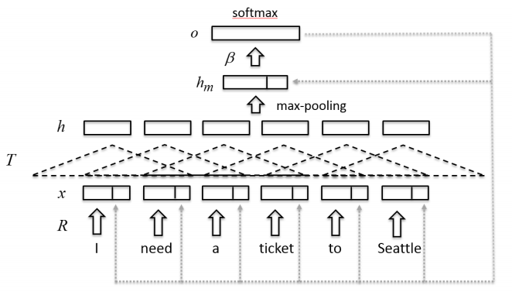
How do we save
historical information?
Introduction
Internal memory
Contextual domain classification in spoken language understanding systems using recurrent neural network[7]

Slide 11
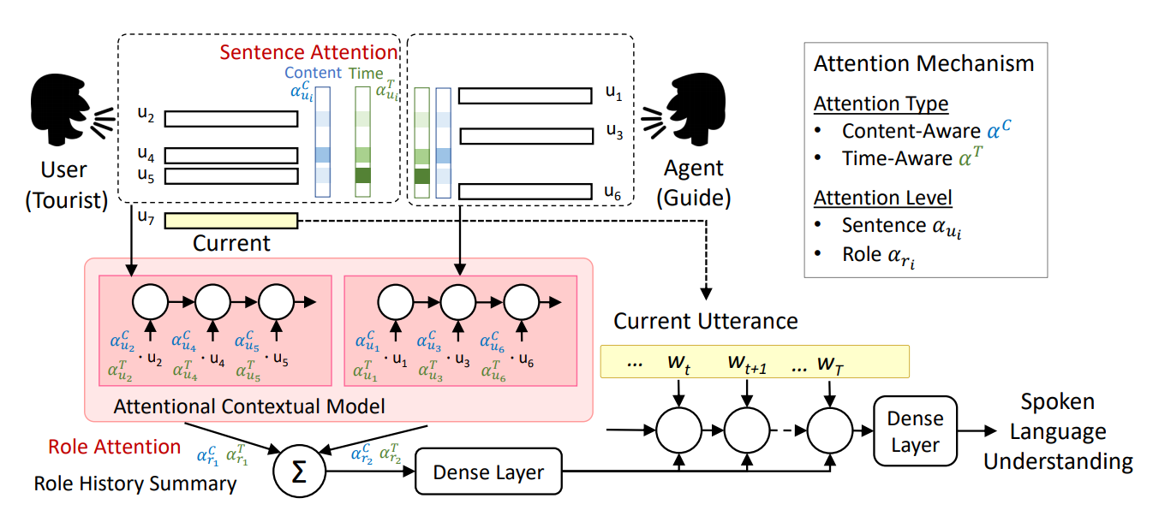
How do we save
historical information?
Introduction
Internal memory
Dynamic Time-Aware Attention to Speaker Roles and Contexts for Spoken Language Understanding[8]

Slide 12
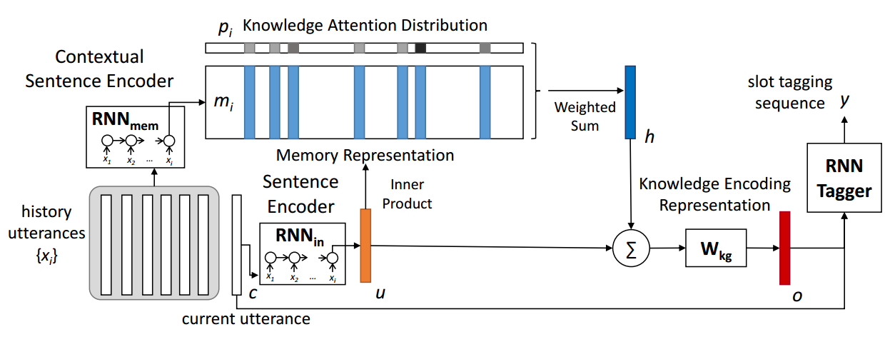
How do we save
historical information?
Introduction
External memory
End-to-End Memory Networks with Knowledge Carryover for Multi-Turn Spoken Language Understanding[9]

Slide 13
Introduction
How do we tell
if we need
historical information
？？？

Slide 14
03
Method

Slide 15
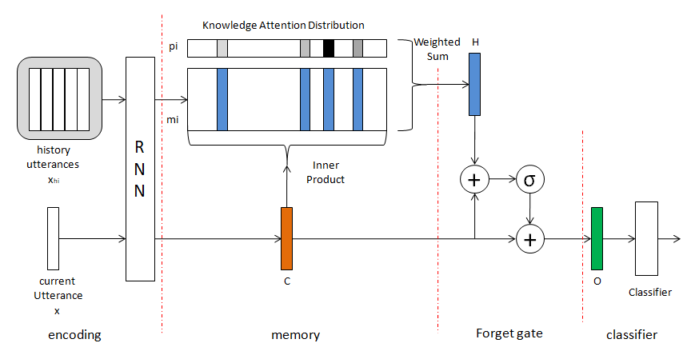

Slide 16
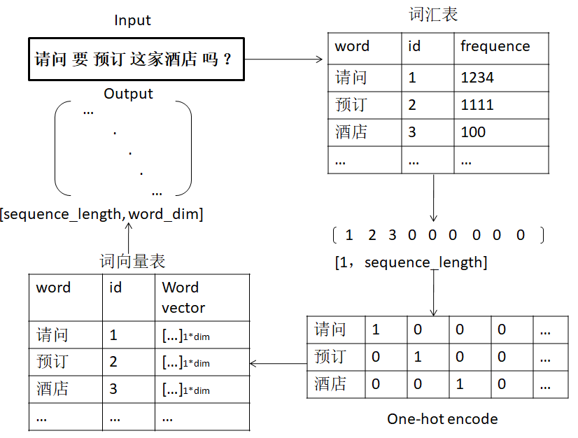
Encoding

Slide 17
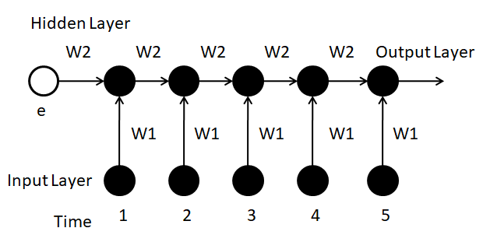
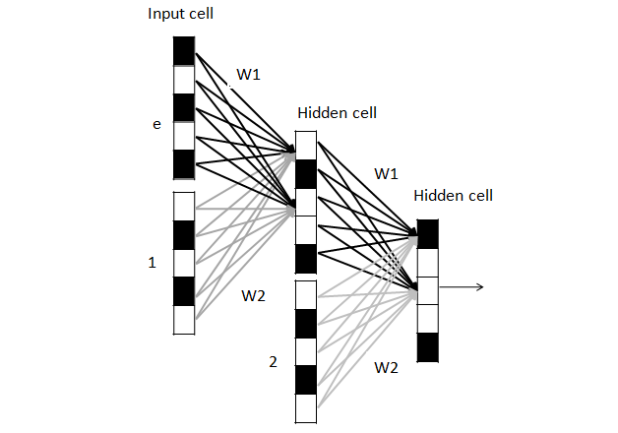
Encoding

Slide 18
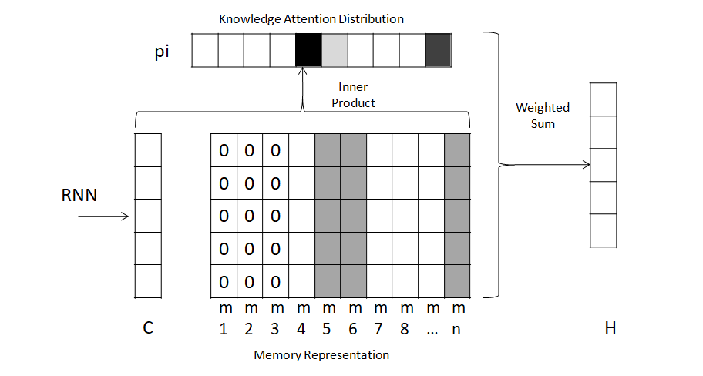
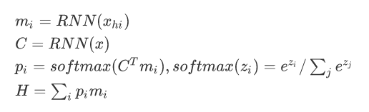
Memory
H

Slide 19
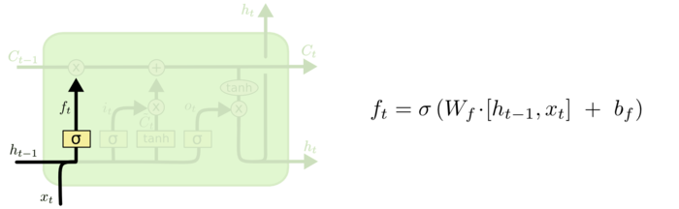
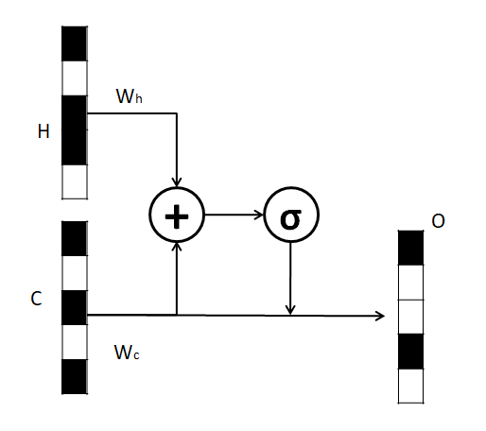
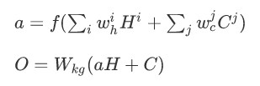
Forget Gate
LSTM
Wkg

Slide 20
04
Reference

Slide 21
Reference
[1]P. Haffner, G. Tur, and J. H. Wright, “Optimizing svms for complex call classification,”in 2003 IEEE International Conference on Acoustics, Speech, and Signal Processing, 2003. Proceedings.(ICASSP), vol. 1.IEEE, 2003, pp.I–632.
[2]C. Chelba, M. Mahajan, and A. Acero, “Speech utterance classification,” in 2003 IEEE International Conference on Acoustics, Speech, and Signal Processing, 2003. Proceedings.(ICASSP), vol. 1. IEEE, 2003, pp. I–280.
[3] Y.-N. Chen, D. Hakkani-Tur, and G. Tur, “Deriving local relational surface forms from dependency-based entity embeddings for unsupervised spoken language understanding,” in 2014 IEEE Spoken Language Technology Workshop (SLT). IEEE, 2014, pp. 242–247.
[4] R. Sarikaya, G. E. Hinton, and B. Ramabhadran, “Deep belief nets for natural language call-routing,” in 2011 IEEE International Conference on Acoustics, Speech and Signal Processing (ICASSP). IEEE, 2011, pp. 5680–5683.
[5] G. Tur, L. Deng, D. Hakkani-Tur, and X. He, “Towards deeper understanding: Deep convex networks for semantic utterance classification,” in 2012 IEEE International Conference on Acoustics, Speech and Signal Processing (ICASSP). IEEE, 2012, pp. 5045–5048.

Slide 22
Reference
[6] R. Sarikaya, G. E. Hinton, and A. Deoras, “Application of deep belief networks for natural language understanding,” IEEE/ACM Transactions on Audio, Speech, and Language Processing, vol. 22, no. 4, pp. 778–784, 2014.
[7] Xu P, Sarikaya R. Contextual domain classification in spoken language understanding systems using recurrent neural network[C] IEEE International Conference on Acoustics, Speech and Signal Processing. IEEE, 2014:136-140.
[8] Chen P C, Chi T C, Su S Y, et al. Dynamic Time-Aware Attention to Speaker Roles and Contexts for Spoken Language Understanding[J]. 2017.
[9] Yun-Nung Chen, Dilek Hakkani-Tur, Gokhan Tur, Jianfeng Gao, and Li Deng. 2016c. End-to-endmemory networks with knowledge carryover for multi-turn spoken language understanding. In Proceedings of The 17th Annual Meeting of the International Speech Communication Association. pages 3245–3249.

Slide 23
THANKS

