Slide 1

Experiment 5
Synthesis of an Iron Oxalate Compound
Chemistry Department UCC 1st Year Practicals

Slide 2
Objectives
To gain further experience of synthetic inorganic chemistry
To learn about reduction-oxidation (redox) titrations
To characterise the synthesised iron oxalate compound

Slide 3
Background
Much of inorganic chemistry involves the preparation and characterisation of compounds
Ferrous ammonium sulphate and oxalic acid dihydrate are reacted in aqueous solution
Oxalate ion is generated and binds to the ferrous ion to produce an insoluble compound
Ammonium and sulphate ions remain in solution

Slide 4
Water of crystallisation
Both ferrous ammonium sulphate and oxalic acid are prepared using excess water
On evaporation crystals form that trap water molecules in solid compounds
These are hydrated compounds
Iron oxalate is hydrated

Slide 5
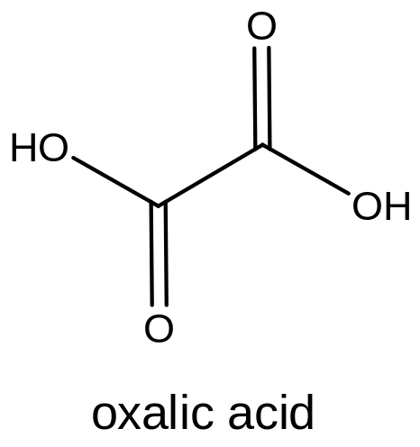
Background
[NH₄]₂Fe[SO₄]₂.6H₂O + H₂O → 2[NH₄]⁺_{aq} + 2[SO₄]²⁻_{aq} + Fe²⁺_{aq}
H₂C₂O₄.2H₂O + H₂O → 2[H⁺]_{aq} + [C₂O₄]²⁻_{aq}
Fe²⁺_{aq} + [C₂O₄]²⁻ → Fe[C₂O₄]. 2H₂O

Slide 6
Synthesis of Iron Oxalate
In a 250 ml beaker add 3.75 g of ferrous ammonium sulphate to 30 ml of water that has been acidified with 5 ml of dilute H₂SO₄
Add a solution of oxalic acid in 40 ml of water
Heat to boiling – yellow ppt will form
Decant the supernatant solution

Slide 7
Synthesis of Iron Oxalate
Add 30 ml of warm water to the ppt
Filter the ppt on the Buchner funnel and flask
The yellow compound is hydrated iron oxalate
Record the mass isolated and divide your sample in two (Exp. 6c)

Slide 8
Report
Exerimental results
Observations
Balanced reaction equations
Calculations
Make sure you keep some sample for experiment 6c

Slide 9
Experiment 6
Reduction-Oxidation Titrations

Slide 10
Objectives
Learn about reduction-oxidation (redox) titrations
Use techniques learned to characterise the Iron Oxalate compound synthesized in Experiment 5
Become familiar with calculation of degree of hydration

Slide 11
Background
In redox titrations permanganate [MnO₄]⁻ is one of the most important reagents (Mn⁷⁺)
Can be reduced in acidic solution to give the manganous ion Mn²⁺
MnO₄⁻ + 8H⁺ + 5e⁻ → Mn²⁺ +4H₂O
One mole of permanganate gains 5e⁻

Slide 12
Background
Reduction must be balanced by oxidation
Permanganate gains 5e⁻
5e⁻ must also be lost
5 atoms of Fe²⁺ can be oxidised to Fe³⁺
MnO₄⁻ + 8H⁺ + 5Fe²⁺ → Mn²⁺ + 4H₂O + 5Fe³⁺

Slide 13
Background
Oxalic acid can also be oxidized by permanganate
Oxalic acid is converted to carbon dioxide gas and 2 electrons are released
2MnO₄⁻ + 5C₂O₄²⁻ +16H⁺ → 2Mn²⁺ + 10CO₂ + 8H₂O

Slide 14
Indicators
The permanganate ion MnO₄⁻ is purple in colour
A drop of excess MnO₄⁻ will result in a solution pink in colour
No indicator is required – self indicating
Colourless → Pink
Acidification is important for colour change

Slide 15
Experiment 6a
Titrating ferrous ammonium sulphate against potassium permanganate
Know K[MnO₄] concentration, calculate the ferrous ammonium sulphate concentration in M and gl⁻¹
K[MnO₄] in the burette
Iron salt and dilute acid in the conical flask

Slide 16
Experiment 6b
Titrating oxalic acid against potassium permanganate
Titration solution heated to accelerate reaction
Oxalic acid solution, water, and dilute acid in conical flask – heat to 80°C
K[MnO₄] in the burette
Calculate oxalic acid conc. in M and gl⁻¹

Slide 17
Experiment 6c
Determining the degree of hydration of the salt synthesized in Exp 5
Titrating Iron Oxalate against permanganate
Heat the titration solution
Perform the titration in the same manner as 6b

Slide 18
Calculations
App. Mol Mass Fe[C₂O₄]=144 gmol⁻¹
3KMnO₄ + 5Fe[C₂O₄] +24H⁺ + 15e⁻ → 3Mn²⁺ + 5Fe³⁺ +10CO₂ +12H₂O +15e⁻
Calculate the no. moles Fe[C₂O₄] from titration value

Slide 19
Calculations
Calculate actual molecular mass of Fe[C₂O₄].XH₂O from the equation
No. of g = no. of moles x Mol mass
actual mol mass – apparent mol mass = mol mass of the water in the hydrated salt
Divide this number by 18 (MW of H₂O) to get the value of X

Slide 20
Report
All observations
All your results
All calculations
Questions in the manual
Exp 5 and Exp 6a today, 6b & 6c next week
No pre-practical talk next week

Slide 21
Experiment 7
Molecular Structure

Slide 22
Objectives
Use the periodic table
Draw Lewis Structures of covalent molecules
Use VSEPR theory to deduce the shape of molecules
Determine the hybridisation of atoms in covalent molecules

Slide 23
Determine the Lewis Structure, molecular structure and hybridisation of the central atom in each of
CF₄, SF₄, NH₄⁺, NH₃, NH₂⁻, SF₆, PF₅, BeCl₂, BF₃, OCl₂, PO₄³⁻, SO₂
Answer the questions in the manual

Slide 24
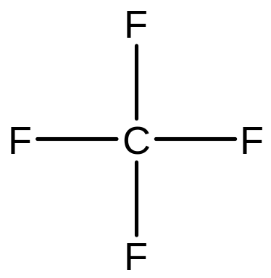
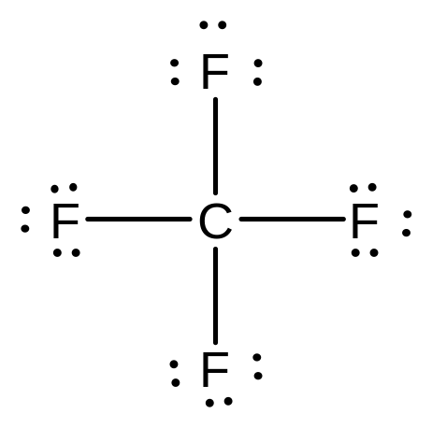
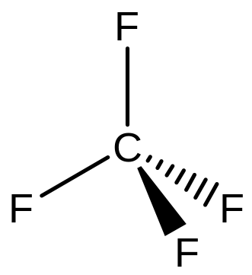
Example: CF₄
C: 4 valence electrons
F: 4 x 7 valence electrons = 28e⁻
32e⁻ in total
8e⁻ in bonding, 24e⁻ to distribute
Identify shape & hybridisation

Slide 25
Report
Do this for each compound
Answer the questions
Use your model kit when deducing the 3D shape of the molecules
Hand up to your demonstrators the 1st session after the holidays

