Slide 1


Slide 2
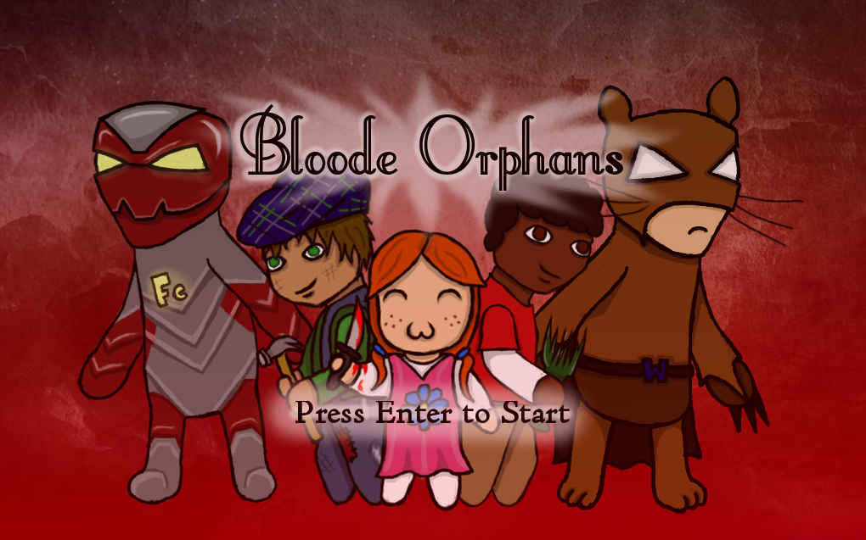

Slide 3
The Team
Rob Malick – Audio/Narrative
Bailey Kuhl – Narrative/Level Design
Kaitlyn Poppe – Art/Narrative
Sarah Bachman – Programming/Art
Luke Reiner – Narrative/Programming
Chris Pueppke – Projector Screen Fixing

Slide 4
Pitch
The Bloode twins have lived in tyranny since the day they were born. Recently orphaned at the age of ten by a "tragic" yacht accident, they are finally free. Take on the brother’s new identities (Wombatman & Fe Man) and use your fellow orphans to recover Bloode Manor. What will you do with an army of orphans? Take over the world of course!

Slide 5
Let’s Get Right Into It!

