Slide 1
Hybrid MPI: Efficient Message Passing for Multi-core Systems
Speaker: Hualiang Li
Department of Electrical Engineering
University of Hawaii, Manoa
Notes:
Hi, My name is Hualiang Li. I am from department of electrical engineering, UH Manoa. Today, I am going to talk about a research paper, which introduce a hybrid MPI. It focus on improving the efficiency of message passing for multi-core system.

Slide 2
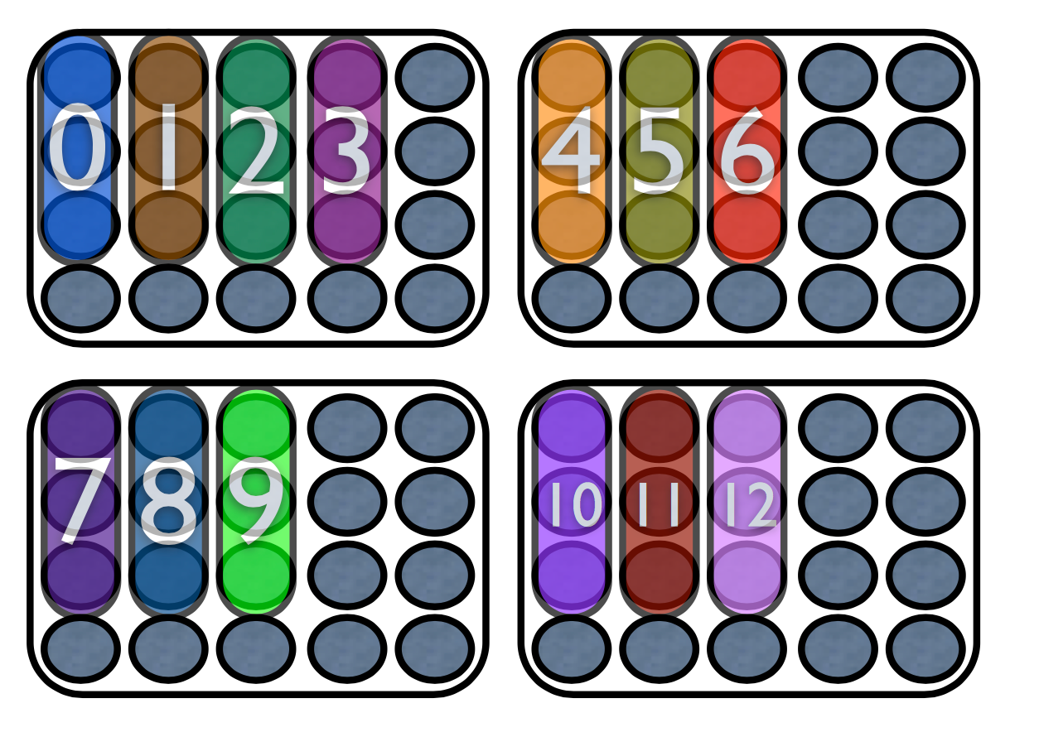
Background
Modern multi-core system
MPI communication overhead
OPENMP thread-safety issue
#SBATCH -n 13
#SBATCH –c 3
#SBATCH –N 4
Notes:
I am going to introduce some background of the research paper. In nowadays, most of the modern computer are multi-cores, especially super computer, the communication between cores are making huge difference in terms of performance.
However, MPI is developed long time ago, the multi-core at that time is not common. So, regardless this hardware architecture, it use two-copy method to communicate with different cores, no matter they are in same nodes or not.
People are aware of this kind of issue and using OPENMP when computing within a same node.
Introduce the graph

Slide 3
Outline
Objective of HMPI
Current MPI implementation
HMPI architecture
Communication protocols
Result analysis
Conclusion
Q&A
Notes:
First, I am going to introduce the basic goal of Hybrid MPI. Then I will also talk about how current MPI is implemented and its limitation. There are two main approach, process oriented and thread oriented. Both of them have advantage and disadvantage. I will talk about it in later section. Then I will focus on the architecture of Hybrid MPI. Which has both advantages from the process oriented and thread oriented, while less disadvantage from those two approach. After that, I will introduce the main communication protocols, which are used to communicate between cores. It introduces different protocols according to different size of messages. Then I will take an overview of the result performance from both communication part and application part. Then I will address the conclusion. Last, we will have a Q&A section.

Slide 4
Objective
Intra-node communication performance
Share memory between ranks
Portability
No extra knowledge needed for MPI user
Without root access to modify system
Notes:
As I mentioned at the beginning, the overhead of same core communication is too large than it supposed to be. The major goal for HMPI is to reduce the communication overhead and improve overall performance of application in multi-core system. But the difference between prior work and HMPI is, we need portability. Some of the current work on this issue require MPI user understand the underlining layer API. The user has to aware of different usage with different scenarios. Therefore, the original MPI software will not working with the implementation without modifying. Another goal is root access will no longer be needed. Most of the current work requires user to install kernel extension and thus requires root access to modify kernel API. HMPI only override the user API instead of kernel API to achieve the performance goal.

Slide 5
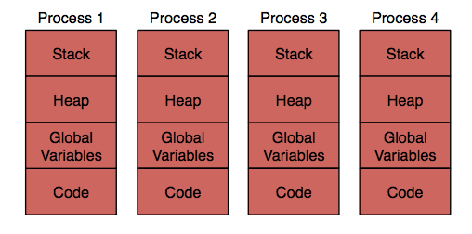
Current MPI implementation
Process-based MPI
Advantage: No synchronization
Disadvantage: 1. Two-copy per message (pipeline)
2. Pair-wise memory allocation
(memory consuming)
Notes:
In this paper, the paper discusses three different approaches to memory layout and intra-node communication in MPI, which includes process-based MPI, thread-based MPI, and hybrid-MPI. First, for process-based MPI, the figure shows the memory layout. By default, each rank is an OS process with its own private memory. As a result, since each core is used by a separate process, their MPI libraries maintain separate state and thus require no synchronization. However, the limitation of this design is in communicating among different ranks that are executing within the same shared memory node. MPI libraries often use a FIFO connection (one for each pair of local ranks) for small messages, and one or more shared memory regions mapped by multiple ranks for larger messages. Either case inherently requires two copy operations per message. The sender copies from its private- memory send buffer into the FIFO queue or shared memory region, and the receiver copies back out into its separate private-memory receive buffer. A common optimization for large messages is to overlap and pipeline the two copies by breaking the message into blocks, allowing the sender and receiver to perform their respective copies simultaneously. FIFOs are a pair-wise connection, and shared memory regions may also be created on a pair-wise basis to simplify communication. Thus, the number of resources grows as the square of the number of MPI ranks per node, which is often the number of cores per node. Such an approach will consume too many resources as the amount of memory available per core continues to decrease on HPC systems.

Slide 6
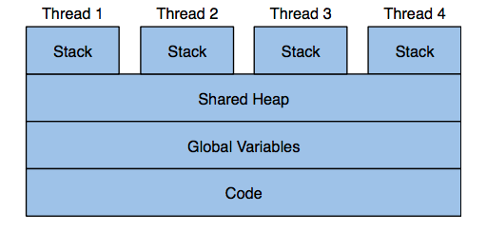
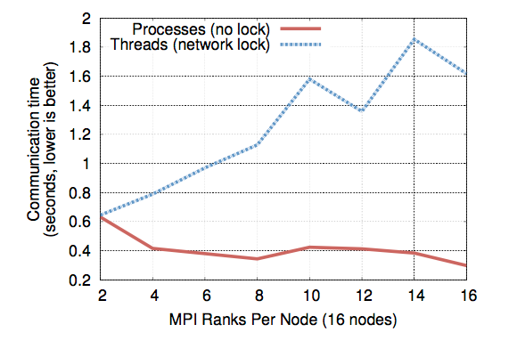
Current MPI implementation
2. Thread-based MPI
Advantage: Shared memory
Disadvantage: Race condition (global variable)
i. Complier transformation tool
ii. Thread-safe API only
Notes:
Another approach is thread oriented. As the name indicates, it uses threads for each rank where MPI ranks are implemented as OS threads, all of which execute within the same process. The figure shows how the memory layout looks like. It share every variables except for the stack. However, many MPI applications are written with the assumption that global variables are private to each MPI rank. While threading gives each rank its own stack and heap within he shared address space, one set of global variables is shared among all MPI ranks in a node. Application state becomes unpredicatable as different MPI ranks write to the common global variables, this will arise the race condition. To encounter that, people usually apply two methods. One is using compiler transformation tool, it transform global variable into private when compiling codes. The other method is to use thread-safe API only. These kinds of approach are either complex or performance-harmful.

Slide 7
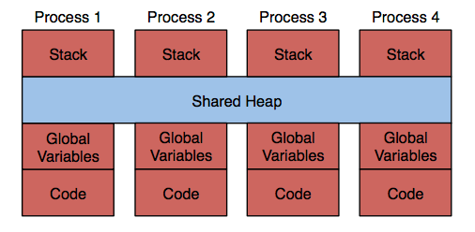
HMPI architecture
Shared memory allocation
a) Some systems allow memory
mapping from other process (require root access)
In HMPI, mmap and sbrk are
used to modify dlmalloc
- virtual memory
- process owned share memory
- one 16G physical memory, up to 16G virtual memory could be allocated for each process
Notes:
In this research paper, the authors demonstrate a Hybrid MPI that combines the advantage from both process-based and thread-based implementation, while being able to reduce the disadvantage sides. As I mentioned before, to improve the performance, we have to think a way to use share memory to avoid communication overhead. Some systems allow memory mapping from other process, but requires root access. In this research paper, it is allowed for HMPI allocate share memory for different processes in same node without root access. In HMPI, mmap and sbrk are used to modify the google dlmalloc API. It allocate share memory in memory heap. The shared region is divided evenly among the ranks on the node, and each rank allocates memory only from its part of the region. This approach eliminates the need for any synchronization between processes within the memory allocator. The author demonstrates that it is able to allow 16G virtual memory allocation for 16G physical memory.Therefore, if the sender’s buffer is shared, we can do a Single-copy communication.

Slide 8
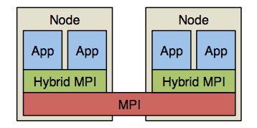
HMPI architecture
HMPI inheritance
Hybrid MPI library
Advantages:
a) portability: Just link it to application
b) transparency: No code transformations, or library modifications are needed
Notes:
This is top layer HMPI architecture. The figure shows how HMPI cooperates between applications and MPI. As we can see, HMPI lies in between application layer and MPI layer. Therefore, if the communication is in side the node, it can use HMPI API instead regular MPI. There are two advantages to our approach: portability and transparency. In terms of portability, we can use it just by linking the library to application when needed. The author demonstrated that it’s able to extend both open- and closed-source MPI implementations on multiple platforms. For transparency, it means No code transformations, object file or library modifications are needed. The user does not have to modify anything to ensure the code runs in all kinds of platform.

Slide 9
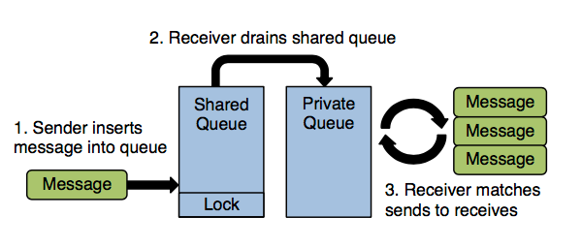
HMPI architecture
Message matching
a) two message queues per receiver, one private, one global.
b) MCS lock (FIFO)
c) Drain from global to
private in constant time
Notes:
In HMPI system, two incoming message queues per receiver are implemented using linked lists. One queue is globally accessible by all ranks. Senders add messages to the global queue owned by the rank for which the message is destined. Each global queue is protected by an MCS lock. The second queue is private. When a receiver attempts to match incoming sends to local receives, it drains its global queue and adds incoming sends to its private queue. Since the queues are linked lists, the draining operation only involves updating two pointers. The receiver then attempts to match sends on its private queue to local receives. A second private queue enables the receiver to loop many times without need for synchronization, and ensures that messages cannot be matched out of order due to senders adding new messages to the queue.

Slide 10
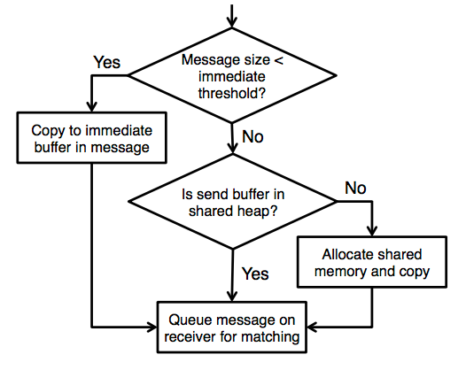
Communication protocols
Immediate Transfer Protocol
memcpy is not always first choice
For small message, use two-copy method
256 bytes threshold
Notes:
The author also find that simply using memcpy to transfer the data is often not the fastest method possible. It use an ‘immediate’ protocol for small messages less than the immediate threshold. Before queuing a message, the sender goes through a series of checks as shown in Figure. If the message is small, we go into the immediate protocol, inlining the message data with the message’s matching information. If the application’s send buffer is not located in the shared heap, we al- locate a shared buffer and copy the data over. Finally, the message is queued on the receiver’s shared queue.

Slide 11
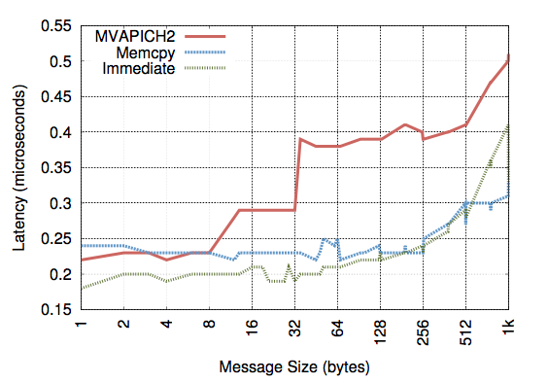
Communication protocols
Sender bring the message into cache
The time saved by avoiding the cache miss more than makes up for the cost of doing two copies
Notes:
The advantage of immediate protocol is less cache miss. When doing a single copy version, when receiver copy from the receive buffer, it will encounter a cache miss. But for ‘immediate’ transfer protocol, it uses double-copy, the sender bring the message into cache, thus the receiver will have a better cache locality most likely. This graph shows that for small messages, the time saved by avoiding the cache miss more than makes up for the cost of doing two copies. Immediate transfer protocol is for the sender, for receiver, there is synergistic transfer protocol.

Slide 12
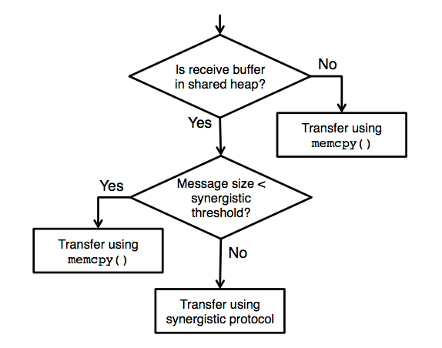
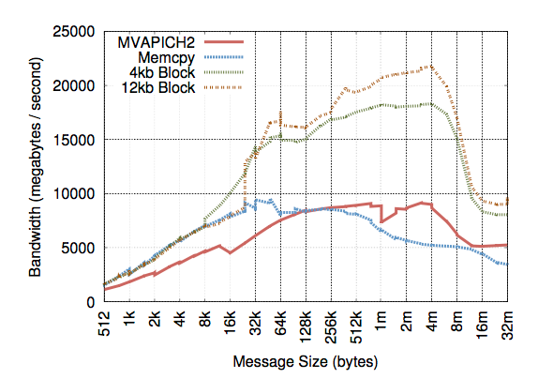
Communication protocols
2. Synergistic transfer protocol
a) Bandwidth bottleneck
b) Receiver can copy entire message without sender
Notes:
As we know, for large messages, bandwidth is most important. We can achieve higher data transfer rates than possible with a single memcpy by having both the sender and receiver participate in copying data from the send buffer to the receive buffer. To do this, we break the data into blocks and utilize a shared counter that is atomically updated by the sender and receiver. When the receiver matches a message, it initializes the counter (used as a byte o↵set) and begins copying data one block at a time. Before copying each block, the counter is incremented. If the sender enters the MPI library and sees that the receiver is copying in block mode, it also begins incrementing the counter and copying blocks of data until the entire message has been copied. The advantage of this protocol is that communication- computation overlap is greater than that of existing protocols when the sender has other work to do. Unlike the two-copy protocols used in current MPI implementations, the receiver can perform the entire data transfer without the sender, and does so when beneficial. Communication performance is dynamically accelerated when the sender is able to assist the receiver in copying data.

Slide 13
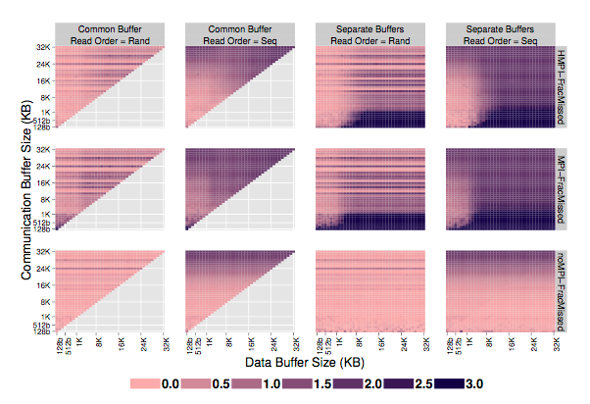
Result analysis
Communication analysis
a) Lowest cache miss
if no communication
b) HMPI has lower cache
miss than MPI
c) Random reading has a
better cache hit means
cache replacement algorithm not good enough.
Notes:
Now here is the performance of HMPI. While raw communication performance is important, an- other way that MPI libraries affect application performance is their effects on the memory cache. This is a graph shows the HMPI has a higher cache hit than the regular MPI. The data shows that the miss rate is low when no communication is performed. This is obvious. Looking at the HMPI and MPI data, we observe both libraries increase the number of cache misses in the read loop. This is caused both by evictions of data from the cache as well as due to poor decisions by the cache replacement algorithm. The impact of the replacement algorithm is observed by looking at the difference between the results for random and sequential access orders. It can be seen that the difference between separate and common is generally small for all the buffer size configurations the two share. In contrast, the sequential access order causes many more misses than the random, indicating that the increase is due to interference with the replacement policy. The likely cause is that the cache access pattern of the communication code trains the replacement algorithm to expect the same access pattern in subsequent code and when control returns to the application it makes poor decisions that result in unnecessary misses. Indeed, in many cases there are more misses than the number of lines in the data buffer, especially for small data buffers and large communication buffers. This indicates that the useless lines from the communication buffer are being prefetched when in fact the application is attempting to access the data buffer.

Slide 14
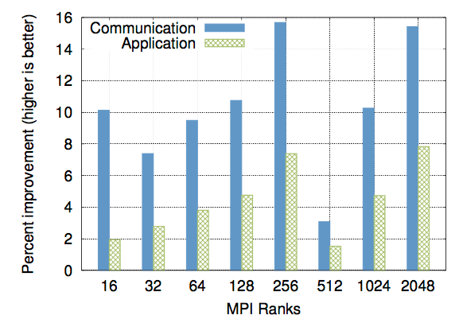
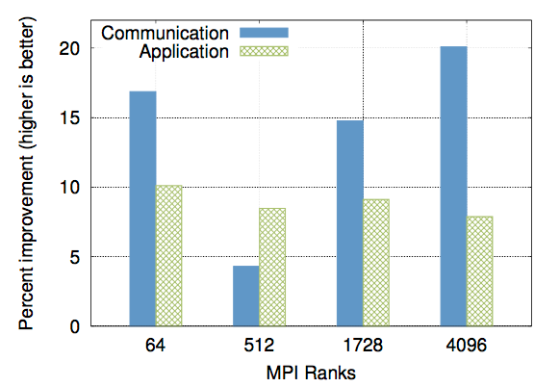
Result analysis
Application analysis
1. For MiniMD, communicationg speedups of 3.1-15.7%, resulting in total application time improvements of 1.5-7.9%
2. For LULESH, communication time speedups of 11-46.1% and application time speedups of 14.1% - 19.5%
MiniMD performance
LULESH performance

Slide 15
Conclusion
Approach
Exploit shared memory hardware in MPI programs that are written for distributed memory systems.
Utilize a layered model for implementing our optimizations.
Use above two mechanisms to develop HMPI, a fast layered MPI library that optimizes hybrid shared memory communication
Result
less on-node communication overheads
Integrates transparently into legacy applications

Slide 16
Reference
[1] The OpenCL specification version 1.0, 2009. [2] A. Friedley, T. Hoefler, G. Bronevetsky, C.-C. Ma, and A. Lumsdaine. Ownership passing: E cient distributed memory programming on multi-core systems. February 2013. PPoPP 2013.
[3] E. Gabriel, M. Resch, and R. RA ̃ijhle. Implementing mpi with optimized algorithms for metacomputing, 1999.
[4] B. Goglin and S. Moreaud. KNEM: a Generic and Scalable Kernel-Assisted Intra-node MPI Communication Framework. Journal of Parallel and Distributed Computing, 73(2):176–188, Feb. 2013. KNEM.
[5] M. A. Heroux, D. W. Dorfler, P. S. Crozier, J. M. Willenbring, H. C. Edwards, A. Williams, M. Rajan, E. R. Keiter, H. K. Thornquist, and R. W. Numrich. Improving performance via mini-applications. 2009.
[6] T. Hoefler, J. Dinan, D. Buntinas, P. Balaji, B. Barrett, R. Brightwell, W. Gropp, V. Kale, and R. Thakur. Leveraging MPI’s One-Sided Communication Interface for Shared-Memory Programming. In EuroMPI 2012, Vienna, Austria, volume 7490, Sep. 2012.
[7] C. Huang, O. Lawlor, and L. V. Kal ́e. Adaptive MPI. In International Workshop on Languages and Compilers for Parallel Computing (LCPC), College Station, Texas, October 2003.
[8] G. Inc. gperftools. https://code.google.com/p/gperftools.
[9] R. Keller, E. Gabriel, B. Krammer, M. S. MA ̃ijller, and M. M. Resch. Towards e cient execution of mpi applications on the grid: Porting and optimization issues. Journal of Grid Computing, 2003.
[10] S. N. Laboratories. Large-scale atomic/molecular massively parallel simulator (LAMMPS). http://lammps.sandia.gov.
[11] L. L. N. Laboratory. Simulation of underwater explosion benchmark experiments with ale3d. Technical Report UCRL-JC-123819, May 1997.
[12] Lawrence Livermore National Laboratory. Hydrodynamics challenge problem, 2012.
[13] D. Lea. Doug Lea’s malloc (dlmalloc). http://g.oswego.edu/dl/html/malloc.html.
[14] S. Li, T. Hoefler, , and M. Snir. NUMA-Aware Shared Memory Collective Communication for MPI. Jun. 2013. HPDC’13.
[15] J. Liu, J. Wu, and D. K. Panda. High Performance RDMA-Based MPI Implementation over InfiniBand. In ACM International Conference on Supercomputing (ICS’03), 2003.
[16] Megan Gilge. IBM system Blue Gene solution: Blue Gene/Q application development, December 20 2012.
[17] J. M. Mellor-Crummey and M. L. Scott. Algorithms for scalable synchronization on shared-memory multiprocessors. ACM Transactions on Computer Systems, 9, 1991.
[18] S. Negara, G. Zheng, K.-C. Pan, N. Negara, R. E. Johnson, L. V. Kale, and P. M. Ricker. Automatic MPI to AMPI Program Transformation using Photran. In 3rd Workshop on Productivity and Performance (PROPER 2010), number 10-14, Ischia/Naples/Italy, August 2010.
[19] OpenMP Architecture Review Board. OpenMP application program interface version 3.0, May 2008.
[20] K. Pedretti and B. Barrett. XPMEM: Cross-Process Memory Mapping. [21] S. Pellegrini, T. Hoefler, and T. Fahringer. On the E↵ects of CPU Caches on MPI Point-to-Point Communications. In IEEE International Conference on Cluster Computing (CLUSTER), sept. 2012.
[22] M. P ́erache, P. Carribault, and H. Jourdren. MPC-MPI: An MPI implementation reducing the overall memory consumption. In EuroPVM/MPI, Berlin, Heidelberg, 2009.
[23] S. Plimpton. Fast parallel algorithms for short-range molecular dynamics. JOURNAL OF COMPUTATIONAL PHYSICS, 117:1–19, 1995.
[24] H. Tang and T. Yang. Optimizing threaded MPI execution on SMP clusters. In ACM International Conference on Supercomputing (ICS), 2001.
[25] R. Thakur and W. Gropp. Test suite for evaluating performance of multithreaded MPI communication. Parallel Comput., 35(12), Dec. 2009.
[26] D. Turner and X. Chen. Protocol-dependent message-passing performance on linux clusters. In IEEE International Conference on Cluster Computing, CLUSTER ’02, Washington, DC, USA, 2002.
[27] M. Woodacre, D. Robb, D. Roe, and K. Feind. The SGI Altix 3000 global shared-memory architecture. 2005.
[28] H. wook Jin, S. Sur, L. Chai, and D. K. Panda. Limic: Support for high-performance mpi intra-node communication on linux cluster. In In International Conference on Parallel Processing (ICPP), pages 184–191, 2005.

Slide 17
Questions?

