Slide 1
Unmanned Aerial Vehicle network communication profiling
Hualiang Li
Department of Electrical Engineering

Slide 2
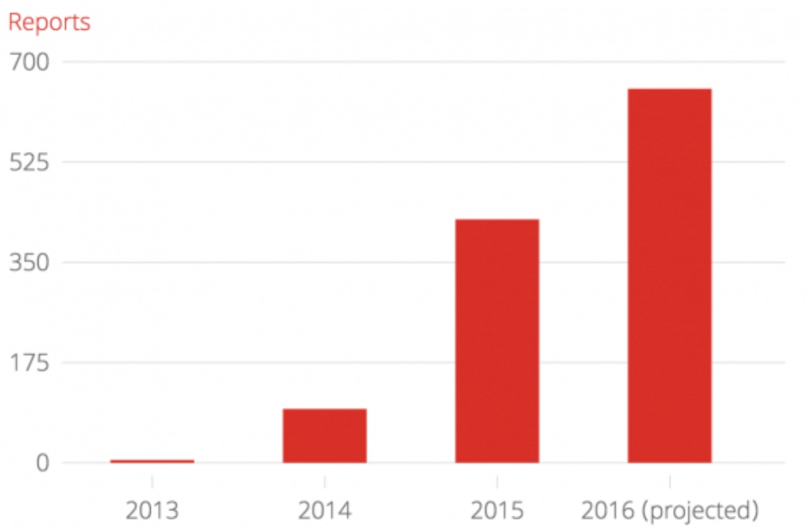
Reports to UK police for involving drones
Source: independent.co.uk

Slide 3
Outline
Motivation of drone profiling
Basic 802.11 Protocol
Technical challenges
Previous work
Current design
Classifier model
Analysis method
Limitation and future work
Conclusion

Slide 4
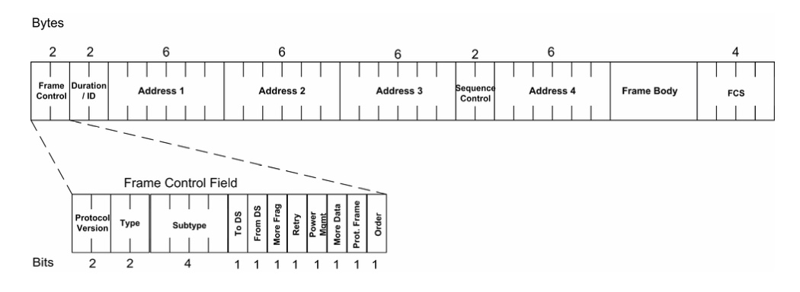
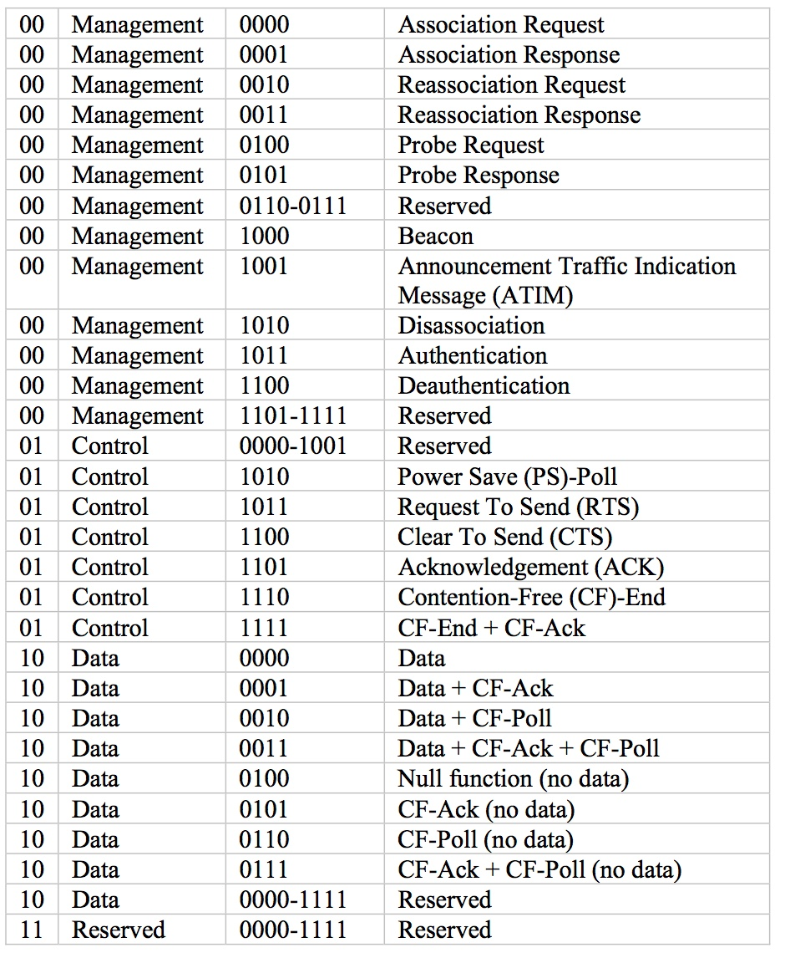
802.11 protocol
Protocol Version: 00 by default
Type: Management, Control, Data
Notes:
Commercial drones have become very popular among many Unmanned Aerial Systems (UASs) recently. As commercial drones are involved in many high-profile incidents, security threats from these systems need to be effectively addressed.

Slide 5
802.11 protocol
Scanning: passive/active scanning
Synchronization
Notes:
Commercial drones have become very popular among many Unmanned Aerial Systems (UASs) recently. As commercial drones are involved in many high-profile incidents, security threats from these systems need to be effectively addressed.

Slide 6
Motivation
Spoof detection
Network reconnaissance
Access control against masquerading attack
Counter-attack
Notes:
Commercial drones have become very popular among many Unmanned Aerial Systems (UASs) recently. As commercial drones are involved in many high-profile incidents, security threats from these systems need to be effectively addressed.

Slide 7
Technical Challenges
Packets are encrypted
Different standards
Less broadcast information

Slide 8
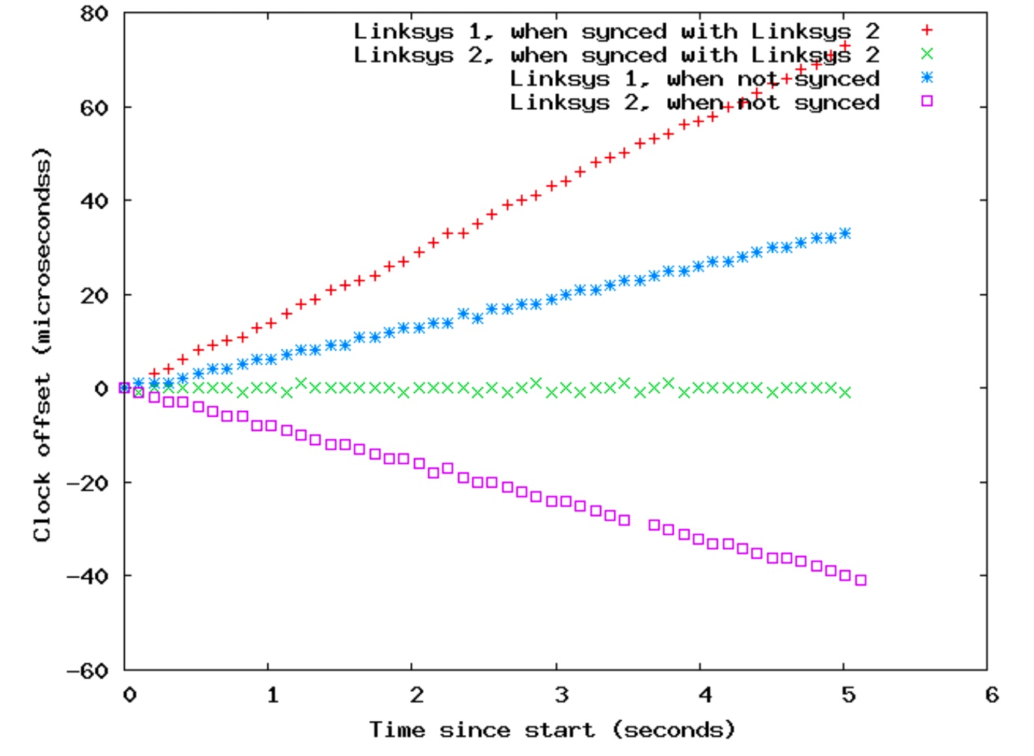
Previous Work
a set of n measurements (ti,Ti),1 ≤ i ≤ n.
xi = ti − t1, w_{i} = T_{i} − T₁
yi = wi −xi
- Clock skew
Notes:
In an 802.11 network operating in infrastructure mode, every station maintains a timer. This timer is synchronized with the timer in the AP the station is associated with via a Timer Synchronization Function (TSF). The synchroniza- tion is achieved through the beacon frames transmitted by the AP at periodic intervals. The most common setting for the beacon interval is 100 milliseconds. The beacon frames contain the TSF timer timestamp of the AP “at the time that the data symbol of the first bit of the timestamp is transmitted to the wireless medium,” adjusting for hardware transmission delays. The timer is of microsecond resolution and is maintained as a 64-bit counter. Client stations set their local TSF timers to the values observed from beacon frames, again, adjusting for hardware delays. This means that beacon timestamps provide a high-precision mechanism to measure the skew in an APs TSF timer.
We now define the notion of clock skew as given by Moon, Skelly, and Towsley [12], and later used by Kohno et al. [11] and Jana and Kasera [10]. To measure the clock skew of an AP, we passively monitor the wireless inter- face of the measuring device for beacon frames from the AP. For beacon frame i we record the time ti when it was received and the timestamp Ti in the beacon frame. In this manner we obtain a set of n measurements (ti,Ti),1 ≤ i ≤ n. We found that sampling n = 100 beacons gave sufficient accu- racy in our experiments (as also observed previously [10]). We denote by xi the elapsed time since the first beacon was observed, i.e., xi = ti − t1. Similarly, let wi = Ti − T1. The quantity yi = wi −xi is called the clock offset of the ith mea- surement. In this way we get a set of n clock offset points (xi,yi). Ideally, there should be no relative skew between the measurer’s clock and the beacon timestamps represent- ing the AP’s clock, when we would have wi = xi,∀i ≤ n. In reality we observe that the clock offset points lie on an ap- proximately linear pattern that has some non-zero slope. A linear least square fit (LSF) is used to fit a line y = s·x+c to the set of clock offset points (yi,xi) by minimizing the least square error Pni=1(yi − (s · xi + c))2. The slope of the line obtained by LSF gives the clock skew of the AP. Skews ob- served in practice are tiny, but consistent, and are reported in parts per million (ppm).

Slide 9
Current Design
1. Probe request pattern classifier
2. Signal strength pattern
3. Packet Header parser

Slide 10
1. Probe request pattern
Measure the time intervals between each probe request packet
Plot the time interval sequence
2 types of pattern

Slide 11
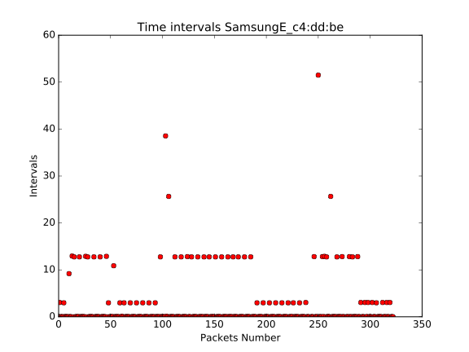
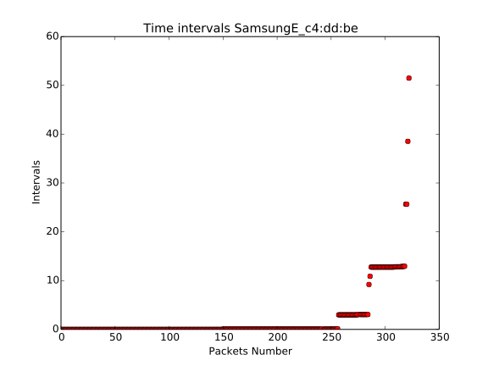
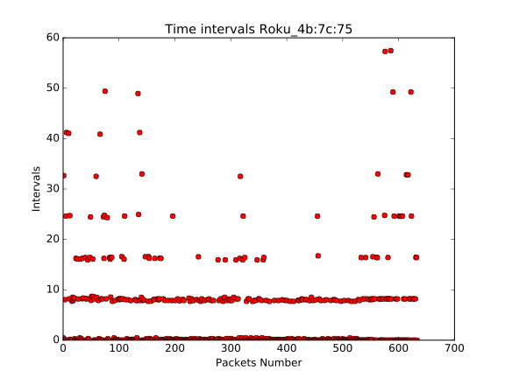
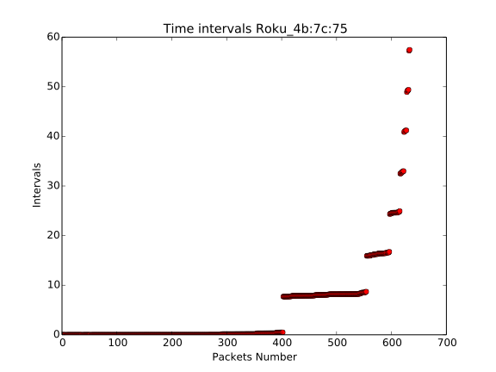
1. Probe request pattern
—>
—>

Slide 12
Current Design
1. Probe request pattern classifier
2. Signal strength pattern
3. Packet Header parser

Slide 13
2. Signal Strength pattern
Signal strength is a indicator of distance between two device, (i.e. drone and monitor device)
Passive characteristic, can’t be manually modified

Slide 14
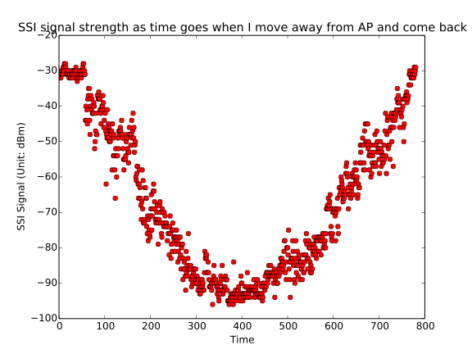
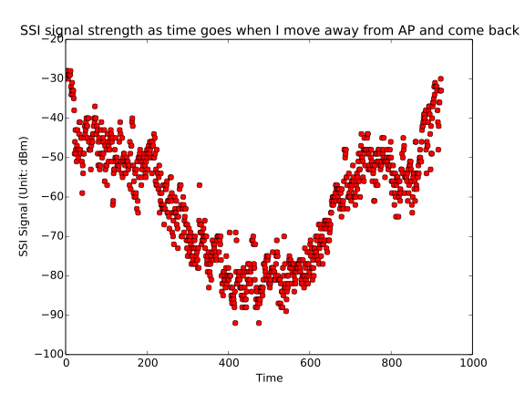
2. Signal Strength pattern
S = f(D)
f’(D) = Velocity
f’’(D) = Acceleration

Slide 15
Current Design
1. Probe request pattern classifier
2. Signal strength pattern
3. Packet Header parser

Slide 16
3. Packet header parser
3DR Solo characteristic:
1. Mac address first 3 bytes: 88:DC:96
2. Acknowledgment packets size sent by drone: 39 bytes
3. Acknowledgment packets data rate: 24Mb/s
4. Data packet rate: 144.4 Mb/s
5. Beacon frame supporting rate: 1(B), 2(B), 5.5(B), 11(B), 6, 9, 12, 18 [Mb/s]
6. Extended supporting rate: 24, 36, 48, 54 [Mb/s]
7. Channel number: 8
8. Security encryption method: AES or TKIP

Slide 17
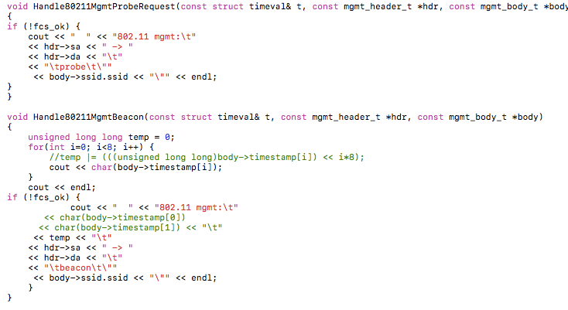
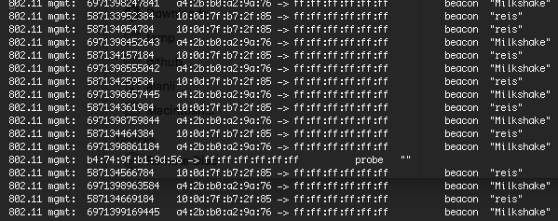
3. Packet header parser

Slide 18
DBSCAN Classifier Model
2 types clustering algorithms: Partitioning, Hierarchical
Partitioning: Number of cluster is pre-defined (K-means)
Hierarchical: Rely on density-based notion

Slide 19
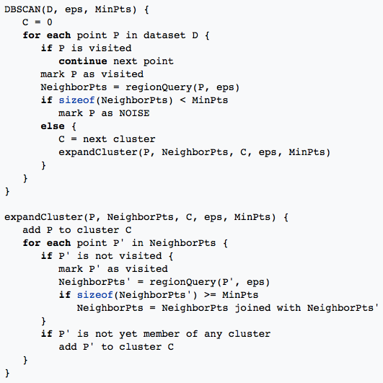
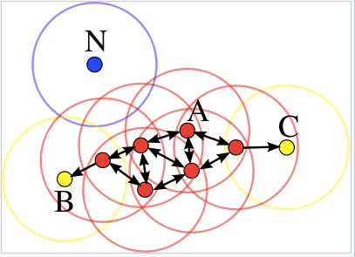
DBSCAN Classifier Model
3 types of points: core points, (density-)reachable points and outliers
2 parameters: ε (eps), minPts

Slide 20
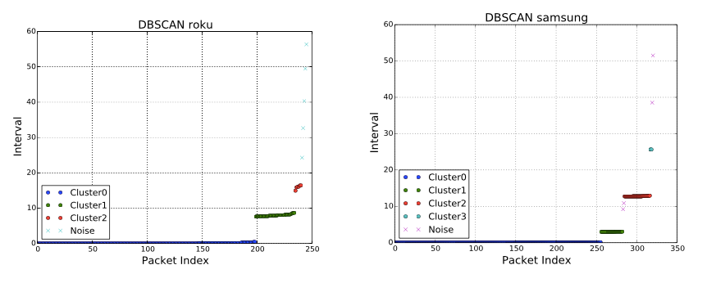
DBSCAN Classifier Model

Slide 21
Analysis Method
Mann-Whitney U-test: Test the null hypothesis that two samples come from the same population (i.e. have the same median) or, alternatively, whether observations in one sample tend to be larger than observations in the other.

Slide 22
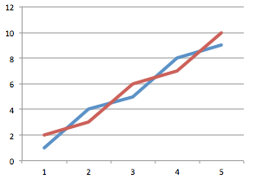
Analysis Method
Sample A: 1, 4, 5, 8, 9; Sample B: 2, 3, 6, 7, 10
U(A) = 0+2+2+4+4=12; U(B) = 1+1+3+3+5 =13

Slide 23
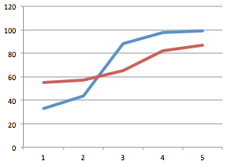
Analysis Method
Sample A: 33, 44, 88, 98, 99; Sample B: 55, 57, 65, 82, 87
U(A) = 0+0+5+5+5=15; U(B) = 2+2+2+2+2 =10
Mean(A) ~= 72
Mean(B) ~= 70

Slide 24
Limitation & Future Work
No probe request after association
Signal strength could be affected by environment
Require relative long time to classify (Not real-time)

Slide 25
Conclusion
1. Probe request pattern classifier
2. Signal strength pattern
3. Packet Header parser
With the combination of above different classify models, we have a strong believe that the profile we create for different drones is sufficient enough to classify each type of drones with high possibility.

