Slide 1
Milestone 2 Group 1
CSC 436 Fall 2020
Jeffrey Veit / Steven Meier / Brian Schultz / Ximan Liu

Slide 2
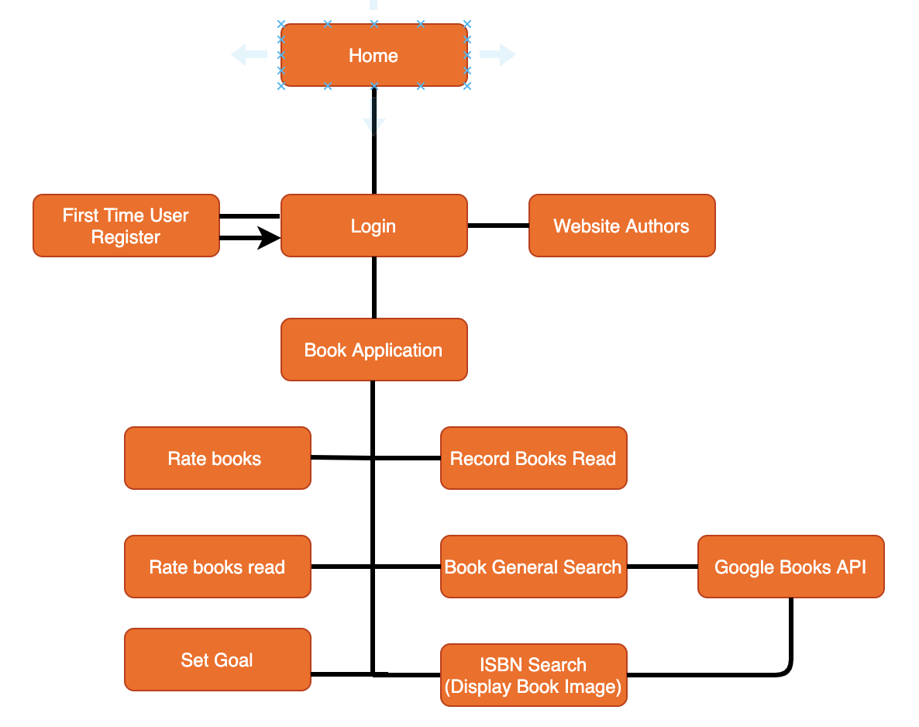
Original Navigation Diagram

Slide 3
Milestone 2 Feedback
"For next milestone, you may need to narrow or refine the scope and so as part of the documentation, make sure the team discuss why you picked one and not the others so you can look back at the end of the quarter for the implication of the decision."

Slide 4
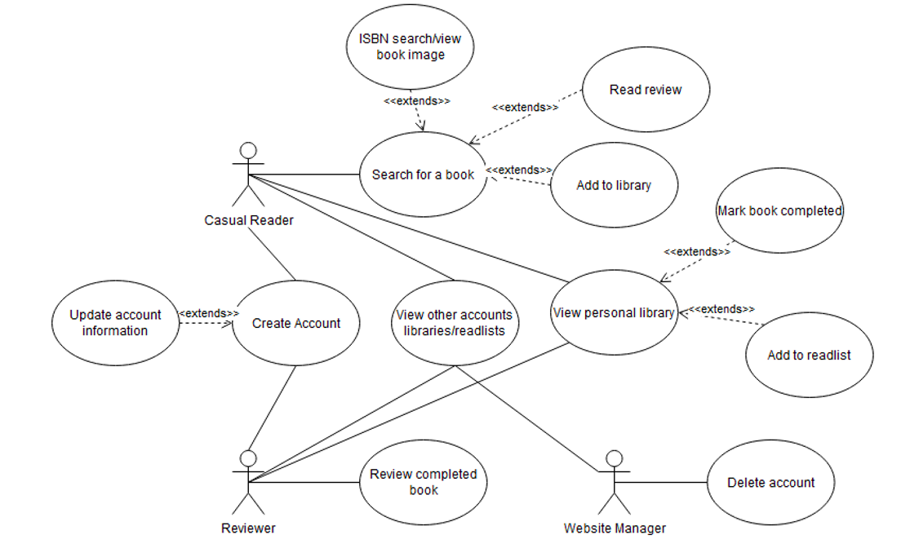
Use Case Diagram

Slide 5
Navigation Diagram with Feedback

Slide 6
Demo
Book: Web Application for Searching and Goal Setting

Slide 7
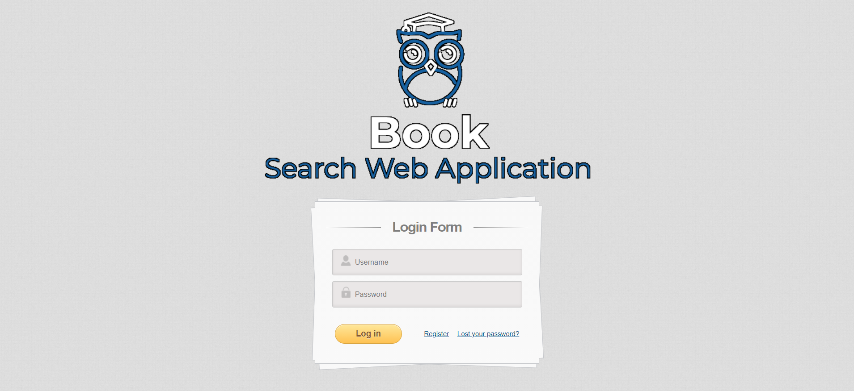
Demo (backup slides): Login / Index

Slide 8
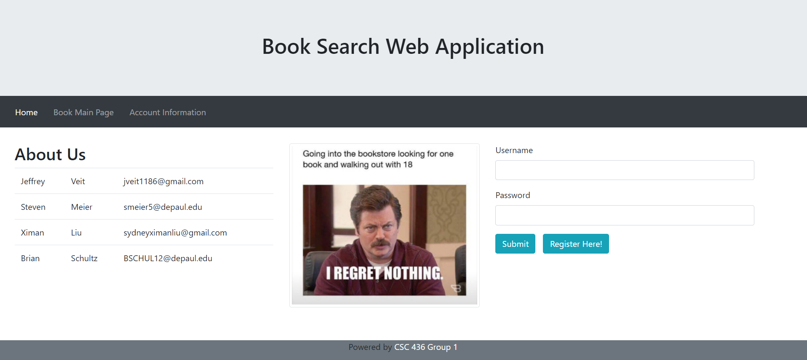
Demo (backup slides): Index / About Us

Slide 9
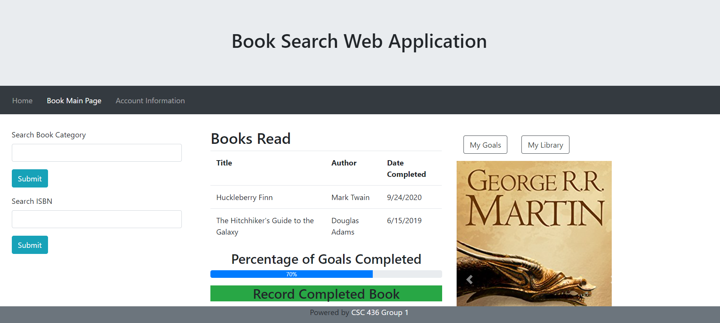
Demo (backup slides): Main

Slide 10
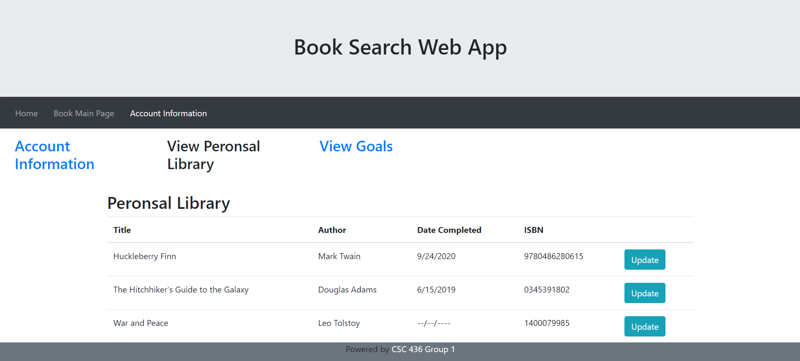
Demo (backup slides): Personal Library

Slide 11
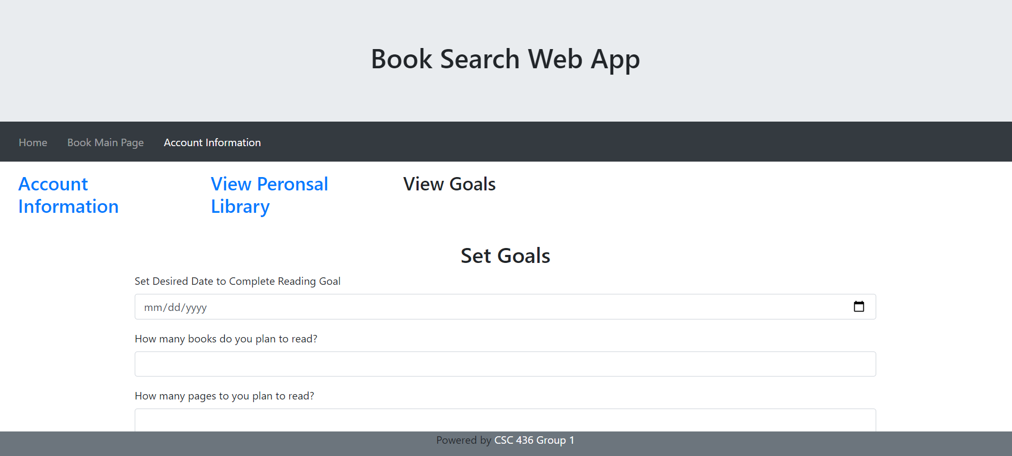
Demo (backup slides): Set Goals

Slide 12
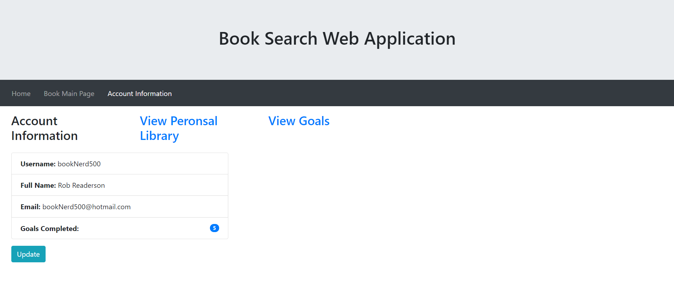
Demo (backup slides): Account Info

Slide 13
External Service
Google Books API
Website: https://developers.google.com/books/docs/overview
Data Format: JSON
Calling Style: REST
Example Call: GET https://www.googleapis.com/books/v1/volumes?q=quilting

Slide 14
The Google Books API v1 gives you programmatic access to many of the operations available on Google Books website. You can use it to create powerful applications that provide deeper integration with Google Books. Some of the main features that the API provides are:
● Search and browse through the list of books that match a given query.
● View information about a book, including metadata, availability and price, links to the preview page.
● Manage your own bookshelves.

Slide 15
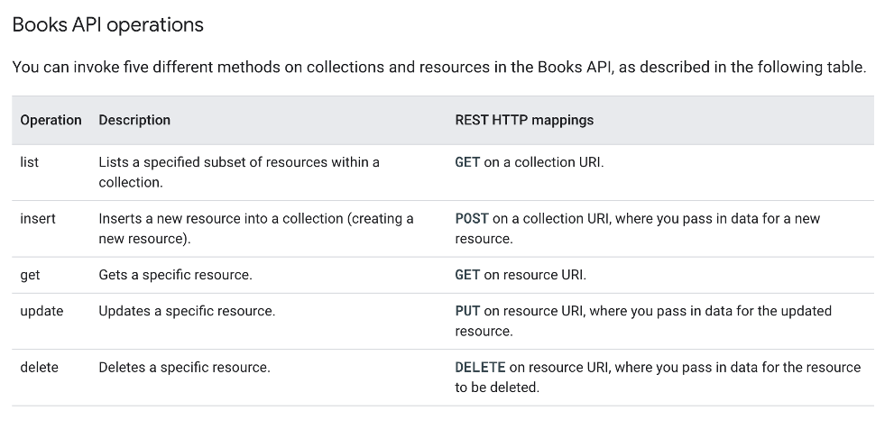

Slide 16
THANK YOU

