Slide 1
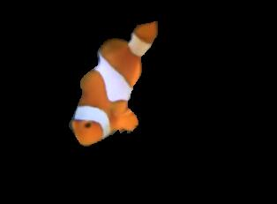

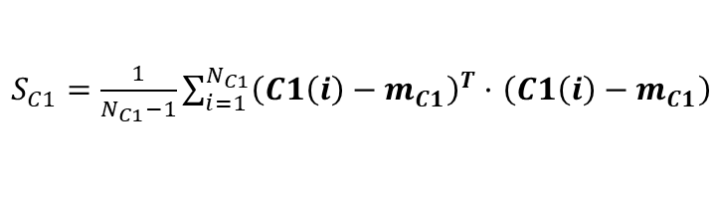

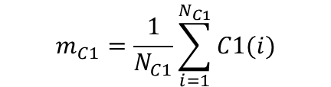
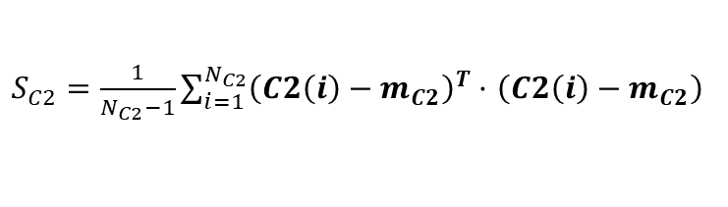
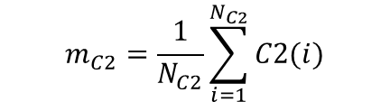

01
贝叶斯决策算法流程
I(i, j)
$$m_{C1}=\frac{1}{N_{C1}}\sum_{i=1}^{N_{C1}}{C1(i)}$$
sample
$S_{C1}=\frac{1}{N_{C1}−1}\sum_{i=1}^{N_{C1}}{{\left(C1\left(i\right)−m_{C1}\right)}^{T}}·$ $\left(C1\left(i\right)−m_{C1}\right)$
x1
1
1
x2
.
.
.
MLE
1
color1
-1
$$P_{C1}= \frac{N_{C1}}{N}$$
.
$$\frac{PDF\left(I\left(i,j\right),m_{C1},S_{C1}\right)∗ P_{C1}}{PDF\left(I\left(i,j\right),m_{C2},S_{C2}\right)∗ P_{C2}}$$
﹤
﹥
.
1
.
$$P_{C2}= \frac{N_{C2}}{N}$$
-1
color2
xN
-1
MLE
data
label
$$m_{C2}=\frac{1}{N_{C2}}\sum_{i=1}^{N_{C2}}{C2(i)}$$
$S_{C2}=\frac{1}{N_{C2}−1}\sum_{i=1}^{N_{C2}}{{\left(C2\left(i\right)−m_{C2}\right)}^{T}}·$ $\left(C2\left(i\right)−m_{C2}\right)$

Slide 2
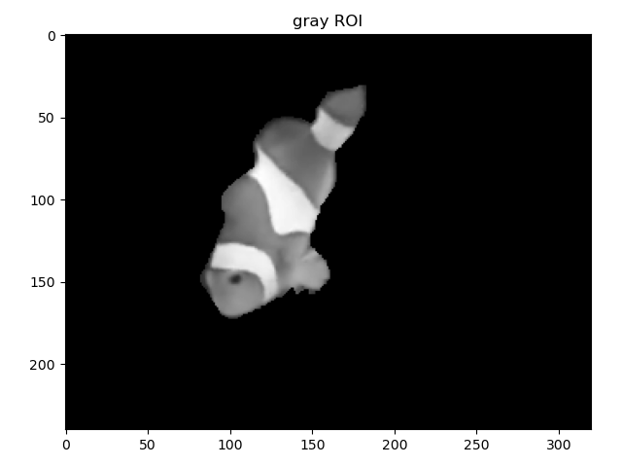
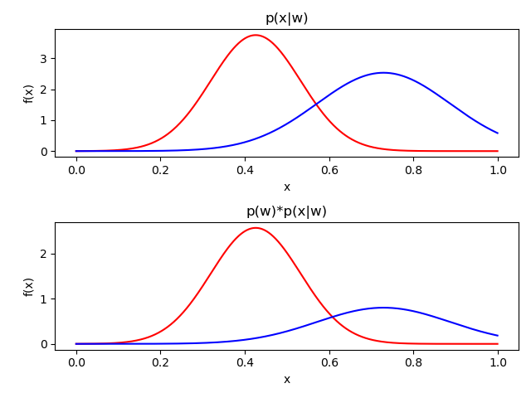

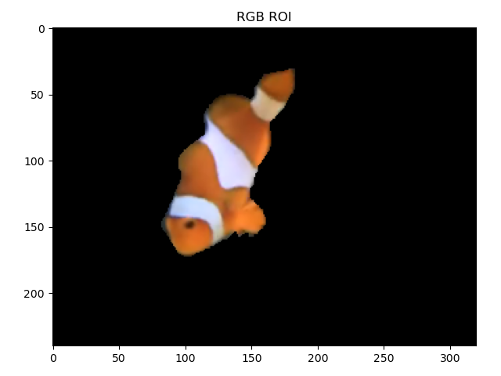
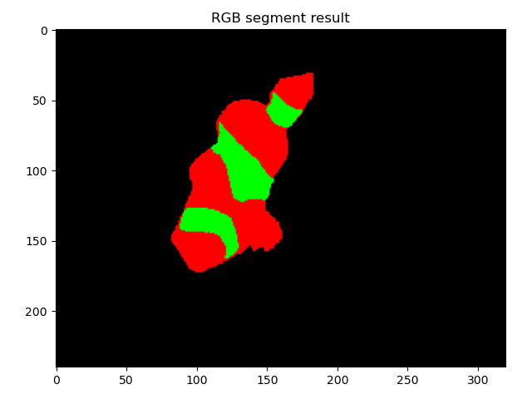
02
贝叶斯分割结果
高维度两类交集更小

Slide 3


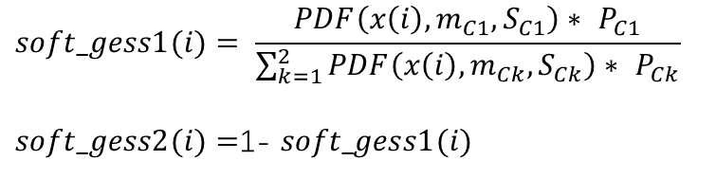
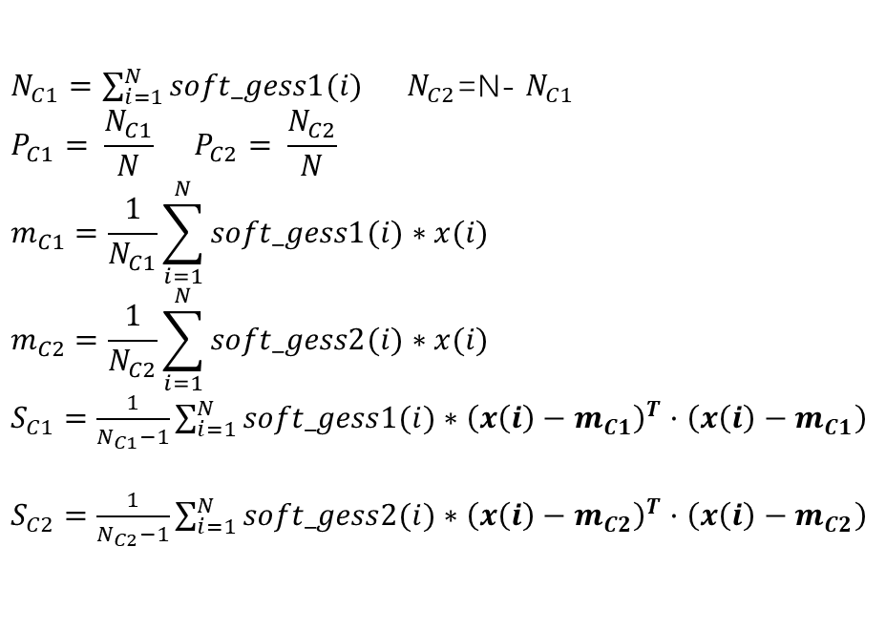
03
EM算法流程
I(i, j)
Bayes
$m_{C1}=$ $m_{C1}$0
$m_{C2}=$ $m_{C2}$0
$S_{C1}=$ $S_{C1}$0
$S_{C2}=$ $S_{C2}$0
$P_{C1}=0.5$
$P_{C2}=$ $0.5$
$$soft_gess1(i)= \frac{PDF\left(x\left(i\right),m_{C1},S_{C1}\right)∗ P_{C1}}{\sum_{k=1}^{2}{PDF\left(x\left(i\right),m_{Ck},S_{Ck}\right)∗ P_{Ck}}}$$
$soft_gess2(i)=$1- $soft_gess1(i)$
MLE
迭代
迭代
$$\frac{PDF\left(I\left(i,j\right),m_{C1},S_{C1}\right)∗ P_{C1}}{PDF\left(I\left(i,j\right),m_{C2},S_{C2}\right)∗ P_{C2}}$$
$N_{C1}=\sum_{i=1}^{N}{soft_gess1(i)}$ $N_{C2}$=N- $N_{C1}$
$$P_{C1}= \frac{N_{C1}}{N} P_{C2}= \frac{N_{C2}}{N}$$
$$m_{C1}=\frac{1}{N_{C1}}\sum_{i=1}^{N}{soft_gess1(i)∗x(i)}$$
$$m_{C2}=\frac{1}{N_{C2}}\sum_{i=1}^{N}{soft_gess2(i)∗x(i)}$$
$S_{C1}=\frac{1}{N_{C1}−1}\sum_{i=1}^{N}{soft_gess1(i)∗{\left(x\left(i\right)−m_{C1}\right)}^{T}}·$ $\left(x\left(i\right)−m_{C1}\right)$
$S_{C2}=\frac{1}{N_{C2}−1}\sum_{i=1}^{N}{soft_gess2(i)∗{\left(x\left(i\right)−m_{C2}\right)}^{T}}·$ $\left(x\left(i\right)−m_{C2}\right)$
完成
sample
color1
x1
﹤
﹥
x2
1
color2
xN
data

Slide 4
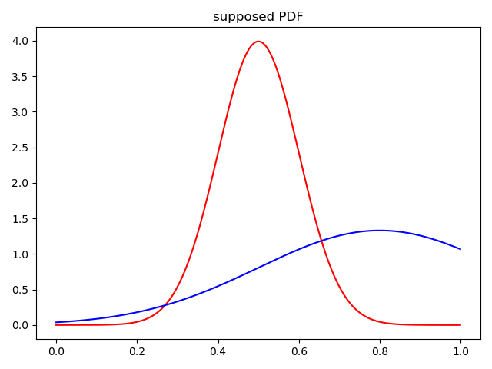
04
EM算法分割结果
高维度两类交集更小

