Slide 1
資訊工程專題報告 Reliable In-Network Aggregation
109611058 王敬智
109611066 吳典謀
指導教授：林靖茹教授

Slide 2
Reliable In-Network Aggregation
Aggregation
Grouping and summarizing specific data
Maybe a ML checkpoints or else
In-Network
Aggregating in Network stage
Not in host terminal
Reliable
Packet loss handling
Sequence ensure
Acknowledgement
1
2
1

Slide 3

Building concepts
In-Network – P4
Software-Defined Network
Programmable switch
Can handling headers from layer 2 to layer 5
Reliability – TCP protocol
Sequence is ensure
Packet loss handling
Packet Acknowledgement

Slide 4
A multi-host In-Network aggregator
Receiving data from multiple hosts
Send to Receiver after aggregation
Works under TCP connections

Slide 5
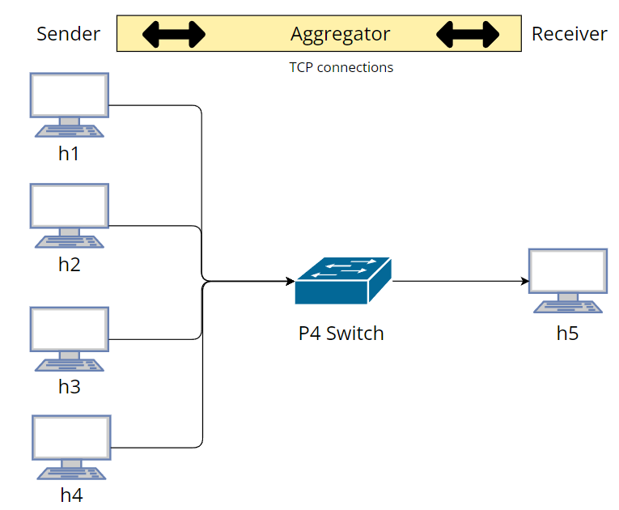
Topology
Environments
Ubuntu: 20.04
Mininet: 2.3.1b4
bmv2
p4c: 1.2.4.2
Devices
4 Sender host
1 Receiver host
1 Aggregator switch
Connections
4 TCP connections

Slide 6
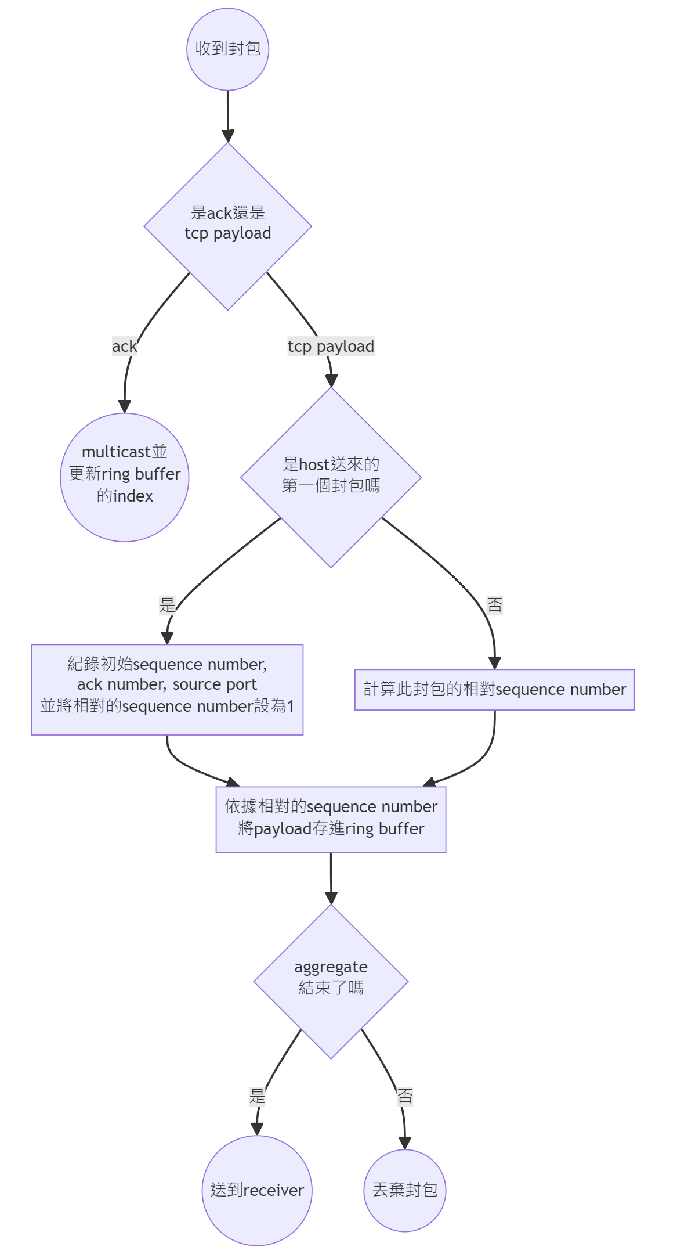
Main component
TCP cheater
Maintaining TCP connections

Slide 7
Main component
TCP cheater
Maintaining TCP connections

Slide 8
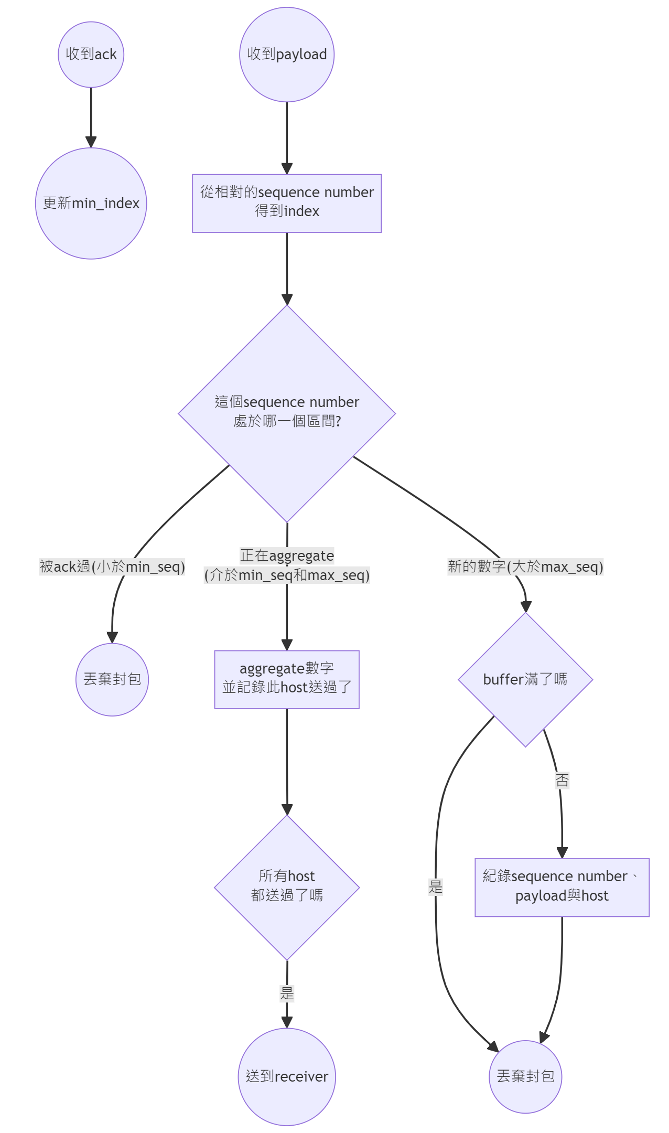
Main component
Ring Buffer
Record and aggregate payload

Slide 9
Main component
Ring Buffer
Record and aggregate payload

Slide 10

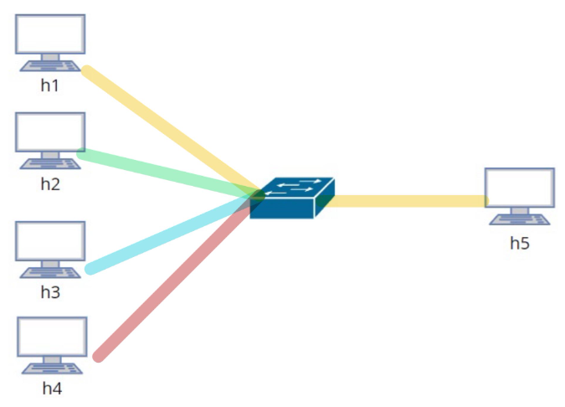
TCP Cheater- PSH
Original
Packet
Aggregated
Packet
Storage initial TCP header of each host
Store in register
To calculate the relative sequence number
Intercept packet and Collect data
Waiting for aggregate
Send the aggregated packet
Modify to leader’s header
Act as only one leader is sending
Recalculated checksum
Packet is drop once error checksum

Slide 11
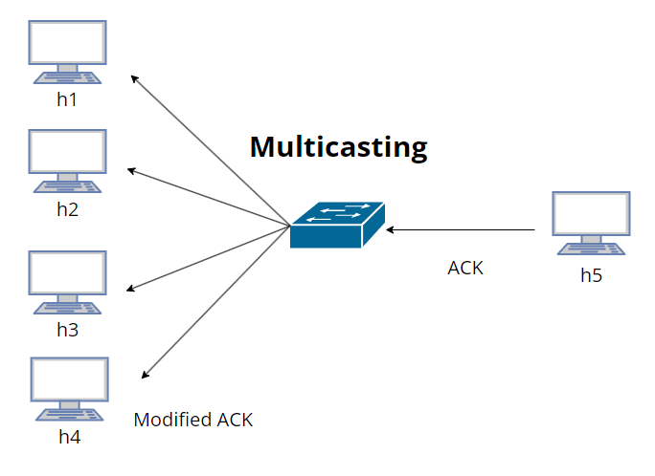
TCP Cheater- ACK
Replicated the ACK packet
To cheat other host their packet is ACKed
Using multicasting group
Modify the packet header
Read the value from register
Recover to original host header
Recalculated checksum
Packet is drop once error checksum

Slide 12
Ring Buffer
The buffer is in the following format:
Sequence Number: The sequence number of corresponding payload.
Payload: The aggregating result.
Count: Record which host has aggregated in bit format.
Sequence Number | Payload | Count
1 | 4 | 0b1111
2 | 6 | 0b0111
3 | 6 | 0b0011
4 | 4 | 0b0001
5 | 0 | 0b0000

Slide 13
Ring Buffer
There are min_index and max_index to maintain the buffer:
If less than min_index: Drop (acked).
If between min_index and max_index: Aggregate.
If more than max_index: Check whether there is space, then save the payload.
Sequence Number | Payload | Count
1 | 4 | 0b1111
2 | 6 | 0b0111
3 | 6 | 0b0011
4 | 4 | 0b0001
5 | 0 | 0b0000
Min_index
Max_index

Slide 14
Experiment Scenario
Sufficient bandwidth
Single slower sender
Slower receiver
All different bandwidth

Slide 15
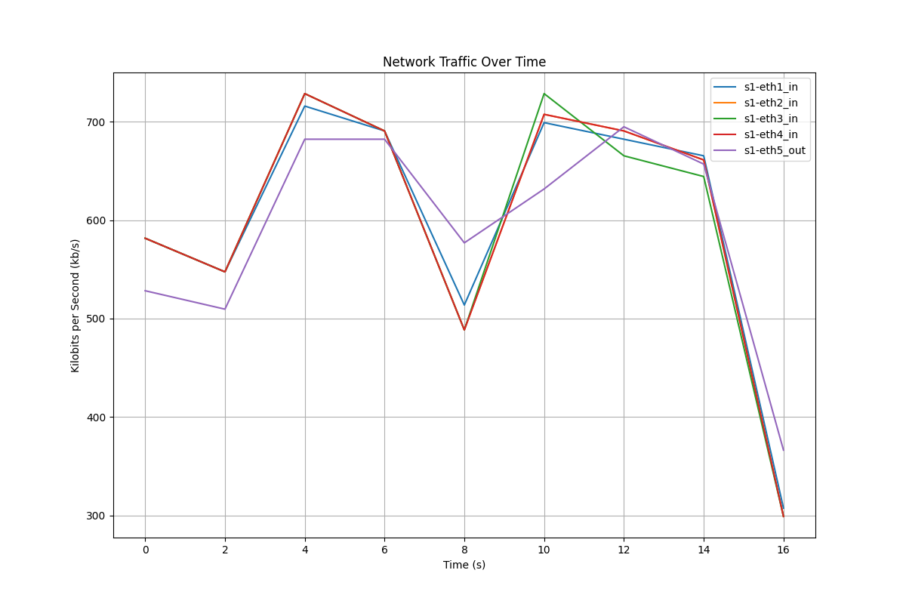
Scenario 1: Sufficient Bandwidth
All 1.0

Slide 16
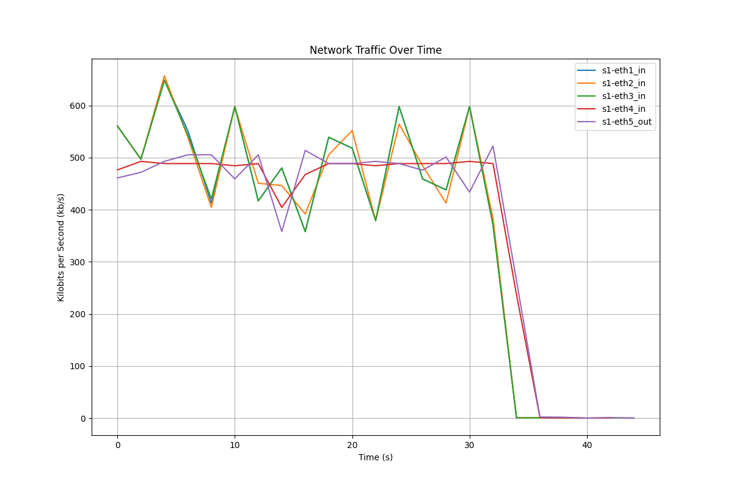
Scenario 2: Single Slower Sender
H1:0.2
H2:0.4
H3:0.6
H4:0.8

Slide 17
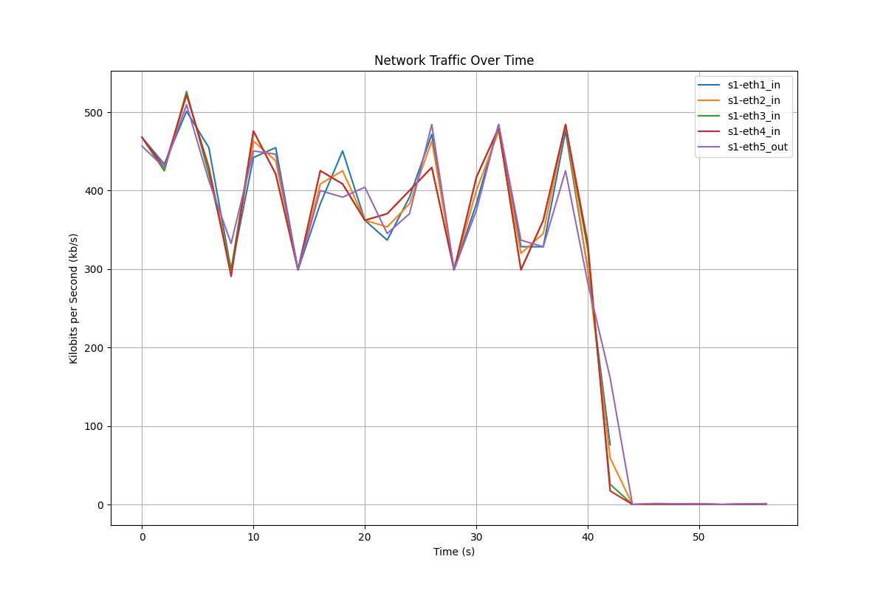
Scenario 3: Slower Receiver

Slide 18
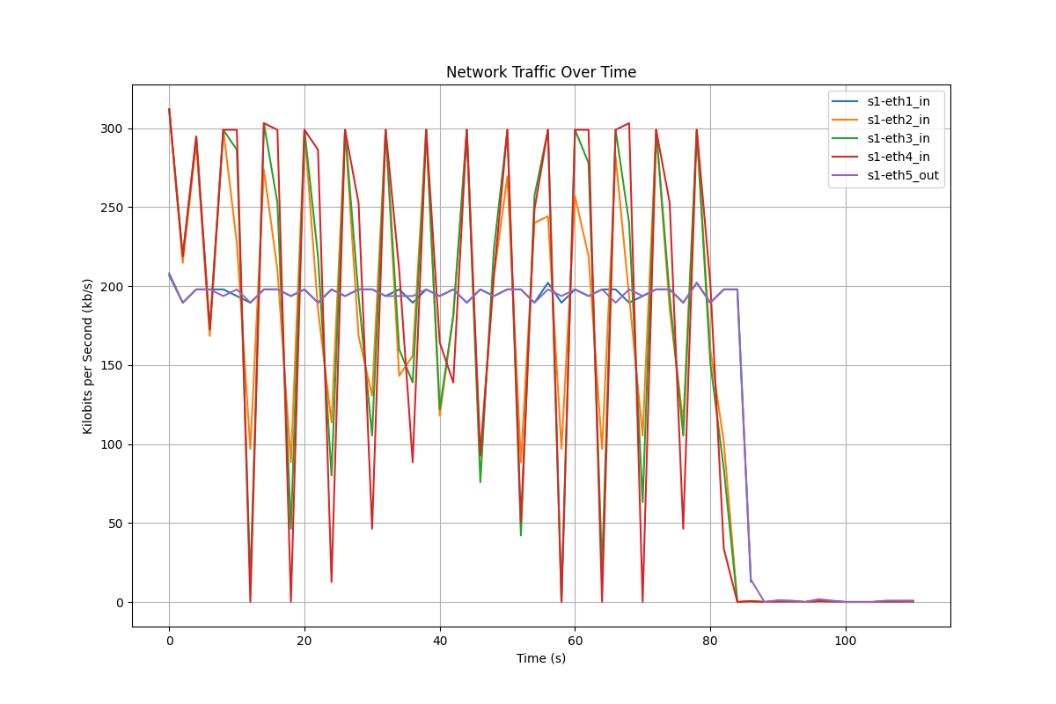
Scenario 4: All different bandwidth
H1:0.2
H2:0.4
H3:0.6
H4:0.8

Slide 19
Thank you for listening.
QA time

