Slide 2
Problem Statement
A consumer bank sales department is starting a campaign. They are trying to get people to subscribe to a term deposit.
They need recommendation on how to do so

Slide 3
Features

Slide 4
Model structure
Ensemble models
Final model = f(logistic, random forest, Adaboosting, SVM)
Advantage:
combine the sloping power of linear and non-linear classifier
better performance than single model
Disadvantage:
None

Slide 5
Model performance
Confusion Matrix | Predict = 0 | Predict = 1
Actual =0 | 7599 | 381
Actual =1 | 484 | 579
Classification report | Precision | Recall | F1-score
0 | 0.94 | 0.95 | 0.95
1 | 0.60 | 0.54 | 0.57
Test sample – random 20% of population.

Slide 6
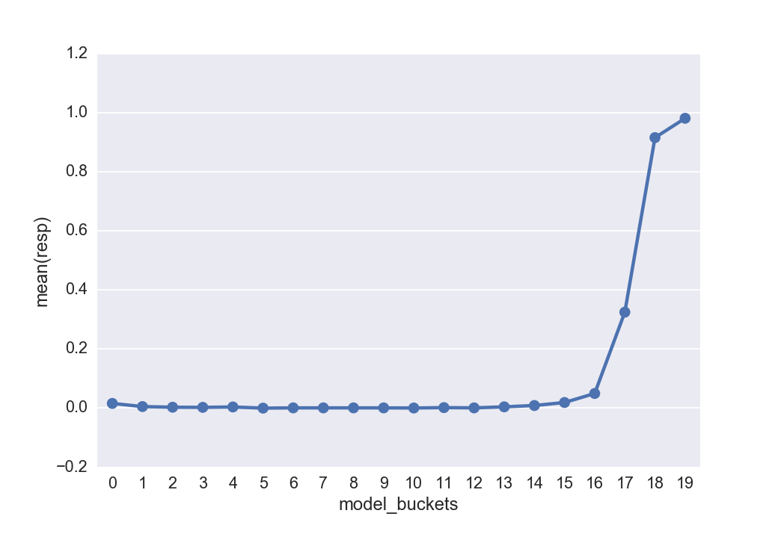
Top 20% model scored population has 95%+ responders

Slide 7
Our model brings superior value to our client
Scenario: Portugal has a population of 11MM, among of them, ~1MM potential prospects for our client. Our model solution can increase the efficacy of the marketing campaign and save cost.
Assumption: limited budget; phone call cost is €3 per call.
Up to 8x higher response rate
Potential marketing cost saving $
%
7.9x
up to €1.6 MM
4.6x
Recent campaign, total 0.5MM minutes phone call was made
(= duration * # of contacts recent campaign)

Slide 8
Strategy recommendation
This way, the bank will
Increase response by 900% (assuming bank is now doing 50% random selection and call)
Cut cost by > 90%
Revenue drop by < 10%
A saving cost of €13.5 MM (assume €3 per phone call)
We would recommend the bank to do:
Job:
Time / month of year: if Mar/Sep/Oct/Dec - ; if

