Slide 1
Programming Project Presentation
Olivia B, Benjamin L, Noah H1, Elspeth CJ

Slide 2
Overview
We were asked to create a program allowing a University Medical School to be able to download pharmaceutical trial data from a trusted scientific partner for medical research
The files are stored on an FTP server, and there should be both command-line options and an interactive front end
There should also be error checking and logging for common issues, for example missing columns, or empty files
We used Python in our solution, and also work on the assumption that the users are able to use the command line to download any missing Python modules

Slide 3
Accessing the FTP server

Slide 4
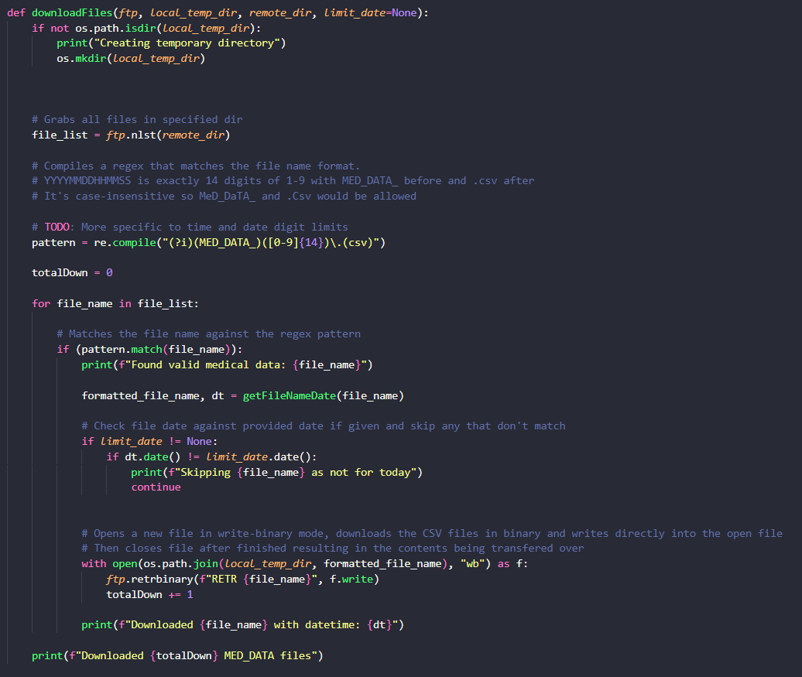
Here, the user creates or specify a local directory, into which files are downloaded.
All files are grabbed from the server, but only the ones matching the user’s inputted date are actually downloaded to their machine

Slide 5
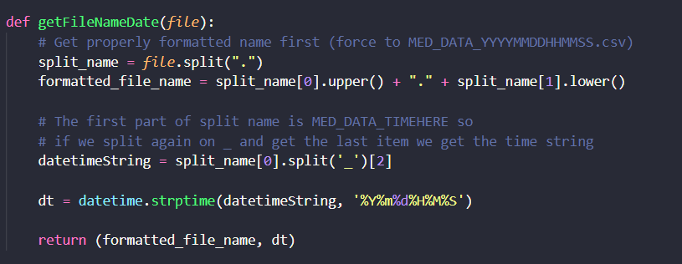
Here, the given file name is split up, so the program can get the date.
This function is used in downloadFiles() to check available files for the desired one

Slide 6
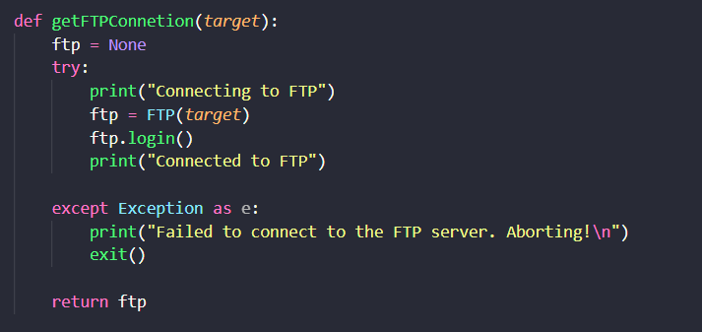
This function allows the user to connect to the target server, or throws an error if unable to

Slide 7
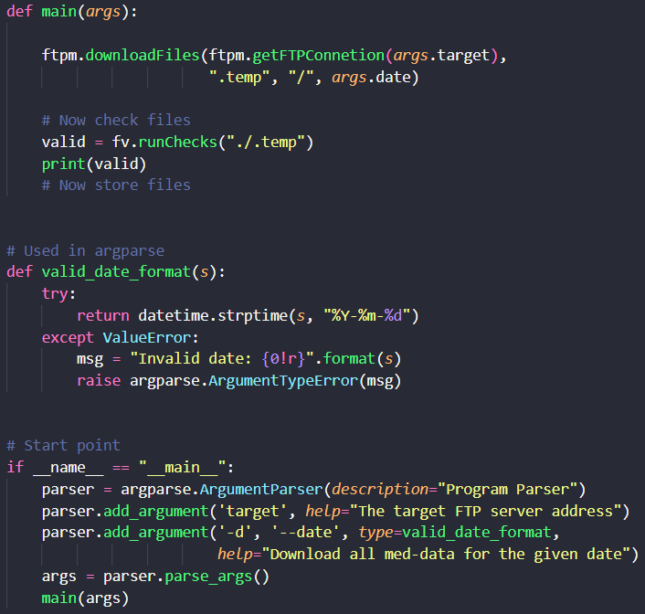
These functions make the program run. The user can use the command line to specify the server to be connected to, and the date of data to be fetched.
Also in this part is valid_date_format(), which ensures the users enters their date in the valid format

Slide 8
File Validation

Slide 9
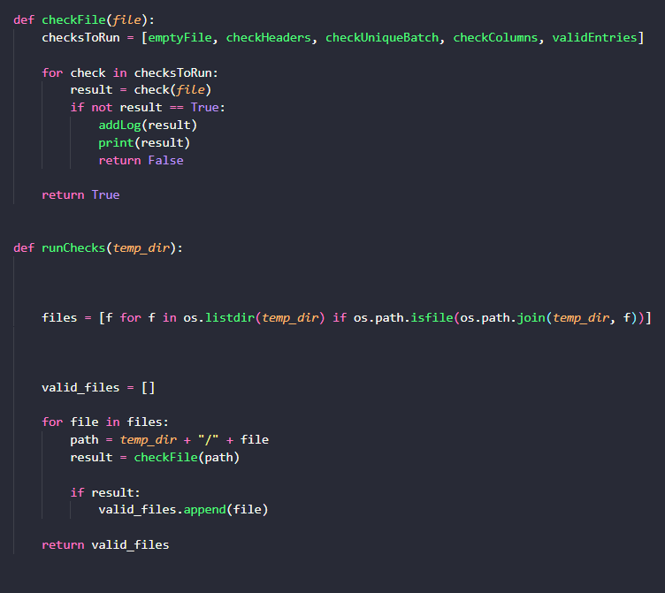
Once all the required files have been downloaded, the program ensures that they are all valid.
The checks made are:
Ensuring file isn’t empty
Ensure all columns headings follow standard naming conventions and order
Ensure each batch in the file has a unique ID
Ensuring there are no missing columns
Ensure data entered is valid (0 < data <= 9.999)
If an error is found, a log containing the filename, a timestamp, and a message about the type of error is added to the log file

Slide 10
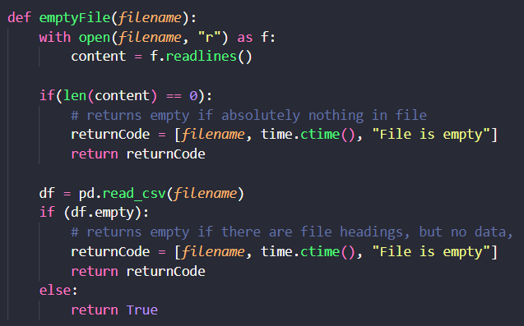
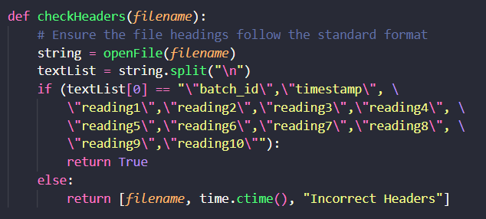

Slide 11
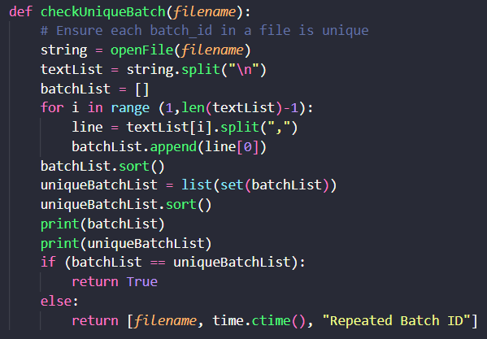
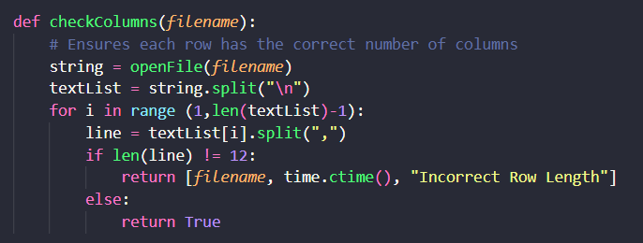

Slide 12
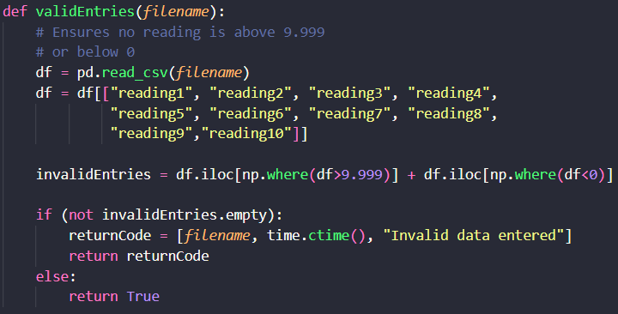
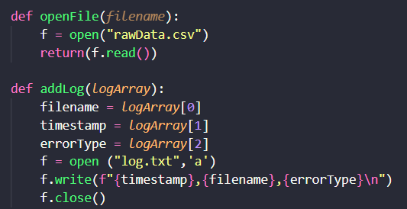

Slide 13
What we learned

Slide 14
Closing thoughts
(max 250 words on what we learned, to be added once project is complete)

