Slide 1
Programming Project Presentation
Olivia B, Benjamin L, Noah H1, Elspeth CJ

Slide 2
Overview
We were asked to create a program allowing a University Medical School to be able to download pharmaceutical trial data from a trusted scientific partner for medical research
The files are stored on an FTP server, and there should be both command-line options and an interactive front end
There should also be error checking and logging for common issues, for example missing columns, or empty files
We used Python in our solution, and also work on the assumption that the users are able to use the command line to download any missing Python modules

Slide 3
Accessing the FTP server
ftpmodule.py and run.py

Slide 4
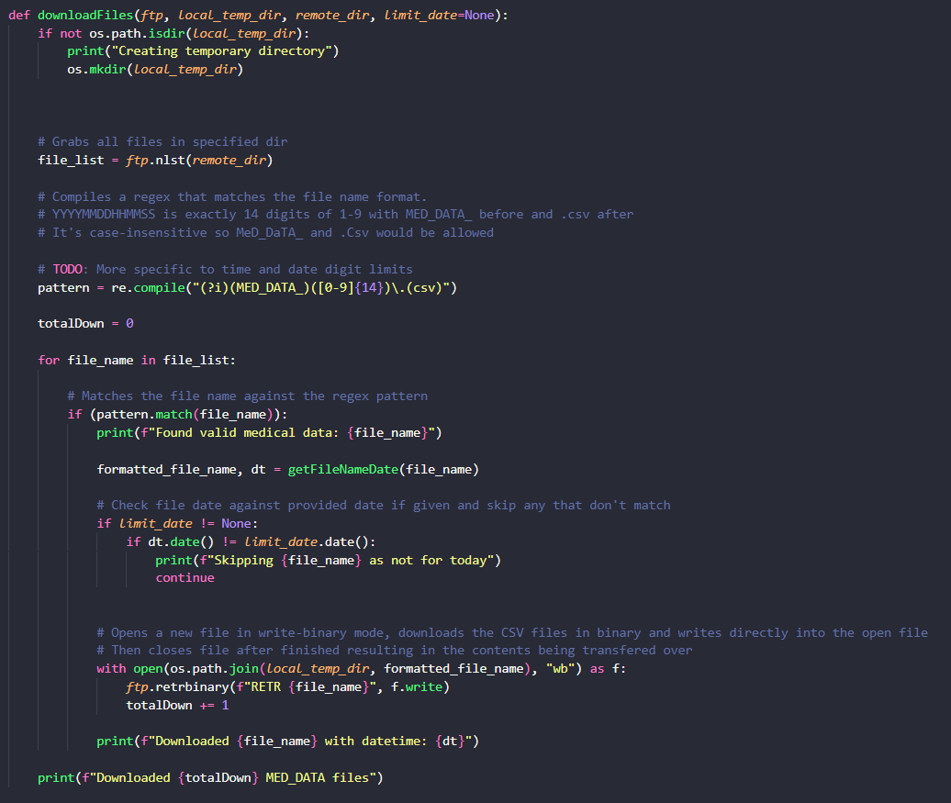
Here, the user creates or specify a local directory, into which files are downloaded.
All files are grabbed from the server, but only the ones matching the user’s inputted date are actually downloaded to their machine
Notes:
Ftpmodule.py

Slide 5
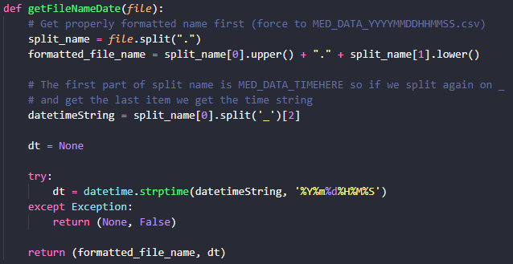
Here, the given file name is split up, so the program can get the date.
This function is used in downloadFiles() to check available files for the desired one
Notes:
Ftpmodule.py

Slide 6
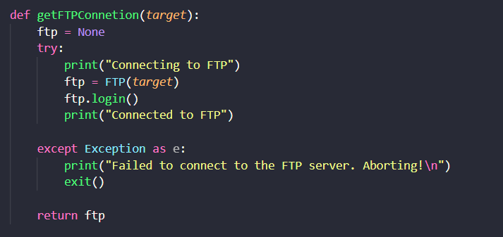
This function allows the user to connect to the target server, or throws an error if unable to
Notes:
Ftpmodule.py

Slide 7
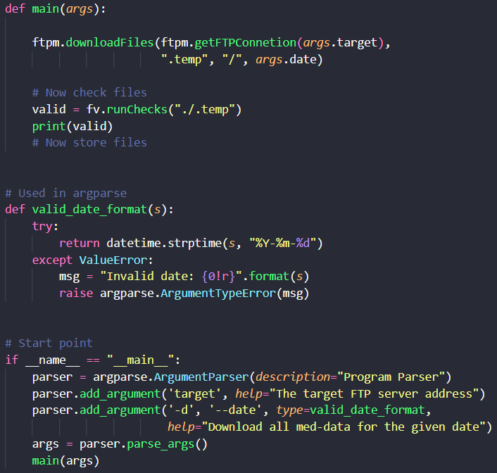
These functions make the program run. The user can use the command line to specify the server to be connected to, and the date of data to be fetched.
Also in this part is valid_date_format(), which ensures the users enters their date in the valid format
Notes:
Run.py

Slide 8
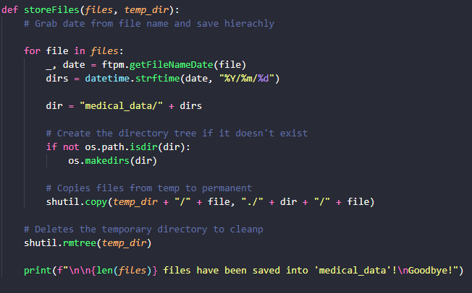
Here, we allow the user to save the files from the server
Notes:
Run.py

Slide 9
File Validation
fileValidation.py

Slide 10
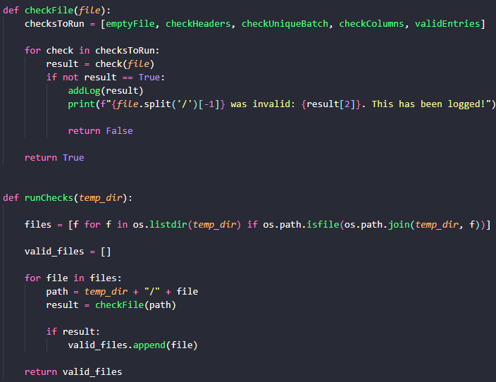
Once all the required files have been downloaded, the program ensures that they are all valid:
File isn’t empty
All columns headings follow standard naming conventions and order
Each batch in the file has a unique ID
No missing columns
Data entered is valid (0 < data <= 9.999)
If an error is found, a log containing is added to the log file

Slide 11
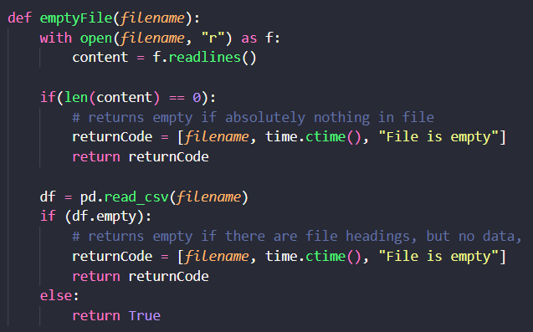
There are two interpretations of empty file – entirely blank, or with the correct headers but no readings taken. This checks for both

Slide 12
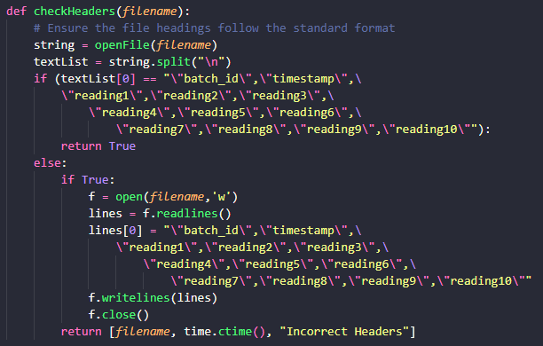
Once we ensure the file does have content, we make sure that the headings have the correct names in the correct orders

Slide 13
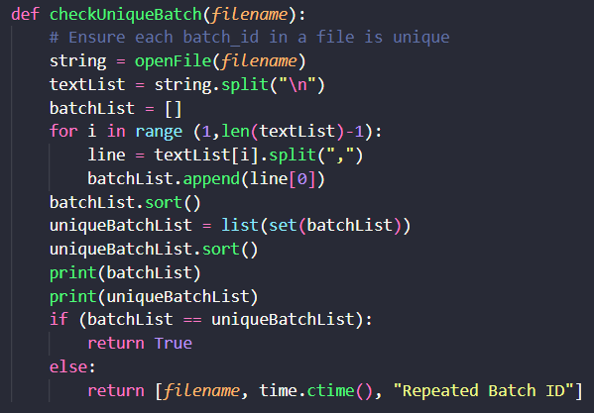
Each file consists of multiple batches. We make sure there are no duplicated batch numbers in the file

Slide 14
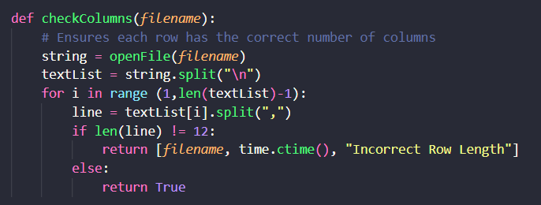
Here, we make sure the columns in each file are valid

Slide 15
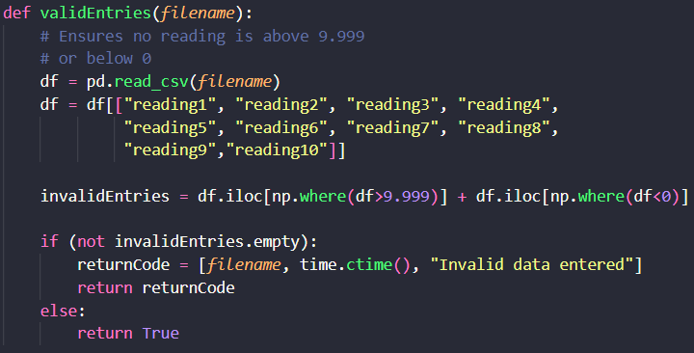
Finally, we ensure each item of data in the file is correct

Slide 16
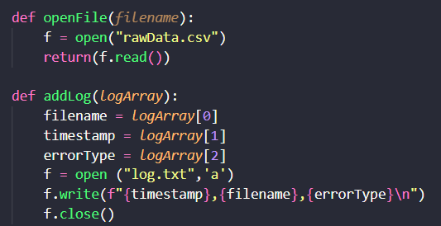
This opens the file, and also contains the code to create a log of any errors raised

Slide 17
What we have learnt

Slide 19
https://github.com/LittleDinoCake/CF-Project

