Slide 1
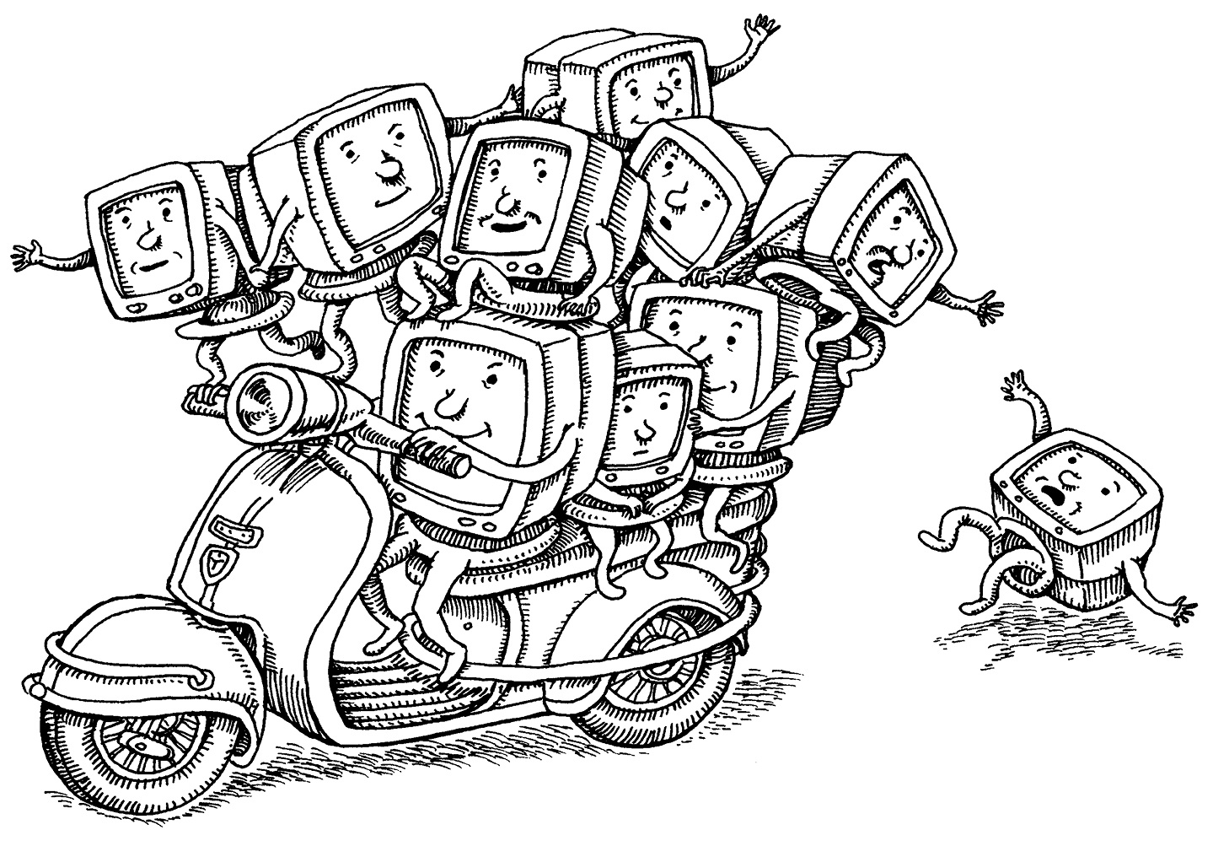
UNIT 6
Virtualisation of a Process Model and Virtual Machine concepts.
Notes:
This chapter focuses on the application of virtualisation to operating system design.
Virtualisation encompasses a variety of technologies for managing computing resources by providing a software translation layer, known as an abstraction layer, between the software and the physical hardware.
Virtualisation turns physical resources into logical, or virtual, resources.
Virtualisation enables users, applications, and management software operating above the abstraction layer to manage and
use resources without needing to be aware of the physical details of the underlying resources.

Slide 2
Unit 5 Learning Objectives
After studying this chapter, you should be able to:
Explain the concept of Virtualisation.
Discuss various virtualisation technologies.
Describe methods used to implement virtualisation.
Understand the issues involved in virtual machine implementation.
Explain the operation of the Linux virtual machine
Discuss Type 1 and Type 2 hypervisors.
Explain the concept of container virtualisation.

Slide 3
applications
applications
UNIX/Linux
OS
MS Windows
OS
Various application
programs
CPU
HDD
CPU
HDD
RAM
NIC
RAM
NIC
Operating System
e.g. Microsoft
Windows
hardware
hardware
Virtualisation layer (VMM)
(Type 1 Hypervisor)
Processor(s)
Disk(s)
Processor(s)
Disk(s)
RAM
memory
Network
NIC(s)
RAM
memory
Network
NIC(s)
Computer Hardware
Computer Hardware
a) Conventional Computer System
b) Virtualised Computer System
Notes:
Consider the figure a) which illustrates a common desktop computer configuration. The system includes a single OS (operating system) on a single hardware machine. Multiple application programs are run on the machine in the normal fashion.
Now consider the configuration as illustrated in figure b), where a special virtualisation layer, referred to as a hypervisor (VMM), is installed directly on the computer hardware and two virtual machines are created which are said to be guest virtual machines (VM) that are hosted by the real machine, via the hypervisor.
In the illustrated example one VM (virtual machine) is running the Linux OS while the other is running the Microsoft Windows OS.
Virtualisation is technology that allows you to create multiple simulated environments or dedicated resources from a single, physical hardware system. Software layer called a hypervisor connects directly to that hardware and allows you to split 1 system into separate, distinct, and secure environments known as virtual machines (VMs). These VMs rely on the hypervisor’s ability to separate the machine’s resources from the hardware and distribute them appropriately.
The original, physical machine equipped with the hypervisor is called the host, while the many VMs that use its resources are called guests. These guests treat computing resources — like CPU, memory, and storage — as a pool of resources that can easily be relocated. Operators can control virtual instances of CPU, memory, storage, and other resources, so guests receive the resources they need when they need them.

Slide 4
Overview
Basic idea – abstract hardware of a single machine (server) into several different execution environments
Layered approach is used as shown in the previous slide
A layer (software) creates a virtual machine (VM) where an OS and applications can run
Components
Host – underlying hardware machine
Virtual Machine Monitor (manager) or hypervisor – creates, runs and manages virtual machines by providing an interface that is identical to the host
Except in the paravirtualisation case (explained later)
Guest(s) – usually Operating System(s) running on a Virtual Machine a.k.a. guest OS(s)
Single physical machine (server) that can run multiple OS(s) concurrently, each in its own VM
Notes:
Virtualisation is technology that allows you to create multiple simulated environments or dedicated resources from a single, physical hardware system. Software layer called a hypervisor connects directly to that hardware and allows you to split 1 system into separate, distinct, and secure environments known as virtual machines (VMs). These VMs rely on the hypervisor’s ability to separate the machine’s resources from the hardware and distribute them appropriately.
The original, physical machine equipped with the hypervisor is called the host, while the many VMs that use its resources are called guests. These guests treat computing resources — like CPU, memory, and storage — as a pool of resources that can easily be relocated. Operators can control virtual instances of CPU, memory, storage, and other resources, so guests receive the resources they need when they need them.

Slide 5
Overview cont.
VM (1)
VM (2)
VM (3)
VM (n)
Service
Management
Console
applications
applications
applications
applications
OS
OS
OS
OS
Emulated
hardware
Emulated
hardware
Emulated
hardware
Emulated
hardware
Virtualisation Layer (VMM)
(Type 1 Hypervisor)
Computer Hardware
Processor(s)
RAM (memory)
Disk(s)
Network NIC(s)
Notes:
Figure V2 shows an expansion of the system where now four VMs are illustrated. The diagram also shows the Service/Management console to allow an administrator to configure and manage the system. Agents and helper applications are run to support management and servicing of the system. This hypervisor architecture is often referred to as a ‘bare metal hypervisor’, as there is no other operating system between the hypervisor and the underlying hardware.
Today it is common to use virtual infrastructures for large IT systems. Data centres use virtualisation to consolidate the number of physical servers, where individual servers can be deployed as virtual machines that run on shared hardware hosts, and these VM servers can be moved transparently across a shared hardware infrastructure. In such schemes the hardware server utilisation rates are reported to increase from some 10% to some 75%.

Slide 6
Types of Virtualisation (1)
Data Virtualisation - data virtualization tools sit in front of multiple data sources and allows them to be treated as single source, delivering the needed data - in the required form - at the right time to any application or user.
Desktop Virtualisation - allows a central administrator (or automated administration tool) to deploy simulated desktop environments to hundreds of physical machines at once.
Server Virtualisation – enables the consolidation of number of physical servers, where individual servers can be deployed as virtual machines that run on shared hardware hosts.
Notes:
Data that’s spread all over can be consolidated into a single source. Data virtualization allows companies to treat data as a dynamic supply — providing processing capabilities that can bring together data from multiple sources, easily accommodate new data sources, and transform data according to user needs.
Desktop Virtualisation: Easily confused with operating system virtualization — which allows you to deploy multiple operating systems on a single machine.
Unlike traditional desktop environments that are physically installed, configured, and updated on each machine, desktop virtualization allows admins to perform mass configurations, updates, and security checks on all virtual desktops.
Server: Virtualizing a server lets it to do more of those specific functions and involves partitioning it so that the components can be used to serve multiple functions.

Slide 7
Types of Virtualisation (2)
Operating System Virtualisation – happens in the OS kernel (central task manager)
Benefits:
Reduces bulk hardware costs, since the computers don’t require such high out-of-the-box capabilities
Increases security, since all virtual instances can be monitored and isolated
Limits time spent on IT services like software updates
Network Functions Virtualisation – separates a network’s key functions (like directory services, file sharing, and IP configuration) so they can be distributed among environments.
Notes:
Once software functions are independent of the physical machines they once lived on, specific functions can be packaged together into a new network and assigned to an environment.
Virtualizing networks reduces the number of physical components — like switches, routers, servers, cables, and hubs — that are needed to create multiple, independent networks, and it’s particularly popular in the telecommunications industry.

Slide 8
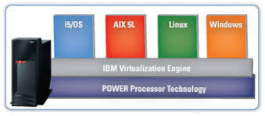
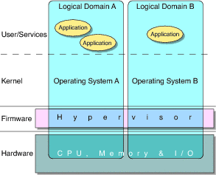
VMMs Implementations
Type 0 hypervisors - Hardware-based solutions that provide support for virtual machine creation and management via firmware
a) IBM LPARs for POWER CPUs
a) Oracle LDOMs for SPARC CPUs
Notes:
Type 0 hypervisors have existed for many years under many names, including “partitions” and “domains”. They are a hardware feature, and that brings its own positives and negatives. Operating systems need do nothing special to take advantage of their features. The VMM itself is encoded in the ﬁrmware and loaded at boot time. In turn, it loads the guest images to run in each
partition. The feature set of a type 0 hypervisor tends to be smaller than those of the other types because it is implemented in hardware. For example, a system might be split into four virtual systems, each with dedicated CPUs, memory, and I/O devices. Each guest believes that it has dedicated hardware because it does, simplifying many implementation details.
Because type 0 virtualization is very close to raw hardware execution, it should be considered separately from the other methods discussed here.
A type 0 hypervisor can run multiple guest operating systems (one in each hardware partition). All of those guests, because they are running on raw hardware, can in turn be VMMs. Essentially, the guest operating systems in a type 0 hypervisor are native operating systems with a subset of hardware made available to them. Because of that, each can have its own guest operating system.
Type 0: A logical partition (LPAR) is the division of a computer's processor s, memory , and storage into multiple sets of resources so that each set of resources can be operated independently with its own operating system instance and application s. The number of logical partitions that can be created depends on the system's processor model and resources available.
The term "LDoms" (logical domains) as a common abbreviation for Oracle VM Server for SPARC V9 CPUs.

Slide 9
Type 0 Hypervisor
Old idea that was presented under many names by HW manufacturers
“partitions”, “domains”
A HW feature implemented by firmware
OS need to nothing special, VMM is in firmware
Smaller feature set than other types
Each guest has dedicated HW
I/O a challenge as difficult to have enough devices, controllers to dedicate to each guest
Sometimes VMM implements a control partition running daemons that other guests communicate with for shared I/O
Can provide virtualization-within-virtualization (guest itself can be a VMM with guests
Other types of hypervisors have difficulty doing this
Notes:
Type 0 hypervisors have existed for many years under many names, including “partitions” and “domains”. They are a hardware feature, and that brings its own positives and negatives. Operating systems need do nothing special to take advantage of their features. The VMM itself is encoded in the ﬁrmware and loaded at boot time. In turn, it loads the guest images to run in each
partition. The feature set of a type 0 hypervisor tends to be smaller than those of the other types because it is implemented in hardware. For example, a system might be split into four virtual systems, each with dedicated CPUs, memory, and I/O devices. Each guest believes that it has dedicated hardware because it does, simplifying many implementation details.
Because type 0 virtualization is very close to raw hardware execution, it should be considered separately from the other methods discussed here.
A type 0 hypervisor can run multiple guest operating systems (one in each hardware partition). All of those guests, because they are running on raw hardware, can in turn be VMMs. Essentially, the guest operating systems in a type 0 hypervisor are native operating systems with a subset of hardware made available to them. Because of that, each can have its own guest operating system.
Type 0: A logical partition (LPAR) is the division of a computer's processor s, memory , and storage into multiple sets of resources so that each set of resources can be operated independently with its own operating system instance and application s. The number of logical partitions that can be created depends on the system's processor model and resources available.
The term "LDoms" (logical domains) as a common abbreviation for Oracle VM Server for SPARC V9 CPUs.

Slide 10
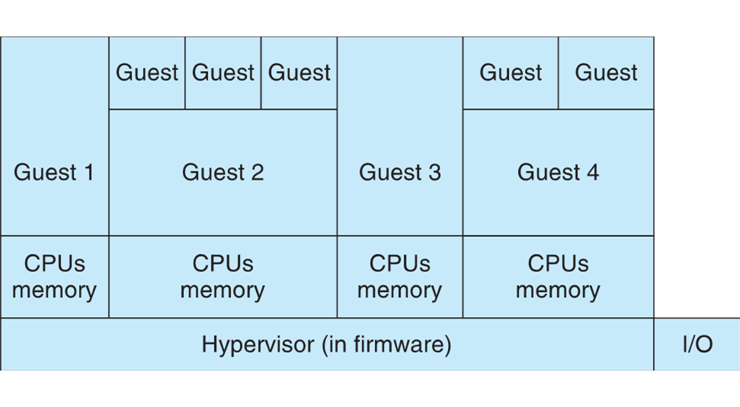
Example: Type 0 Hypervisor

Slide 11
VMMs Implementations (1)
Type 1 hypervisors - Operating-system-like software built to provide virtualization.
Considered to be special-purpose operating systems that run natively on the hardware, but rather than providing system calls and other interfaces for running programs, they create, run, and manage guest operating systems.
Type 1 hypervisors run in kernel mode, taking advantage of hardware protection.
They provide:
CPU scheduling
Memory management
I/O management
Security & protection
Examples: Vmware ESXi, Joyent SmartOS and Citrix XenServer
Notes:
Type 1 hypervisors are commonly found in company data centers and are in a sense becoming “the data-center operating system.
In addition to running on standard hardware, they can run on type 0 hypervisors, but not on other type 1 hypervisors. Whatever the platform, guests generally do not know they are running on anything but the native hardware.
They implement device drivers for the hardware they run on, because no other component could do so. Because they are operating systems, they must also provide CPU scheduling, memory management, I/O management, protection, and even security.
Frequently, they provide APIs, but those APIs support applications in guests or external applications that supply features like backups, monitoring, and security. Many type 1 hypervisors are closed-source commercial offerings, such as VMware ESX while some are open source or hybrids of open and closed source, such as Citrix XenServer and its open Xen counterpart.
By using type 1 hypervisors, data-center managers can control and manage the operating systems and applications in new and sophisticated ways. An important beneﬁt is the ability to consolidate more operating systems and applications onto fewer systems.

Slide 12
Example: Type 1 Hypervisor
VM 1
VM 2
applications
applications
UNIX/Linux
OS
MS Windows
OS
CPU
HDD
CPU
HDD
RAM
NIC
RAM
NIC
hardware
hardware
Virtualisation layer (VMM)
(Type 1 Hypervisor)
Processor(s)
Disk(s)
RAM
memory
Network
NIC(s)
Computer Hardware
Notes:
Type 1 hypervisors run in kernel mode, taking advantage of hardware protection. Where the host CPU allows, they use multiple modes to give guest operating systems their own control and improved performance. They implement device drivers for the hardware they run on, because no other component could do so.
An important beneﬁt is the ability to consolidate more operating systems and applications onto fewer systems. For example, rather than having ten systems running at 10 percent utilization each, a data center might have one server to manage the entire load. If utilization increases, guests and their applications can be moved to less-loaded systems live, without interruption of service.

Slide 13
VMMs Implementations (2)
Type 2 hypervisors – applications that run on standard Operating System but provide VMM features to the guest operating systems
It relies on the Host OS to handle all of the hardware transactions on the hypervisor’s behalf
Key differences between type 1 and type 2 hypervisors:
Performance – Type 1 performs better than type 2 because type 1 doesn’t compete for resources with an OS.
Security – Type 1 is considered to be more secure because VMs on type 1 hypervisor make resource requests that are handled externally and can’t affect other VMs. Not the same case for VMs on type 2 hypervisor. A malicious guest OS could potentially affect more than itself.
Ease of use – Type 2 hypervisor has the advantage here.
Examples: VMware Workstation and Fusion, Parallels Desktop and VirtualBox
Notes:
A type 2 hypervisor exploits the resources and functions of a host OS and runs as a software module on top of the OS. It relies on the OS to handle all of the hardware interactions on the hypervisor’s behalf. Some examples of type 2 hypervisors are VMware Workstation and Oracle VM Virtual Box.
Key differences between the two hypervisor types are as follows:
• Typically, type 1 hypervisors perform better than type 2 hypervisors. Because a type 1 hypervisor doesn’t compete for resources with an OS, there are more resources available on the host, and by extension, more virtual machines can
be hosted on a virtualization server using a type 1 hypervisor.
• Type 1 hypervisors are also considered to be more secure than the type 2 hypervisors. Virtual machines on a type 1 hypervisor make resource requests that are handled external to that guest, and they cannot affect other VMs or the hypervisor they are supported by. This is not necessarily true for VMs on a type 2 hypervisor, and a malicious guest could potentially affect more than itself.
• Type 2 hypervisors allow a user to take advantage of virtualization without needing to dedicate a server to only that function. Developers who need to run multiple environments as part of their process, in addition to taking advantage of the personal productive workspace that a PC OS provides, can do both with a type 2 hypervisor installed as an application on their LINUX or Windows desktop.

Slide 14
Example: Type 2 Hypervisor
Windows
Various
Applications
VM
Applications
Guest OS
e.g. Linux
Emulated HW
Virtualisation
Layer
Type-2 hypervisor
Host OS (Windows)
Processor(s)
Disk(s)
RAM
memory
Network
NIC(s)
Computer Hardware

Slide 15
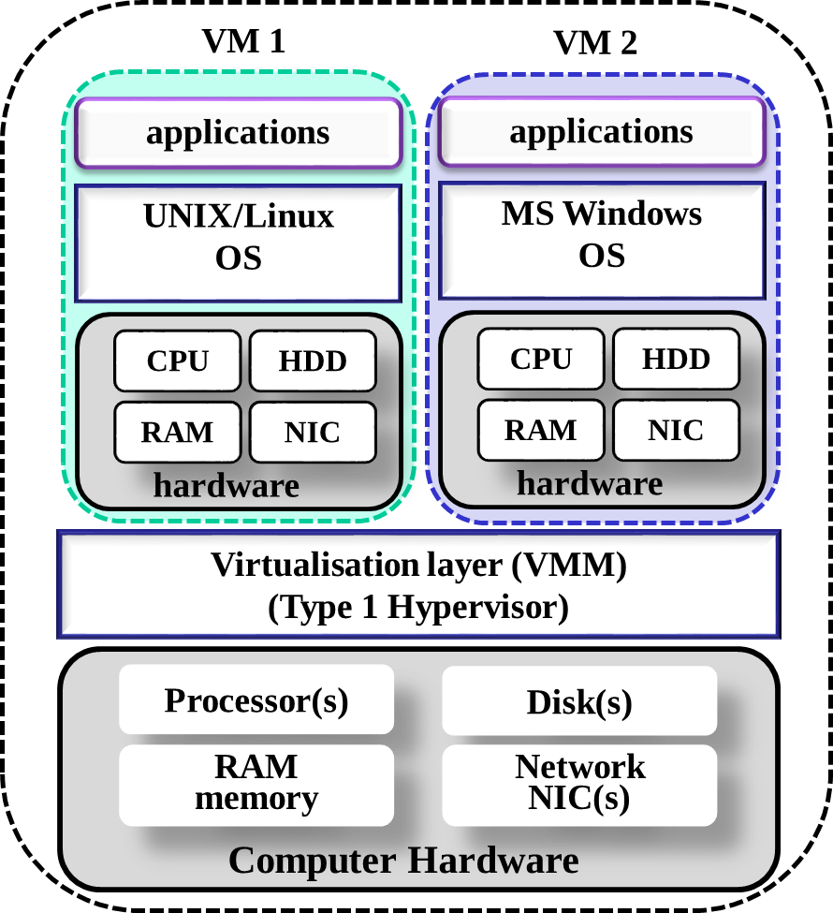
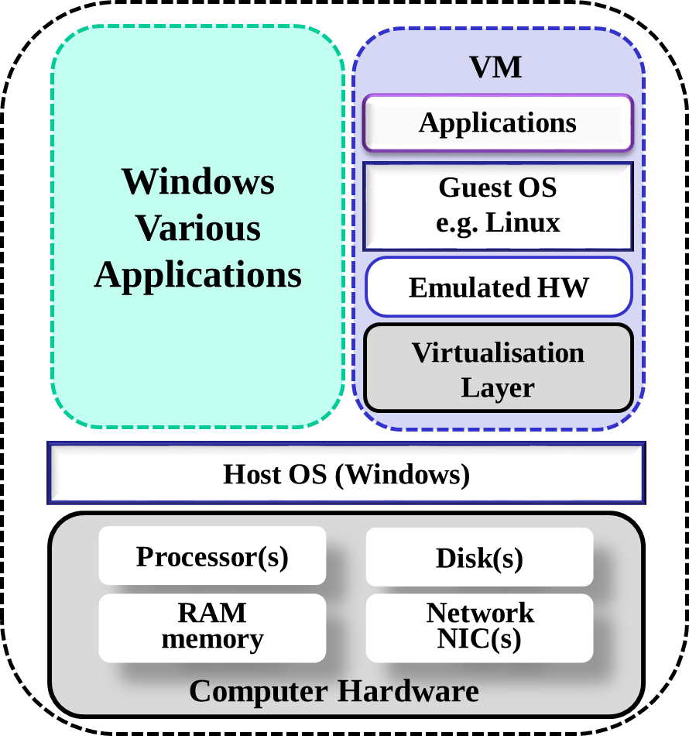
Type 1 & Type 2 hypervisors
Type-2
hypervisor
Notes:
Many reference materials draw a somewhat dubious distinction between “type 1” and “type 2” hypervisors. A type 1 hypervisor runs directly on the
hardware without a supporting OS, and for that reason is sometimes called a bare-metal or native hypervisor.
Type 2 hypervisors are user-space applications that run on top of another general-purpose OS. Exhibit above depicts these two models.

Slide 16
VMMs Implementations (3)
Paravirtualization - Technique in which the guest operating system is modified to work in cooperation with the VMM to optimize performance.
Programming-environment virtualization - VMMs do not virtualize real hardware but instead create an optimized virtual system.
It is used by Oracle Java (JVM) and Microsoft.Net
Emulators - Allow applications written for one hardware environment to run on a very different hardware environment, such as a different type of CPU architecture.
Application containment - Not virtualization at all but rather provides virtualization-like features by segregating applications from the operating system, making them more secure and manageable.
Including Oracle Solaris Zones, BSD Jails, and IBM AIX WPARs
Notes:
As virtualisation became more prevalent in corporations, both hardware and software vendors looked for ways to provide even more efficiencies. Unsurprisingly, these paths led to both software-assisted virtualisation and hardware-assisted virtualisation.
Paravirtualization is a software-assisted virtualisation technique that uses specialized APIs to link virtual machines with the hypervisor to optimize their performance. The OS in the virtual machine, Linux or Microsoft Windows, has specialized paravirtualization support as part of the kernel, as well as specific paravirtualization drivers that allow the OS and hypervisor to work together more efficiently with the overhead of the hypervisor translations.
This software-assisted offers optimized virtualisation support on servers with or without processors that provide virtualisation extensions.
Paravirtualiation support has been offered as part of many of the general Linux distributions since 2008.
For Linux distributions, this scheme requires extensive changes to the operating system kernel so that it can coexist with the hypervisor.
Programming-environment: Here, a programming language is designed to run within a custom-built virtualized environment. For example,
Oracle’s Java has many features that depend on its running in the Java virtual machine (JVM), including speciﬁc methods for security and memory
management. Java programs run within the JVM environment, and the JVM is compiled to be a native program on systems on which it runs.
This arrangement means that Java programs are written once and then can run on any system (including all of the major operating systems) on which a JVM is available.
Emulators: useful when the host system has one system architecture and the guest system was compiled for a different architecture. For example, suppose a company has replaced its outdated computer system with a new system but would like to continue to run certain important programs that were compiled for the old system. The programs could be run in an emulator that translates each of the outdated system’s instructions into the native instruction set of the new system.
Application containment: The goal of virtualization in some instances is to provide a method to segregate applications, manage their performance and resource use, and create an easy way to start, stop, move, and manage them. In such cases, perhaps full-ﬂedged virtualization is not needed.
If the applications are all compiled for the same operating system, then we do not need complete virtualization to provide these features. We can instead use application containment.

Slide 17
VM 1
VM 2
VM 3
applications
applications
applications
Paravirtualized Type 1 Hypervisor
with Paravirtualized Guest OSs
Paravirtualized
Guest OS
Paravirtualized
Guest OS
Paravirtualized
Guest OS
Modified
Drivers
Modified
Drivers
Modified
Drivers
Type 1 Hypervisor
Hypervisor Driver Interface
Real Drivers
Computer Hardware
Notes:
We have seen that paravirtualization takes a different approach by modifying the source code of the guest operating system instead. Rather than performing sensitive instructions, the paravirtualized guest executes hypercalls.
In effect the guest operating system is acting like a user program making system calls to the operating system (the hypervisor).
When this route is taken, the hypervisor must define an interface consisting of a set of procedure calls that guest operating systems can use. This set of calls forms what is effectively an API (Application Programming Interface) even though it is an interface for use by guest operating systems, not application programs.

Slide 18
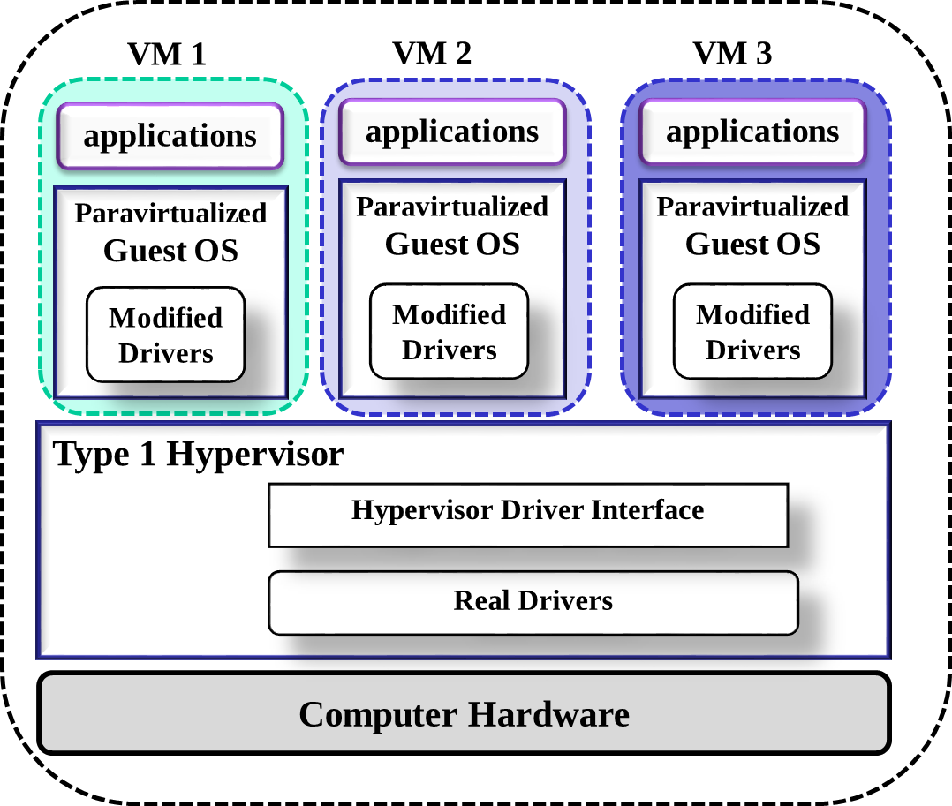
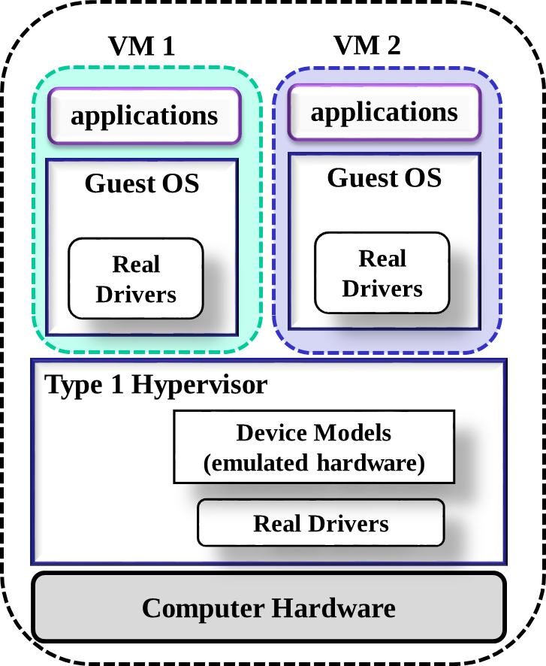
a) Type 1 Hypervisor
b) Paravirtualized Type 1 Hypervisor with PV Guest OSs

Slide 19
Hardware-assisted virtualisation
All types of virtualisation needs some HW support
More support leads to feature rich, stable and improved performance of the Guest OS
Intel added VT-x instructions in 2005 and in AMD followed with adding the
AMD-v instructions to their processors in 2006
CPUs with these instructions remove the need for binary translation
Two new modes of operation are defined – “guest” & “host” for AMD-v, and “root” & “nonroot” for VT-x
VMM can enable host mode, define characteristics of each guest VM, switch to guest mode and guest(s) on CPU(s)
In guest mode, guest OS thinks it is running natively, sees devices (as defined by VMM for that guest)
Notes:
Without some level of hardware support, virtualisation would be impossible.
The more hardware support available within a system, the more feature-rich and stable the virtual machines can be and the better they can perform.
In 2004 and 2005, Intel and AMD introduced CPU features (Intel VT and AMD-V) that facilitate virtualization on the x86 and AMD platforms. These extensions gave rise to “hardware-assisted virtualisation,” also known as “accelerated virtualisation.”
These enchantments deﬁne two new modes of operation—host and guest—thus moving from a dual-mode to a multimode processor. The VMM can enable host mode, deﬁne the characteristics of each guest virtual machine, and then switch the system to guest mode, passing control of the system to a guest operating system that is running in the virtual machine.
In guest mode, the virtualised operating system thinks it is running on native hardware and sees whatever devices are included in the host’s deﬁnition of the guest.
If the guest tries to access a virtualized resource, then control is passed to the VMM to manage that interaction.
Intel processors offer an extra instruction set called Virtual Machine Extensions (VMX). By having some of these instructions as part of the processor, the hypervisors no longer need to maintain these functions as part of their codebase, the code itself can be smaller and more efficient, and the operations they support are much faster as they occur entirely on the processor. This hardware-assisted support does not require a modified guest OS in contrast with paravirtualization.

Slide 20
Hybrid VMM Implementations
A general purpose OS e.g. Linux/Windows that provides VMM type 1 functionality
RedHat Enterprise Linux with KVM (Kernel-based Virtual Machine)
Microsoft Windows with Hyper-v
Both perform normal duties as well as VMM duties
Typically less features rich than a dedicated Type 1 hypervisor
The Guest OSs are treated as just another process
Special handling is in place when guest is trying to execute special instructions

Slide 21
KVM
Full virtualisation solution for Linux on x86/AMD hardware platforms containing virtualisation extensions VT-x or AMD-v
It consists of loadable kernel module, kvm.ko, that provides the core virtualisation infrastructure and a processor specific module, kvm-intel.ko or kvm-amd.ko
KVM uses a combination of security-enhanced Linux (SELinux) and secure virtualisation (sVirt) for improved VM security and isolation.
Using KVM, one can run multiple virtual machines running unmodified Linux or Windows images.
Each virtual machine has private virtualized hardware:
a network card, disk, graphics adapter, etc.
Notes:
The KVM (Kernel–based Virtual Machine) is neither a clear Type 1 nor a Type 2 hypervisor. It is a hypervisor that is implemented by adding modules to a Linux or FreeBSD kernel so that the host operating system acts as a Type 1 hypervisor.

Slide 22
KVM Architecture
Userspace
Process
Userspace
Process
Userspace
Process
Userspace
Process
. . .
Guest Userspace
Processes
Guest Kernel
(e.g. Linux Kernel)
QEMU-KVM
Linux Kernel
KVM (Module)
Hardware Support, virtualisation technologies/extentions for x86 and AMD
(Intel-vt / AMD-v)
Notes:
QEMU is a machine emulator — it can run unmodified OS images for a variety of architectures that it supports, and emulate those architecture's instructions for the host architecture it runs on. This is of course very slow, but the advantage of the QEMU project was that it had quite a few devices already emulated for the x86 architecture — such as the chipset, network cards, display adapters, and so on.
Today, there are several projects that use KVM as the default hypervisor: OpenStack and oVirt are the more popular ones. These projects concern themselves with large-scale deployments of KVM hosts and several VMs in one deployment.

Slide 23
Hyper-V
First released in 2008 as a part of Windows Server 2008 Operating System
Hyper-V has a parent partition that serves as an administrative adjunct to the Type 1 hypervisor
Guest virtual machines are designated as child partitions.
The parent partition in Hyper-V uses a Virtualization Service Provider (VSP) to provide device services to the child partitions
The child partitions communicate with the VSPs using a Virtualization Service Client (or Consumer) (VSC) for their I/O needs.
Notes:
Microsoft Hyper-V has similar availability challenges to Xen due to the operating system needs in the parent partition, the resource contention an extra copy of Windows requires on the server, and the single I/O conduit.
From a feature standpoint, Hyper-V is very robust, though not as widely used as ESXi since it is still
relatively new to the marketplace.

Slide 24
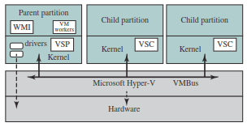
Hyper-V Architecture

Slide 25
Virtual Appliances & Containers
Virtual Appliance - standalone software that can be distributed as a virtual machine image. Thus, it consists of a packaged set of applications and guest OS. It is independent of hypervisor or processor architecture, and can run on either a type 1 or type 2 hypervisor.
It can also be described as “shrink-wrapped” virtual machine
Container Virtualisation - In this approach, software, known as a virtualization container, runs on top of the host OS kernel and provides an isolated execution environment for applications.
Containers do not aim to emulate physical servers. Instead, all containerized applications on a host share a common OS kernel.
Notes:
Deploying a pre-installed and pre-configured application appliance is far easier than preparing a system, installing the app, and configuring and setting it up. Virtual appliances are becoming a de-facto means of software distribution and have spawned a new type of business—the virtual appliance vendor.
A virtual appliance is created by installing a software appliance on a virtual machine and then packaging that into a VM image. In general, a software appliance is designed to eliminate any special installation and configuration effort, and the virtual appliance in the same way should not require any special configuration on installation.
A virtual appliance runs on a VM but it is not a complete virtual machine platform; it is an image that is built to run on a virtual machine platform.

Slide 26
container
container
App
App
App
App
App
App
App
App
libraries
libraries
Container Engine
Host OS
Computer Hardware
a) Type 1 Hypervisor
b) Type 2 Hypervisor
c) Container
Notes:
Figure above compares container and hypervisor software stacks. For containers, only a small container engine is required as support for the containers. The container engine sets up each container as an isolated instance by requesting dedicated
resources from the OS for each container. Each container app then directly uses the resources of the host OS. Although the details differ from one container product to another, the following are typical tasks performed by a container engine:
• Maintain a lightweight runtime environment and toolchain that manages containers, images and builds.
• Create a process for the container.
• Manage file system mount points.
• Request resources from kernel, such as memory, I/O devices, and IP addresses.

Slide 27
Storage in Virtual Computer Systems
This section will introduce some concepts and technologies that are used in data centres, where virtualisation architectures are heavily used.

Slide 28
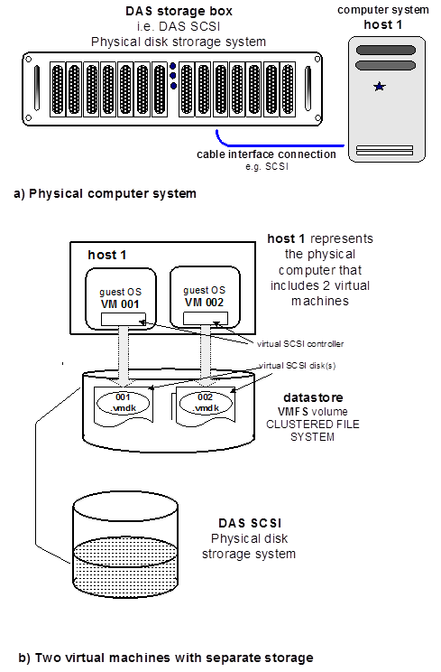
Notes:
Consider a computer server that is connected to a disk array using a SCSI (Small Computer Storage Interface) as shown in figure a).
We say this is a system that uses a DAS (Direct-Attached Storage) SCSI storage subsystem.
Now let’s say we want to make two virtual computers, so two virtual machines (VMs) will be created and each virtual machine will be allocated its own storage; based on the hardware in figure a). The single physical computer here is referred to as a single host. The configured scenario is shown in figure b).
Storage architecture consists of layers of abstraction to manage the complexity of physical storage subsystems. Each virtual machine will accommodate a guest operating system; and for this guest OS and its applications the storage subsystem is treated as a virtual SCSI controller connected to one or more virtual SCSI disks.
Such a virtual SCSI disk is provisioned from a data store which is a storage appliance that supports storage space for VMs across multiple physical hosts.
Each VM is stored as a defined set of files in a directory in the datastore. In the figure it is seen that the host 1 server has two VMs, VM001 and VM002, and each VM has its own virtual storage, represented by the 001.vmdk and 002.vmdk files respectively.
VMware VMFS (Virtual Machine File System) is VMware's clustered file system, as used by VMware’s server virtualisation suite, vSphere.
VMFS organises the shared storage system to support multiple physical hosts with the capability to read and write to the storage resources.
VMFS provides the necessary on-disk locking and synchronisation services and also features failure consistency and recovery mechanisms.
In VMware the NFS file system can be used in situations where a NAS configuration is required, as will be illustrated later on.

Slide 29
Direct-attached Storage
Direct-attached storage can be deployed in a number of forms:
Directly into the server
As an external storage enclosure attached directly into a SCSI/SAS card on the server's internal bus.
Either way, DAS has the following pros and cons:
DAS is less expensive than NAS and SAN
DAS is not shareable – dedicated to the server that is connected to
DAS is not scalable – scalability is restricted in several areas
DAS doesn’t perform as good as NAS & SAN solutions
DAS lacks advanced features like remote replication and snapshots
Notes:
Pros: If plugged directly into the server, the cost may be as simple as purchasing hard drives, which today have a capacity of up to 2 TB.
Cons: Because of this, the resources can't easily be shared with another server, especially if hard drives plug directly into the server chassis. Limited sharing may represent a serious drawback in larger virtual server deployments where physical servers are "clustered" to the storage in order to provide local resiliency through features such as VMware's VMotion, which doesn't work unless storage is sharable.
Not scalable: First, the enclosure itself will usually be limited in size and therefore in storage capacity. Second, connectivity into the server will be limited by the number of expansion slots available to accommodate SCSI and SAS cards.
Performance: Performance is a significant factor in delivering a high throughput virtual server environment.
Features: Keep in mind, however, that while these features are good to have, they may not be necessary in your virtual environment.
So when is direct-attached storage a better solution than a storage area network or network-attached storage? Clearly if cost is an issue, DAS offers the best price point. You should also consider DAS if advanced features such as remote replication or high performance/scalability aren't required in your virtual environment.

Slide 30
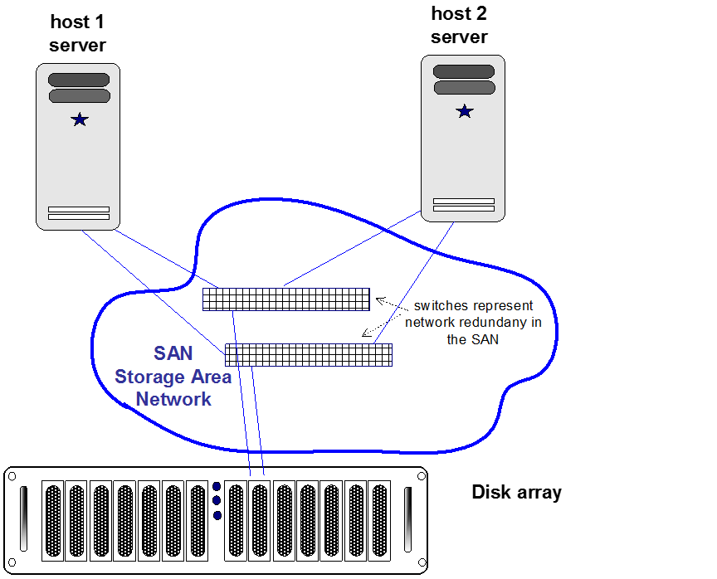
Storage Area Network (SAN)
Notes:
Consider the system shown above. This is an illustration of a physical system which has two physical servers and uses a SAN (Storage Area Network) storage subsystem. SAN is a dedicated high-speed network or subnetwork that interconnects and presents shared pools of storage devices to multiple servers.

Slide 31
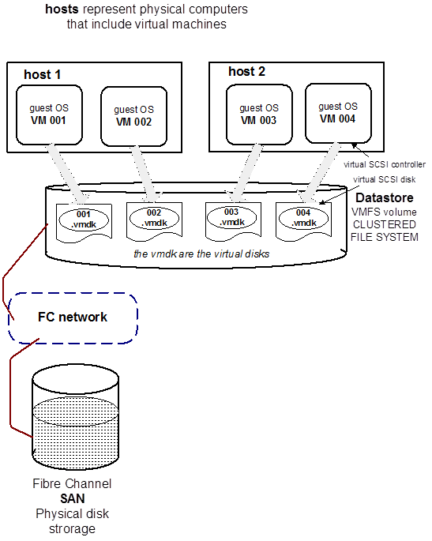
Storage Area Networks in a
Virtual Environment
Notes:
Let’s say on the above system we can run two VMs on each physical server. The physical servers are referred to as host 1 and host 2 in the configuration. Like before, the datastore is created as a VMFS volume and each VM is stored as a defined set of files in a directory in the datastore as seen in the diagram.

Slide 32
SAN cont.
SAN storage has the following pros and cons:
SAN storage is sharable. Resources may be easily shared between multiple virtual server hardware devices. This is important in clustered virtual server environments.
SAN storage is highly scalable, both from a capacity and performance perspective. For large deployments of virtual servers, scalability is extremely important and the whole premise of SAN is to provide high levels of scale.
SAN storage provides synchronous replication. Synchronous replication isn't typically available on NAS implementations, and for many environments, this may be a key requirement for a disaster recovery strategy.
SAN environments are highly resilient. SAN environments are well equipped with dual fabrics, Host Bus Adapters (HBAs) and highly available storage arrays.

Slide 33
Network-attached Storage (NAS)
Networked-attached storage provides connectivity to the virtual server through a TCP/IP connection and storage access is provided at the file level. NAS pros and cons include:
NAS is shareable. Resources may be shared by multiple ESX deployments. This is a key benefit when using clustered virtual environments and features such as VMotion.
NAS is scalable in terms of capacity and performance. For larger virtual deployments, performance becomes a big issue.
NAS provides advanced features such as thin provisioning, replication and snapshots. For many virtual environments, these features are particularly beneficial.
NAS abstracts storage management from the server. This means the virtual machine images can be managed (and subsequently backed up) as a file system.
NAS can be costly. Despite that the range of NAS devices grows continuously.
Notes:
Features: Thin provisioning can be used to limit the amount of real storage provided to virtual hosts, which will not use all of the storage they are presented with.
Snapshots allow virtual machine images to be captured for data backup or used for cloning, where multiple virtual images are created from a single "gold master" image.
The combination of thin provisioning and snapshots offers the opportunity to create hundreds of virtual machines for very little storage cost.
This is an extremely efficient provisioning method for development or on-demand environments.
Storage VMotion: Permits the relocation of the data files that compose a virtual machine, while that virtual machine is in use.
Network Attached Storage (NAS): NAS systems are networked appliances that contain one or more hard drives that can be shared with multiple, heterogeneous computers. Their specialized role within networks is to store and serve files. NAS disk drives typically support built-in data protection mechanisms including redundant storage containers or redundant arrays of independent disks (RAID).
NAS enables file serving responsibilities to be separated from other servers on the network and typically provide faster data access than traditional file servers.

Slide 34
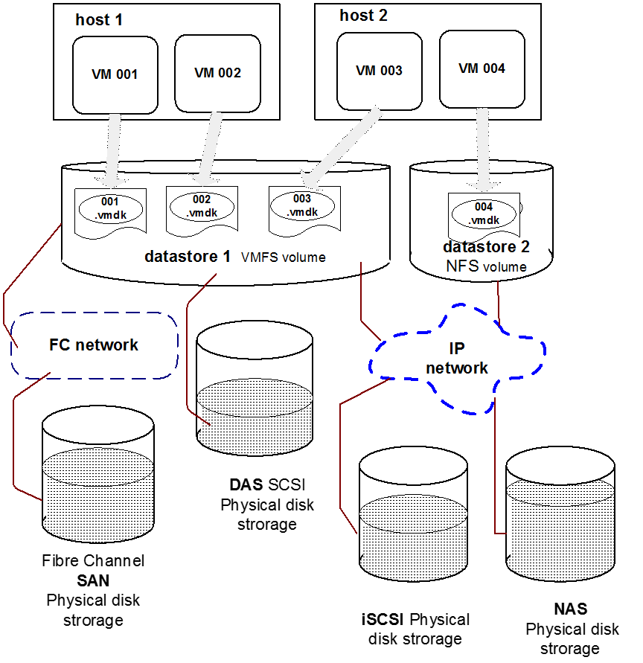
A System with various types of storage subsystems
Notes:
Consider a system that contains a DAS subsystem that is connected directly to a server, a SAN subsystem, a iSCSI based SAN subsystem, and a NAS subsystem.
These subsystems represent the physical storage resources that are available on the system.
On a virtualised system the storage available on these subsystems can be virtualised into datastores for allocation as individual virtual disk stores for various VMs.
The figure shows that each host supports two VMs in the example.
The datastore 1 is created as a VMFS volume that uses storage resources from the FC SAN, the DAS and the iSCSI SAN array.
The datestore 2 is created as a NFS volume.

Slide 35
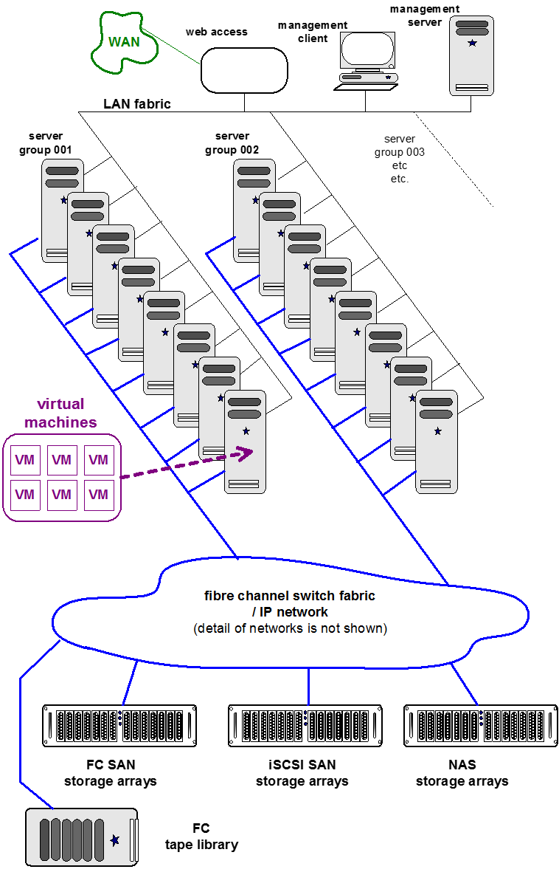
A Data Centre
example
Notes:
A typical data center configuration, as illustrated in the figure, includes virtualisation servers, storage networks and disk arrays, IP networks, a management server, and various desktop client PCs.
The physical computers in the server groups are virtualisation servers, and a bare metal hypervisor is installed on each server to facilitate the running of various VM (virtual machines) on each physical server. As stated already, each one of these physical servers is referred to as a host.
A cluster can be defined as a set of similarly configured physical servers, with defined storage subsystems resources, that is configured to provide an aggregate set of resources in the virtual environment, to provide some common computing application.
The figure illustrates the inclusion of Fibre Channel SAN storage arrays, iSCSI SAN arrays, and NAS arrays. The full collection of storage resources is connected to and shared by the server groups through the storage network which is illustrated as the ‘fibre channel switch fabric / IP network’, but the detail of the network is not shown.

