Slide 1
ED5502 Embedded Software
Lecture 6:
STM32 ADCs
Ciaran MacNamee
Spring 2019
Lecture 6
<number>
Notes:
<number>

Slide 2
What we will cover today
Analog to Digital Converters (Brief Outline)
STM32L476RG Analog to Digital Converters (ADCs)
Simple application example
Similar to the application in Project 1
Spring 2019
Lecture 6
<number>

Slide 3
After this lecture you should be able to:
Initialise and use the STM32L476RG ADCs to acquire analog input voltages and use them in software
Spring 2017
ADC Lecture
<number>
Notes:
<number>

Slide 4
Analog to Digital Converter
Most of today’s microcontrollers have at least one analog to digital converter (ADC)
For very high performance (very high resolution or very high data rates) a dedicated ADC may be required
We will not go into detailed ADC design here
We will see that the programmer’s view of the ADC is:
Control Register
Status Register(s)
Data Register (Conversion Result)
Again, this is the general view of on-chip peripherals in any microcontroller
Spring 2017
ADC Lecture
<number>

Slide 5
Analog to Digital Converter
Most ADCs convert over a voltage range
Starting at 0V up to a maximum input Voltage
The maximum voltage should convert to the maximum number that the ADC can have
Suppose that the maximum input voltage is 5V and we have an 8-bit ADC
An input of 5V should be read as a value of 255
An input of 0V should be read as a value of 0
An input of 2V should be read as 255*(2/5)
This applies to a linear ADC – other types, eg logarithmic ADCs are also available
Spring 2017
ADC Lecture
<number>

Slide 6
ADC Resolution
For the programmer, the ADC resolution is determined by the number of bits that the ADC has
Typical values are 8, 10 or 12 bits
8 bits: 0 – 255 for full-scale
10 bits: 0 -1023 for full scale
We have: Vin/Vfs = x/(2^{n} -1)
Getting 10-bit or higher resolution requires good circuit design, from the analog signal to the ADC input pin
Even with a 10-bit ADC it may not be possible to get the full 10-bit resolution from the ADC
We may have to settle for 8-bits and discard some lower bits
Note that the biggest voltage you can measure will be 5V
STM32 makes this easier
Spring 2017
ADC Lecture
<number>

Slide 7
ADC Resolution (2)
– the voltage for one bit (one LSB in ADC terms)
Given: Vin/Vfs = x/(2^{n}-1)
The number of bits and the full-scale voltage fix the best resolution we can get
E.g. Vfs = 3.3V, n = 12
For resolution put x =1 (ie getting the voltage that will change the ADC output by 1 bit)
Vin (1-bit) = Vresolution = 3.3/4095 = 0.81mV (approx)
You can’t resolve the input voltage more precisely than 0.81mV
If you need to measure with better resolution, then some other approach will be required
Spring 2017
ADC Lecture
<number>

Slide 8
ADC Resolution (3): Full-scale
Full-scale voltage may be set by the power-supply, but is more often fixed by a reference Voltage, VRef
In STM32 Vref must be <= VDDA the ADC supply voltage
This places an upper limit on the voltages you can convert
The reference voltage for the ADC (Ref) indicates the conversion range for the ADC
Spring 2017
ADC Lecture
<number>

Slide 9
ADC Resolution (4): Full-scale
The reference voltage for the ADC (Ref) indicates the conversion range for the ADC
In the STM32L476RG, with12 bit resolution (0-4095 or 0xFFF) single ended channels that exceed VREF will result in codes close to 0xFFF
So VRef fixes the full-scale voltage
VRef can be selected as either VDDA, an internal Voltage reference, or external pin
Note that noise (or other problems) on this signal can seriously affect the ADC performance
Spring 2017
ADC Lecture
<number>

Slide 10
ADC Conversion Techniques
The STM32 ADC uses Successive Approximation to generate a digital representation of the input analog voltage
Compare the input voltage first against Vref/2
If Greater than or equal, set the MSB
Otherwise clear the MSB
The compare against either (Vref-(Vref/2))/2 or Vref/2 and set or clear the next bit
Repeat until all bits have been defined
Final Result is in the (SAR) Data Register
This takes time: 1 clock per bit resolution
Spring 2019
Lecture 6
<number>

Slide 11
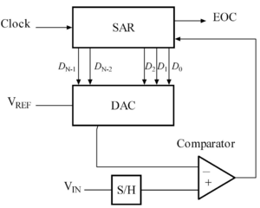
ADC Conversion Techniques
ADC using Successive Approximations
The Clock is used to sequence operations
Note the Sample and Hold (S/H) amplifier which provides a stable voltage for conversion
Also the DAC to generate a voltage against which to compare
The EOC output indicates End Of Conversion
Spring 2019
Lecture 6
<number>

Slide 12
ADC Conversion Clock and sampling
Each comparison is carried out the clock that you select for the ADC
In general, slower clocks give better accuracy
But note that the ADC must also sample the input voltage so that the voltage you’re converting is stable during the conversion
Performance limitations on conversion time
For a slowly changing input, sample time can be short
Total Conversion Time = Sample Time + SAR Conversion Time
Spring 2019
Lecture 6
<number>

Slide 13
ADC on the STM32L476RG
STM32 3 x ADCs have 12-bit resolution (0-4095 resolution
STM32L476RG has 3 ADCs but has many more analog inputs
Uses multiplexers to select analog pins as inputs to one of the ADC inputs
Extra complexity but gives flexibility
Choice of differential and single ended analog inputs
Choice of interleaved conversions, direct DMA to memory and other options
Spring 2019
Lecture 6
<number>

Slide 14
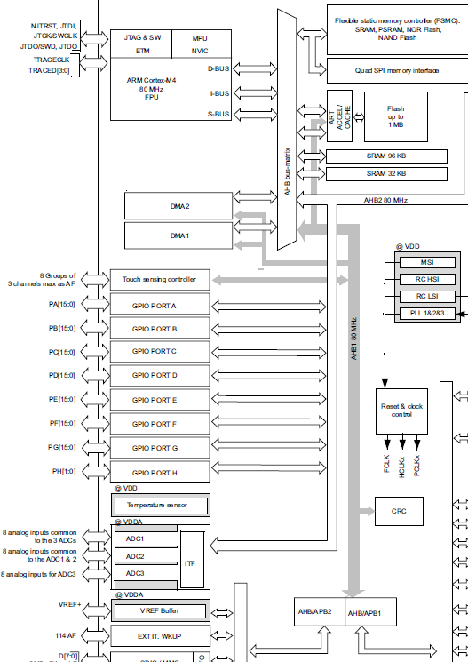
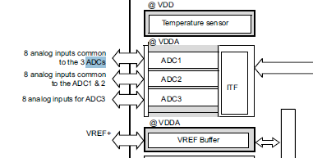
ADCs are on the AHB2 Bus
The ADCs are on the AHB2 bus, so we will have to enable the clock for the ADC we are using on the AHB2 Clock control register, RCC_AHB2ENR
Spring 2019
Lecture 6
<number>

Slide 15
STM32L476RG ADC Registers
STM32L476 has 34 registers for ADC control status and data and has the ability to have ADC masters and ADC slaves
We will use a simple configuration to get a single ended analog voltage from input pins PA0 or PA4 (connected to the potentiometer on our Arduino Shield)
These are A0 or A2 on an Arduino Shield
Spring 2019
Lecture 6
<number>

Slide 16
Steps in using the ADC
STM32 ADCs can have differential or single mode inputs
We use single ended
To use the ADC you need to set a Reference Voltage
We’ll select VDDA, the analog voltage source, which is 3.3V in our case
You need to select a sample time and the number of bits of resolution for the conversion
We use 2.5 cycles sampling and 12-bits resolution
Conversion time = 2.5 + 12.5 clocks
Spring 2019
Lecture 6
<number>

Slide 17
Steps in using the ADC
STM32L476RG ADCs allow you to select different clock sources and optionally divide the selected source
We select the AHB clock and divide it by 256
We have a very slowly changing input voltage
Spring 2019
Lecture 6
<number>

Slide 18
Selecting the ADC Input
You can have 16-20 analog inputs to the 3 ADCs, some of the inputs are internal signals
16 pins can become ADC inputs
So first we use the GPIOx MODER register to set the pins we want to use to analog mode
Next we need to select this pin as the input to ADC1, ADC2 or ADC3 as needed
This is the hard part
Spring 2017
ADC Lecture
<number>

Slide 19
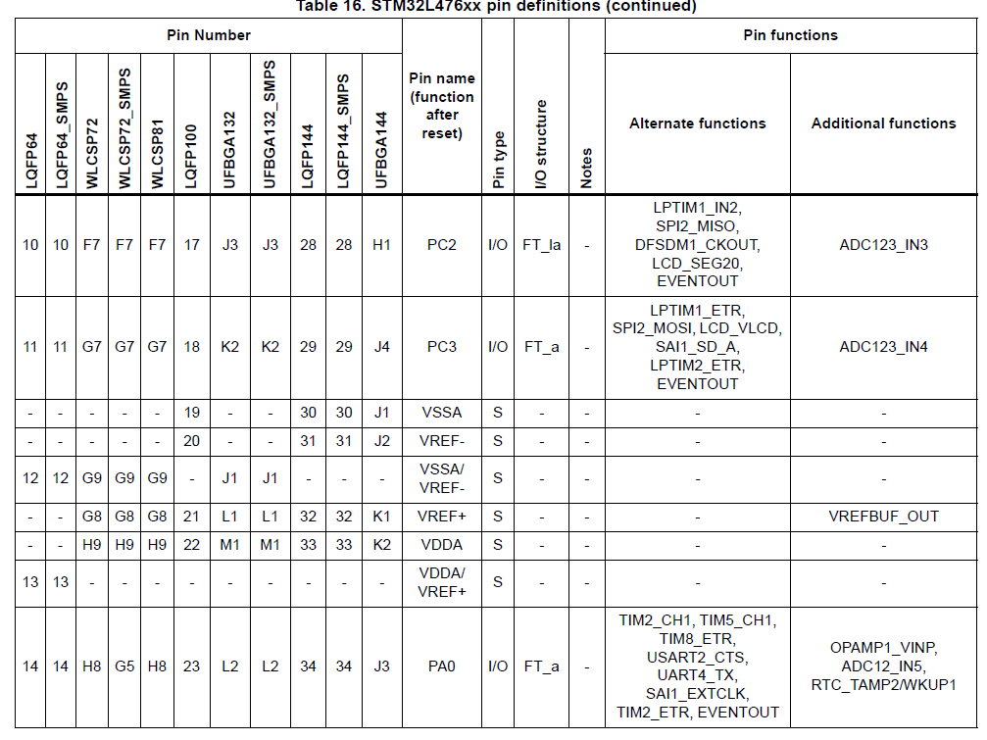
ADC Input on Pin PA0
Pin PA0 is connected to the A0 Arduino pin which we use to connect to a potentiometer on our Shield
So we have to use this pin (or A2) as our ADC Input
We see that PA0 is connected to ADC1 Input 5 or ADC2 Input 5
Table is from STM32L476RG.pdf
Spring 2019
Lecture 6
<number>

Slide 20
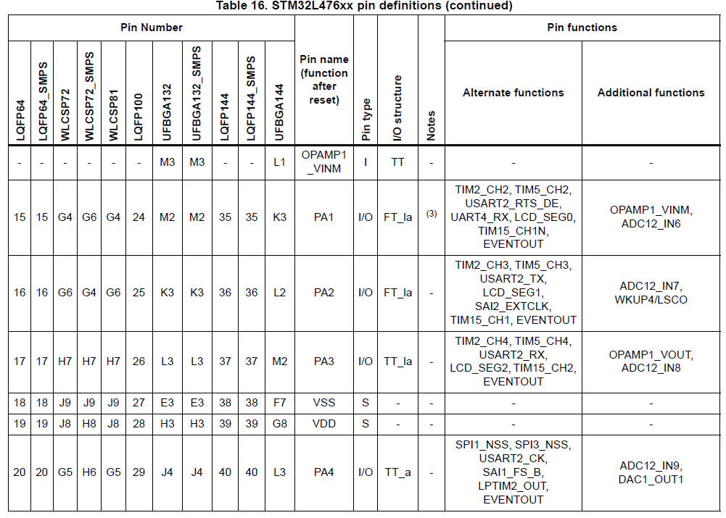
ADC Input on Pin PA4
Pin PA4 is connected to the A2 Arduino pin which we can use to connect to a potentiometer on our Shield
So we have to use this pin (or A0) as our ADC Input
We see that PA4 is connected to ADC1 Input 9 or ADC2 Input 9
Spring 2019
Lecture 6
<number>

Slide 21
Which ADC will we use?
STM32L476RG has 3 ADCs, which can be used in Master-Slave mode if desired
ADC1 can be the Master controlling ADC2 or ADC3
For simplicity we’ll use ADC1 and its PA0/ADC12_IN5 input, ADC1_IN5 in our case
(We could use ADC2 instead)
Spring 2019
Lecture 6
<number>

Slide 22
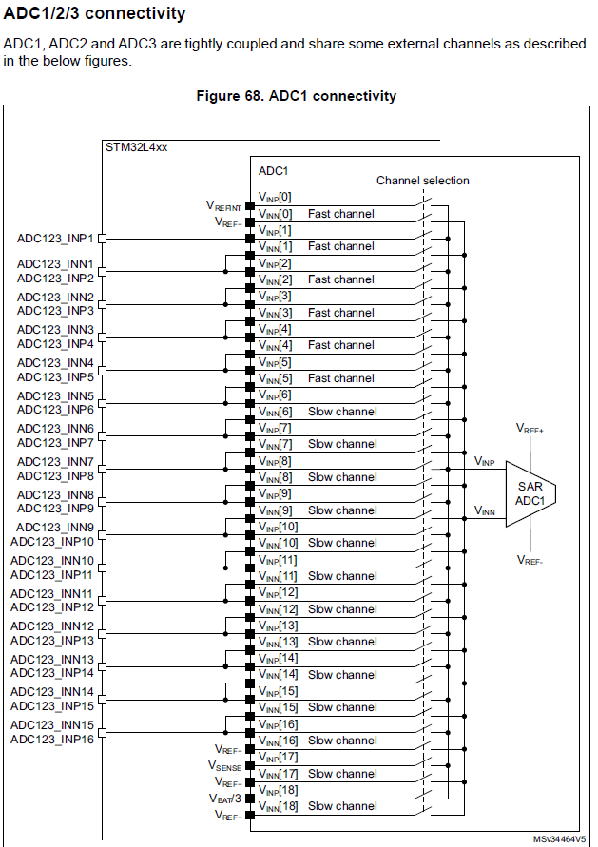
Inputs to ADC1
You can connect input pins to measure the difference between voltages at pairs of pins
We don’t want this option
We’ll use ADC1_INP5 with ADC1_INN5 set of VSS (Ground)
Figure is from STM32L4xx Reference Manual
Spring 2019
Lecture 6
<number>

Slide 23
ADC Registers
The ADC flexibility comes at the cost of complexity
Many bits in many registers
With STM32L476RG you can set up sequences of ADC conversions using multiple inputs and channels, and use DMA to transfer acquired data to memory
We just want one input and one channel and a simple sequence
We look at some of the ADC Registers
Spring 2019
Lecture 6
<number>

Slide 24
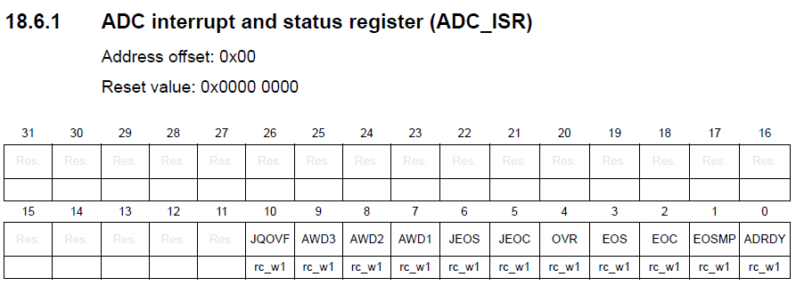
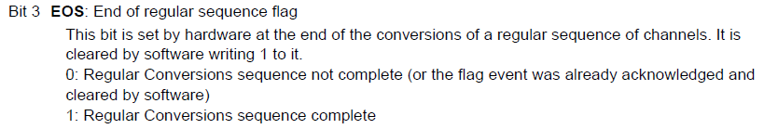
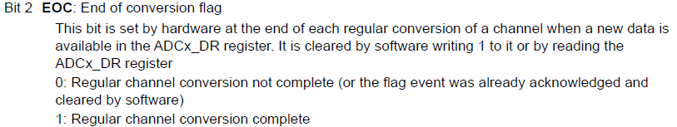
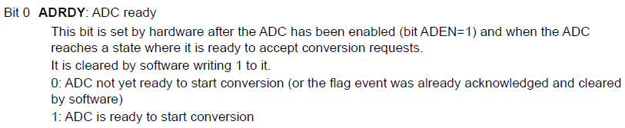
ADC Registers: ISR
We care about EOC, EOS and ADRDY only
Spring 2019
Lecture 6
<number>

Slide 25
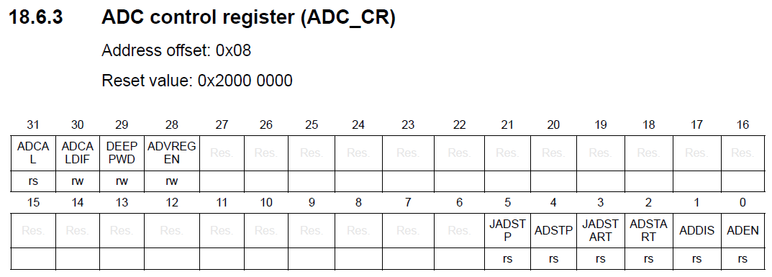
ADC Registers: CR
We care about DEEP PWD, ADVREGEN, ADEN and ADSTART only
DEEP PWD and ADVREGEN are for low power operation
(Deep Power Down and ADC Voltage Regulator Enable)
Initialisation: you have to exit DEEP PWD mode and enable the ADC Voltage
Spring 2019
Lecture 6
<number>

Slide 26
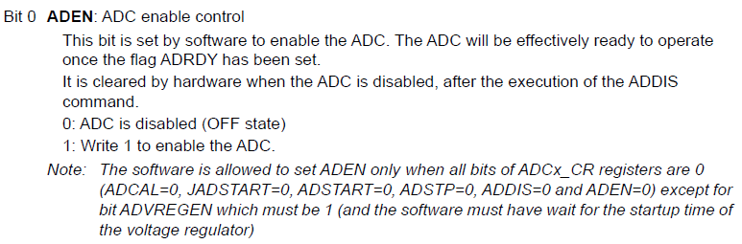
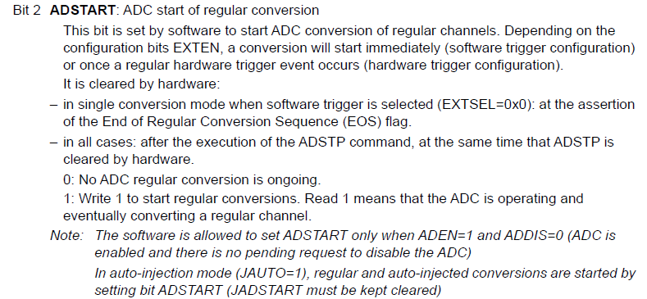
ADC_CR
Spring 2019
Lecture 6
<number>

Slide 27
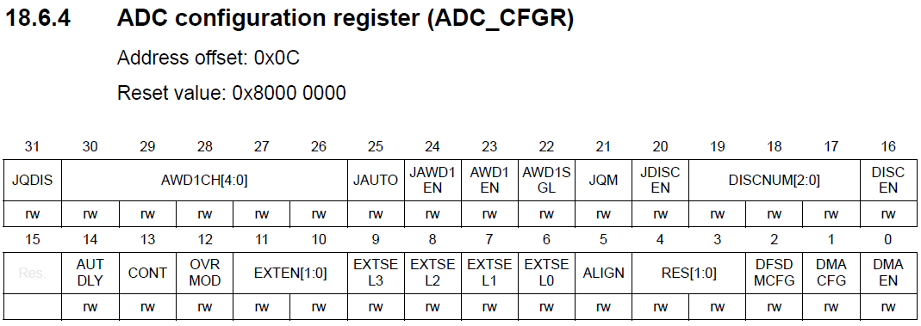
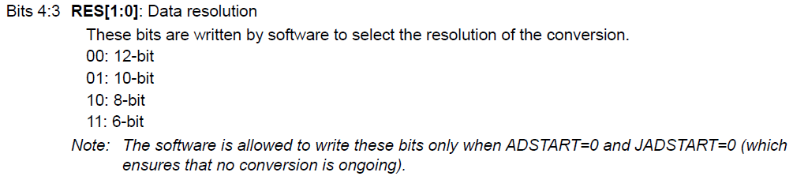
ADC Registers: ADC_CFGR
We care about EXTEN, EXTSE and RES
We can leave the bits of ADC_CFGR1 (another register) at their reset values
Spring 2019
Lecture 6
<number>

Slide 28
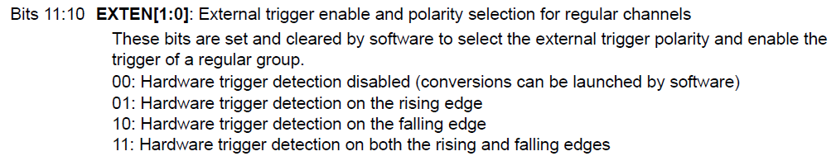
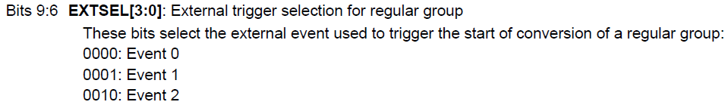
ADC_CFGR
This is the option we want
Goes up to 15
Spring 2019
Lecture 6
<number>

Slide 29
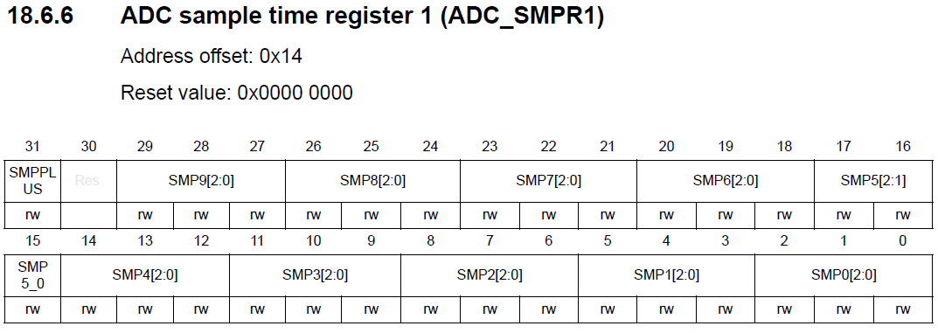
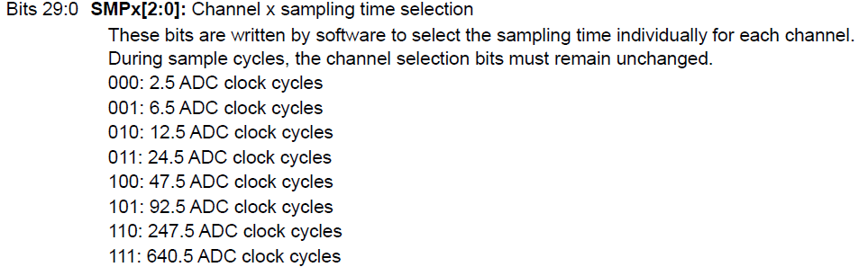
ADC Registers: ADC_SMPR1
ADC_SMPR2 applies to the higher-numbered channels
We will use SMP5 or SMP9
Spring 2019
Lecture 6
<number>

Slide 30
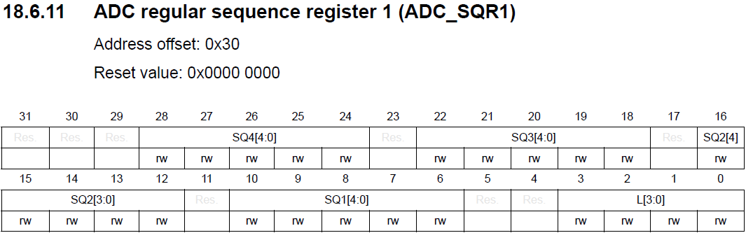
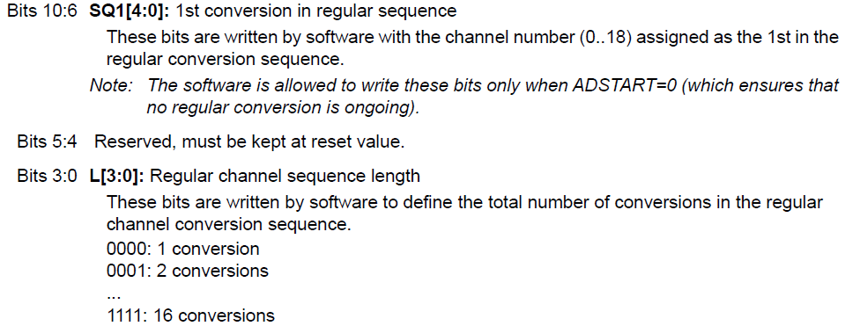
ADC Registers: ADC_SQR1
ADC_SQR2, _SQR3 and _SQR4 are for more elements in a sequence
We want the simple option:
Sequence of 1 conversion with 1 channel
Spring 2019
Lecture 6
<number>

Slide 31
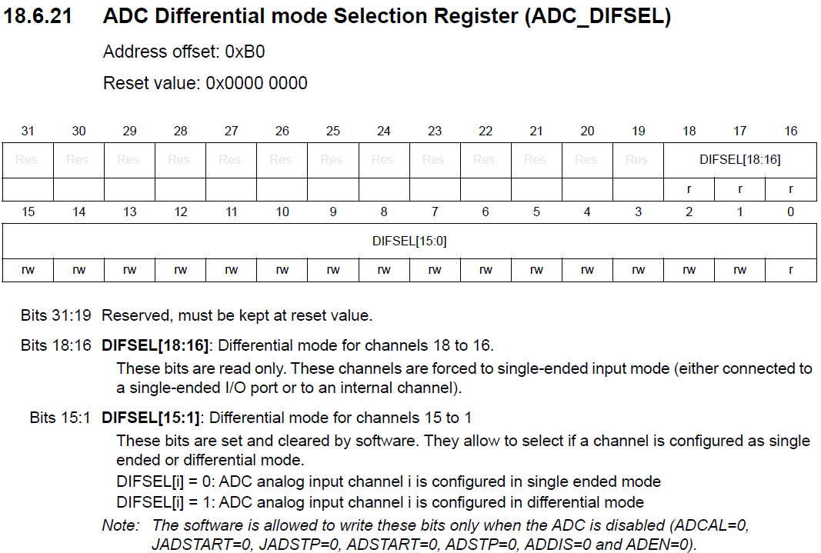
ADC Registers: ADC_DIFSEL
Spring 2019
Lecture 6
<number>

Slide 32
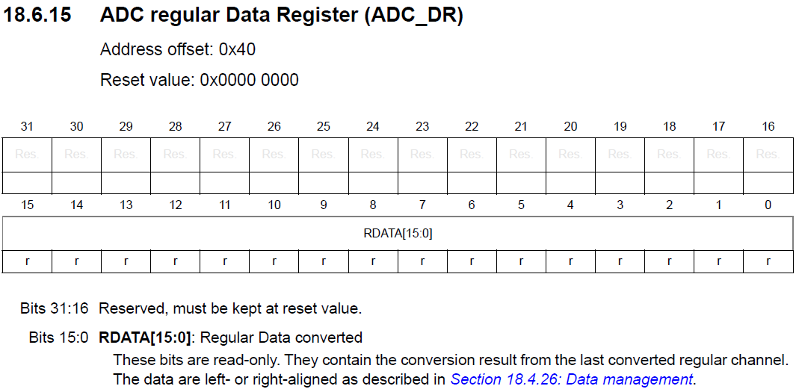
ADC Registers: ADC_DR
And, of course, the result of the conversion!
We use the right-aligned data format
Spring 2019
Lecture 6
<number>

Slide 33
Other ADC Registers
STM32L476RG can set analog watchdog options
If the ADC result is outside set limits, an event is triggered
It can support regular and injected sequences of conversions using multiple ADC input channels
It can send data direct to memory without CPU intervention – DMA
We have not discussed the control registers to select these options
Spring 2019
Lecture 6
<number>

Slide 34
Example: Read the voltage at PA0
We could use ADC2 in place of ADC1
Enable Clock to GPIOA
Enable the Clock to ADC1
Select the Analog Mode PA0
Setup ADC1 – release from Deep PWD mode, enable ADC Voltage regulator, wait for ADC Ready
Set ADC1 oversampling on/off, DMA Enable, input channel source, regular sequence channels and length of sequence
Finally Enable ADC1, ADEN bit (ADC1>CR)
These are the initialisation steps
This is very specific to STML476RG
Low Power support
Spring 2019
Lecture 6
<number>

Slide 35
Example: Read the voltage at PA0
Start the ADC1 conversion from software
Set ADSTART in ADC1->CR
Wait until the conversion has completed
Wait until the EOC bit of ADC1->ISR is set to 1
Read the conversion result
Store the data from ADC1->DR to a variable
Go to step 1
See Example p7_1.txt from Mazidi’s book
See PA0_ADC1.c
Continuous Execution Steps
Spring 2019
Lecture 6
<number>

Slide 36
Summary
STM32L476RG has 3 very powerful ADCs, with 12-bit resolution
Allows some very complex data acquisition
For simpler applications we have to remove some of the more complex options
Spring 2019
Lecture 6
<number>

