Slide 1
ED5502 Embedded Software
Lecture 7:
STM32 Timer/Counters (1): Introduction and Setting Time Periods
Ciaran MacNamee

Slide 2
What we will cover today
Timer/Counters – general ideas
Timers/Counters as counters with various clock inputs
Timer/Counter use – tick or similar applications

Slide 3
After these lectures you should be able to:
Initialise and use the STM32L476RG Timer/Counters to generate Timer Periods (Ticks), Output Signals, and Measure Times, Counts and Frequencies of input signals
In this lecture, we generate a time delay or period

Slide 4
STM32L476RG Timer/Counters
Arm Cortex-M3/M4 all have a SysTick timer
STML476RG also has two Basic Timers
TIM6 & TIM7
One Low Power Timer
LPTIM
7 General Purpose Timers (2 Groups)
TIM2, TIM3, TIM4, TIM5 and TIM15, TIM16, TIM17
2 Advanced Control Timers
TIM1 & TIM8
Many of these are common across all STM32 MCUs - Often having the same name for compatibility and reuse reasons

Slide 5

Arm Cortex-M3/4 SysTick Timer
SysTick is available on the Cortex core
So it’s on any Cortex-based microcontroller
Intended for use as an Operating System tick
Having it in the core makes portability easier
We could use it for our setting time delays – but only if we do not have an Operating System (OS)
The SysTick counter has 24-bits
STM32L476RG SysTick

Slide 6
Arm Cortex-M3/4 SysTick Timer
SysTick is available on the Cortex core
So it’s on any Cortex-based microcontroller
Intended for use as an Operating System tick
Having it in the core makes portability easier
We could use it for setting time delays – but only if we do not have an Operating System (OS)
The SysTick counter has 24-bits
We have been using SysTick already without knowing it
All code generated by CubeMX uses SysTick, for example HAL_IncTick() and HAL_Delay(500);

Slide 7
Timer/Counters
Very widely used on-chip peripherals in many MCU applications
Found in one form or another on most microcontrollers
Typical uses:
Periodic Events, Ticks or Interrupts
Measure Time Periods
Determine Pulse Widths
Measure Speed
Measure Frequency
Generate Output Signals

Slide 8
Microcontroller Timer/Counters
Most of today’s microcontrollers have more than one Timer/Counter
We will see that the programmer’s view of the Timer/Counter is:
Control Register(s)
Status Register(s)
Data Register (The Counter/Timer Count Register)
Again, this is the general view of on-chip peripherals in any microcontroller

Slide 9
Timer/Counters
Essentially Timer/Counters are simply up-counters or down-counters
For timing, the counters are counting time periods at their inputs (e.g. an internal or external clock)
For counting, they count events or pulses or similar
Or count events in a given time, by making these events the input to the counter, and checking the count periodically – e.g. engine driveshaft RPM
Even very simple microcontrollers have at least one timer/counter system

Slide 10
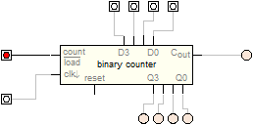
Four Bit Up Counter
Counts to 15 (all ones) then wraps around to Zero
Cout (Carry Out) indicates the rollover
You can generalise this idea to counters of any size
The D and Load* inputs allow loading of a start value other than zero
Clock Input
General Idea
0000 -> 0001 -> ….1110->1111->0000->0001
Cout
You can extend this idea to a larger number of bits

Slide 11
Four Bit Down Counter
Counts to 0 (all zeroes) then wraps around to all ones
Cout (Carry Out) indicates the rollover
You can generalise this idea to counters of any size
The D and Load* inputs allow loading of a start value other than zero
Clock Input
General Idea
1111 -> 1110 -> ….0010->0001->0000->1111
Cout
In both up and down cases Cout can be used to extend the effective number of bits
You can count Cout occurrences to extend the counter

Slide 12
Extending the Counter
A 4 bit counter would be pretty useless to us
Microcontroller counters come in 8-bit, 16-bit and 32-bit variants mostly
Even the 16-bit counters can reach their maximum or minimum count quickly
Divide by N
Clock Input
0000 -> 0001 -> ….1110->1111->0000->0001
Cout
Count Cout
Two solutions
Detect the Overflow or Underflow event and use it to update a software counter – you can extend the count to an arbitrary length
Divide down (Prescale) the clock input so it’s clocked by a lower frequency input – reduced precision but longer effective counting

Slide 13
Four Bit Up Counter for events
Connect the Clock Input to an event detector to enable event counting
Sensor Output

Slide 14
Four Bit Up Counter timing delays
Clock Signal
Option2:
Connect the Clock Input to a clock input of known frequency
Load the counter with zero, load a comparison counter with a set value
Count until the counter reaches the comparison counter – the time taken gives your delay or tick
Option1:
Connect the Clock Input to a clock input of known frequency
Load the counter with a known value
Count until rollover gives your delay or tick
Works well with down counters too

Slide 15
Four Bit Down Counter timing delays
Clock Signal
Option2:
Connect the Clock Input to a clock input of known frequency
Load the counter with a reload counter value
Count until the counter reaches zero – the time taken gives your delay or tick, and automatically reloads the counter
Option1:
Connect the Clock Input to a clock input of known frequency
Load the counter with a known value
Count down until rollover gives your delay or tick

Slide 16
Four Bit Up Counter Input Capture
Connect the Clock Input to a clock input of known frequency
Capture the Counter Value when an event occurs
Save the Counter Value
Capture the Counter Value again when the next event occurs
The difference between the counts tells you the time between the occurrences of the event
Clock Signal
Capture Register
Capture Event
Save to memory before the occurrence of the next event

Slide 17
Four Bit Up Counter Output Generation
Compare Value
Clock Signal
Connect the Clock Input to a clock input of known frequency
Start at zero
Compare with a known preset value
When they match you have made your delay or tick
Comparator
Delay Generated or Event Occurrence
The Event Occurrence can be sent to an output pin
You can generate an output signal this way
E,g. for motor control (PWM)

Slide 18
Typical Uses of Timers/Counters
Typical uses:
Periodic Events, Ticks or Interrupts
Measure Time Periods
Determine Pulse Widths
Measure Speed
Measure Frequency
Generate Output Signals
Let’s start with a Periodic Event
We will use TIM2 General Purpose Timer

Slide 19
Setting a Timer Tick or Delay
The idea is simple
What delay do we want?
Choose a clock source that will easily generate this time (Time per clock below)
Time = Timer Count Value * Time per clock
Set the Timer Count Value by writing this data to the Timer’s Automatic Reload Register (ARR)
Start the timer
Wait until the timer reaches the ARR value
Notes:
This is very wasteful on CPU resources
We will see that this kind of application is better implemented using interrupts

Slide 20
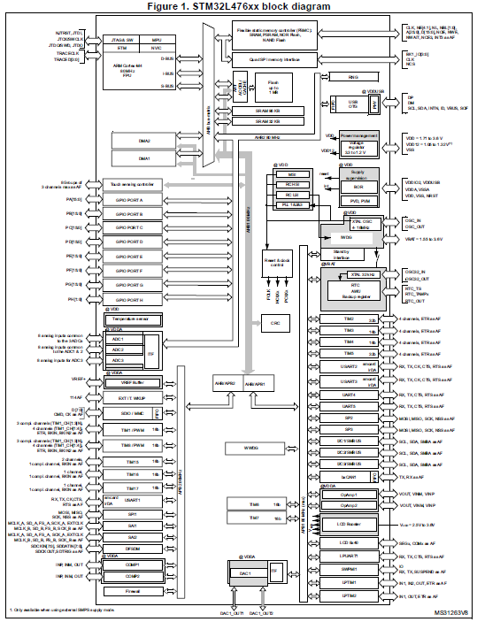
First Step: which bus?
Remember: we need to know this to find the RCC_ENR register with our timer’s clock enable bit
Nothing happens until this bit has been set

Slide 21
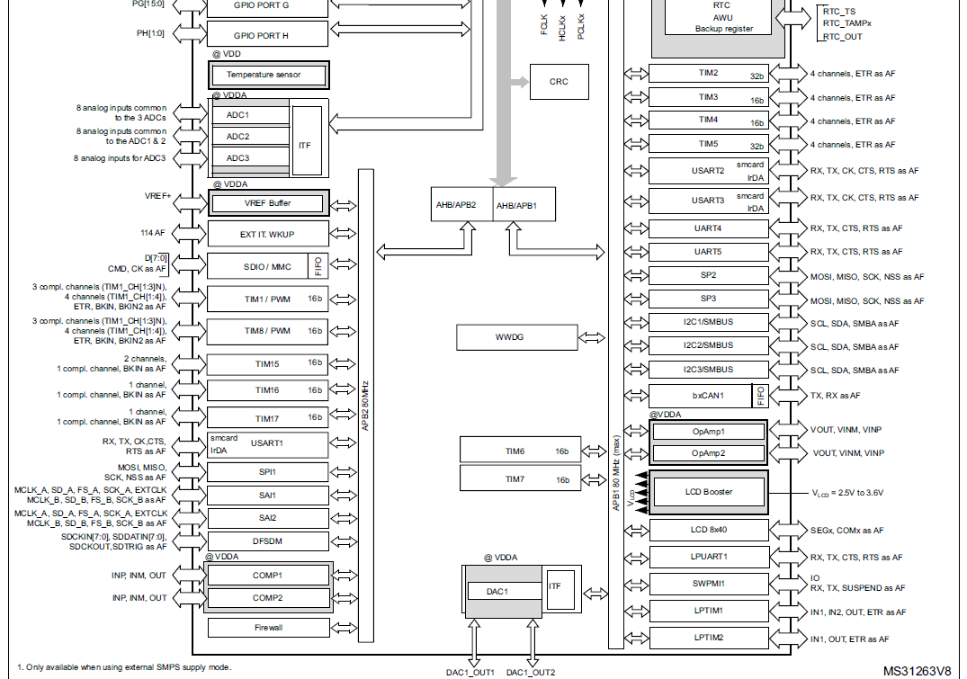
First Step: which bus?
We see that TIM2, TIM3, TIM4, TIM5 are on the APB1 Bus
TIM1, TIM8 and others are on APB2

Slide 22
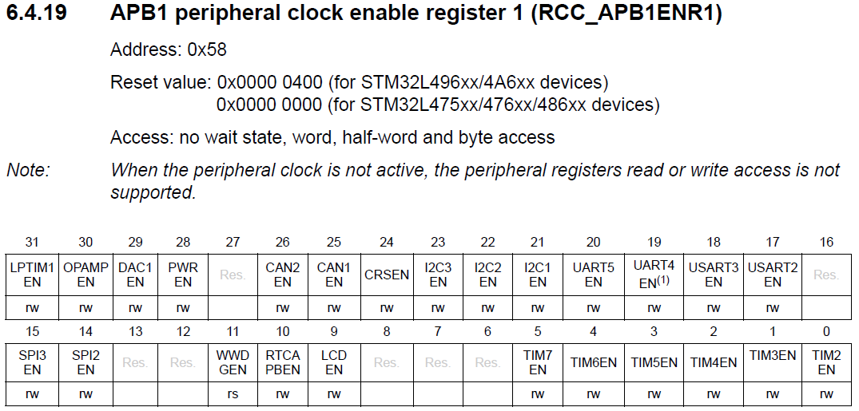
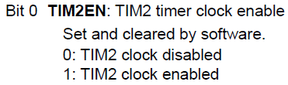
RCC_APB1ENHR
This bit for TIM2

Slide 23
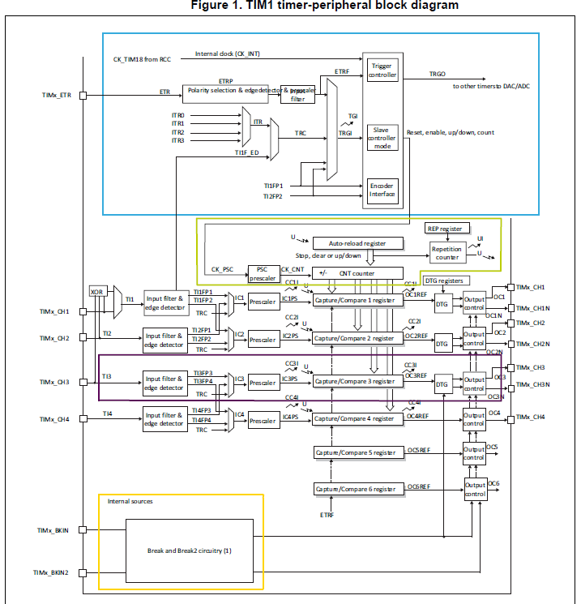
Timer Structure (TIM1 as example)
Master-Slave Controller
Timebase
Timer Channels
Break Feature

Slide 24
Master-Slave Unit
Provides the time-base unit with the counting clock signal and the counting direction control signal
Mainly provides the control signals for the time-base unit.
Sets the counting configuration for the time-base unit
Sets the counting status
Its Trigger Out (TRGO) signal could be Trigger In (TRGI) to another Timer

Slide 25
Time-Base Unit
Includes the timer counter, a prescaler stage and a repetition counter
Timer counter is controlled by two registers:
TIMx_CNT: to read and write the timer counter
TIMx_ARR: timer counter reload value
Also triggers a timer ‘update event’ when a new counting cycle is restarted, depending on the value of the repetition counter
If non-zero: no event
Notes:
TIMx_ARR: timer counter reload value
Up-counting: when the timer reaches the TIMx_ARR value, the timer resets itself and a new counting cycle is restarted
If down-counting and reaches zero value, the timer counter value is set to the content of TIMx_ARR and a new counting cycle is restarted

Slide 26
Timer Channels Unit
In general, this is the connection of the Timer Counter to the microcontroller pins – input or output (with a few exceptions)
Break Unit
For Timers with complementary outputs, the break unit can ensure safe shutdown

Slide 27
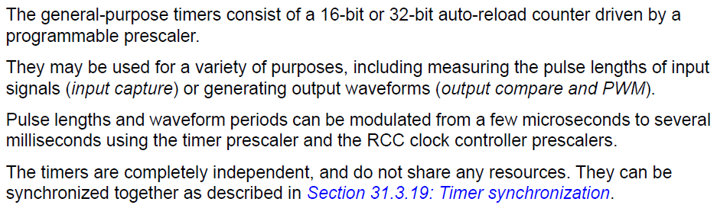
TIM2/TIM3/TIM4/TIM5

Slide 28
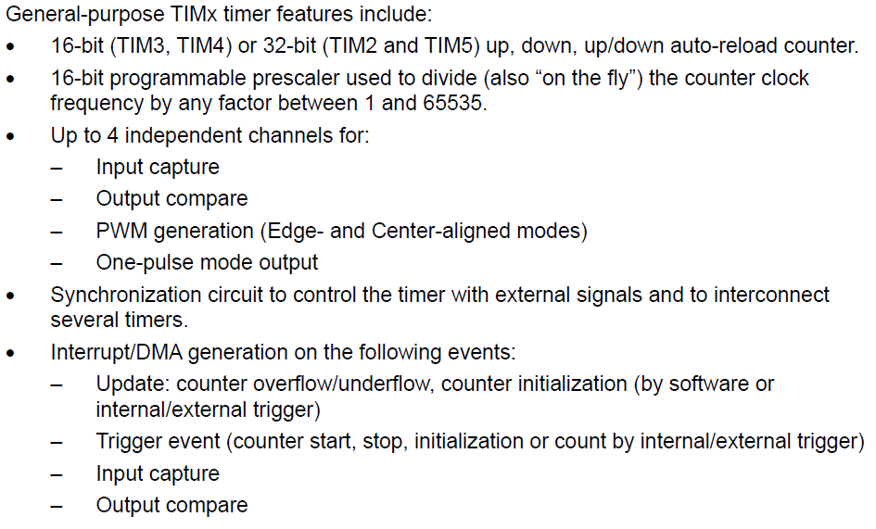
TIM2/TIM3/TIM4/TIM5

Slide 29
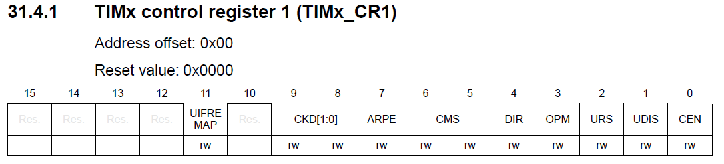
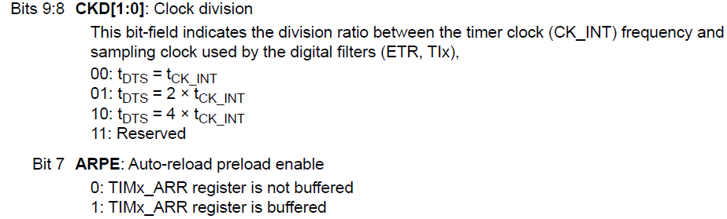
TIMx Control Register 1
Only Relevant Bits shown

Slide 30
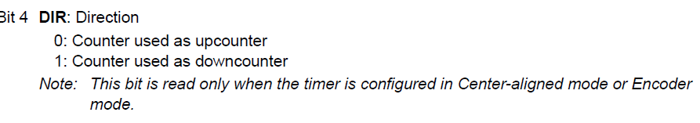
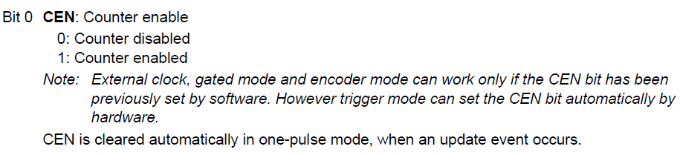
TIMx Control Register 1
TIMx_CR2 is not relevant for now
Relevant Bits

Slide 31
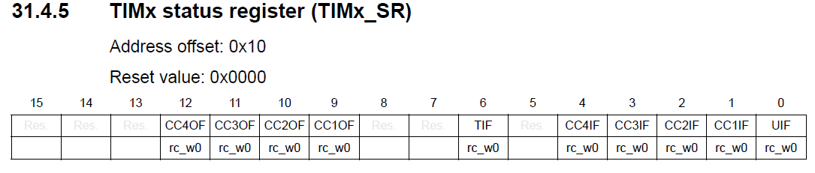
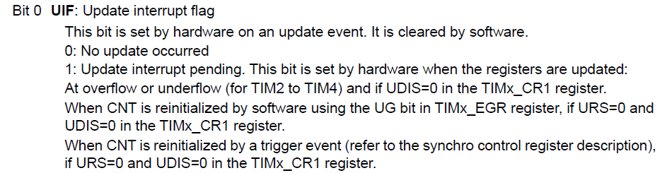
TIMx Status Register
Relevant Bits

Slide 32
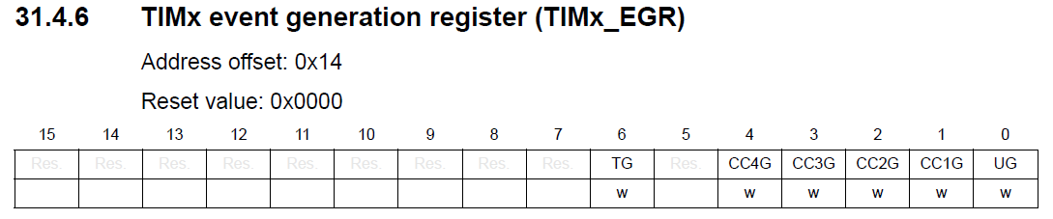
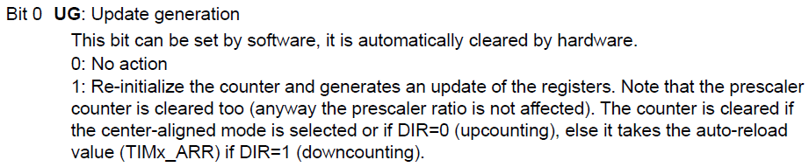
TIMx Event Generation
Relevant Bits

Slide 33
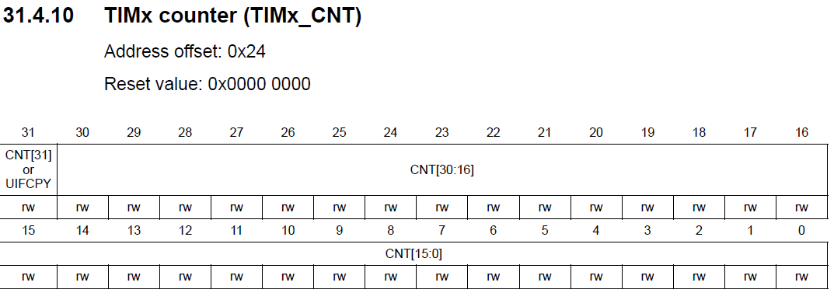
TIMx Counter Register
Some GP Registers are 16-bits
TIM2 is always 32-bits across all STM32 MCUs

Slide 34
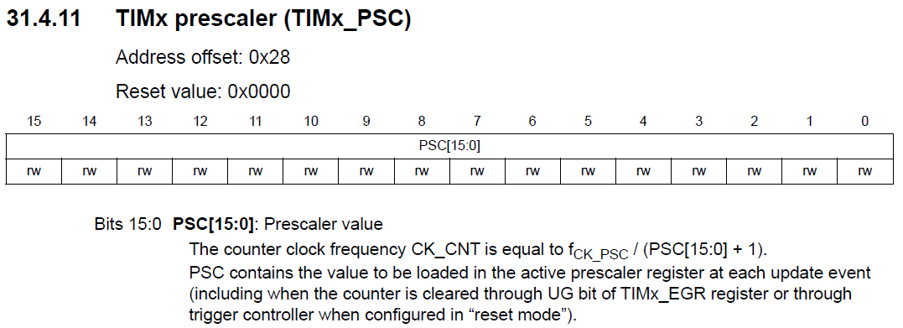
TIMx Prescale Register

Slide 35
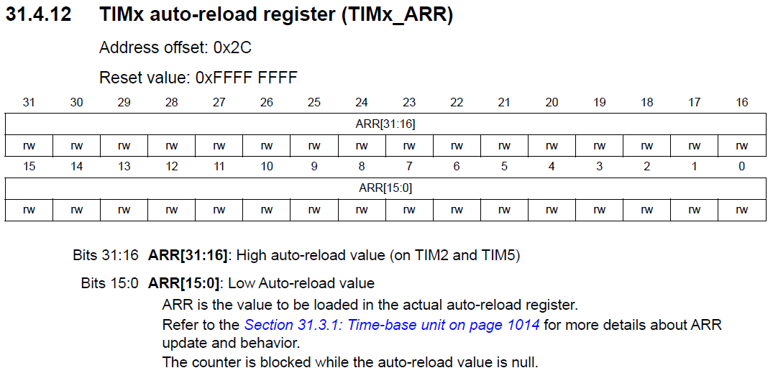
TIMx Auto-Reload Register

Slide 36
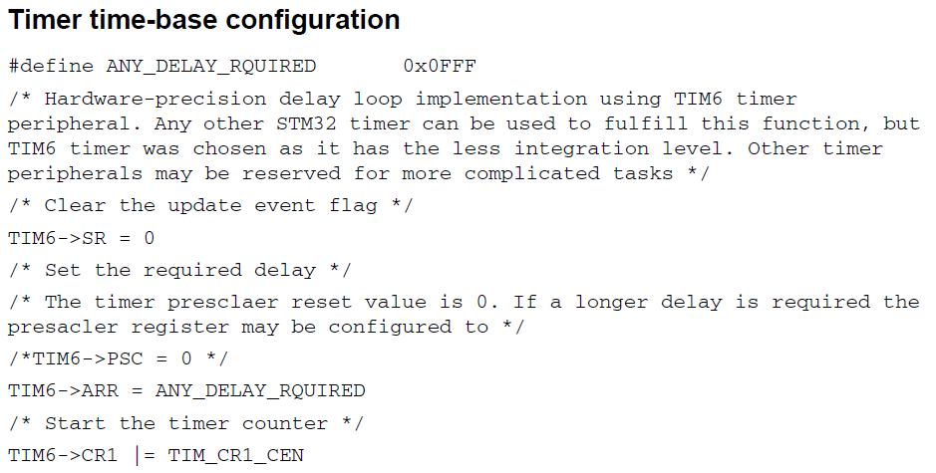
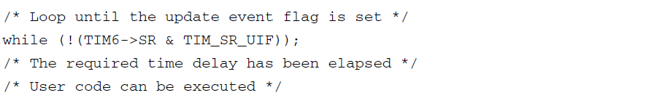
Time Delay Example (STM32 App Note)

Slide 37
What Time Delay?
The target delay will guide us to what prescaler setting we use and what count we set
Let’s say 1 second (f = 1 Hz)
Our SYSCLK runs at 80 MHz – look at the TIM2 clocking schemes next

Slide 38
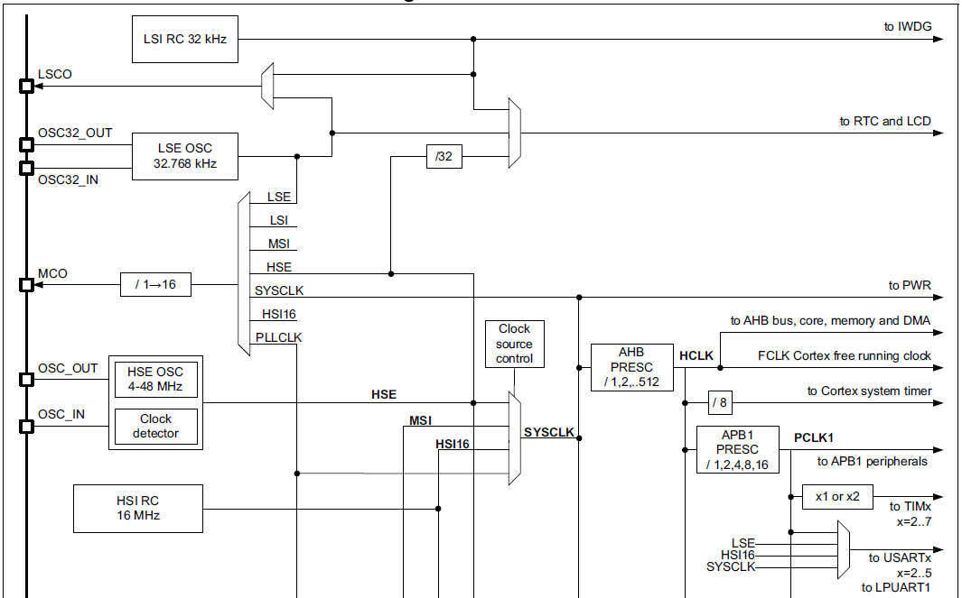
SYSCLK and TIM2 Clock
Clock source for TIM2..7 is here
PCLK1 is at 80 MHz

Slide 39
Generating 1 Hz event (1 sec delay)
Let’s Prescale TIM2 by 8000
80MHz/8000 = 10kHz, T = 0.1ms
Count 10000 * 0.1ms = 1 second
// configure TIM2 to wrap around at 1 Hz
RCC->APB1ENR |= 1; /* enable TIM2 clock */
TIM2->PSC = 8000 - 1; /* divide by 8000 */
TIM2->ARR = 10000 - 1; /* divided by 10000 */
TIM2->CNT = 0; /* clear timer counter */
TIM2->CR1 = 1; /* enable TIM2 */
while (1) {
while(!(TIM2->SR & 1)) {} /* wait until UIF set */
TIM2->SR &= ~1; /* clear UIF */
/* Do something useful, eg toggle LED */
}

Slide 40
Summary
Looked at Timer/Counters in general
Introduced STM32 Timers
A lot of common features across the product range
Looked at some of the General Purpose Timer Registers – those relevant to generating a clock tick

