Slide 1
ED5502 Embedded Software
Lecture 10:
STM32 Timer Modes,
Input Capture Interrupts
Ciaran MacNamee

Slide 2
What we will cover today
We look at the Compare/Capture features of STM32 Timers
We look at how to set up a Timer for Input Capture (IC) using IC interrupts

Slide 3
After these lectures you should be able to:
Explain the use of the Capture/Compare features of the STM32 timers
Explain how the HAL libraries describe the Timer Registers
Initialise and use Timer Interrupts starting with ST32CubeMX

Slide 4
Input Capture using MCU Timers
Given a free running counter, an event (usually a rising or falling edge of an input signal) causes the current counter value to be captured into a register, providing a timestamp of the event
If you save the timestamp, and allow the next event to capture a subsequent counter value, then the difference between the timestamps is the number of clocks between events
If you know the clock period, you can calculate the time difference

Slide 5
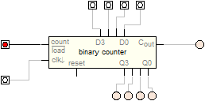
Four Bit Up Counter Input Capture
Connect the Clock Input to a clock input of known frequency
Capture the Counter Value when an event occurs
Save the Counter Value
Capture the Counter Value again when the next event occurs
The difference between the counts tells you the time between the occurrences of the event
Clock Signal
Capture Register
Capture Event
Save to memory before the occurrence of the next event

Slide 6
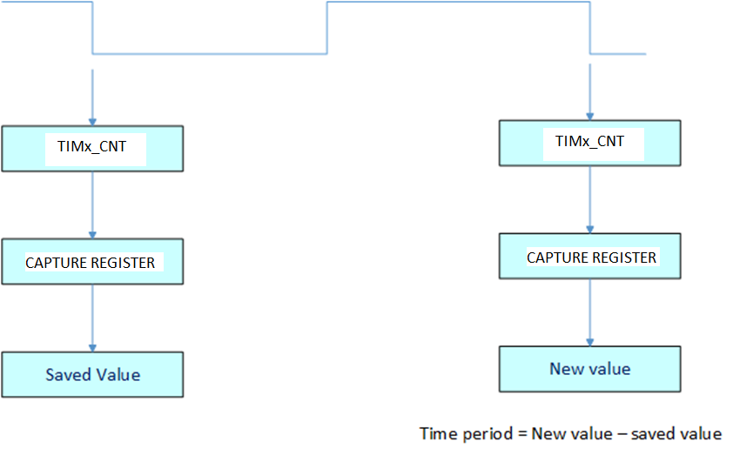
Example using Input Capture
Input Signal

Slide 7
STM32 Timers
STM32 has four types of Timer:
Advanced-Control Timers (TIM1/TIM8)
16-bit timers with master-slave and break features
General-Purpose Timers (TIM2/TIM3/TIM4/TIM5)
TIM2 and TIM5 are 32-bit timers
TIM3 and TIM4 are 16-bit timers
Basic Timers (TIM6/TIM7)
No connection to IO pins (Channels)
Low Power Timer (LPTIM)

Slide 8
General Purpose Timers
These timers may be used for time delays or for output (compare) signal generation or for input capture
Output Compare (including PWM) changes the state of an output pin (Channel in STM32)
Input Capture detects an edge on an inout pin (or channel)
These timers support 4 channels

Slide 9
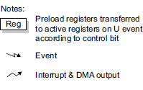
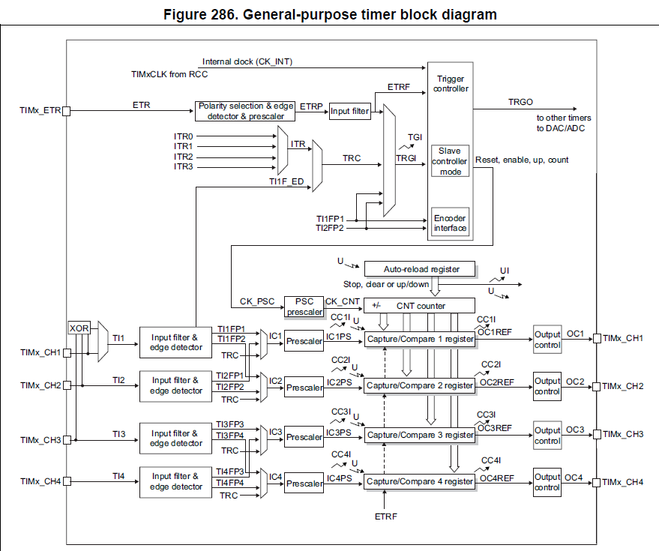

Slide 10
You can clock the Timer’s Counter from an External Signal
These are the Timer Inputs (also the Outputs)

Slide 11
Timer Components
We can think of three components
Control Block
Selects clock sources and enables, including triggers in and out
The Timer Time base unit
Includes the timer counter (CNT) and auto-reload register
Input and output functionality
Compare/Capture Registers and Channel connections

Slide 12
Trigger and Clocks

Slide 13
Time Base Unit
Counter, ARR

Slide 14
Capture Compare Registers
And Channels
Inputs to the left
Outputs to the Right
(Same pins used)

Slide 15
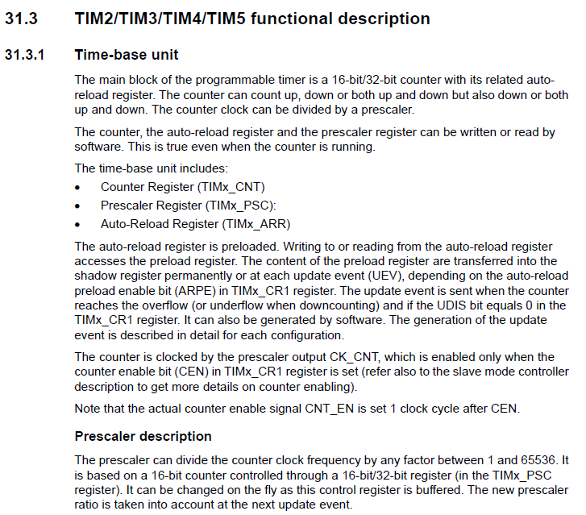

Slide 16
Time Base Unit
No matter what mode we use for the Timer/Counter, we have to set up options to control the Time Base Unit
These options must be setup to enable Input Capture too
Clock and Prescaler affect timing resolution

Slide 17
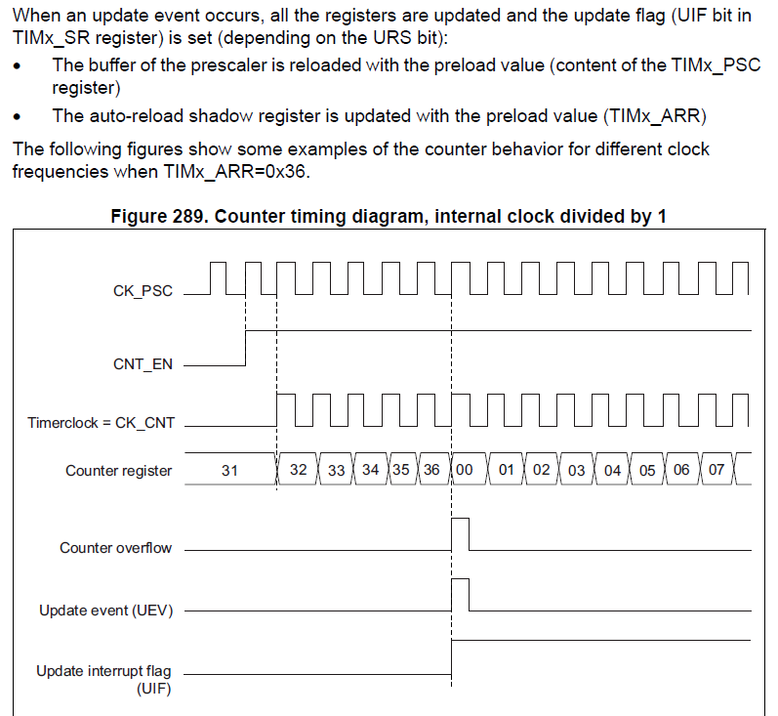
Auto-Reload Register and Update Events
You must set ARR to a value > 0
or counting will not start
You can also count down or even up and down

Slide 18
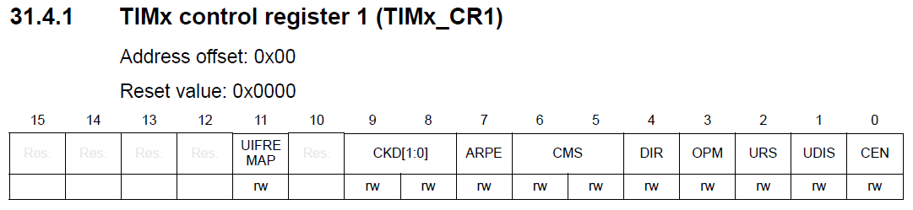
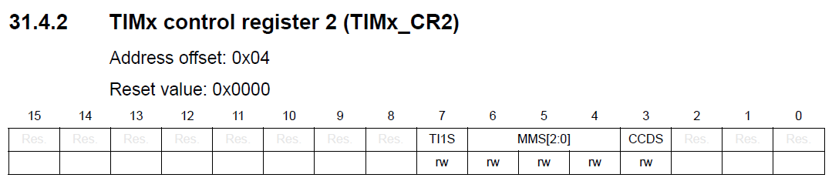
Control Registers
We will see how these registers map to STM32CubeMX and to HAL TypeDefs
Sets Direction, ARR Source, whether an Update Event updates the counter etc
CCDS enables DMA mode

Slide 19
Example: TIM2 CH1 Input Capture
We will configure TIM2 CH1 for Input Capture
First, what pin does this map onto?
See STM32L476RG Data Sheet, Alternate Functions

Slide 20
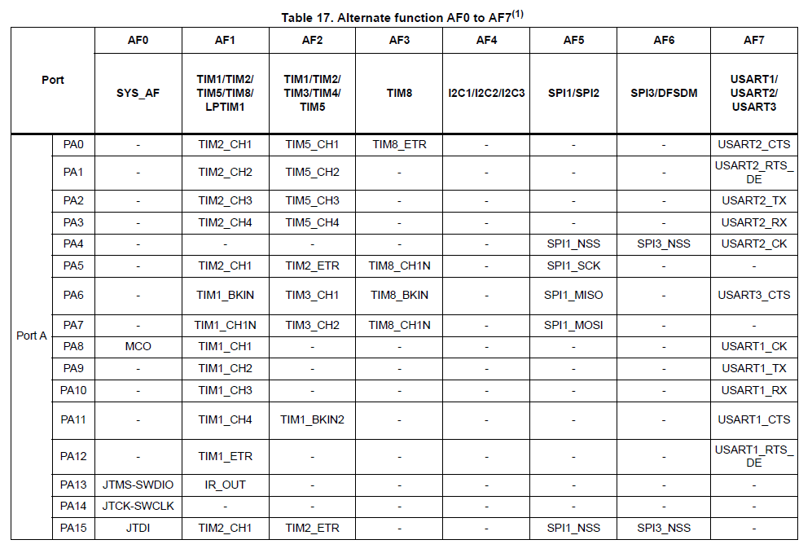
We could use PA0 or PA5
Both are on the Arduino Headers
Use PA0 this time

Slide 21
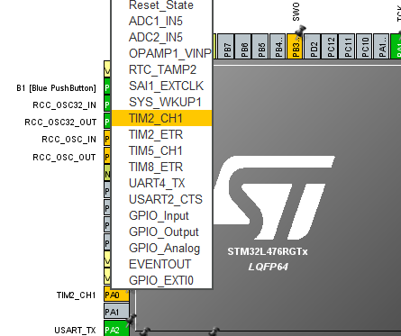
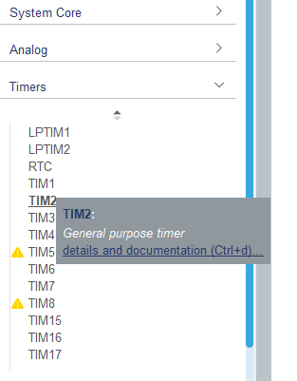
STM32CubeMX: PA0
Next select TIM2 under Timers
We used this pin for ADC1_IN5 in the past

Slide 22
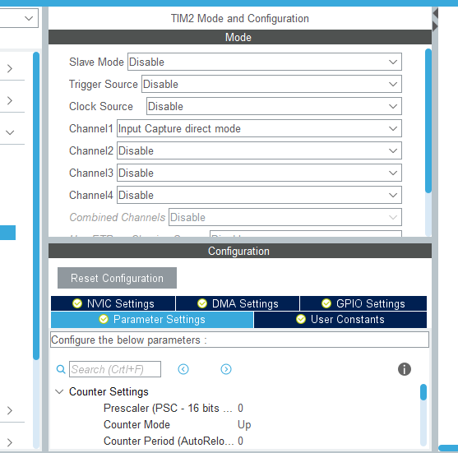
STM32CubeMX: PA0
Channel 1, Select Input Capture Direct Mode
(We’ll see why shortly)
This opens up the Configuration and Parameter Settings

Slide 23
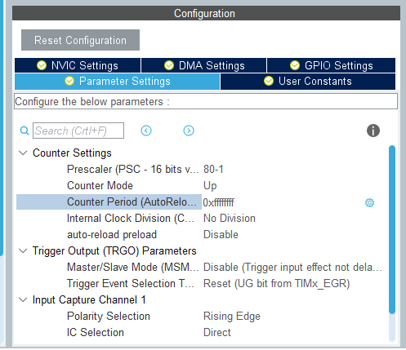
STM32CubeMX: PA0
The Clock Frequency is 80MHz
Divide by 0 will give a TIM2 Clock frequency of 1 MHz, Period = 1 us
Select 0xffffffff (8 f’s – max count for a 32 bit counter)
Up counter
No division of the internal clock

Slide 24
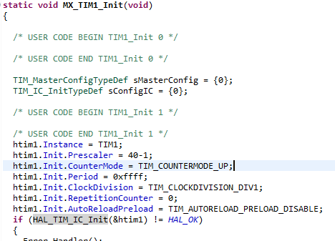
STM32CubeMX Generated Code
This example refers to TIM1, but TIM2 is similar
Calls HAL_TIM_IC_Init(&htim1);
IC means Input Capture here

Slide 25
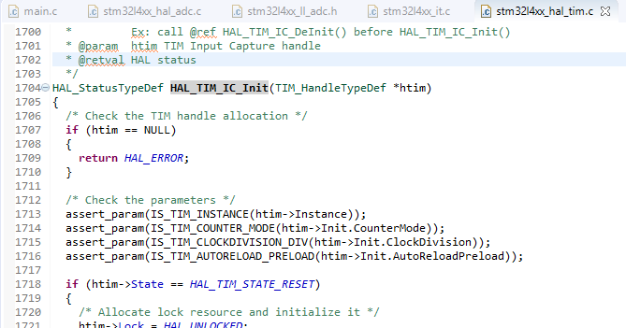
HAL_TIM_IC_Init()
This is found in stm32l4xx_hal_tim.c

Slide 26
HAL_TIM_IC_Init()
This is found in stm32l4xx_hal_tim.c

Slide 27
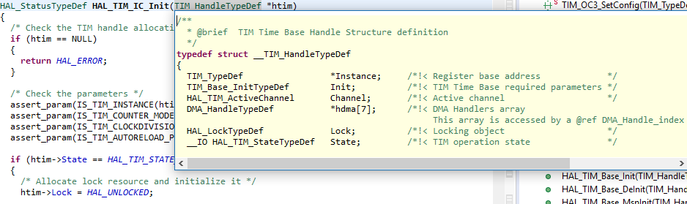
HAL_TIM_IC_Init()
Here is the typedef used
*Instance is just a pointer to the Timer we’re using, eg TIM2

Slide 28
Trigger and Clocks
Trigger and Master Slave options are also initialised
(Even if not used)

Slide 29
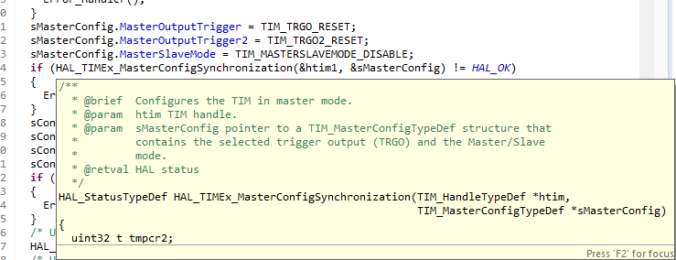
Triggers, Master/Slave Options
For Input Capture, if you’re not using these options, you could probably leave them at their default conditions (unused or not enabled, but CubeMX generated code may include initialisations of these conditions
(Trigger Outputs are sent to slave timers)

Slide 30
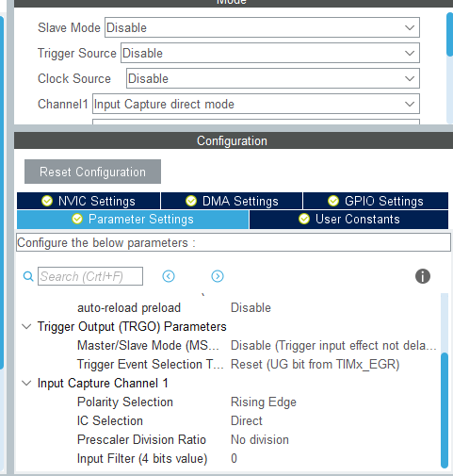
CubeMX and Input Capture Options
These correspond to bit settings in the Timer (Capture Compare) Control Register Settings

Slide 31
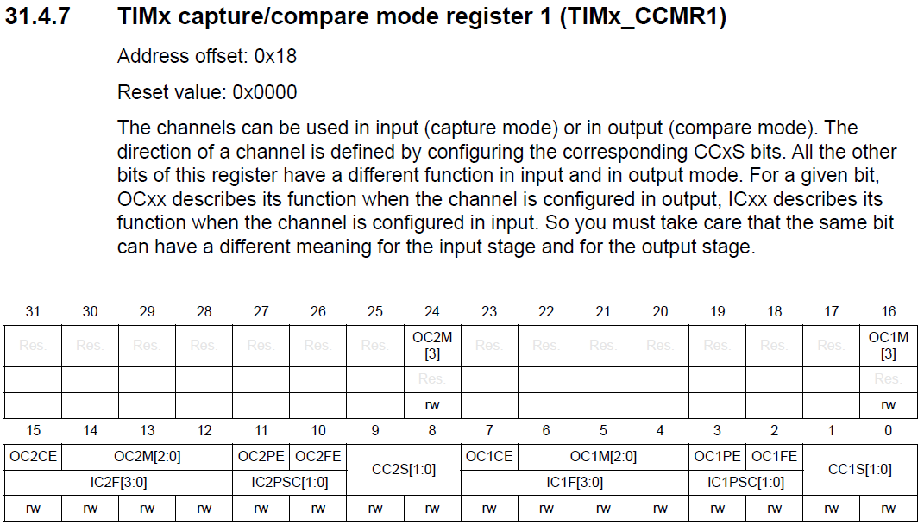
TIMx_CCMRy Registers

Slide 32
TIMx_CCMRy Registers
This register applies to CH1 & CH2
CCMR2 applies to CH3 & CH4
Depending on the setting of these fields, the upper or lower rows determine what’s enabled
The lower row applies to Input Capture

Slide 33
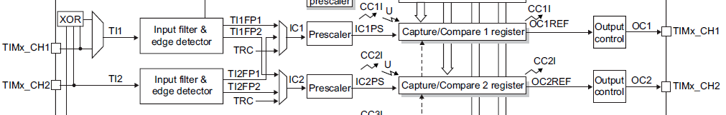
TIMx_CCMRy Registers
This is Direct Input Capture
This is what is being selected here

Slide 34
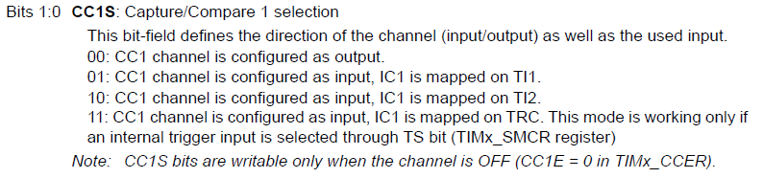
TIMx_CCMRy Registers
The other bits select input filter prescaler and other options

Slide 35
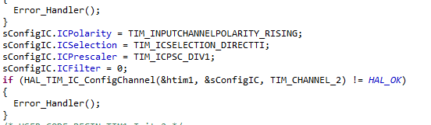
CCMRx Registers: CubeMX code
This screen capture was for TIM1 CH2, but the idea is the same

Slide 36
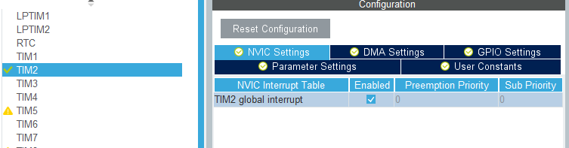
CubeMX TIM2 CH1 NVIC Settings
Enable TIM2 Interrupt and set priorities (if using)

Slide 37
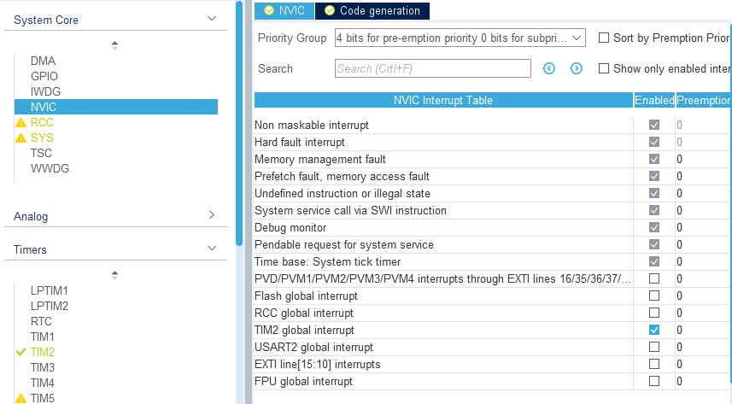
CubeMX TIM2 CH1 NVIC Settings
Enable TIM2 Interrupt and set priorities (if using)
Appears here because we set it in the TIM2 NVIC field

Slide 38
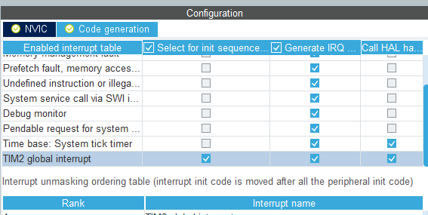
CubeMX TIM2 CH1 NVIC Settings
Make sure that Interrupt handler code is generated and that initialisation code is generated

Slide 39
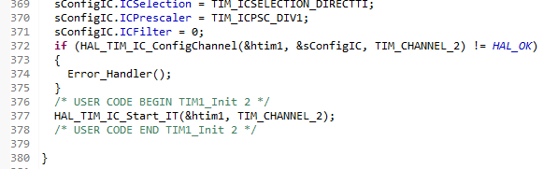
Input Capture Interrupt Init and start
This example is for TIM1 CH2, but TIM2 CH1 would be similar
Note that I included this in the USER CODE BEGIN – END block
This is needed to start input capture
IT means do this with Interrupt enabled

Slide 40
Input Capture Interrupt Handler (ISR)
TIM1 & TIM2 are slightly different
TIM1 has a dedicated capture interrupt
TIM2 has a general interrupt for all its IRQs
But its (CubeMX/HAL) handler will check for the interrupt source and call the Capture Handler – Capture Callback
We can find the __weak version in the Timer HAL, stm32l4xx_hal_tim.c
Next slide shows where to find it (and similar code)

Slide 41
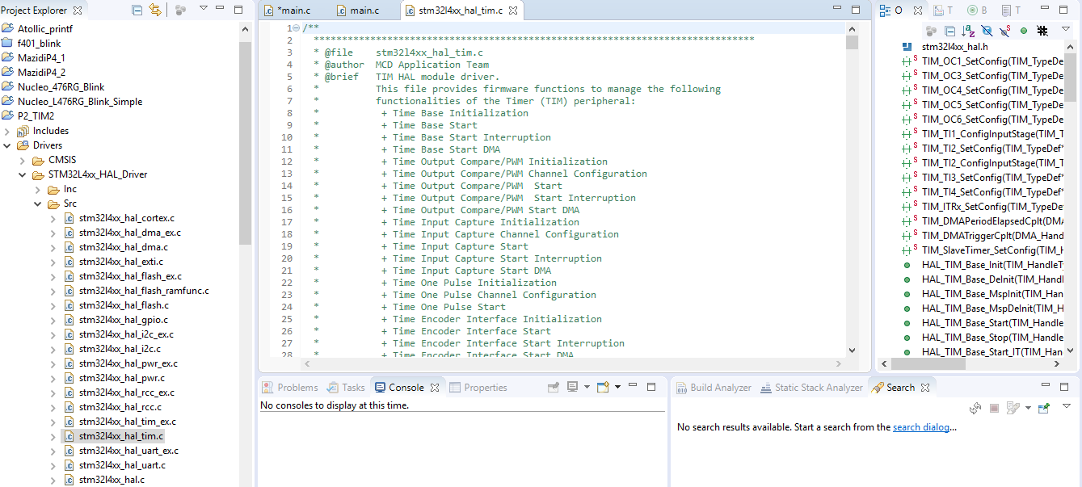
Drivers/STM32l4xx_HALDrivers/Src/stm32l4xx_hal_tim.c
Now browse through function list in the RHS pane

Slide 42
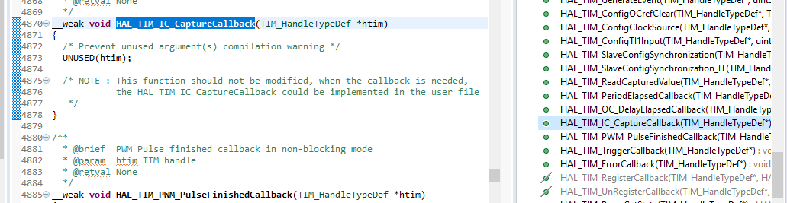
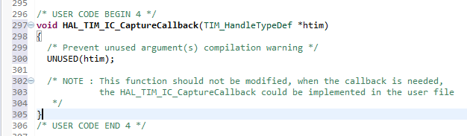
Capture Callback Handler shell
Now we can copy this (without the __weak attribute) to our code to build our handler
Delete the body and add our own

Slide 43
Example using Input Capture
Input Signal
We need two variables for the captured data
We can ping-pong them for following edges

Slide 44
Example using Input Capture
Input Signal
But our timer is free running – so it could overflow between captures
Our calculation has to account for this
(This is less likely with the 32-bit counter.
In this case I also assume that the relative counter clock and input signals only cause one overflow)
Project 2: only one rollover is possible

Slide 45
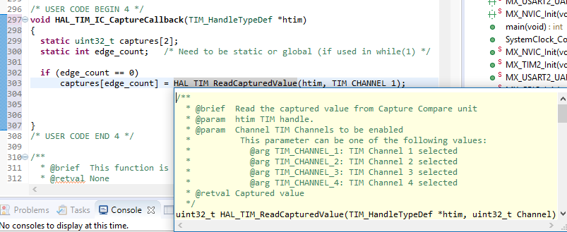
Capture Callback
Use two variable (here in an array) for capture values and a counter to keep track
Use HAL_TIM_ReadCapturedValue() to get the captured register (you could also read TIM2 CCR1 register if not using the HAL)

Slide 46
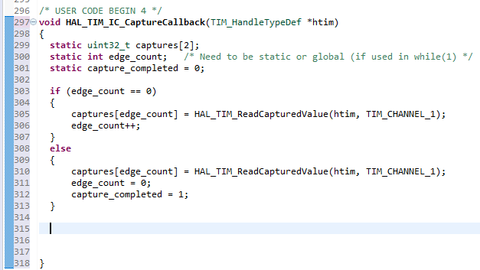
More Capture Callback
We store successive captures
I am going to do the difference calculation here, so I use static local variables, but in your project, these may need to be global because they will be used in the main while(1) loop
I also introduce a completed flag

Slide 47
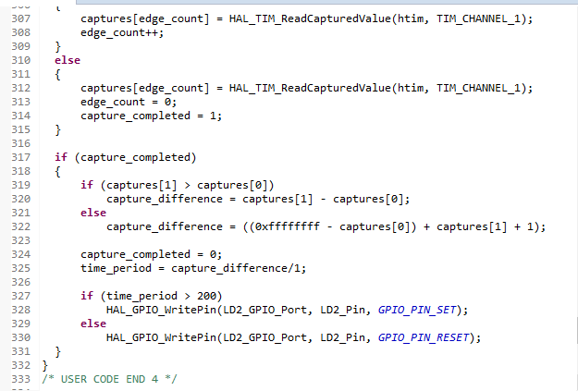
Capture Callback – Clock Difference
To keep everything relatively simple, I did everything in the ISR. In your case, you want to calculate frequency and report to the user, so the calculations would probably be in main- while(1)

Slide 48
Difference calculation - Notes
If captures[1] > captures[0], the count difference is obvious, but if captures[0] > captures[1], then there has been a rollover
If there was a rollover, then the counter counted to it maximum value and started again
Count difference = time to rollover + time to captures[1], time to rollover = max count – captures[0]
Strictly max count is the ARR register, for this 32-bit case I knew I had set it to 0xffffffff

Slide 49
Difference calculation - Notes
To get the Time Difference (and hence the frequency) you should multiply the number of clock cycles by the time per clock
In this example, I knew that the PCLK source to TIM2 was 80 MHz, and the prescaler was set to divide by 80, so each clock was 1us
1 us is a good choice for the frequencies we’re using
Strictly, you should use a HAL library to get the ABP1 PCLK1 frequency and then scale this value with the prescaler

Slide 50
Difference calculation - Notes
In your application, you should return the data to the while loop and do the calculations (especially reporting data to the user) after exiting the interrupt handler
This code just uses the Green LED on the Nucleo board as a status indicator (greater or less than 5kHz (200us period))

Slide 51
Difference calculation - Notes
This code is running on TIM2
TIM1 code is similar but note that the maximum count is 0xffff not 0xffffffff because it’s a 16-bit timer
(In fact, in all cases it is set by the ARR setting – I initialised ARR to 0xffff for TIM1 and 0xffffffff for TIM2)

Slide 52
Summary
Worked example using CubeMX and the HAL libraries to implement a measurement of a periodic signal using the STM32 bit counter in input capture mode

