Slide 1
ED5502 Embedded Software
Lecture 12:
STM32 DMA
Ciaran MacNamee

Slide 2
What we will cover today
We look at the DMA capability of the STM32 family and at its implementation in the STM32L476RG
DMA organisation varies with different STM32 families and Cores

Slide 3
After these lectures you should be able to:
Initialise and use DMA transfers using the STM32 HAL
Initialise and use DMA transfers starting with ST32CubeMX

Slide 4
Direct Memory Access
This is often called an advanced feature of the STM32 family
It supports direct data transfer from an on-chip peripheral device to memory and vice versa
Also supports peripheral-device to peripheral device and memory to memory transfers
All without direct CPU intervention
Apart from initialisation

Slide 5
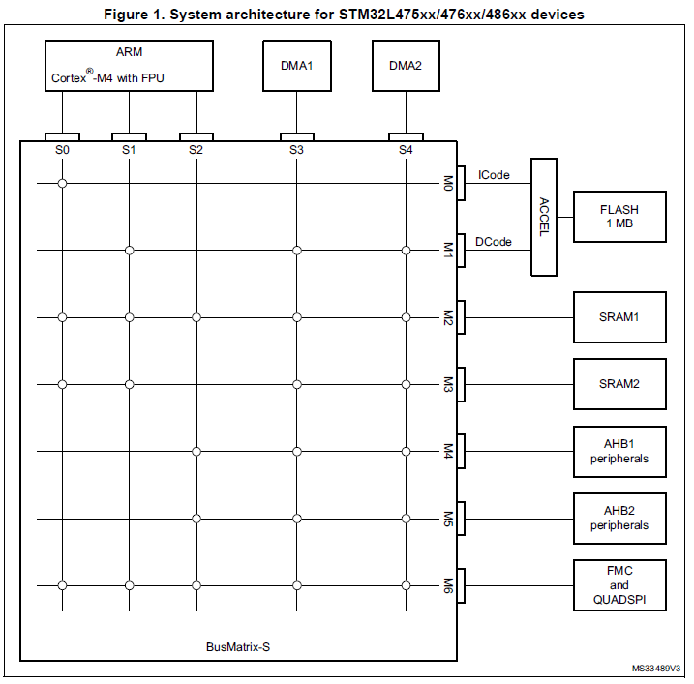
STM32L476 Interconnect
Source: Reference Manual
Diagram shows how the ARM CPU interfaces with memory and peripherals
The two DMA controllers have similar interfaces
Similar but not identical interconnect exists in other STM32 devices

Slide 6
STM32L476 Interconnect
In our examples, the ARM CPU reads a peripheral device and stores its data to SRAM memory

Slide 7
STM32L476 Interconnect
Using DMA, the DMA Controller allows data transfer from the peripheral to memory
The DMA Controller needs the source and destination addresses, number of data elements to transfer, transfer mode etc
These have to be initialised before the DMA can be used

Slide 8
DMA and MCUs
In hardware, complex bus arbitration schemes are needed to decide which devices can use the common buses (which device becomes bus master)
A typical use case is transfer to and from disk
Advanced MCUs can use DMA to reduce computational load on the CPU
In general, a DMA transfer needs to know the number of data elements to transfer and where in memory to find or store data
Requires Global Storage

Slide 9
STM32L476: Two DMA Controllers
Each has 7 channels
Each DMA channel is independently configurable
DMA request signal can come from a peripheral or a software trigger
Programmable priority between the requests (4 levels per channel)
Programmable number of data to be transferred: 0 to 2¹⁶ - 1
Channels can cause an interrupt request

Slide 10
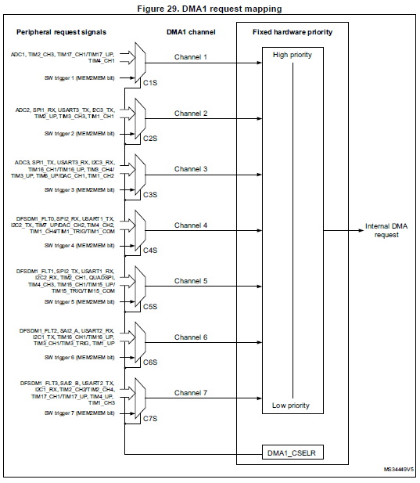
How DMA1 Requests are mapped
Similar arrangement for DMA2

Slide 11
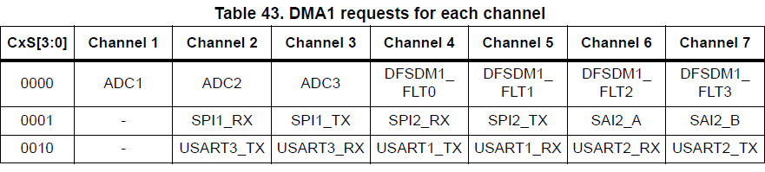
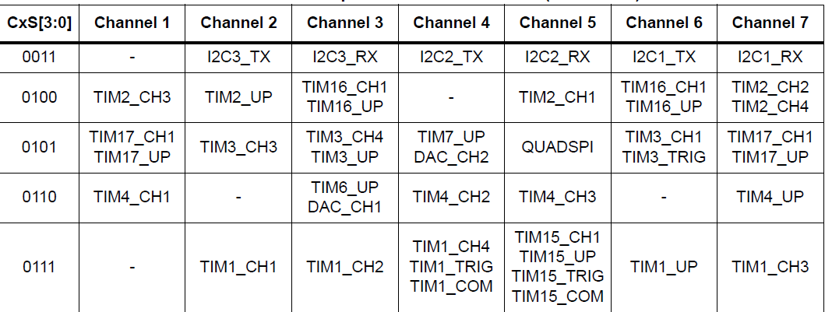
DMA1 Mapping
If you’re using Mazidi’s book, note that the terminology is different here because of differences between STM32F4 and STM32L4

Slide 12
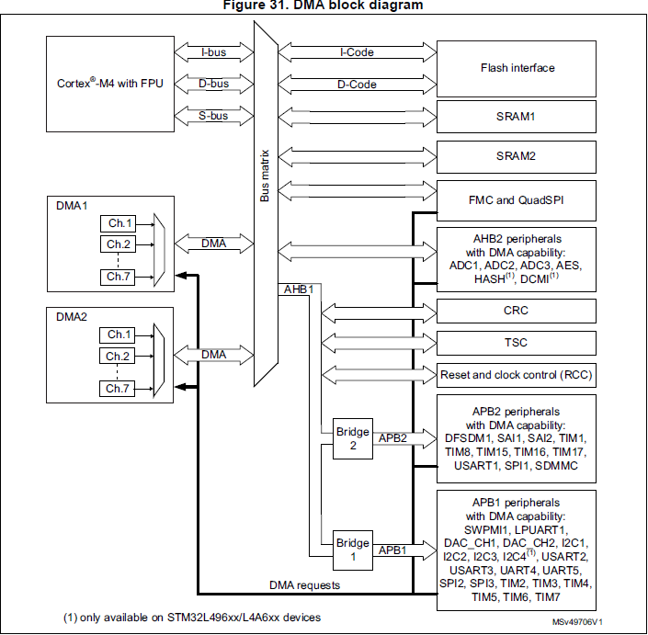
DMA Block Diagram
Single or block data transfer are supported

Slide 13
DMA: What you have to set up
What channel is used
Type of transfer: memory to/from peripheral, peripheral to peripheral, memory to memory
Normal or circular buffer
Data Alignment (size of data)
Increment addresses? Memory addresses should increment, peripherals probably not
Amount of data

Slide 14
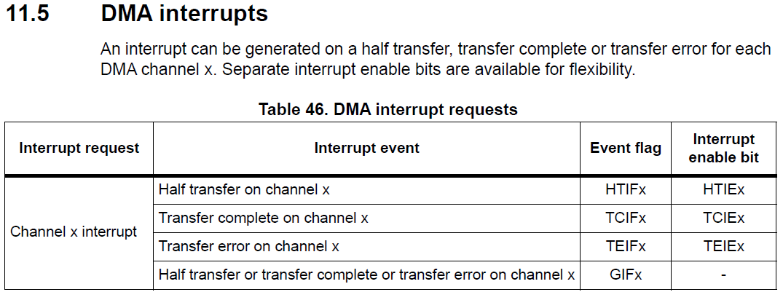
DMA Example: USART2 TX
We will transfer data from memory to the USART TDR register using DMA
Use an interrupt (from the DMA) to indicate when the transfer has been completed
We could poll, but it misses the whole point!

Slide 15
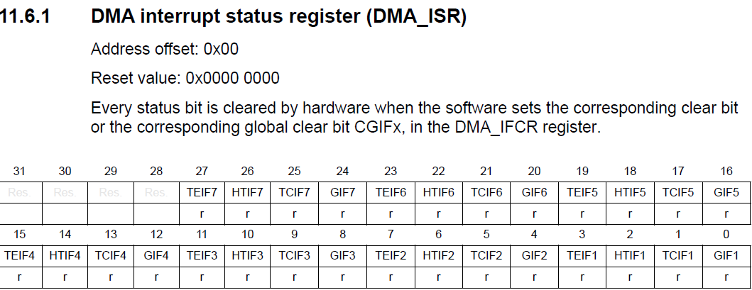
Relevant DMA Registers: ISR
Previous slide explained the meanings of each bit – 4 bits per channel

Slide 16
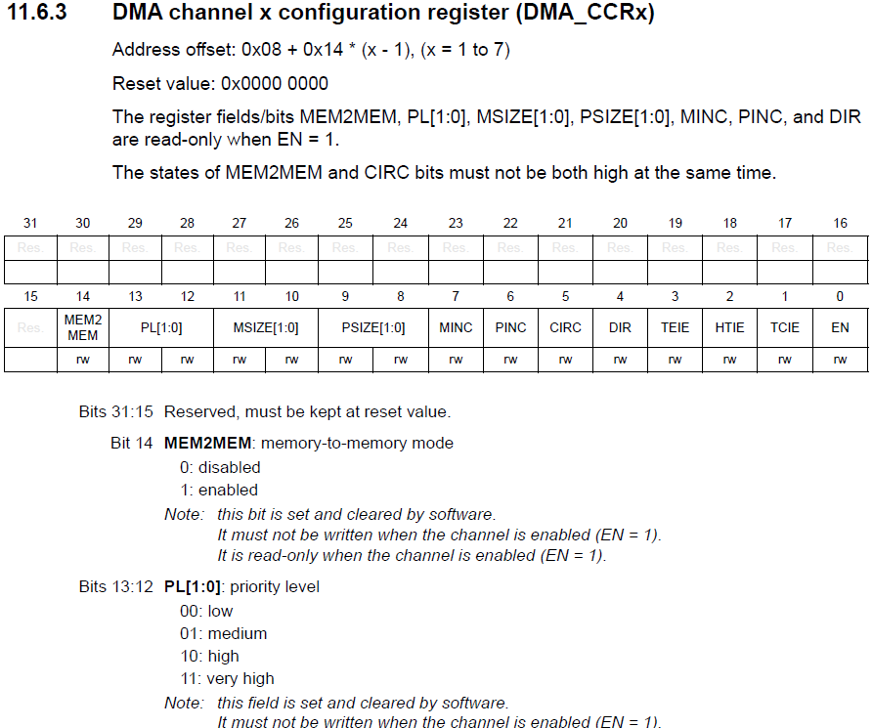
Relevant DMA Registers: Channel CFG
Read from Mem (1) or Peripheral (0)
Inc Mem or Peripheral Address
8-, 16-, 32-bits?
Refer to Reference Manual for other bits

Slide 17
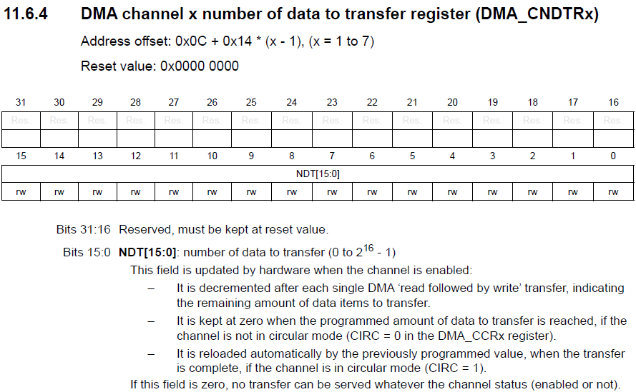
Number of Data Elements

Slide 18
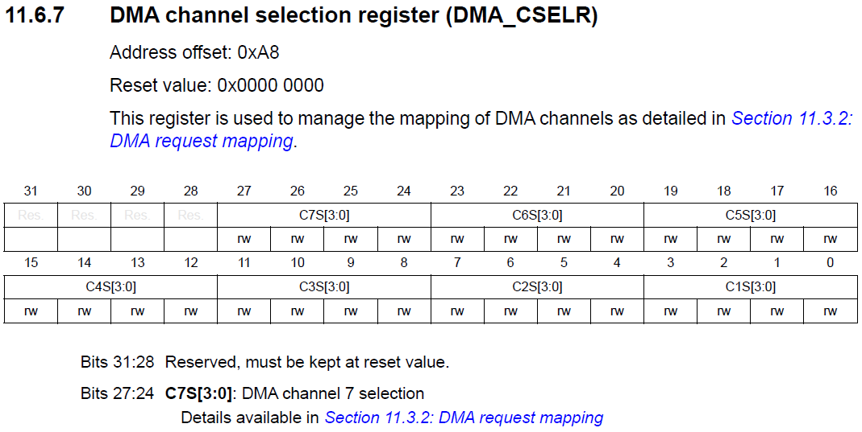
Other Registers
DMA_CPARx and DMA_CMARx specify the Start addresses of the Peripheral or Memory in the transfer
Channel Selection: These bits refer to the table we saw earlier, ie USART or Timer etc

Slide 19
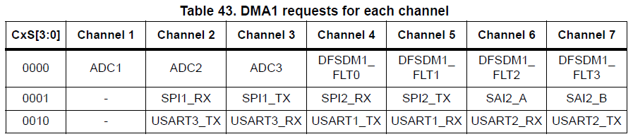
DMA Example: USART2 TX
We will transfer data from memory to the USART TDR register using DMA
Use an interrupt (from the DMA) to indicate when the transfer has been completed
We’ll use the HAL here
First what Channels?

Slide 20
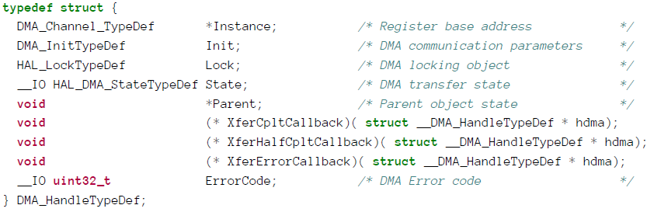
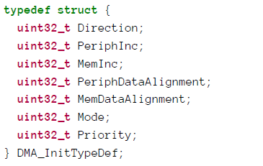
HAL Structs
XferCpltCallback, XferHalfCpltCallback, XferErrorCallback: pointers to callback functions, automatically called by the HAL on a DMA interrupt by the function HAL_DMA_IRQHandler()
Pointers to functions we write
These bits map to the DMA_CCR registers
Normal or Circular
(Memory Buffer)

Slide 21
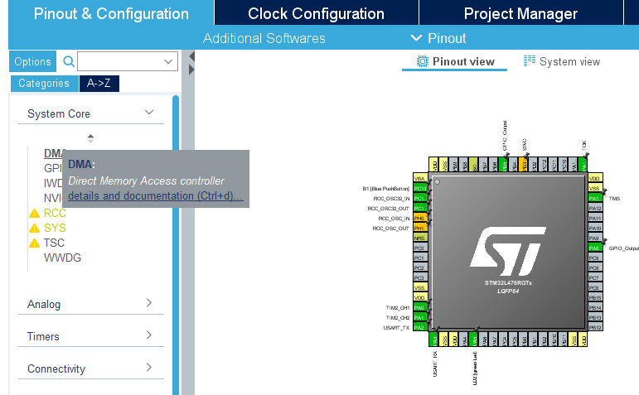
Using CubeMX to set up DMA
Begin by Selecting the DMA option under System Core

Slide 22
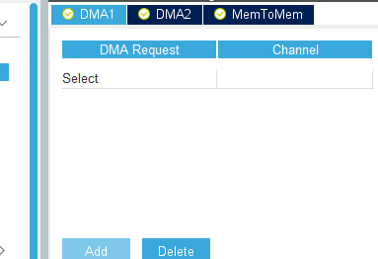
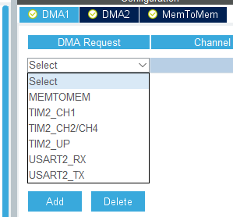
Using CubeMX to set up DMA
Select ’Add’ to enable the Select Pull Down

Slide 23
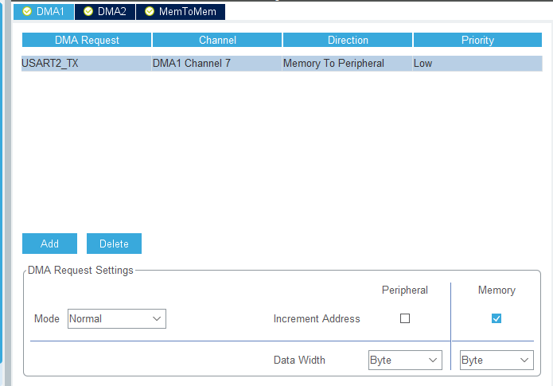
Using CubeMX to set up DMA
The default options make sense
Memory to peripheral and from a memory buffer to the USART TDR
Memory increments
Peripheral does not
Byte transfers because we are using char variable

Slide 24
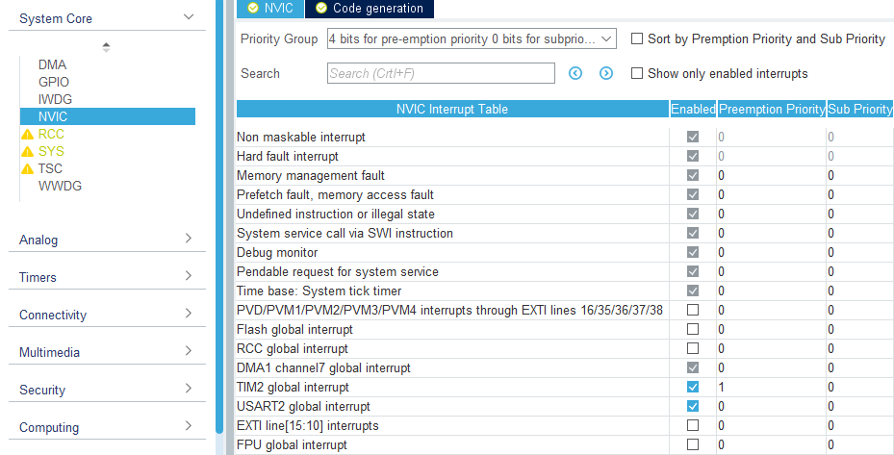
USART DMA with CubeMX: NVIC
Next make sure that the Interrupt Request for DMA1 Channel 7 is enabled

Slide 25
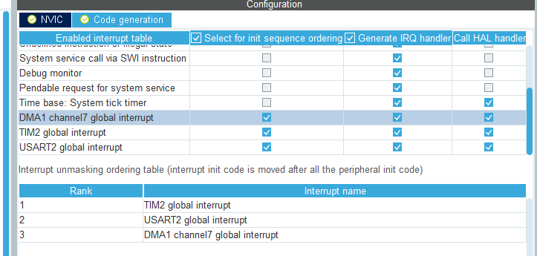
USART DMA with CubeMX: NVIC
Select Code generation to ensure that initialisation, IRQ handling and Call Back will be included in the generated code

Slide 26
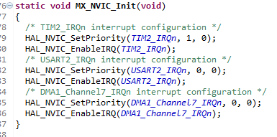
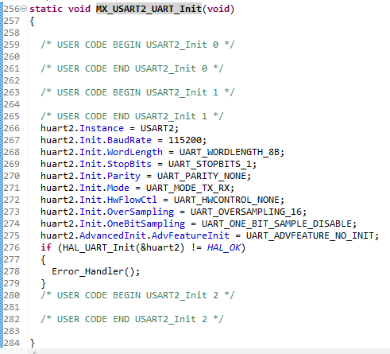
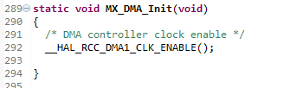
Code generated from CubeMX

Slide 27
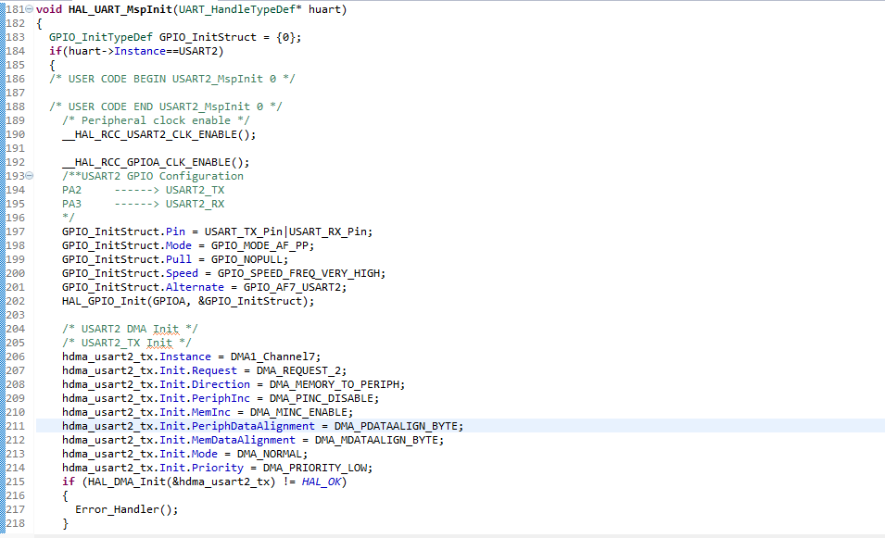
CubeMX Code: stm32l4xx_hal_msp.c
The DMA relevant initialisation is done here

Slide 28

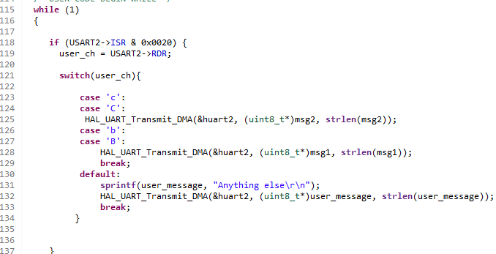
User Code in main.c
Note the similarity to HAL_UART_Transmit_IT();

Slide 29
Summary
Worked example using CubeMX and the HAL libraries to send a string using USART2 and DMA

