Slide 1
ED5502 Embedded Software
Lecture 14:
STM32: FreeRTOS Example
Ciaran MacNamee
See www.freertos.org for FreeRTOS

Slide 2
At the end of this lecture you should be able to:
Distinguish between hard real-time and soft real-time systems
Explain the limitations of foreground / background systems operation
Describe how a real-time kernel organises and schedules tasks
Explain the states that a task can be in
Write the outline of a task to run in a real time operating system or kernel

Slide 3
Real Time Systems: Hard and Soft RT
Think of real-time systems as being systems where events must occur within a fixed time period
The timing behaviour of a system is as important as its logical correctness
Real-time systems can be soft real-time or hard real-time
Soft real-time: tasks are performed as fast as possible, but don’t have to finish by specific times
Hard real-time: tasks have to be performed correctly but also on time
Most hard real-time systems are embedded

Slide 4
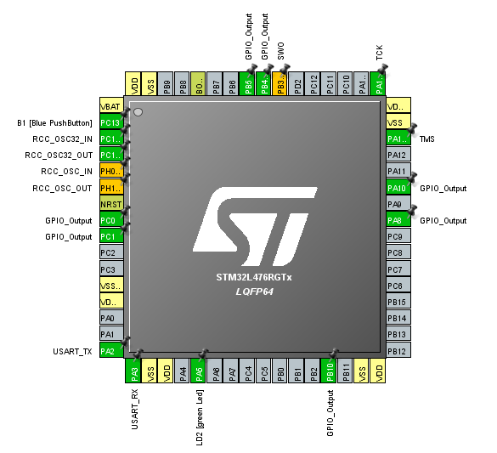
Begin with CubeMX
We use the Nucleo-64 with Defaults
Then enable some GPIO Outputs

Slide 5
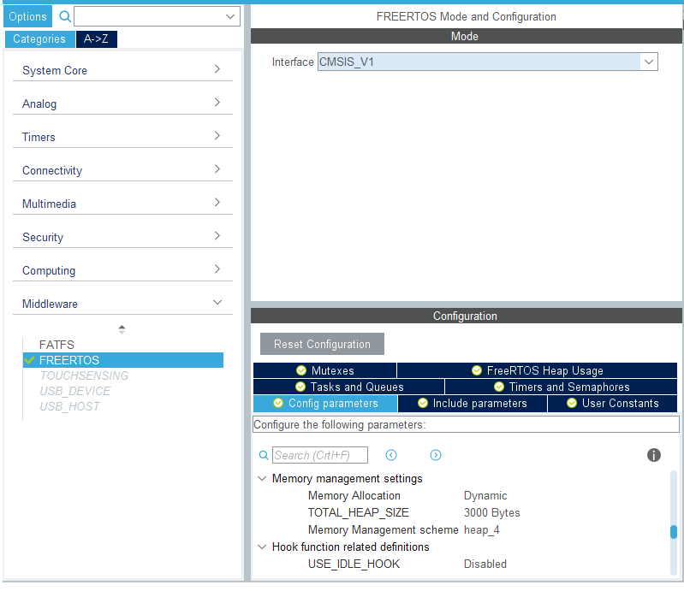
MiddleWare -> FreeRTOS
Only one possible entry in the drop down
These are the types of services you expect in the RTOS
Accept the defaults for now

Slide 6
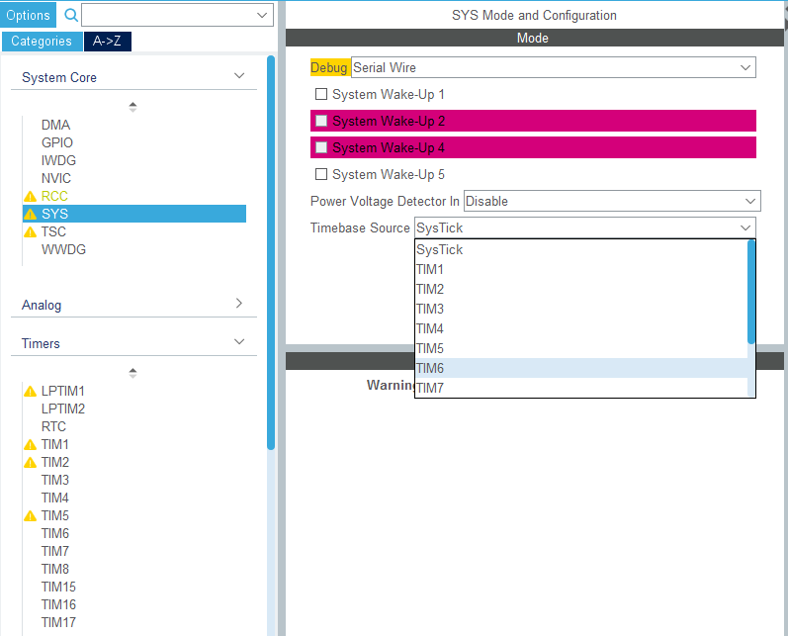
System Tick
We have to change the SYS Timebase source from SysTick
We change it to the Basic Timer TIM6

Slide 7
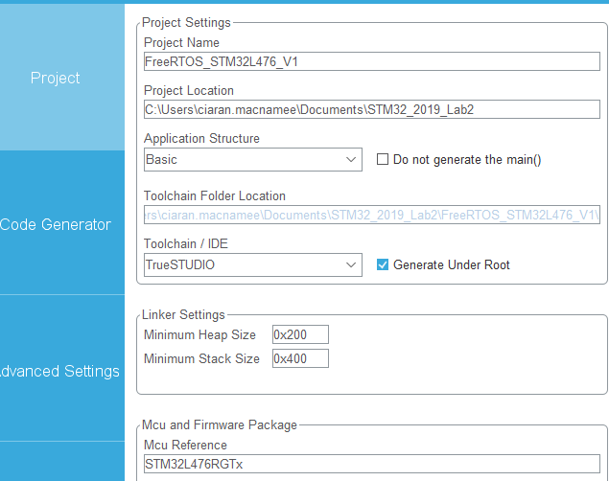
Next Define our Project
Generate Code and open our project as usual

Slide 8
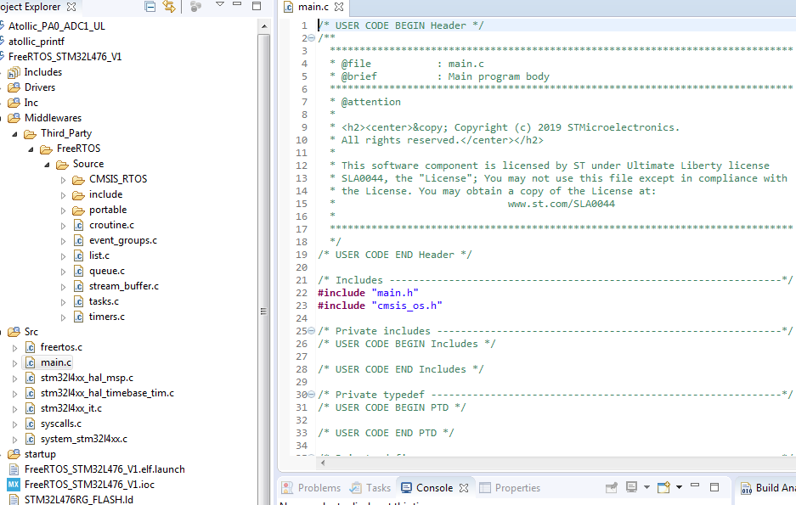
Project in TrueStudio

Slide 9
Project in TrueStudio
These files are new
Note include cmsis_os.h

Slide 10
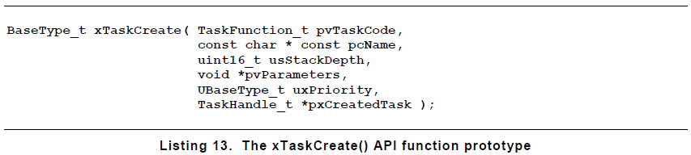
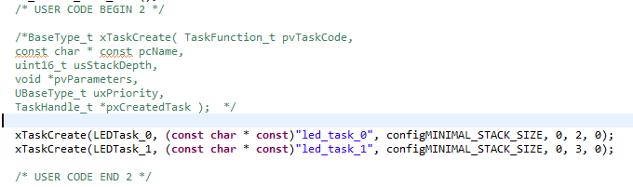
Adding Tasks in FreeRTOS
We will add two tasks to the FreeRTOS code, to toggle LEDs at different frequencies
FreeRTOS documentation gives this API to show how to create a Task
Task Code (ie Task Function)
Priority (High numbers – higher priority)!
Task Handle (could be used to change priority)
Prototypes to create two tasks
Name For documentation only
Each task needs a stack
Passed in parameters

Slide 11
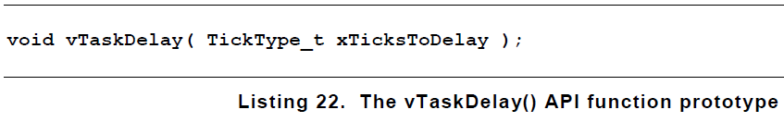
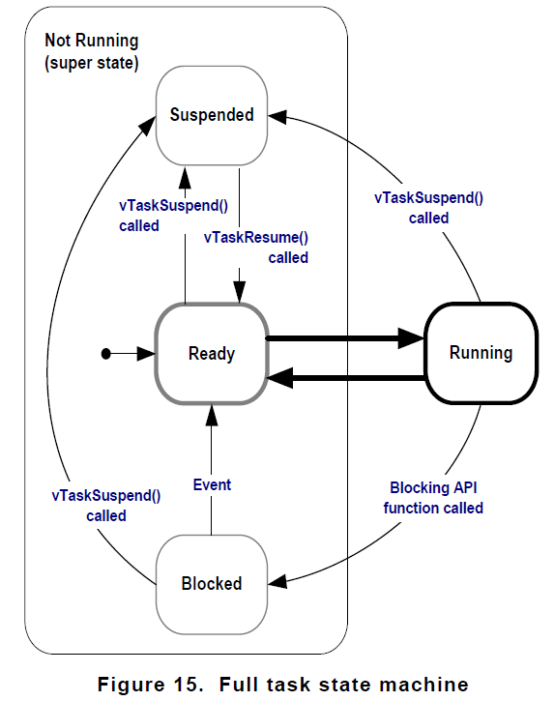
FreeRTOS Delay
This delay is different from the ones we have used
It places the task in the Blocked mode for a fixed number of , so that other tasks can run Tick Interrupts - the task does not use any processing time while it is in the Blocked state

Slide 12
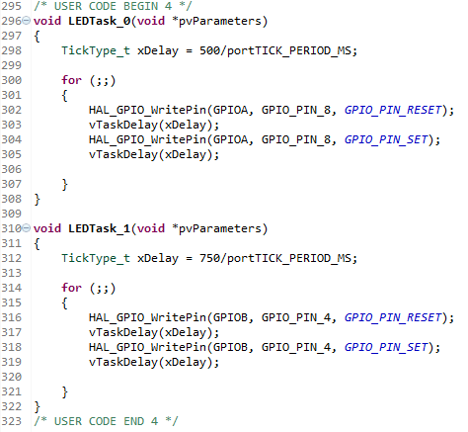
FreeRTOS LED Toggle Tasks
Slight differences in the two tasks
Then just Build and Go as usual
(First compile may be slow)

Slide 13
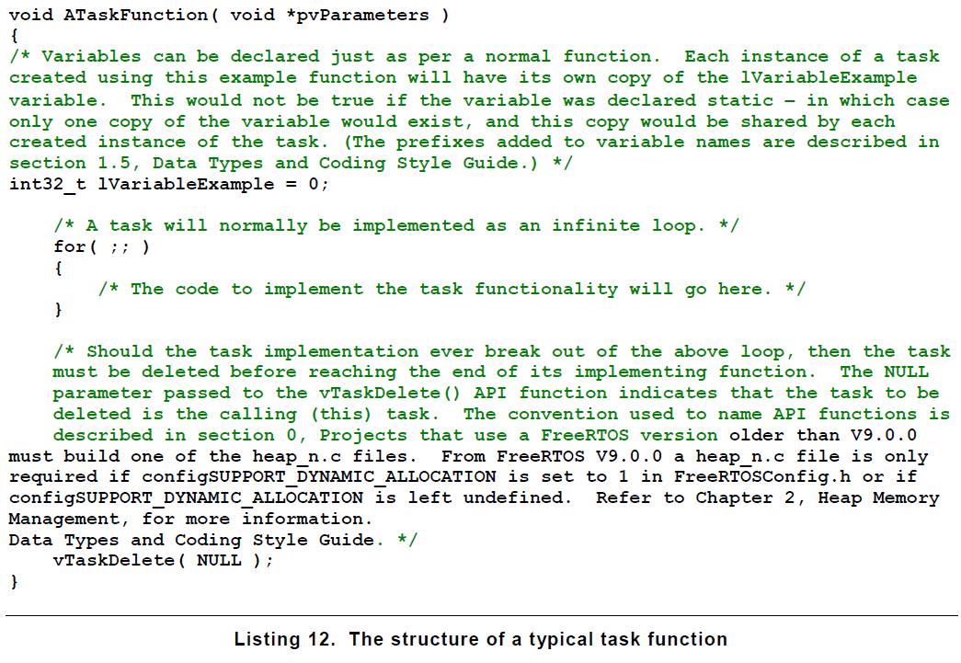
FreeRTOS Task
We omitted this – if our code exits the infinite it should delete itself

Slide 14
Summary
Getting started with FreeRTOS in STM32 with CubeMX is fairly straightforward

