Slide 1
ED5502: Digital Systems 3 Embedded Software
Lecture 1:
Introduction
Ciaran MacNamee

Slide 2
Embedded Systems and Software
Lecturer: Ciaran MacNamee
E-mail: ciaran.macnamee@ul.ie
Room No: ER-2020 (Engineering Research Building)
Tel: 061-213470 (internal: 3470)
Notes:
I’ll use the Sulis site for announcements and project submissions, and I’ll announce open office hours this way, when my timetable is stable.

Slide 3
Embedded Systems and Software: Texts
The Definitive Guide to ARM Cortex-M3 and Cortex-M4 Processors, by Joseph Yiu
Newnes, 3rd Edition, ISBN-13: 978-0-12-408082-9
STM32 Arm Programming for Embedded Systems, by Muhammad Ali Mazidi et al
www.microdigitaled.com
Programming with STM32 Nucleo Boards, by Dogan Ibrahim
Elektor Publication, ISBN-13: 978-1-907920-68-4
Programming with STM32: Getting Started with the Nucleo Board and C/C++, by Donald Norris
McGraw-Hill, ISBN-13: 978-1260031317
There are many other ARM Cortex-M textbooks
Notes:
There are many ARM Cortex books around. These are some that I have used in this module. The first is a reference text, and goes into a lot of detail about the Cortex M3 and M4 architecture. The early material is based on this book and I return to it towards the end of the module too.
The other texts are more practical.

Slide 4
Assessment
Programming is a practical discipline – we learn best by doing
So Module assessment:
Final exam: 30%
Homework assignments: 4 x 5% each (20%)
Labs & Projects: 50%
Project 1: 20%
Project 2: 30%
Labs Start Week 2

Slide 5
At the end of this course you should be able to:
Describe what is meant by an embedded system
Explain how C, assembly, machine code relate to each other
Describe the Cortex M3 and M4 architectures and explain how the elements of the architecture influence how devices are programmed
Program the I/O peripherals in a microcontroller
Program a microcontroller in an embedded system
In C and possibly in Assembly Language
Build and debug the software for a simple embedded system
Notes:
Embedded systems programming takes in a wide variety of programming styles from quite abstract descriptions to low-level operations.
In this module, we are going to look at the detailed organisation of a microcontroller so we will look at the machine code and assembly code running on the device as well as the at the source code that produced it.
The main emphasis will be on programming a microcontroller in a simple embedded system and on debugging our code and getting it working.

Slide 6
Embedded Microcontrollers
An embedded microcontroller is a microcomputer that contains most of its peripherals and the memory it needs along with a CPU on a single IC
Around for over 35 years: Intel 8051 (8-bit CPU) was one of the earliest MCUs – still widely used
You find it everywhere – window winders in a car, intelligent payment systems – a long list
Other processors include 6801 (sold in billions), PIC, etc
ARM 32-bit MCU has become the dominant 32-bit microcontroller
Notes:
A few words on the origins of microcontrollers as opposed to microprocessor devices.
Some of you may be familiar with the 8051 MCU. Today, Arm Cortex devices are dominant 32-bit MCU architecture around – although there are still some other competitors for 32-bit embedded systems design.

Slide 7
Computers are all around
Computers are found everywhere … Not just in ‘computers’
E.g., a car might have up to 100 embedded computers in it
Mobile Phones, Pagers, MicroWave ovens, washing machines, VCRs, DVD/CD players, TVs, MP3 players, Remote controls etc all incorporate Microprocessors
A Telephone switch is an embedded computer
An electronic toy might be an embedded computer
Your calculator probably has more processing power than the guidance computer used by Apollo 11 for the first moon landing.
Notes:
One way of thinking about embedded systems is as computing systems that don’t look like computers. This slide has a few examples – but there are millions of examples.

Slide 8
Microcontroller Families
Most microcontrollers come in ranges of families
So you can get many types of 8051 MCU: they differ in the amount of memory, the peripherals (types of I/O) they have, the packages they come in, and so on
Usually you pay for what you get: more memory and I/O costs more
Embedded systems are extremely cost sensitive
You usually try to use the cheapest possible microcontroller that will do the job
Development tools are a big part of the decision
Notes:
There are many variants of the Arm Cortex M3 and M4, for example. Microcontrollers containing M3 or M4 are also programmed in a similar way but the end use and cost of the devices vary widely.
You pay for higher performance, for more memory and I/O pins. I/O pins are expensive, as are higher clock frequency support and low power modes.
A difference of only a few cents could mean the difference between making and losing money on a given product.
So cost is a big issue.
But time to market is also important – so the good development tools are very important

Slide 9
The Internet of Things
Embedded computers are very widespread
You have been using them for years, maybe without realising it
Mostly these devices have been working standalone or with limited communications to other devices
But (and it’s fairly obvious) what if they could communicate and especially over the internet?
So now we will have millions of sensors and controllers all interconnected using the web
Thus we have the Internet of Things (IoT)

Slide 10
ARM Cortex
In this module we use microcontrollers based on the ARM Cortex M3 or M4 core
This microcontroller has an ARM Cortex-M processor core along with on chip program and data memory and I/O peripheral devices that can interface to the real world
You can build embedded system that is small and low cost with a microcontroller like this
But ARM is a powerful CPU so it can do very complex operations
And ARM can be very low power – longer battery life

Slide 11
ARM Cortex families
ARM processors have many generations
Recent generations are named Cortex
Cortex processors have three profiles
A – High performance (iPads, servers)
R – High performance but deterministic operation for Real-Time (hard drive controllers, automotive drive trains)
M – Deeply Embedded microcontrollers, low power, low cost, high efficiency
Notes:
Cortex devices come in different profiles – we use the M profile.

Slide 12
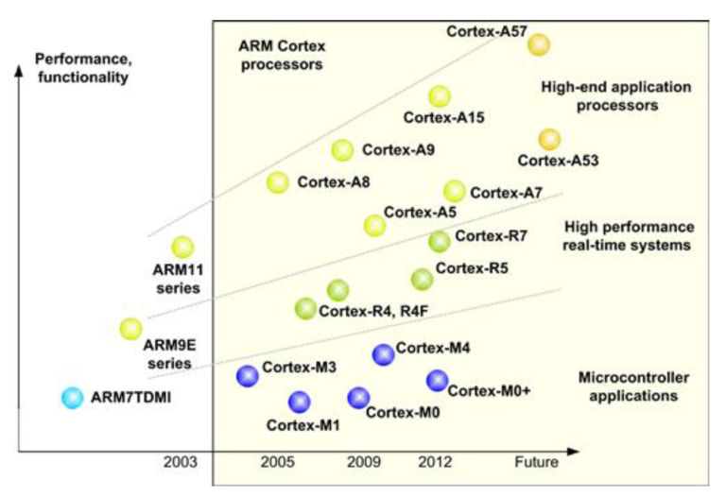
ARM Families and Architectures
J. Yiu, The Definitive Guide to ARM Cortex-M3 and Cortex-M4 Processors, 3rd ed, Newnes 2014
Notes:
This diagram from Yiu’s book shows the relationships between the Cortex profiles

Slide 13
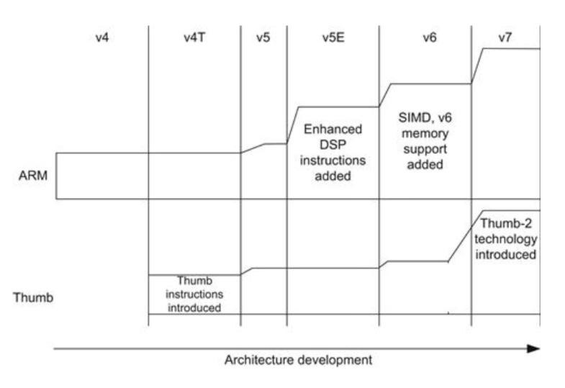
ARM Families and Architectures
ISA Versions
J. Yiu, The Definitive Guide to ARM Cortex-M3 and Cortex-M4 Processors, 3rd ed, Newnes 2014
Notes:
The term ISA means Instruction Set Architecture and it determines what the CPU can do.
Arm processors have gone through many generations and unlike x86 generations they are not binary compatible with each other.
Cortex processors may implement v6, v7 or v8 versions of the Arm ISA.
Cortex M3 and M4 (our focus) implement the v7 ISA.
Note that Crtex m0, M0+ and M1 processors implement the earlier (and smaller) v6 ISA

Slide 14
ARM Cortex M3 and M4
Cortex-M3 (2005) and Cortex-M4 (2010) are 32-bit processors designed by ARM
The Instruction Set Architecture (ISA) used in the Cortex-M processors is the Thumb ISA based on Thumb-2 Technology
Supports a mixture of 16- and 32-bit instructions
Earlier ARM processors had separate ARM (32-bit instructions) and Thumb (16-bit instructions) and you had to transition between modes to use each one
Notes:
Using a 32-bit instruction word simplifies the CPU design but at the cost of larger code. Using 16-bit instructions reduces code size, at the cost of more decode logic. Some instructions were not available in 16-bit operation, so earlier Arm processors had to switch operating modes from 32-bit Arm instructions to 16-bit Thumb instructions.
Arm ISA v7 contains 16-bit and 32-bit instructions so you don’t need to transition between modes – this is a better option for programmers.

Slide 15
ARM Cortex M3 and M4 features (1)
Three-stage pipeline
Harvard bus architecture with unified memory space: same address space for instructions and data
(von Neumann at ISA level, Harvard at implementation level)
On-chip bus interfaces based on AMBA
NVIC interrupt controller: up to 240 interrupt requests and 8 to 256 interrupt priority levels
Support for implementing OS: system tick timer, shadowed stack pointer
Notes:
Some architecture details.
Note:
von Neumann architecture: single memory space for code and data
Harvard architecture: separate code and data memory spaces
Many modern CPUs are von Neumann at the ISA level, but Harvard atht eth implementation level.
What are the advantages of doing this?
Also note that Arm has a very powerful interrupt mechanism and has built-in support for operating system design.

Slide 16
ARM Cortex M3 and M4 features (2)
Sleep mode and other low power features
Support for optional Memory Management Unit (MMU)
Bit Band: support for bit-data accesses in two specific memory areas
Can be used in single-processor or multiple processor designs
Notes:
These are desirable embedded system features.

Slide 17
ARM Cortex M3 and M4 ISA
General data processing, including hardware multiplication and division
Memory access instructions support 8-, 16-, 32- and 64-bit data and multiple 32-bit data transfers
Bit-field processing instructions
Multiply Accumulate (MAC) and saturate instructions
Unconditional and conditional Branches and function calls
Instructions for system control, OS support etc
Notes:
A summary of aspects of the ISA

Slide 18
ARM Cortex M4 ISA
Single instruction multiple data (SIMD) operations
Additional fast MAC and multiply instructions
Saturating arithmetic instructions
Optional floating point instructions (M4F option)

Slide 19
ARM Cortex M family
Cortex-M3 and –M4 are based on the ARMv7-M architecture
Cortex-M0+, -M0 and –M1 (for FPGAs) processors are based on the ARMv6-M architecture (smaller ISA)
Choice of processor depends on the end application
Older ARM7, ARM9 processors are not Cortex processors
Notes:
Arm Cortex M0 designs are very low cost, hence the emphasis is on a smaller COU core – lower area so lower cost.

Slide 20
Cortex-M processor family
Notes:
This illustrates the end use and performances to be expected form different Cortex processor or processor cores.

Slide 21
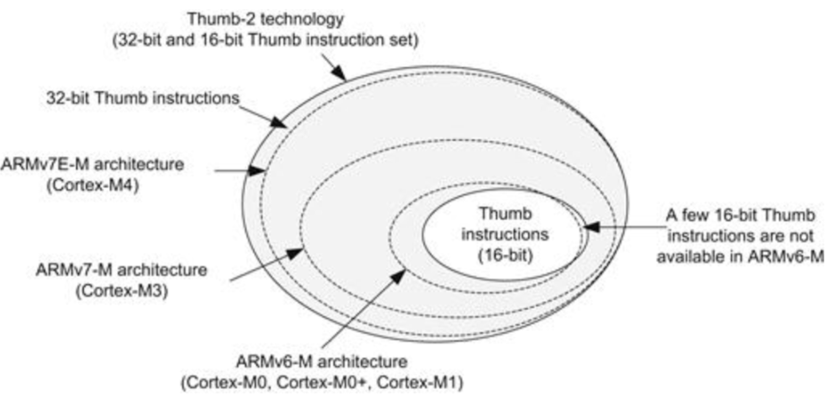
Cortex-M processor family
Relationships between Instruction Set Architecture Versions
Notes:
This slide illustrates the relationships between Instruction Set Architecture Versions for M profile Cortex devices.
Cortex M3 and M4 are quite similar. M4 is s superset of M3.

Slide 22
ARM Processors and Microcontrollers
ARM does not make microcontrollers: it designs Processors
ARM processors are licensed to manufacturers who design microcontrollers using ARM cores
A microcontroller contains a processor and also on-chip memory and hardware I/O modules like ADCs, Ports, Timers etc
Semiconductor companies license ARM processors and surround the processor with I/O modules and varying amounts of memory
This differentiates products from each other
Notes:
One of the key points about Arm is that Arm processors are designed by Arm, but sold as IP to semiconductor manufacturers.
Analog Devices, NXP, ST microelectronics, Texas Instruments and many others licence Arm core designs and build a microcntroller around the Arm Core – we’ll see an example next slide.

Slide 23
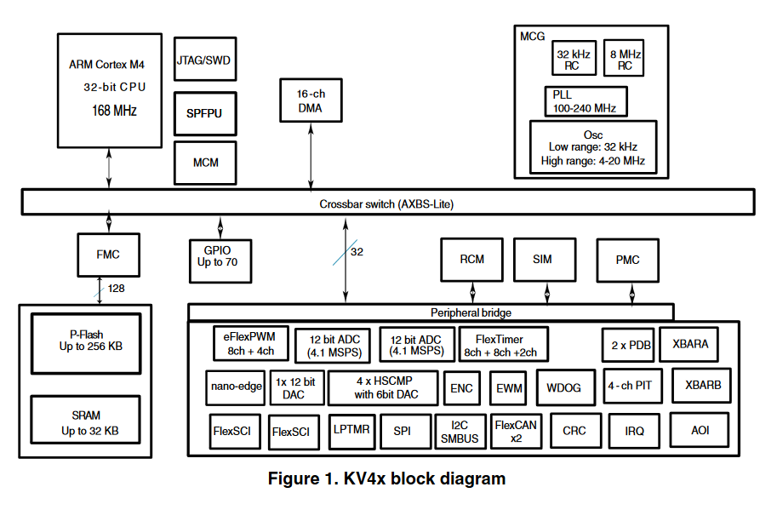
ARM Cortex-M4 based microcontroller
CPU is just one part of the microcontroller
Notes:
This is a typical Cortex M4 microcontroller. (This one is a Kinetis microcontroller, now supplied by NXP).
You can see that the Arm processor is just one component of the microcontroller. The semiconductor manufacturer has designed and implemented (or re-used) the other blocks that define the microcontroller’s overall functionality. Other devices would have a different mix of on-chip functional modules or might have more or less memory, or might run at different clock frequencies.

Slide 24
Features of ARM Cortex M Processors
Low Power, High Performance, Energy Efficient
Code Density
Interrupts: Configurable interrupt controller
Ease of use, C friendly Scalable
Debug support
OS support
Software portability
Wide range of support tools from multiple vendors
Notes:
Advantages of ARM Cortex M Processors
Low Power: ARM cores are small and designed for low power consumption
High Performance: Cortex M3/M4 score highly using established perfomance benchmarks
Energy Efficiency
Code Density: Thumb-2 ISA can encode many instructions in 16-bits, meaning the amount of memory to realise a given program or task can be minimised
If you can fit your program in a smaller memory you can reduce costs
Interrupts: The Cortex M3/M4 interrupt controller is configurable, supporting up to 240 vectored interrupts and multiple levels of interrupt priorities
Ease of use, C friendly: Simple Cortex memory map supports efficient C compilers
Scalability
Debug features: very important for time-to-market reasons
OS support
Software portability
Widely range of support tools from multiple vendors

Slide 25
C and C++ Programming Languages
All processors execute binary or machine code
But you can generate machine code in many ways
The closest thing to machine code is to program in assembly language
Gives great insight into the details of the microcontroller
But assembly programming is processor dependent – not portable – and often is more detailed than you want
C is a high level programming language that allows access to the low level resources of a microcontroller but is easier to use
We use C and possibly a small amount of assembly
Notes:
As you know, a processor executes binary machine code. This slide illustrates how the machine code is produced from the source files that you write.
C and C++ are commonly used embedded software programming languages, though scripting languages like Python are starting to become popular too. For this module we use C, and possibly some assembly code.

Slide 26
Computer instructions are in bits
Computer instructions are formed from binary bits
The instructions are simple operations such as arithmetic and logical operations like Add, Subtract, Move data, Test a condition and so on
These instructions are what the computer can do
The CPU fetches the binary patterns, decodes them and completes executing the specified operation
Notes:
A graphic showing program fetch from memory to the processor.
Note that I tend to use the terms CPU (Central Processing Unit), MPU (Micro Processing Unit), processor and microprocessor interchangeably.

Slide 27
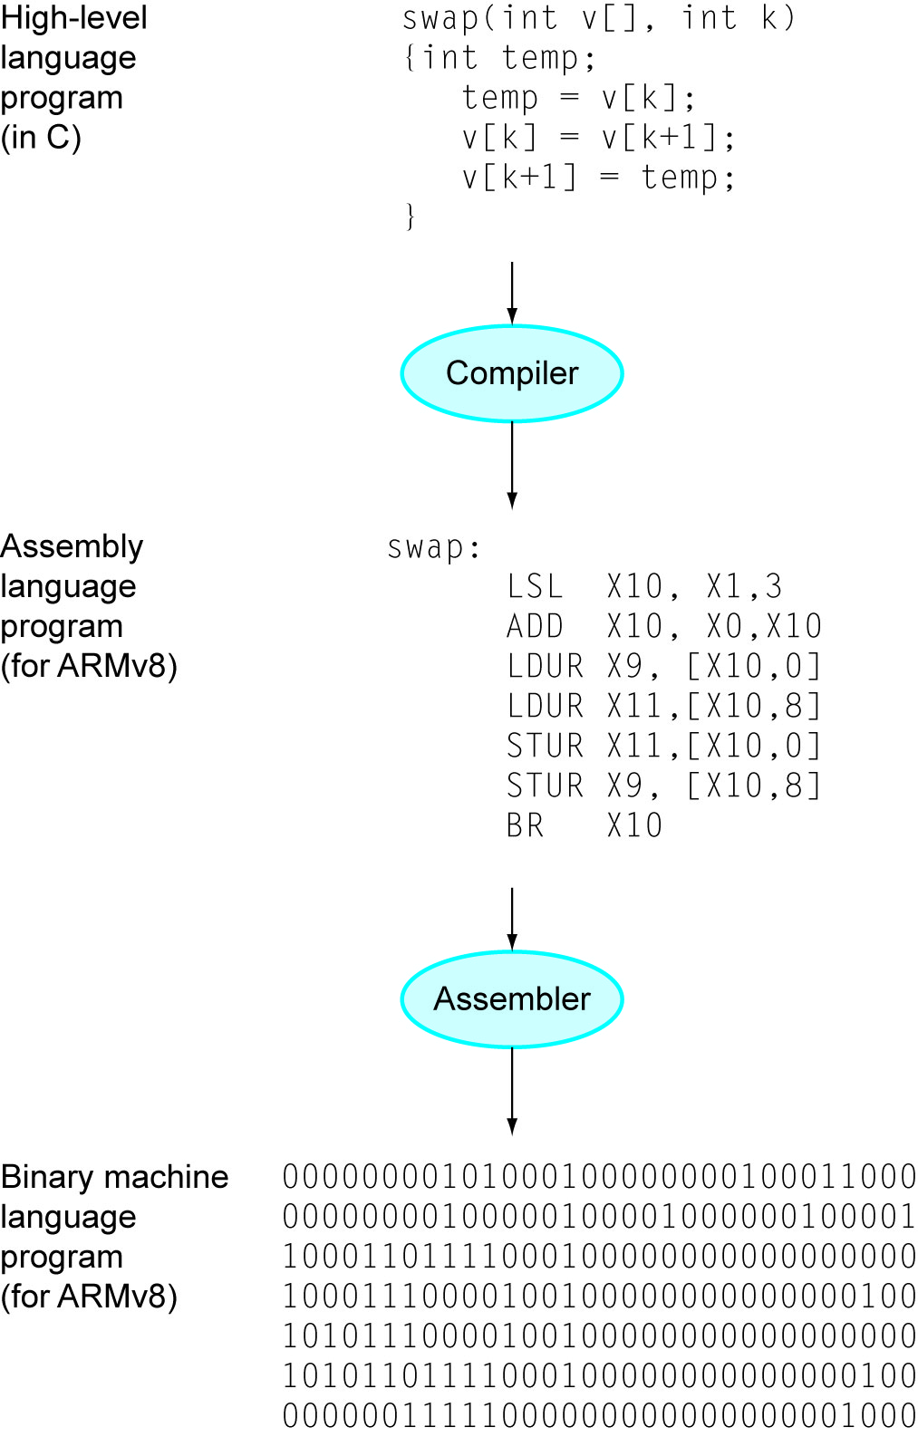
Higher level computer languages
This is how High Level Computer Languages, Assembly Language and Machine code are related
For programming, we use tools to generate lower level code from higher level code
Notes:
A graphic showing the relationships between C source, assembly code and machine code. This is shown for ARM v8, but it’s the same for ARM v7.

Slide 28
Support tools
ARM provides many tools to support chip design based on ARM processors as well as tools to support AEM software development
Many third-party vendors also provide ARM software development tools and IDEs
An IDE is an Integrated Development Environment - typically includes a compiler, linker, program loader or flash programming tool as well as debugging tools all within the same Environment
Atollic IDE for STM32 Cortex-M microcontrollers
Notes:
Development support tools are essential for programming embedded systems. We are using the STM32L476RG microcontroller in an ST Nucleo-64 development board. It is supported by a number of powerful development environments, including Keil, mbed and Atollic. The Atollic IDE is based on the Eclipse and uses the open source GNU compiler collection (gcc) C compiler, linker and also includes a debugging interface.

Slide 29
STM32 and ARM
ST Microelectronics is an ARM Cortex-M licensee: produces Cortex-M microcontrollers under the generic name STM32
The STM32 portfolio includes Arm®Cortex®-M cores (M0, M0+, M3, M4 and M7)
STM32 feature: it’s easy to port applications from one device to another
Devices have similar pinouts and are supported by good tools
We use STM32 & the Atollic TrueStudio IDE
Notes:
ST Microcontroller produces a wide range of microcontrollers based on the various Cortex cores.

Slide 30
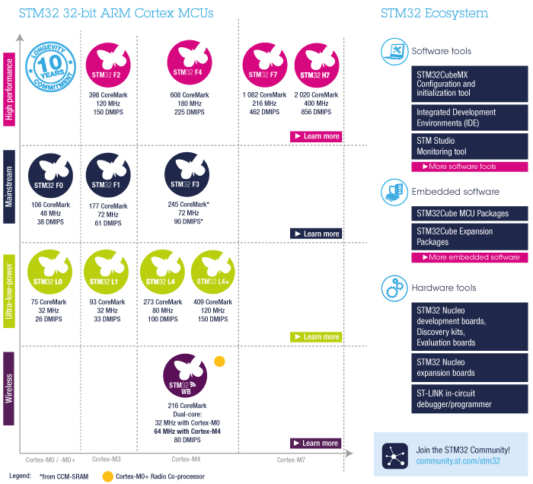
STM32
Colour code refers to performance grades
Notes:
ST Microcontroller produces a wide range of microcontrollers based on the various Cortex cores.
This diagram illustrates the performance ranges that they broadly cover.
In this module I chose the L4 series because of its low power applications.

Slide 31
Development Tools: Software and Hardware
Software Tools: C/C+ compiler based on the Gnu Compiler Collection (gcc) ported to ARM
Development Environment: Atollic TrueStudio –GCC compiler for ARM supports STM32 (ARM) microcontrollers
https://atollic.com/truestudio/
Hardware Tools: STM32L476RG Nucleo Board
CPU: ARM Cortex-M4 Core running at up to 80MHz
1MB Flash program memory, 128 KB SRAM Data memory
On-board debugging and programming interface
Notes:
You should download True Studio for your PC as we use this environment during the module. The first lab session steps you through the process.

Slide 32
STM32 Nucleo Boards
Small low-cost development boards based on the 32-bit ARM Cortex Architecture
Compatible with Arduino shields (but be careful of voltage levels) as well as ST Morpho based boards
Compatible with mbed, Atollic, and other debugging and programming environments
Over 32 different boards of varying sizes available using a number of different STM32 microcontrollers
Notes:
ST produce a large number of development boards and kits. We use the STM32 Nucleo-64 boards. -64 refers to the number of available pins: -32 and -144 boards are also available.

Slide 33
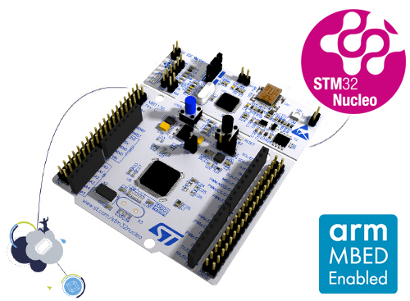
STM32 Nucleo 64 Boards
Arduino UNO R3 headers mean it can interface with (3.3V) Arduino Shields
STM32 Nucleo-64 boards are an affordable way for users to try out
new concepts and build prototypes with the STM32 microcontrollers
Arduino™ Uno R3 connectivity support and the ST morpho headers
STM32 Nucleo-64 board does not require a separate probe - integrates the ST-LINK/V2-1 debugger and programmer.
Comes with the STM32 comprehensive software HAL library
Nucleo-144 and Nucleo-32 boards are also available
Notes:
We can add Arduino shields to this board for some project work, but note that you must be careful if the Arduino shield you use is running at 5 volts.

Slide 34
Summary
Overview of ARM Cortex-M microcontrollers and place of M3 and M4 in the family
Overview of Cortex M3 and M4 features
STM32 L476RG MCU and its Nucleo-64 development board

