Slide 1
ED5502 Embedded Software
Lecture 3:
Software Development for ARM Cortex-M and STM32 MCUs: CMSIS and STM32CubeMX
Ciaran MacNamee

Slide 2
What we will cover today
Review ARM processor and microcontrollers
C Data types relevant to embedded development
Microcontroller I/O and software
CMSIS and STM32CubeMX

Slide 3
What’s in an ARM microcontroller?
Program memory (e.g., flash memory)
SRAM
Peripheral devices
Internal bus infrastructure
Clock generator
(including Phase Locked Loop), reset generator, and clock distribution network
Voltage regulator and power control circuits
Other analog components (e.g., ADC, DAC, voltage reference circuits)
I/O pads
Support circuits for manufacturing tests, etc.

Slide 4
Programming a microcontroller
Some microcontroller resources are visible to programmers, some are not
For programming, we need a basic understanding of the processor, and the programmer’s model of the peripherals
Programmer’s model? The control, status and data registers that are the way a programmer views the on-chip peripheral
Peripherals are mostly designed by chip manufacturers not ARM
We need these microcontrollers’ data books

Slide 5
Programming a microcontroller
Peripherals’ data and control registers are accessible from the memory map
Most microcontroller vendors provide C header files and driver libraries
These files are often developed with the Cortex Microcontroller Software Interface Standard (CMSIS)
They use a set of standardized headers for accessing MCU features

Slide 6
Programming the Peripherals
Typically we need to initialise the peripheral devices:
Enable the clock signal connection to the peripheral, and possibly clock signal connection to corresponding I/O
Configure the operation mode of the I/O pins
Configure the Peripheral, using control registers
Configure the Interrupt controller (NVIC) if using interrupts with the peripheral
Notes:
Programming the clock control circuitry to enable the clock signal connection to
the peripheral, and clock signal connection to corresponding I/O pins if needed.
Typically the clocks to peripherals are turned off by default
and you need to enable the clock before programming the peripheral.
You mmay need to configure the operation mode of the I/O pins. Most
microcontrollers have multiplexed I/O pins that can be used for multiple purposes.
In order to use a peripheral, it might be necessary to configure its I/O pins to match
the usage (e.g., input/output direction, function, etc.) as well as its electrical characteritics.
Peripheral configuration. Most peripherals contain a number of programmable
registers that need configuration before using the peripheral. In some cases, you
can find the programming sequence a bit more complex than that of a 8-bit microcontroller,
because the peripherals on 32-bit microcontrollers are often much
more sophisticated than peripherals on 8-bit/16-bit systems. On the other hand,
often the microcontroller vendors will have provided device-driver library code
and you can use these driver functions to reduce the programming work required.
Interrupt configuration. If a peripheral is to be used with interrupt operations, you
will need to program the interrupt controller on the Cortex-M3/M4 processor
(NVIC) to enable the interrupt and to configure the interrupt priority level.

Slide 7
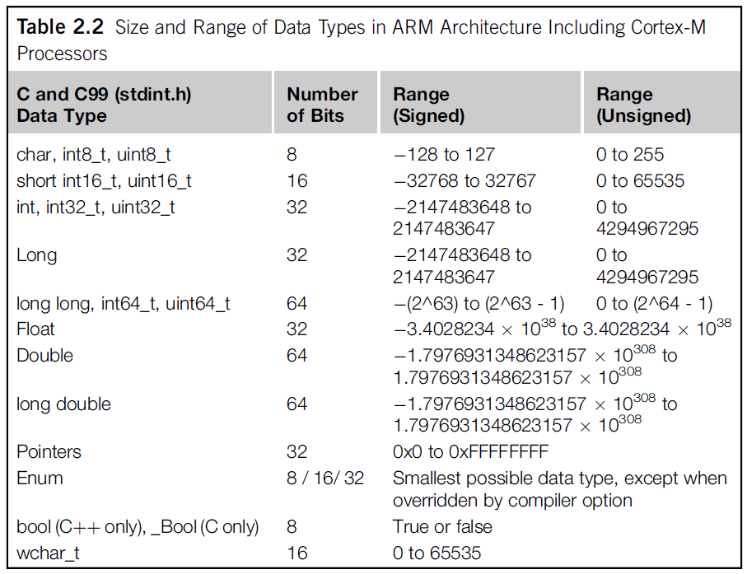
Data Types sizes

Slide 8
Inputs, Outputs, on-chip peripherals
Microcontrollers have various Input/Output (I/O) interfaces and peripherals such as timers, Real-time Clock (RTC) etc
Most are vendor designed not ARM designed
On ARM microcontrollers, the peripherals are memory-mapped
The registers are accessed as addresses in memory
In C programs, we can use pointers to read and write these registers

Slide 9
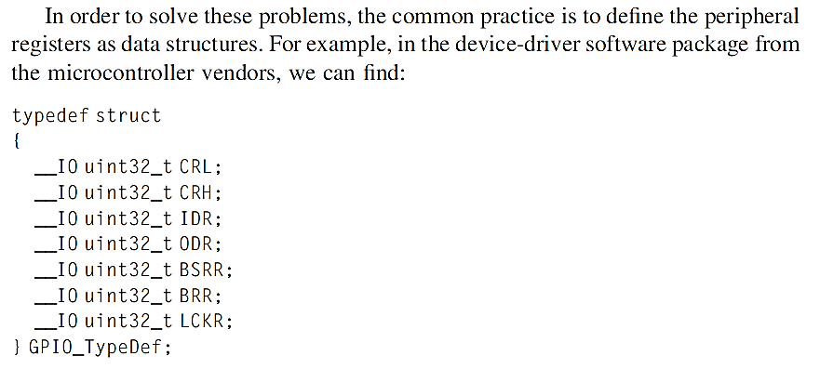
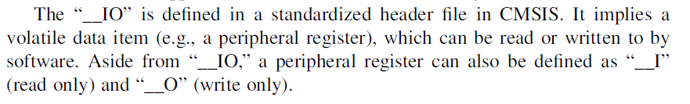
Efficient definition of GPIO registers

Slide 10
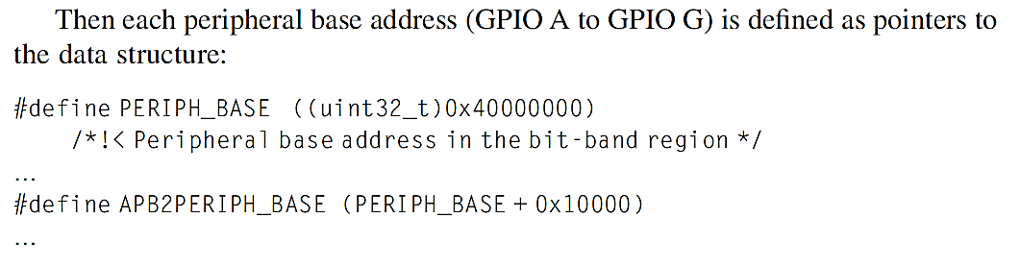
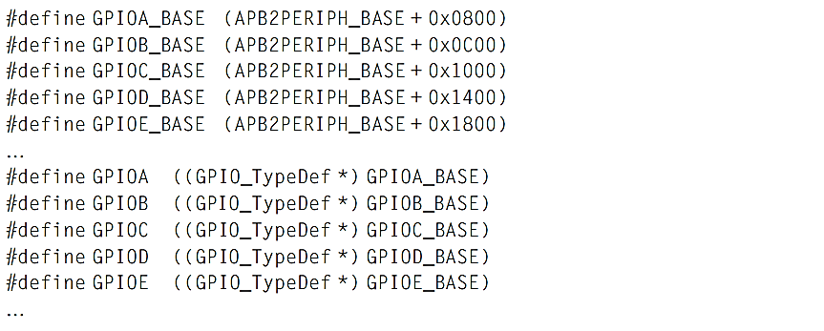
Efficient definition of GPIO registers

Slide 11
CMSIS
CMSIS: Cortex Microcontroller Software Interface Standard
A consistent software infrastructure for Cortex-M software developers, aims:
Software reuse
Software compatibility
Ease of use
Toolchain independent
Open: CMSIS core files source code can be downloaded from Github
New CMSIS projects have also been released
eg CMSIS-RTOS, CMSIS-DSP, etc

Slide 12
CMSIS Standardises:
Definitions for the processor’s peripheral registers including:
Nested Vector Interrupt Controller (NVIC)
System tick timer in the processor (SysTick)
Optional Memory Protection Unit (MPU)
Programmable registers in the System Control Block (SCB)
Some software programmable for debugging

Slide 13
CMSIS Standardises:
Standardized functions to access processor features, including interrupt control functions using NVIC, and functions for accessing special registers in the processors
You can still access the registers directly, but using the access functions (or Application Programming Interface, API) helps portability
Standardized functions to access special instructions (e.g., Wait- For-Interrupt, WFI)
Alternatives like intrinsic functions or inline assembly make the software less reusable

Slide 14
CMSIS Provides:
Function names for system exception handlers
Using standardized names makes it easier to develop software solutions across multiple Cortex-M products
Important for embedded OS developers, as the embedded OS requires the use of several types of system exception
A common platform for device-driver libraries
Each device-driver library has the same look and feel, making it easier to learn

Slide 15
CMSIS Functions for System Initialisation
Arm microcontrollers require configuration of clock circuit and power management registers before the application starts
CMSIS-compliant device-driver libraries place these configuration steps in a function called “SystemInit()” – provides:
Standard variables for clock speed information
Information to set up the baud rate in a UART, or initialize the SysTick timer for an embedded OS
A software variable called “SystemCoreClock” is defined in the CMSIS-Core.

Slide 16
CMSIS-Core: Organisation
Microcontroller vendors integrate CMSIS files into their device-driver library packages
Arm provides some of the device-driver library files – common across all or most Arm implementations
Vendors provide vendor/device specific files

Slide 17
CMSIS-Core Organisation: Layers
Core Peripheral Access Layer
Name and address definitions, and helper functions to access core registers and peripherals - processor specific - provided by ARM
Device Peripheral Access Layer
Name and address definitions of peripheral registers, system implementations such as interrupt assignments, exception vector definitions, etc. - vendor or device specific
Access Functions for Peripherals
The driver code for peripheral accesses.
Vendor specific and optional

Slide 18
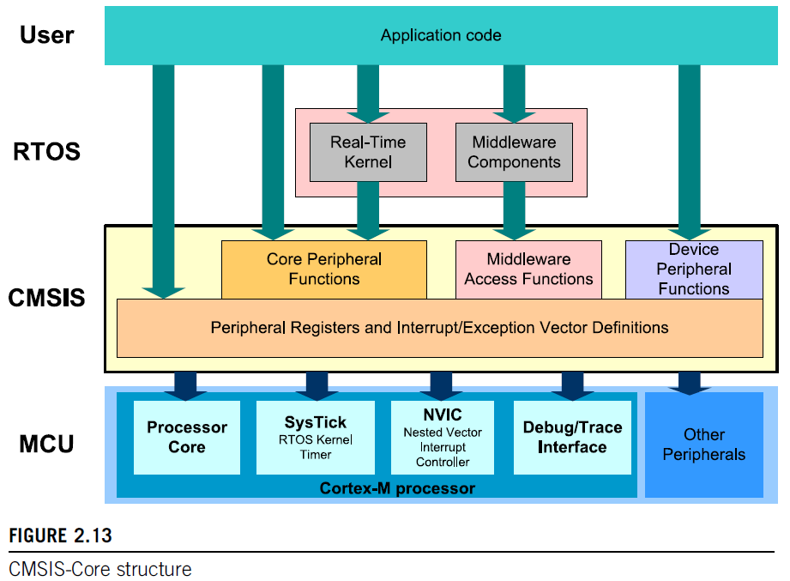
CMSIS-Core Organisation: Layers

Slide 19
Using CMSIS Core (1)
Add source files to project, includes:
Device-specific, toolchain-specific startup code, in assembly or C
Device-specific device initialization code (e.g., system_<device>.c)
Additional vendor-specific source files for peripheral access functions. Optional.

Slide 20
Using CMSIS Core (2)
Add header files into the project search path:
A device-specific header file for peripheral registers definitions and interrupt assignment definitions. (e.g., <device>.h)
A device-specific header file for functions in device initialization code (e.g., system_<device>.h)
A number of processor-specific header files (e.g., core_cm3.h, core_cm4.h; - generic for all microcontroller vendors)
Optionally additional vendor-specific header files for peripheral access functions

Slide 21
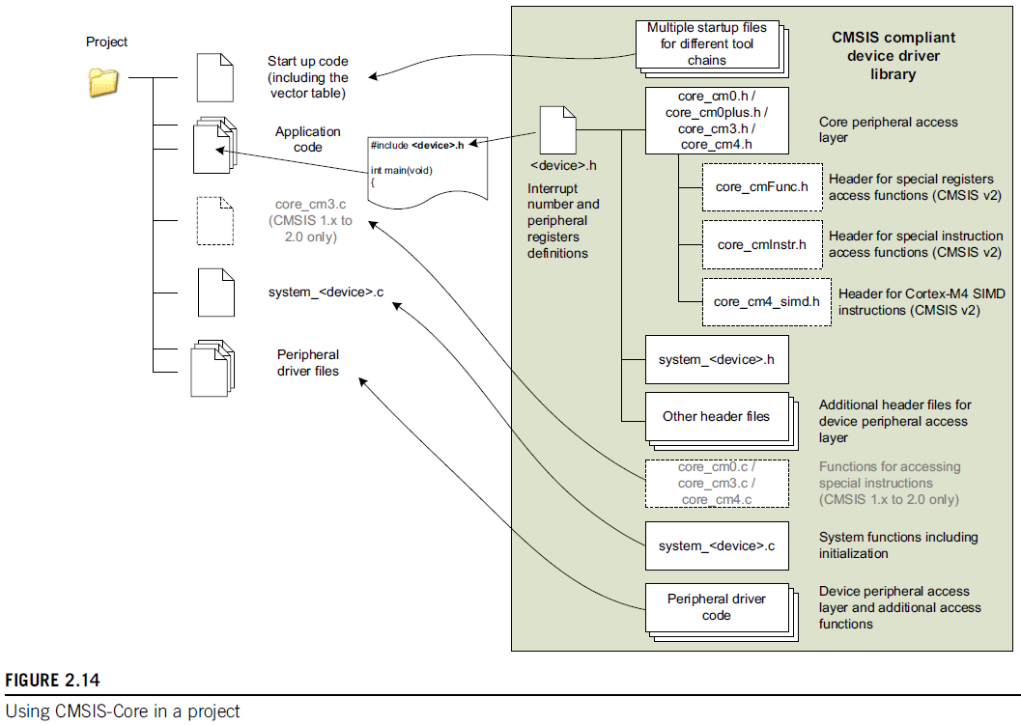
Using CMSIS Core
CMSIS supported across many tool-chains (Keil, IAR, GNU etc)

Slide 22
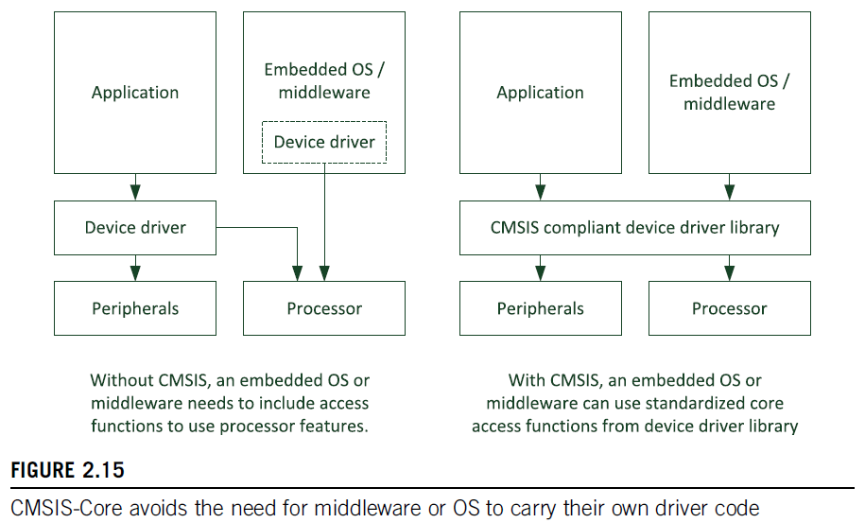
CMSIS Benefits for OS and middleware
Find the latest CMSIS version: https://developer.arm.com/embedded/cmsis

Slide 23
STM32CubeMX and STM32Cube
STM32CubeMX: part of STM32Cube
Productivity tools for STM32 microcontrollers
STM32Cube includes:
STM32CubeMX, a graphical software configuration tool that allows automatic generation of C initialization code using graphical wizards
STM32CubeProgrammer
STM32CubeMonitor-Power

Slide 24
STM32Cube also includes
STM32Cube MCU Packages, for each MCU series
Example: STM32CubeF4 for STM32F4 Series
Each package includes:
STM32Cube hardware abstraction layer (HAL) STM32Cube low-layer APIs
Middleware components such as RTOS, USB, TCP/IP, and graphics.
Embedded software utilities with peripheral and application examples

Slide 25
STM32CubeMX and STM32Cube
These tools make development task easier at the cost of hiding some details
Some of these details are what we want to see, so we do some work with and without STM32Cube
(The first lab exercise uses STM32CubeMX and you need to download it and also the STM32Cube package for STM32L4)

Slide 26
Summary
C Data types for embedded development
C data types and variable sizes
Port and on-chip peripherals naming conventions – set by CMSIS
Arm CMSIS as a standard way of using on-chip peripherals
Microcontroller I/O and software
STM32CubeMX and automatic code generation

