Slide 1
ED5502 Embedded Software
Lecture 5:
STM32 Clocks Configuration
STM32 USART
Ciaran MacNamee

Slide 2
What we will cover today
STM32 Clock Sources and use
STM32 USART – serial I/O to communicate with other devices (eg PC, eg Wireless interfaces)
We have already seen that we have to enable the clocks to a peripheral (in general)
But we need to know a bit more now to use the USART because it makes use of the clocks to determine its Baud Rate (transmission rate in bits per second)

Slide 3
STM32L476RG Clocks
STM32L476RG has 4 clocks that can be used as the clock source for various on-chip devices
This is quite complex, as many options can be set up
You can generate an internal clock of up to 80MHz using an on-chip PLL
For now we will use the MSI clock source (default) and set the PLL to multiply this clock source to 80MHz when needed
This is done in STM32CubeMX when you make the project using Board Selector (TrueStudio) or set the clock to 80 MHz (Keil)

Slide 4
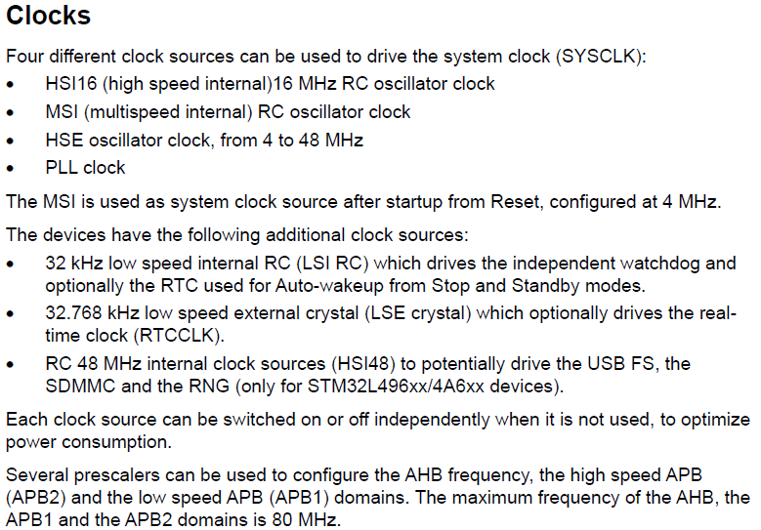
STM32L476RG Clocks (Reference)
The MCU initialisation code is where you would normally set up the option you want to use
Not fitted on Nucleo64 boards
(But could be, with some soldering!)
Reference Manual p205
Notes:
The internal clock sources HSI16 and MSI are not very accurate (MSI is about 1% when trimmed for 25 degC)
You can calibrate MSI using a low speed crystal (32.768 kHz clock as used in watches etc)
Providing them really brings down costs

Slide 5
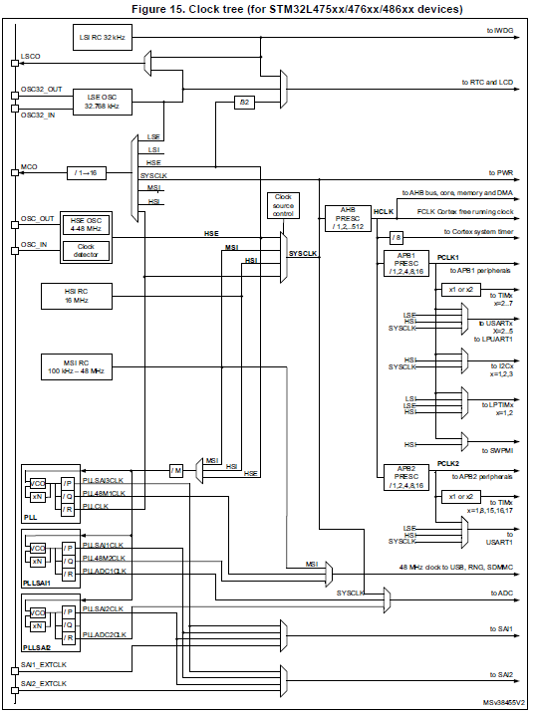
STM32L476RG Clock Tree
Reference Manual p208
Notes:
There are many clocks used in STM32L476RG. Most are derived from SYSCLK with some exceptions.

Slide 6
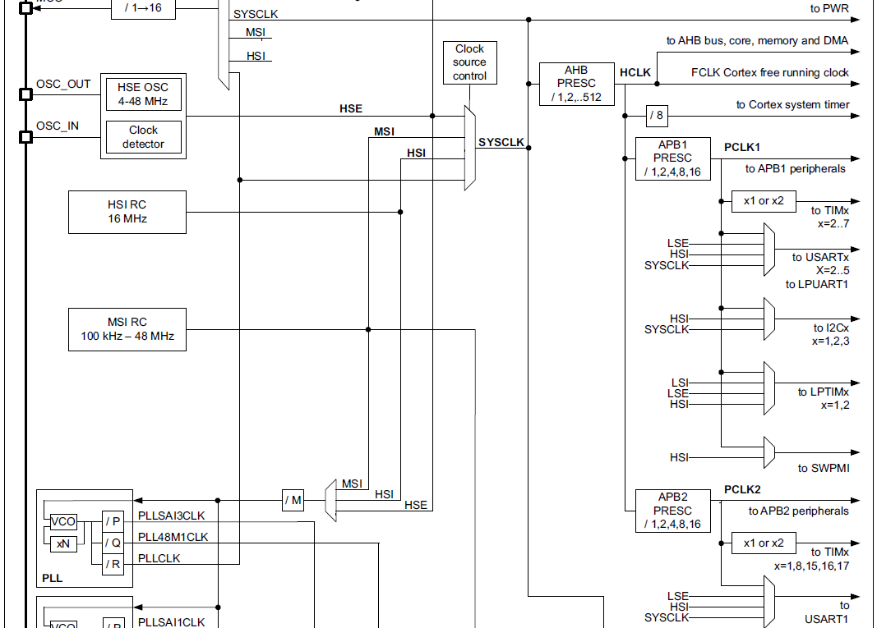
STM32L476RG Clock Tree (Detail)
Reference Manual p208
Notes:
This is a detail of the clock tree

Slide 7
STM32L476RG Clock Tree (Detail)
SYSCLK is the Clock source for the CPU and most peripherals
Reference Manual p208
HCLK is the Clock source for the CPU and peripherals on the AHB buses
Notes:
This is a detail of the clock tree

Slide 8
STM32L476RG Clock Tree (Detail)
Four possible sources for SYSCLK: HSE, HSI16, MSI48 and PLLCLK (for high frequency operation)
Reference Manual p208
Notes:
This is a detail of the clock tree

Slide 9
STM32L476RG Clock Tree (Detail)
Note the division ratios
PCLK1 is the Clock source for most APB1 peripherals and possibly USARTs, Timers
USART2 is on APB1
Reference Manual p208
PCLK2 is the Clock source for APB2 peripherals and optionally USART1
Notes:
This is a detail of the clock tree

Slide 10
Introduction: serial ports
Serial communication - sending multiple bits over a single wire
Bits are separated in time so the receiver can determine the logic level for each bit
The Universal Synchronous and Asynchronous serial Receiver and Transmitter (USART) is used to communicate with other microcontrollers or with a PC
STM32L476RG has 4 USARTS, 1 LPUART and also several synchronous serial ports like I2C, SPI, SAI etc
What do you think is the difference between synchronous and asynchronous serial ports?

Slide 11
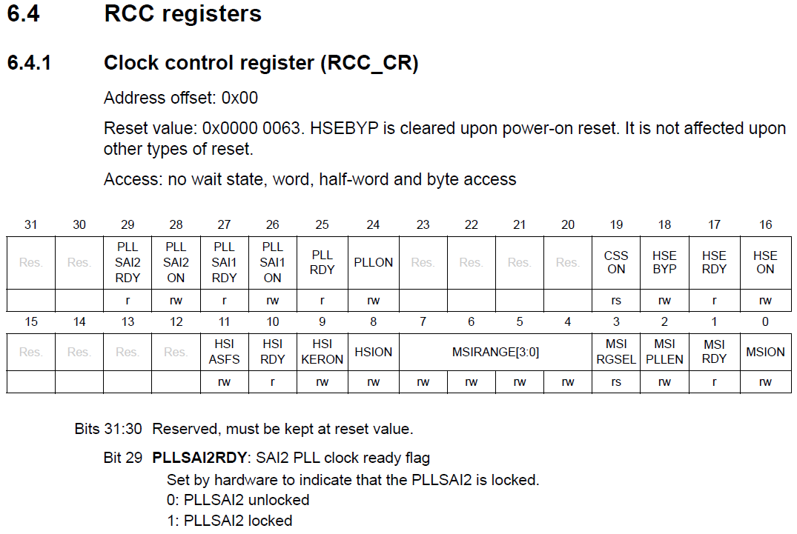
Selecting the clock options
RCC_CR allows you set up (and check status) of these clocks
Reference Manual Pp 223 - 226
Example bit. See ref manual for the others

Slide 12
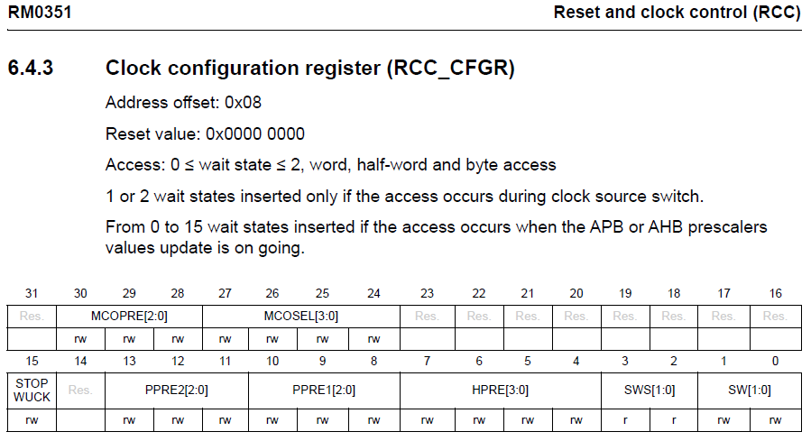
Selecting the clock prescale options
RCC_CFGR allows you set up how the peripheral clocks are prescaled
Reference Manual P 227

Slide 13
Introduction: serial ports
Most often the USART communication we use is asynchronous –transmitter and receiver do NOT have a common clock to synchronise the data
Asynchronous serial communications uses a start bit and one or more stop bits
The receiver uses the start bit to determine the timing of each data bit
NB: Serial Comms has a Transmit pin (TxD) and a Receive pin (RxD)
TxD of device A connects to RxD of device B

Slide 14
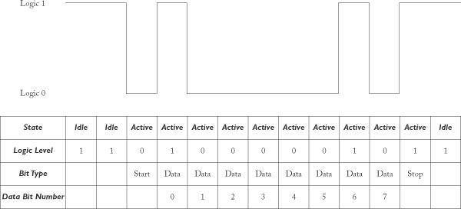
Serial Comms Byte Format
The quiescent state is that the signal is high.
A low indicates a Start bit – receiver will use this to start counting 8 data bits. Then one or more Stop bits end the data byte and return to the quiescent state
The receiver uses the falling edge to detect a new transmission
It waits 1.5 but times to sample the next bit and then samples every bit time
(Note that the data is presented least significant bit first)

Slide 15
Serial Comms Bit Sampling
The transmitter uses a higher frequency clock to generate output bits in the transmission sequence
The receiver uses the same higher frequency clock to decide when to sample the input bits – hence the significance of the previous section on clocking

Slide 16
RS232C for Serial Comms
Microcontroller pins send out CMOS logic levels: e.g. 3V/5V for 1, 0V for 0
Most commonly serial comms use the RS232C “standard”
In RS232C, a logic 1 is a voltage level between -3V and -15V, while a logic 0 is a voltage level between +3V and +15V
You need an extra device (RS232C transceiver) to change the voltage levels (and invert the signals)
PC to microcontroller communications usually use RS232
RS232 can have other signals in addition to the data signals that help to handshake the data (CTS, DTE, RTS etx)
It’s common to use a device like MAX232 for the level shifting

Slide 17
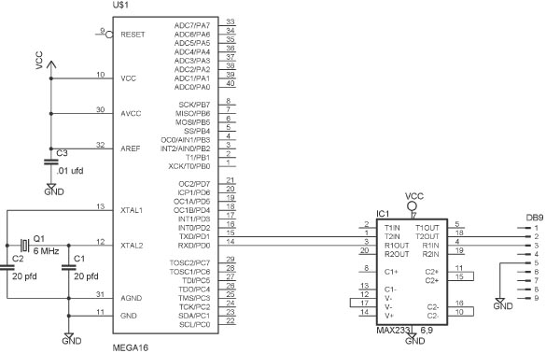
Typical Microcontroller to RS232 I/F
In many cases (Nucleo-64) it’s more convenient to package Serial port data on a USB link and send the data to the PC as a Virtual COM port, where the physical interface is USB
No need for MAX 232 in this case
MAX232/3 converts logic signals (3V or 5V) to RS232 levels (actually -9V and +9V)
PC COM1 interface

Slide 18
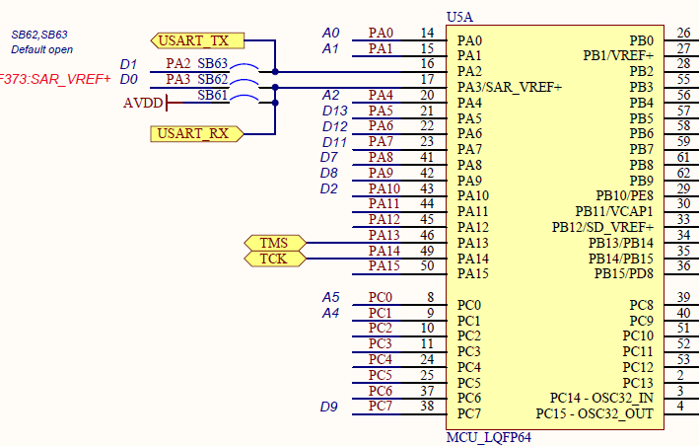
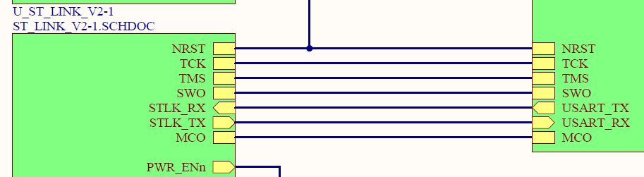
STM32L476RG USART2 Interface
USART2 connections from STM32L476RG
USART2 connections from STM32L476RG to STLINK V2 (and from there to PC)
Notes:
We’ll use USART2 because this gives us a Virtual COM port interface to a PC where we can send data to and receive data from the STM32L476RG

Slide 19
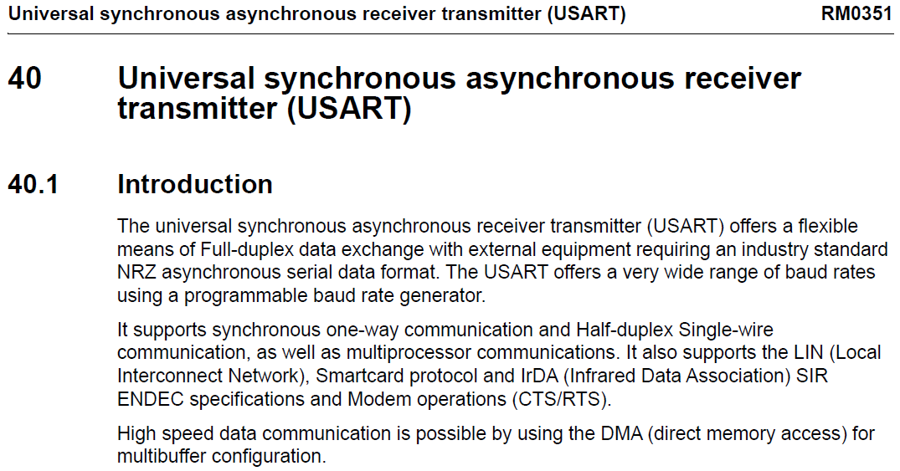
STM32L476RG USART
Q: What is meant by full-duplex?, half-duplex?
Reference Manual P 1332

Slide 20
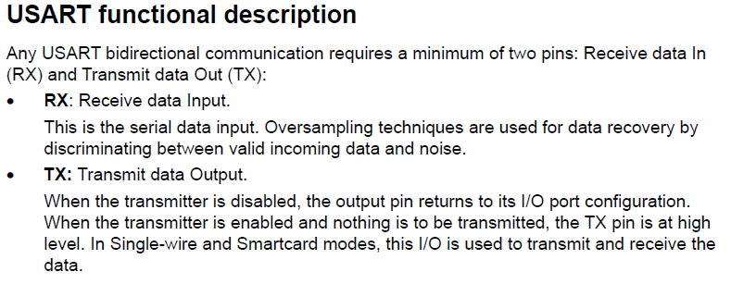
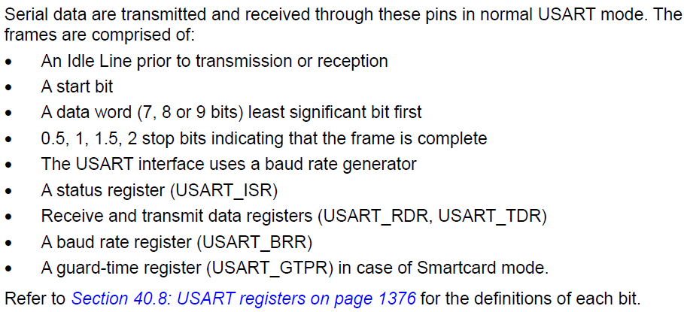
USART Description

Slide 21
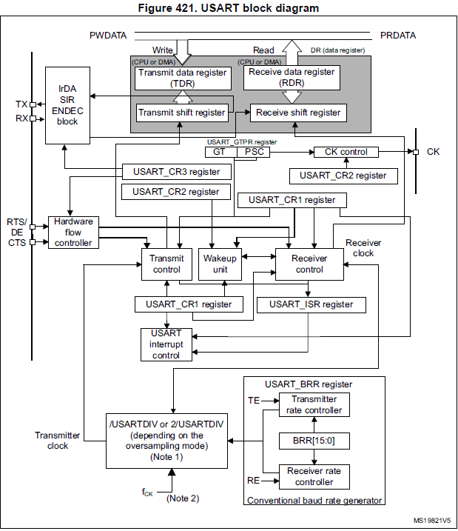
USART Block diagram
A Shift Register converts the serial bitstream to a parallel data word that the CPU can read or write
These are the registers we read from and write to when using the USART
Notes:
The CK signal is used for synchronous (S) communication

Slide 22
Programming the Serial Port (USART)
The USART hardware does all the bit timing for both transmit and receive
So the programming tasks involve setting up the USART correctly:
Getting the data bit rate correct usually called Baud rate
Getting the number of bits and stop bits correct
Setting up what parity (if any) to use for error checking
Reading and writing the data correctly at the right times
Notes:
We use the USART control registers to set up these options, and a special Baud Rate register to sort out the bit rate timings

Slide 23
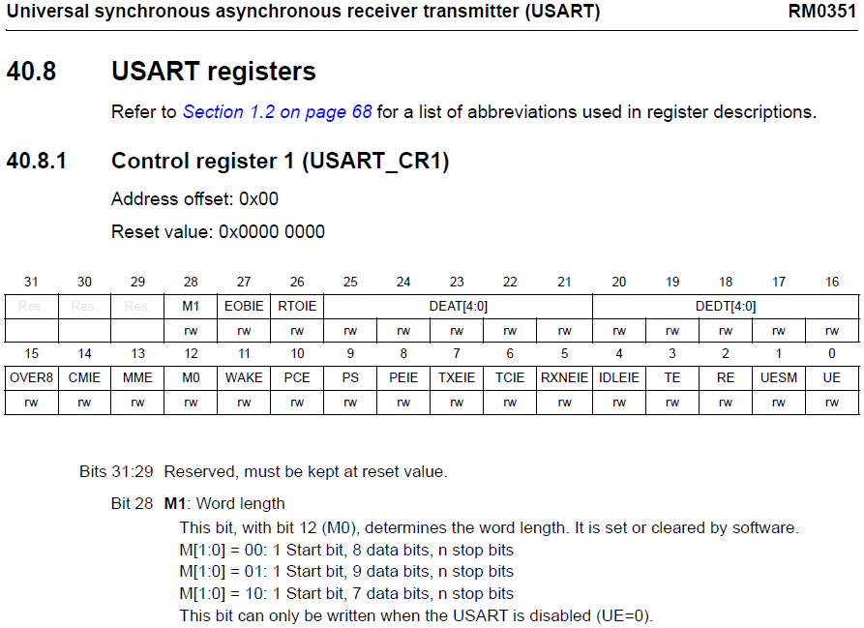
USART CR1
Ref Manual P1377
Notes:
There are many possible options here – not all are relevant to simple serial comms operation

Slide 24
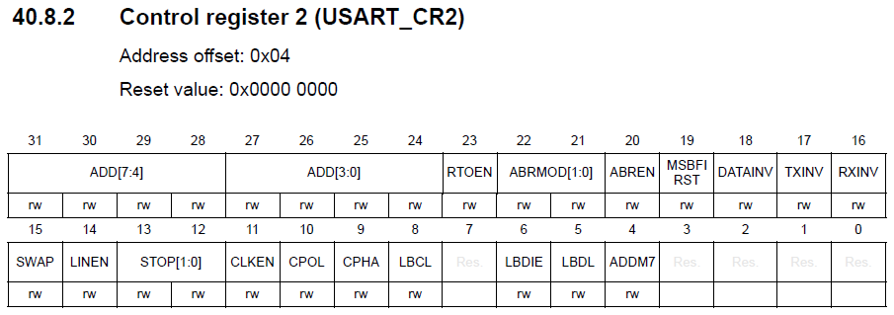
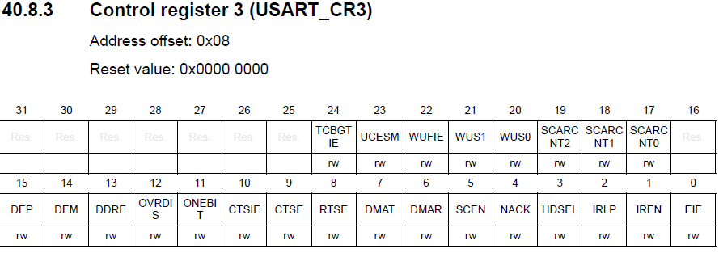
USART CR2 and CR3
Ref Manual P1379
Ref Manual P1383
Notes:
There are many possible options here – not all are relevant to simple serial comms operation.
Number of STOP bits is set here. CR3 controls RS232C handshaking signals (if used)

Slide 25
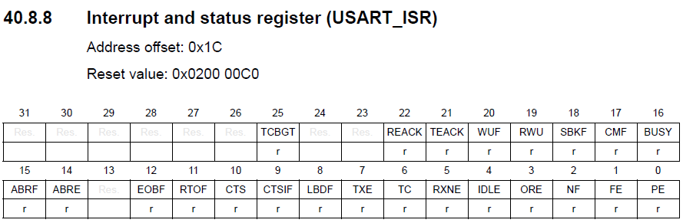
USART Interrupt and Status Register
Ref Manual P 1391
Note that most bits are read only

Slide 26
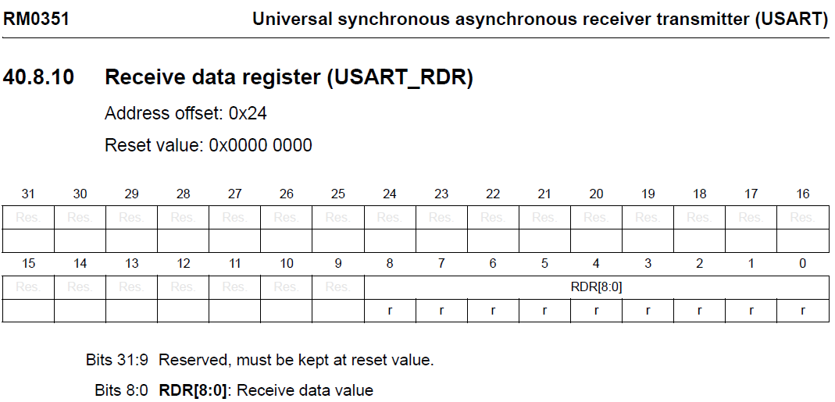
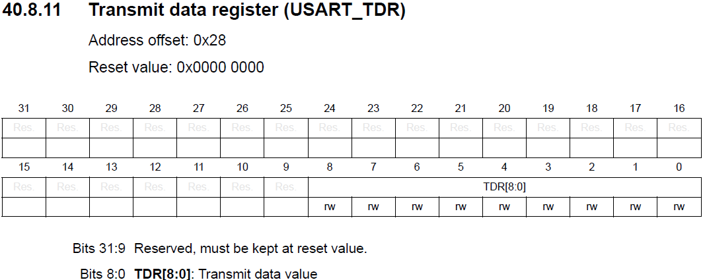
USART TDR and RDR
Ref manual P 1397
Note that only 9 bits are used
(In most cases only 8 bits are used)
Ref manual P 1397
Notes:
Page 1398 of the Reference Manual has a table showing all the USART registers

Slide 27
Baud Rate Calculations
To communicate using asynchronous communications both sides must be using the same baud rate (no of bits per second)
This means ensuring that the USART clock is divided correctly to give the target Baud Rate
Write a divider number to the Baud Rate Register to do this taking into account the clock source to the USART

Slide 28
Baud Rate Calculation with USARTDIV
USARTDIV is the divider to set Baud Rate
It’s affected by whether the USART clock is oversampled by 16 or by 8
By 16 case:
USARTDIV = Clock/(16*Target Baud Rate)
By 8 case:
USARTDIV = Clock/(8*Target Baud Rate)
USARTDIV will contain a fraction part
Usually this gives errors but STM32 allows better approximations

Slide 29
Baud Rate Calculation with USARTDIV
USART_BRR has 16 bits for USARTDIV
12 bits for the whole number (mantissa) part
4 bits for the fraction part
Express these in hex
Suppose we want Baud Rate of 9600 with clock = 80MHz, Oversampling = 16
USARTDIV = 80*10**6/(16*9600) = 520.833
Mantissa = 520 = 0x208 (fits in 12 bits)
Fraction = 0.833 = 0xd53 (but only have 4 bits, so use 0xd

Slide 30
Baud Rate Calculation with USARTDIV
USARTDIV = 80*10**6/(16*9600) = 520.833
Mantissa = 520 = 0x208 (fits in 12 bits)
Fraction = 0.833 = 0xd53 (but only have 4 bits, so use 0xd
USARTDIV = 0x208d
In our case, the USART clock will most often be 80MHz

Slide 31
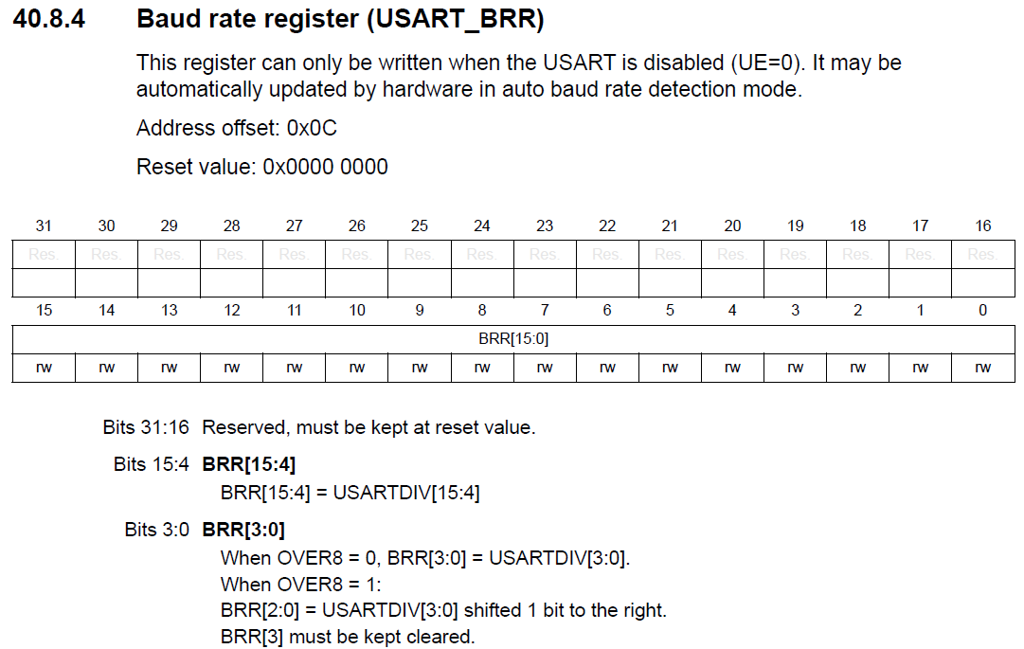
USART_BRR (Baud Rate Register)
0x208 in our example
0xd in our example

Slide 32
Example: Transmit to PC with USART2
Enable Clock to GPIOA
Enable the Clock to USART2
Select the USART2_TxD as AF for PA2
Set up the Baud Rate using USART2_BRR
Set up CR1 for sampling rate, data size, and enable TX (TE)
Set up CR2 for number of stop bits
Set up CR3 for no HW flow control
Enable USART2
These are the initialisation steps

Slide 33
Example: Transmit to PC with USART2
Enable Clock to GPIOA
Enable the Clock to USART2
Select the USART2_TxD as AF for PA2
Set up the Baud Rate using USART2_BRR
Set up CR1 for sampling rate, data size, and enable TX (TE)
Set up CR2 for number of stop bits
Set up CR3 for no HW flow control
Enable USART2
These are the initialisation steps

Slide 34
Example: Transmit to PC with USART2
Enable Clock to GPIOA
Enable the Clock to USART2
Select the USART2_TxD as AF for PA2
Set up the Baud Rate using USART2_BRR
Set up CR1 for sampling rate, data size, and enable TX (TE)
Set up CR2 for number of stop bits
Set up CR3 for no HW flow control
Enable USART2
Initialisation Steps

Slide 35
Example: Transmit to PC with USART2
Wait until TXE (Transmit Empty) is set in USART_ISR
Write the byte to be transmitted to the USART2_TDR register
Go back to 1 until all the characters have been sent
See Example p4_1.txt from Mazidi’s book
Continuous Execution Steps

Slide 36
Example: Receive from PC (USART2)
Enable Clock to GPIOA
Enable the Clock to USART2
Select the USART2_RxD as AF for PA3
Set up the Baud Rate using USART2_BRR
Set up CR1 for sampling rate, data size, and enable RX (RE)
Set up CR2 for number of stop bits
Set up CR3 for no HW flow control
Enable USART2
Initialisation Steps

Slide 37
Example: Receive from PC (USART2)
Wait until RXNE (Receive Not Empty) is set in USART_SR
Read the that was received in the USART_RDR register
Go back to 1 for the next character
See Example p4_2.txt from Mazidi’s book
Continuous Execution Steps

Slide 38
Summary
Looked at ARM processor and microcontrollers to see where relevant information comes from
Software tools and IDEs
Software Development Flow for some IDEs
Structures of Embedded Software
Come back to this later
C Data types for embedded development
Microcontroller I/O and software
Come back to this later too

