Slide 1
ED5502 Embedded Software
Lecture 2:
Embedded Software Development for ARM Cortex-M3/M4 and STM32 MCUs
Ciaran MacNamee

Slide 2
What we will cover in this lecture
Review ARM processor and microcontrollers
Software tools and Integrated Development Environments (IDEs)
Software Development Flow
Structures of Embedded Software
C Data types relevant to embedded development
STM32 L476RG MCU and its Nucleo-64 development board
Notes:
In this lecture we discuss the Arm processor and the STM32 Arm-based microcontroller that we use.
We also look at the tools and tool chains we use and the structures of embedded software.
ARM (and others) supply compilers, linkers etc for the CPU and related blocks and interfaces, but the details of the on-chip I/O devices are known to the chip designer not ARM, so device-aware software tools or support are also required.

Slide 3
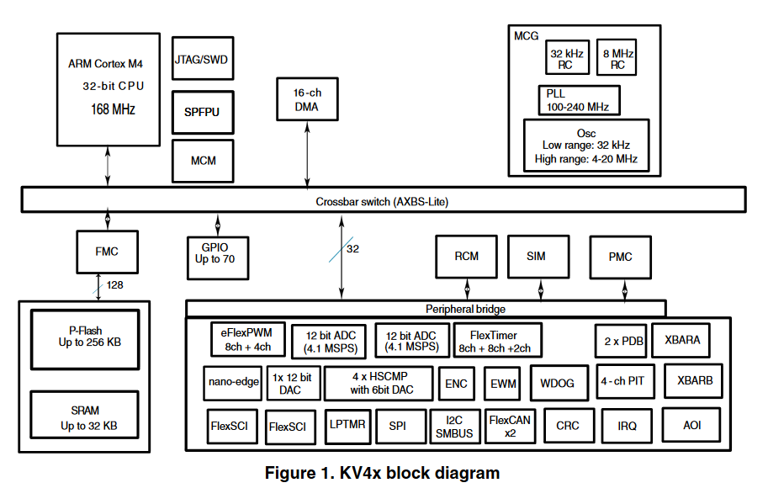
ARM Cortex-M4 based microcontroller
The CPU and support modules are from ARM
Memory and I/O devices are from the microcontroller designer
Notes:
This is a typical Arm microcontroller – this one from NXP (formerly Freescale).
Arm design the Cortex M4 core, but NXP build the device with their one set of I/O modules and their one memory technology.

Slide 4
STM32 and ARM
ST Microelectronics is an ARM Cortex-M licensee: produces Cortex-M microcontrollers under the generic name STM32
The STM32 portfolio includes Arm®Cortex®-M cores (M0, M0+, M3, M4 and M7)
STM32 feature: it’s easy to port applications from one device to another
Devices have similar pinouts and are supported by good tools
We use STM32 & Atollic TrueStudio or Keil-MDK
Notes:
ST Microelectronics license the Arm processor and have integrated it into many microcontroller devices.
These are suitable for a range of applications, and come at several cost ranges.
Arm supply a number of different Cortex Cores, which have more or less computing power, pinouts, memory support and power requirements.

Slide 5
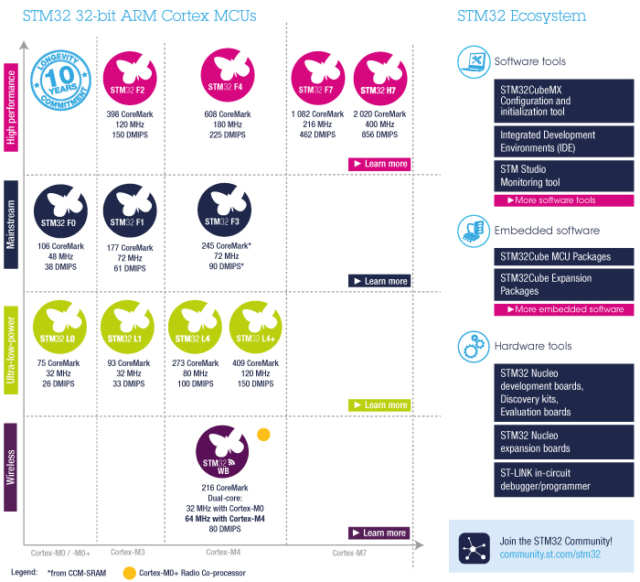
STM32
Colour code refers to performance grades
STM32L476 is in the STM32 L4 Series
Notes:
This, from the ST web-site summarises the range of STM32 Arm microcontrollers families

Slide 6
Development Tools: Software and Hardware
Software Tools: C/C+ compiler based on the Gnu Compiler Collection (gcc) ported to ARM
Development Environment: Atollic TrueStudio –GCC compiler for ARM supports STM32 (ARM) microcontrollers
Hardware Tools: STM32L476RG Nucleo Board
CPU: ARM Cortex-M4 Core running at up to 80MHz
L means it’s a low power device
1MB Flash program memory, 128 KB SRAM Data memory
On-board debugging and programming interface
Notes:
These are the tools, boards and tool-chain we use.

Slide 7
Development Tools: Software and Hardware
Software Tools: Keil armcc compiler, optimising compiler
Development Environment: Keil-MDK – includes Editor, compiler, linker, project managers, debugger, flash programmer etc
Hardware Tools: STM32L476RG Nucleo Board
CPU: ARM Cortex-M4 Core running at up to 80MHz
L means it’s a low power device
1MB Flash program memory, 128 KB SRAM Data memory
On-board debugging and programming interface
Notes:
These are the tools, boards and tool-chain we use.

Slide 8
STM32 Nucleo Boards
Small low-cost development boards based on the 32-bit ARM Cortex Architecture
Compatible with Arduino shields (but be careful of voltage levels) as well as ST Morpho based boards
Compatible with mbed, Atollic, and other debugging and programming environments
Over 32 different boards of varying sizes available using a number of different STM32 microcontrollers
Notes:
The same basic board can be used for multiple devices.

Slide 9
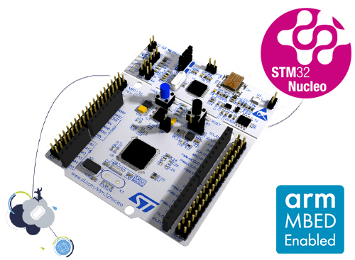
STM32 Nucleo 64 Boards
Arduino UNO R3 headers mean it can interface with (3.3V) Arduino Shields
STM32 Nucleo-64 boards are an affordable way for users to try out
new concepts and build prototypes with the STM32 microcontrollers
Arduino™ Uno R3 connectivity support and the ST morpho headers
STM32 Nucleo-64 board does not require a separate probe - integrates the ST-LINK/V2-1 debugger and programmer.
Comes with the STM32 comprehensive software HAL library
Nucleo-144 and Nucleo-32 boards are also available
Notes:
Nucleo 64 is the mid-range board.
It also has Arduino UNO compatible headers so we can use Arduino shields (3.3V only) with it.

Slide 10
Software: Atollic TrueStudio
IDE built around the GNU Compiler Collection (gcc) C and C++ compilers
The IDE integrates a compiler, assembler, linker, debugger, flash programmer as well as higher level project and software management and analysis tools
Originally for many Cortex microcontrollers, it’s now targeted at STM32 Cortex-M microcontrollers
Based on the Eclipse framework
Notes:
Atollic was bought by ST, so their now tools are available for free – but are targeted at ST microcontrollers only.
Eclipse is a general IDE – it is tailored for STM32 in Atollic

Slide 11
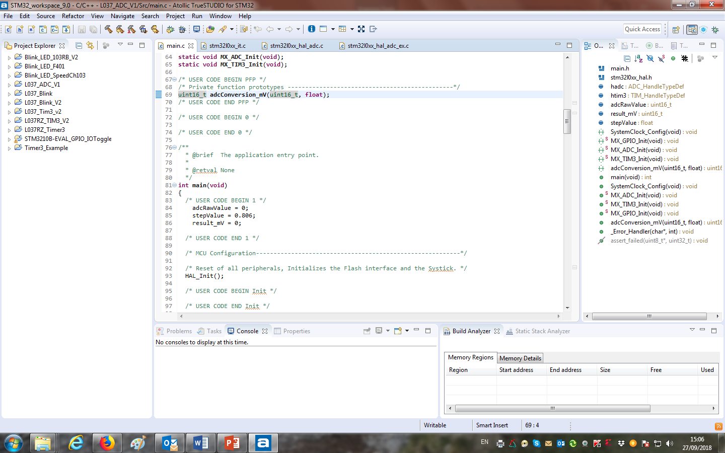
True Studio Compiler Perspective
The Keil-MDK uVision project screen is similar
Notes:
Eclipse support views and perspectives
A view is like one window, a perspective is a set of views that, taken together, make up a particular way of using the the development environment.
This is the compiler perpsective – you can see the editor, the recently used projects, compiler output messages etc.

Slide 12
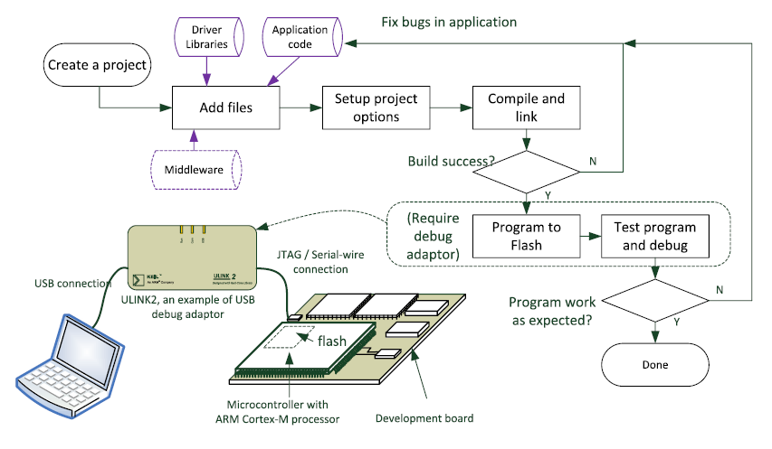
Software Development Flow
J. Yiu, The Definitive Guide to ARM Cortex-M3 and Cortex-M4 Processors, 3rd ed, Newnes 2014
Notes:
This diagram shows how these tools work together and how a developer uses them
This is called a flow, because each tool output forms the input to the next type of tool

Slide 13
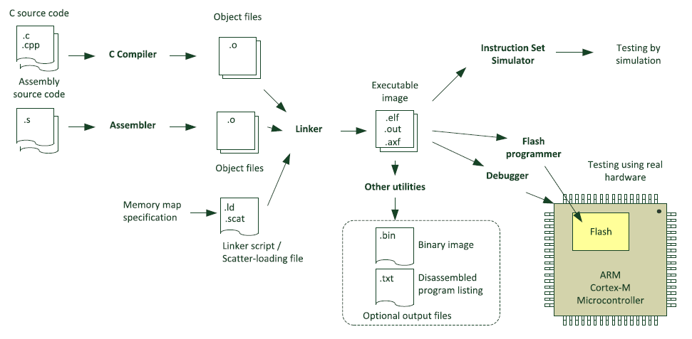
Software Development Keil-MDK
J. Yiu, The Definitive Guide to ARM Cortex-M3 and Cortex-M4 Processors, 3rd ed, Newnes 2014
Notes:
Keil is an tools manufacturer owned by Arm, dedicated to high quality (not free!) tools.
This diagram shows how the Keil tools work together.

Slide 14
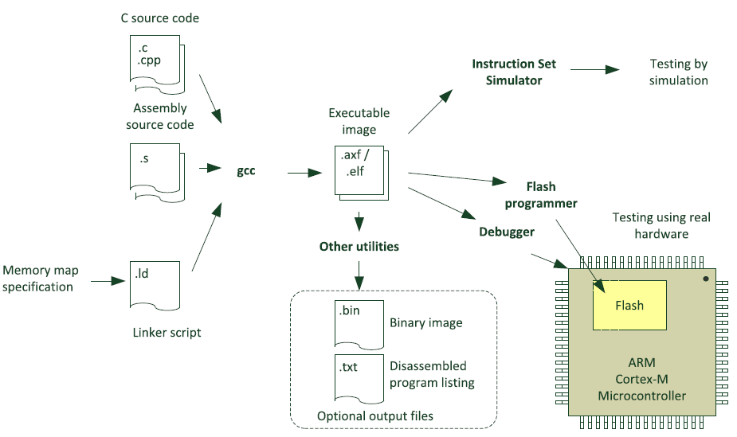
Software Development, gcc tools
When using gcc tools, the compiling and linking steps are often merged
(but .o, object files are still produced)
J. Yiu, The Definitive Guide to ARM Cortex-M3 and Cortex-M4 Processors, 3rd ed, Newnes 2014
Notes:
The GNU Compiler Collection (gcc) tools are open-source and work in a similar but not identical way to the Keil ones.
The .axf or .elf files are the outputs of the compiler and linker tools. In addition to containing the binary executable code, they also contain information that allows the binary executable code to be related to the user’s source. This is what supports source-level symbolic debugging – ie debugging at the source code level.

Slide 15
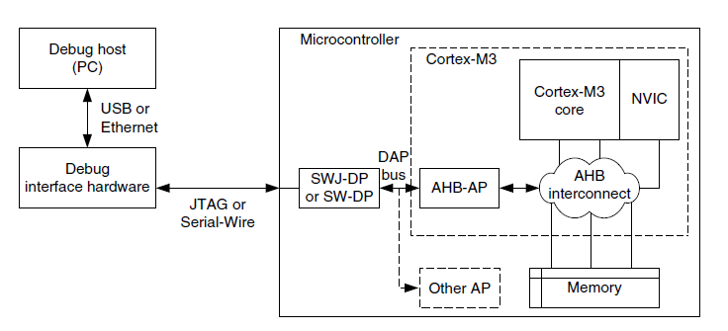
Software Development: debugging
This block is integrated onto the STM32 Nucleo64 Board
- ST-LINK/V2-1 Debugger/Programmer
J. Yiu, The Definitive Guide to ARM Cortex-M3 and Cortex-M4 Processors, 3rd ed, Newnes 2014
Notes:
You could use simulation tools for debugging, but for microcontroller development in circuit or in system debugging at or near full clock rate in the target system is the best option.
Nucleo boards contain a debug interface that supports debugging from the Atollic IDE.

Slide 16
Tools found in an IDE
Tools | Descriptions
C Compiler | To compile C program files into object files
Assembler | To assemble assembly language program files into object files
Linker | To join multiple object files together and define memory configuration
Flash Programmer | To program the compiled program image to the flash memory of the microcontroller
Debugger | To control the operation of the microcontroller and to access internal operation information to allow the status of the system to be examined and program operation to be checked
Simulator | To allow the program execution to be simulated without real hardware
Other Utilities | Various tools, eg file converters to convert compiled file to various formats.
Notes:
A summary of the types of tools you expect to find underneath the IDE,
You could use these tools from a command line if you wanted to, but he IDE includes them all in a user friendly environment.

Slide 17
Embedded Software Development
In this section, we look at how an embedded program is structured, and compare it to programs that might run in a PC
This is a Hello World that you might run to print Hello World on a PC
/* Hello World program */
#include <stdio.h>
void main() {
printf ("Hello World");
}
This program is different from a program that we would run in an embedded system
How?
Notes:
Now we turn to the types of program you’d expect to find in an embedded environment.

Slide 18
How is this different from a microcontroller program?
Leaving aside how the output is defined the biggest difference is that the program ends
After printing the text the program ends and returns control of the computer to the operating system
But if you have an embedded system (say controlling a nuclear reactor) you don’t want the program to stop ever
It needs to run forever
Notes:
18

Slide 19
Two embedded microcontroller Hello Worlds
In the program, while(1) is always true so it forms an infinite loop
/* Hello World program */
#include <stdio.h>
void main() {
printf ("Hello World");
while (1)
;
}
/* Hello World program */
#include <stdio.h>
void main() {
while (1)
printf ("Hello World");
}
Note: you can have a ; on its own
If you ran these programs, what do you think would happen?
Notes:
19
Embedded programs (one way or another) must run forever.
We are often supported by an operating system that hides this from us.

Slide 20
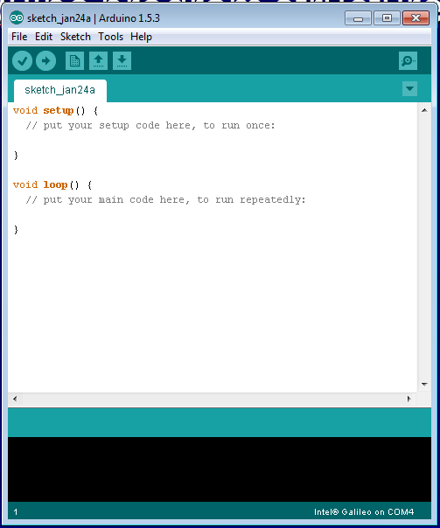
Arduino program structure (Sketches)
If you program with Arduino you’ll already be familiar with this structure
The setup – loop structure has the run once, loop forever structure built in automatically
Notes:
Arduino shows this explicitly.

Slide 21
Organisation of Embedded Software
The basic idea is an infinite loop, but what happens in a program varies
Typical ways of organising programs include:
Polling Loops – the simplest technique
Super loop polling – more advanced polling
Interrupt Driven programs – more efficient programs
Real Time Operating System (RTOS) based code – multi-tasking with real-time constraints
Notes:
These are different programming styles in an embedded system. One of the big problems is how to handle I/O events.
Typically these are driven by asynchronous actions (often inputs) so we need to ensure that we do not miss an event.

Slide 22
Polling Loops
The processor
Waits until there is data ready for processing
Processes it
Then waits again
Very easy to setup
Works well for simple tasks
Inefficient and power hungry
Notes:
The simplest approach: sit in a loop until something happens. Then do something based on the input event – then repeat the process.
We respond to the event but the microcontroller is completely tied up waiting for the event.

Slide 23
Polling with Multiple Devices
Notes:
This is a variation on a simple polling loop but has many of the same disadvantages.

Slide 24
Interrupt Driven Application
Notes:
Interrupt driven applications are much more efficient but can be unpredictable and hard to debug and organise when the number of interrupts increases.
In particular, it can be hard to guarantee timings because the current interrupt has priority.

Slide 25
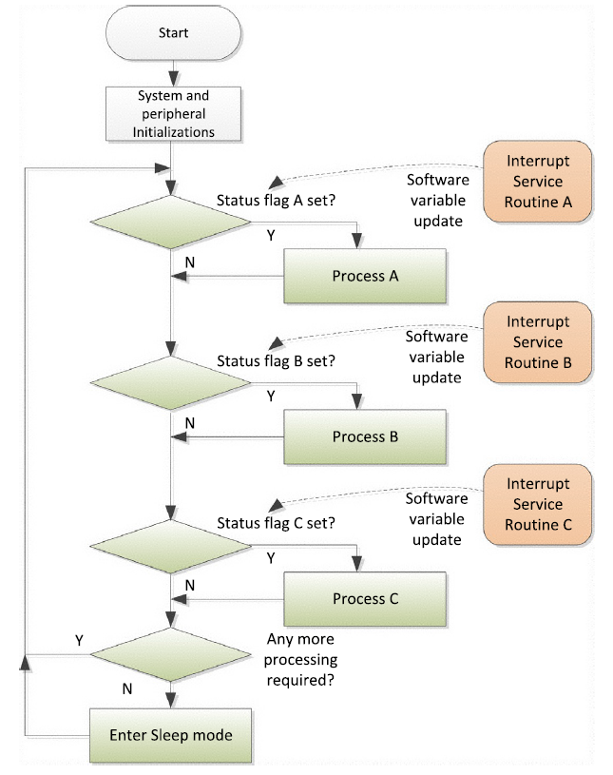
Combined Interrupt and Polling
Notes:
This organisation attempts to improve the timing response. ISRs are short, and set status flags, while the main loop processes the less time critical tasks.
This means that the main loop can be very messy, and again timing is hard to predict.

Slide 26
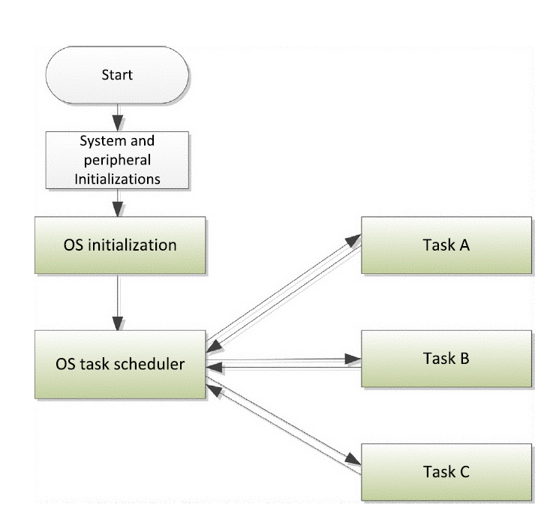
Real Time Operating System
An RTOS can handle multiple tasks
Notes:
An RTOS can be the best option for more complex embedded systems. High priority tasks can have guaranteed timing. The disadvantages are costs and complexity as you need to learn how to set up and work with the RTOS. The advantage is that the system becomes more predictable and the code for individual tasks can be easier to develop and can be made independent (within limits) of each other.

Slide 27
C and Embedded Systems
All the well-known C programming techniques can be applied here
We look at some points that are relevant to this module
Scope of variables
Size of variables
Bitwise logic operations
Access to microcontroller on-chip I/O devices
Notes:
Now we look at some more details. Issues like scope (because of shared variables), bitwise operations, and even the size of variables are more important in embedded systems.
In addition, we also want to see how to use the on-chip I/O devices in a microcontroller.

Slide 28
Variables
These are stored in the microcontroller’s memory
Declared by the reserved word for its type followed by an identifier
unsigned char anyone;
int dogs, cats;
long int total_dogs_and_cats;
Note that int is not necessarily 8, 16 or 32 bits – it can vary from C compiler to compiler
In fact the way that data is stored may be implementation dependant
This something to be careful about
Notes:
28
Note that the variable type ‘int’ does not have a fixed size. In PC programming this doesn’t matter, but with the microcontroller I/O devices have a fixed size – so this is relevant here.

Slide 29
Scope: how a program can access variables
Scope can be local or global
Local variables are in memory set aside when you enter a function
When you leave the memory is freed up and the local variable disappears
You can use the same local variable name in different functions – because they’re local there is no problem
Global variables are memory set aside by the compiler and can be accessed by all the functions in a program
They can be very dangerous!
Notes:
29
We try to avoid global variables – but they may be needed to communicate status information between an ISR and a main loop.
Global variables can make your software bug-prone. Also note that if you declare a local variable in a function with the same name as a global, the local variable will be used in the function

Slide 30
Local Variables Storage
Variables are auto by default but you can select them as static
auto: uninitialised when allocated. Its memory space is released when you exit the function so its value is not valid when you reenter the function
static: local static variables are only valid in the function they’re defined in, but they’re placed in global memory space. They’re initialised to zero and hold their values when you re-enter the function
Notes:
30
Here are some variations in the way that local variables can be defined and used.

Slide 31
Variables Storage: Size of ints etc
Note that in the C language int is not necessarily 8, 16 or 32 bits – it can vary from C compiler to compiler
So the way that data is stored may be implementation dependant
This something to be careful about
The 1999 specification of the language (C99) adds types where the data size is explicit
Why is this relevant in microcontroller programming?
Notes:
31

Slide 32
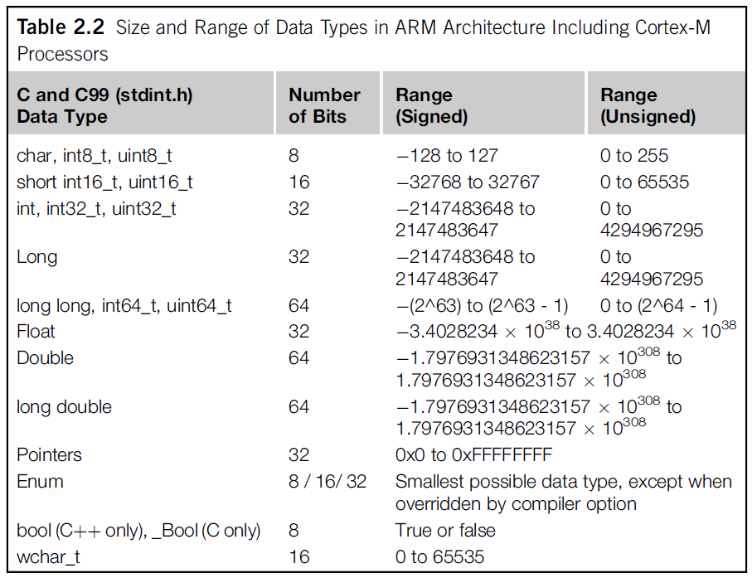
Data Types sizes
Notes:
C99 (stdint.h) allows you to use variables whose size is defined

Slide 33
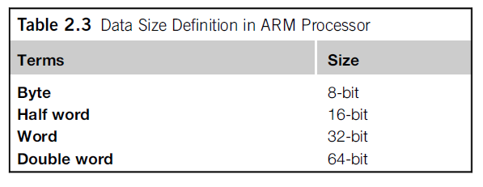
Data Types Sizes in ARM programs
ARM documentation also uses the terms byte, word, etc as follows:
In other contexts (Intel) a Word might be 16-bits, Double Word 32-bits, Quad Word 64-bits
The sizes of data types are important when we are accessing the registers used in the on-chip I/O of an ARM microcontroller
Notes:
But there is some variation still in how certain terms are to be interpreted.

Slide 34
Bitwise operators
Perform operations that affect operands at bit level
Work on non-floating point operands: char, int, long
Very important in microcontrollers because we often manipulate bits
Logical Inversion (One’s Complement, NOT): ~
Left Shift: <<
Right Shift: >>
AND: &
Exclusive OR: ^
OR (Inclusive OR): |
This also their precedence order
These operations are important in embedded programming because we often want to test, set, or clear an individual bit in a Port or on-chip peripheral register
Notes:
In a microcontroller I/O device, individual bits in a word may have a significance, so we review bit wise operations here.

Slide 35
Examples
~ inverts each bit of the operand, 1->0 and 0->1
<< followed by a number shifts the bits in the operand left that number of times
Each shift is like multiply by 2
Lower bits filled with 0s (from the right)
>> followed by a number shifts the bits in the operand right that number of times
Each shift is like divide by 2
Unsigned numbers: upper bits filled with 0s
Signed numbers: upper bits filled to be the same as the sign bit

Slide 36
Examples
AND (&): AND each bit of an operand with the bit at the same position in 2nd operand
EX-OR (^): EX-OR each bit of an operand with the bit at the same position in 2nd operand
OR (|): OR each bit of an operand with the bit at the same position in 2nd operand
Very useful in embedded software

Slide 37
Examples
Suppose y is an unsigned char, y = 0xC9 (11001001)
x = ~y; // x = 0x36; (00110110)
x = y << 3; // x = 0x48; (01001000)
x = y >> 4; // x = 0x0c; (00001100)
x = y & 0x7f; // x = 0x49; (01001001)
x = y ^ 0x41; // x = 0x88; (10001000)
x = y | 0x20; // x = 0xE9; (11101001)
To see how these work, you have to look at the operand in binary – bit by bit
AND, OR, ~ are very useful dealing with Ports and control and status registers.

Slide 38
Logical Operators: AND, OR
These work on binary values giving either a TRUE or FALSE result
TRUE – non-zero; FALSE – zero
AND represented by &&
OR represented by ||
AND (&&) has higher precedence
A big difference between && and &
A big difference between || and |

Slide 39
Inputs, Outputs, on-chip peripherals
Microcontrollers have various Input/Output (I/O) interfaces and peripherals such as timers, Real-time Clock (RTC) etc
Most are vendor designed not ARM designed
On ARM microcontrollers, the peripherals are memory-mapped
The registers are accessed as addresses in memory
In C programs, we can use pointers to read and write these registers
Notes:
Programming the on-chip peripherals reduces the programming load on the CPU, and is a characteristic of embedded software.

Slide 40
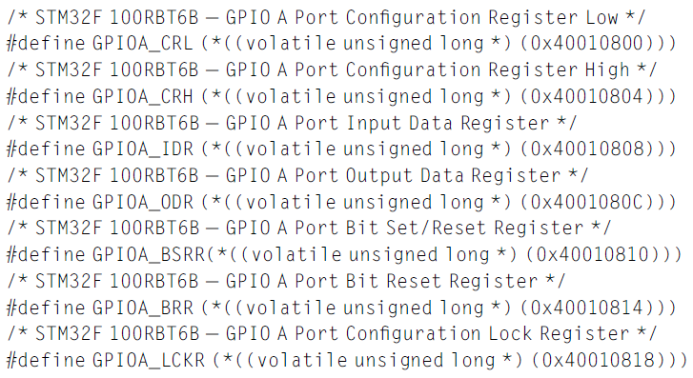
Example: GPIO registers and pointers
Notes:
The GPIO ports are the most straightforward of the on-chip I/O devices.
At heart it’s just an output port, and input port and a direction register that allows individual bits of a port to be used as an input or as an output.
Using pointers, we can give symbolic names to the ports, even though what is involved is the address of a register.

Slide 41
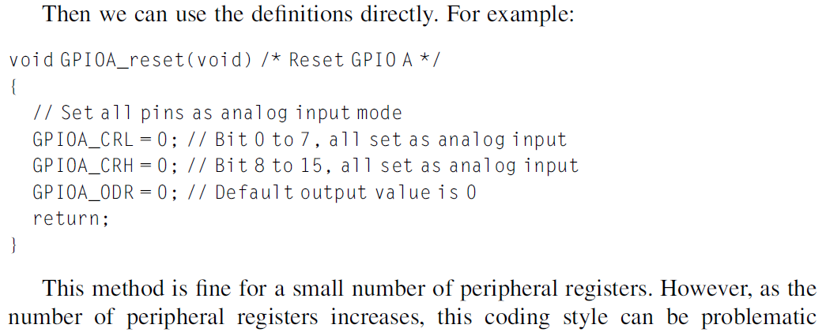
Example: Using the GPIO registers and pointers
See next slide for how this can be done more efficiently

Slide 42
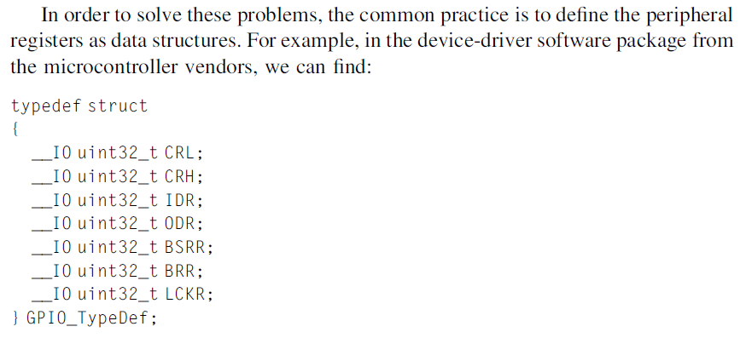
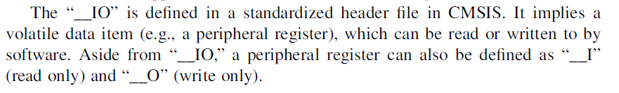
Efficient definition of GPIO registers
CMSIS: Cortex Microcontroller Software Interface Standard

Slide 43
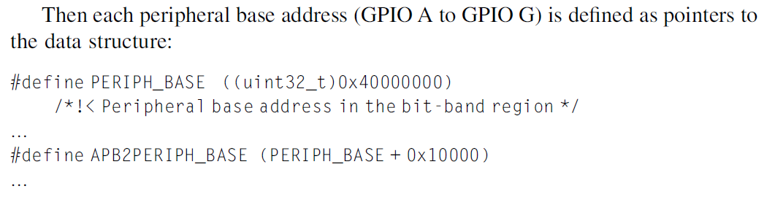
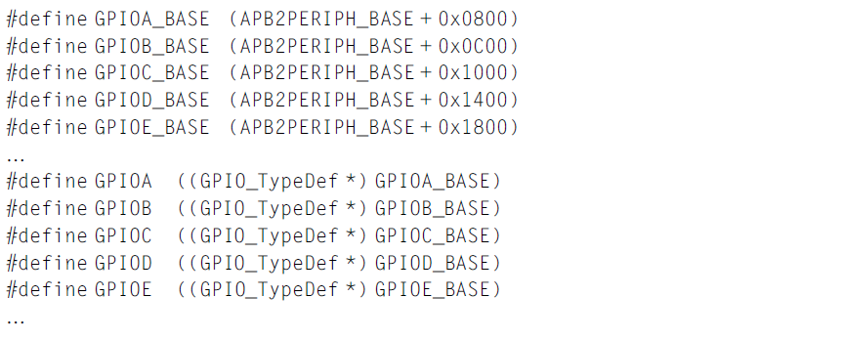
Efficient definition of GPIO registers

Slide 44
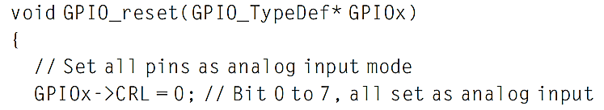
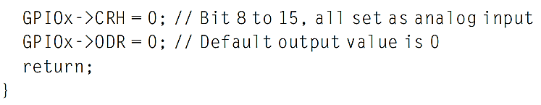
Using the technique
Now we can create functions that can be used for each instance of the peripheral
E,g. the code to reset the GPIO port can be written as:

Slide 45
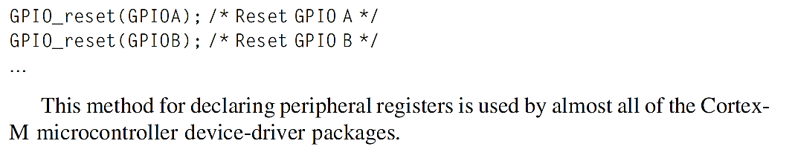
Using the reset function
Use the function by passing the peripheral base pointer to the function:

Slide 46
Summary
Looked at ARM processor and microcontrollers to see where relevant information comes from
Software tools and IDEs
Software Development Flow for some IDEs
Structures of Embedded Software
Come back to this later
C Data types for embedded development
Microcontroller I/O and software
Come back to this later

