Slide 1
EE5012 – Operating Systems
Hristo Trifonov
Email: hristo.trifonov@ul.ie
Phone: 061-234254 (Ext.4254)
Room: C2056 (Main Building)

Slide 2
UNIT 1
Introduction to EE5012
Hristo Trifonov

Slide 3
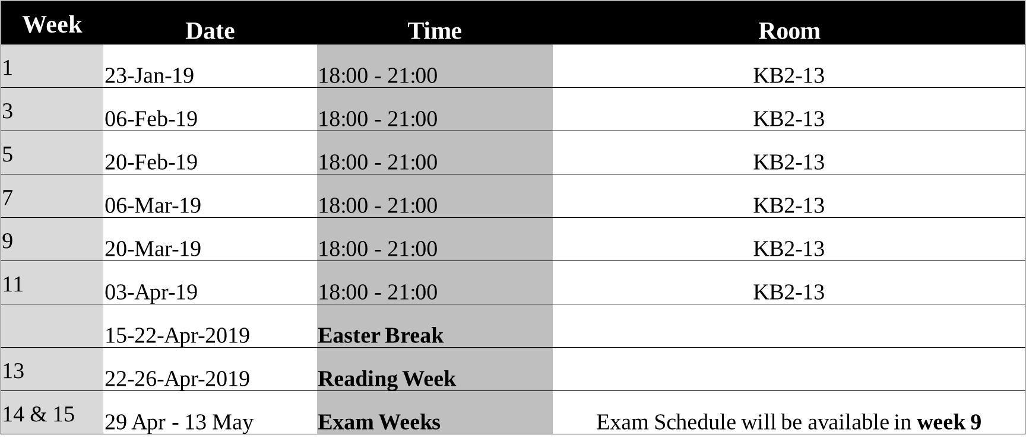
EE5012-Schedule

Slide 4
EE5012-Assessment
Laboratory assignments: 40% (also examined by questions in mid-term and final exam, so effective importance of the assignments is very high, as it is fully integrated with the teaching)
Mid-term exam: 10% (assess first 6 weeks of learning)
Final exam: 50%
Notes:
There are four assignments allocated for this module with each one of them weighing 10% towards the final grade.
The Mid-term exam is a 50 minute short exam which contains a mixture of theory questions (multiple choice perhaps) and some small coding questions.
The final exam is 2h 30 minutes and has 4 questions. Students are required to answer any 3 of the questions if possible.
Sample exam papers will be provided.

Slide 5
UNIT 1 Objectives
To provide description of basic computer hardware system components
To attempt to describe what Operating system is and how it interacts with the underlying hardware.
To explore various types of Operating systems and their practical significance
To provide a summary of the major components of an Operating system
To list and explain the services provided by the Operating system

Slide 6
Credits
The slides/diagrams in this course are an adaptation, combination, and enhancement of material from the following resources and persons:
1. Slides of A. Silberschatz, P. B. Galvin and G. Gagne (see book references ahead) with some enhancements by Y. Wiseman.
Operating Systems Internals and Design Principles, 9th edition, W. Stallings
Modern Operating Systems, 4th edition, A. Tanenbaum
Operating Systems in Depth, Thomas W. Doeppner
Donal Heffernan UL, Lab Book Tutorial Style, Slides and Notes.

Slide 7
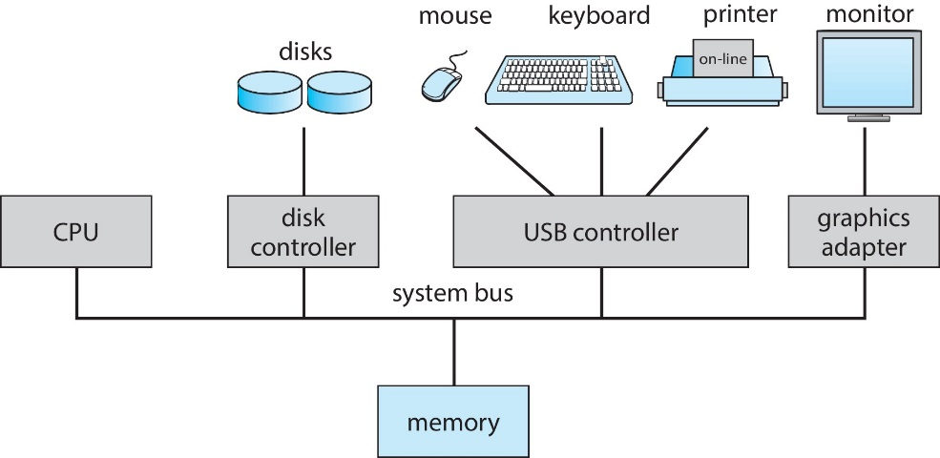
Computer Hardware Components
Notes:
Hardware – provides basic computing resources (CPU, Memory, I/O devices,Communication).
CPU: The ‘‘brain’’ of the computer is the CPU. It fetches instructions from memory and executes them. The basic cycle of every CPU is to fetch the first instruction from memory, decode it to determine its type and operands, execute it, and then fetch, decode, and execute subsequent instructions. The cycle is repeated until the program finishes. In this way, programs are carried out.
Each CPU has a specific set of instructions that it can execute. Thus an x86 processor cannot execute ARM programs and an ARM processor cannot execute x86 programs.
Memory (RAM): The second major component in any computer is the memory. Ideally, a memory should be extremely fast (faster than executing an instruction so that the CPU is not held up by the memory), abundantly large, and dirt cheap. No current technology satisfies all of these goals, so a different approach is taken.
Disk: Next in the hierarchy is magnetic disk (hard disk). Disk storage is two orders of magnitude cheaper than RAM per bit and often two orders of magnitude larger as well. The only problem is that the time to randomly access data on it is close to three orders of magnitude slower.
I/O: I/O devices generally consist of two parts: a controller and the device itself. The controller is a chip or a set of chips that physically controls the device. It accepts commands from the operating system, for example, to read data from the device, and carries them out. In many cases, the actual control of the device is complicated and detailed, so it is the job of the controller to present a simpler (but still very complex) interface to the operating system.
System Bus: Modern systems has many buses (e.g., cache, memory, PCIe, PCI, USB, SATA, and DMI), each with a different transfer rate and function. The operating system must be aware of all of them for configuration and management. The main bus is the
PCIe (Peripheral Component Interconnect Express) bus. The PCIe bus was invented by Intel as a successor to the older PCI bus, which in turn was a replacement for the original ISA (Industry Standard Architecture).
Operating System – controls and coordinates use of the hardware among various application programs for various users
One or more CPUs, device controllers connect through common bus providing access to shared memory.
Concurrent execution of CPUs and devices competing for memory cycles.

Slide 8

Computer System Operation
Initialises all hardware components of the system. Locates the OS Kernel and loads it into memory.
BOOTSTRAP
(BOOTLOADER)
Provides services to the system and its users. Kernel is interrupt driven (hardware and software)
Hardware – device can trigger an interrupt by sending a signal to the CPU usually by the system bus.
Software:
- Software error
- System call (request for OS service)
- Other process problems (infinite loops etc.)
OPERATING
SYSTEM
KERNEL
OPERATING SYSTEM
SERVICES & DAEMONS
All system services are running as long as the operating system kernel is running
Notes:
The initial program that runs when a computer is started is called a “bootstrap program”. Typically, it is stored within the computer hardware in read-only memory (ROM) or electrically erasable programmable read-only memory (EEPROM), known by the general term ﬁrmware. It initializes all aspects of the system, from CPU registers to device controllers to memory contents.
The bootstrap program must know how to load the operating system and how to start executing that system. To accomplish this goal, the bootstrap program must locate the operating-system kernel and load it into memory.
Some services are provided outside of the kernel, by system programs that are loaded into memory at boot time to become system processes, or system daemons that run the entire time the kernel is running.
On UNIX, the ﬁrst system process is “init” or “systemd” and it starts many other daemons. Once this phase is complete, the system is fully booted, and the system waits for some event to occur.
The occurrence of an event is usually signaled by an interrupt from either the hardware or the software. Hardware may trigger an interrupt at any time by sending a signal to the CPU, usually by way of the system bus. Software may trigger an interrupt by executing a special operation called a system call.

Slide 9
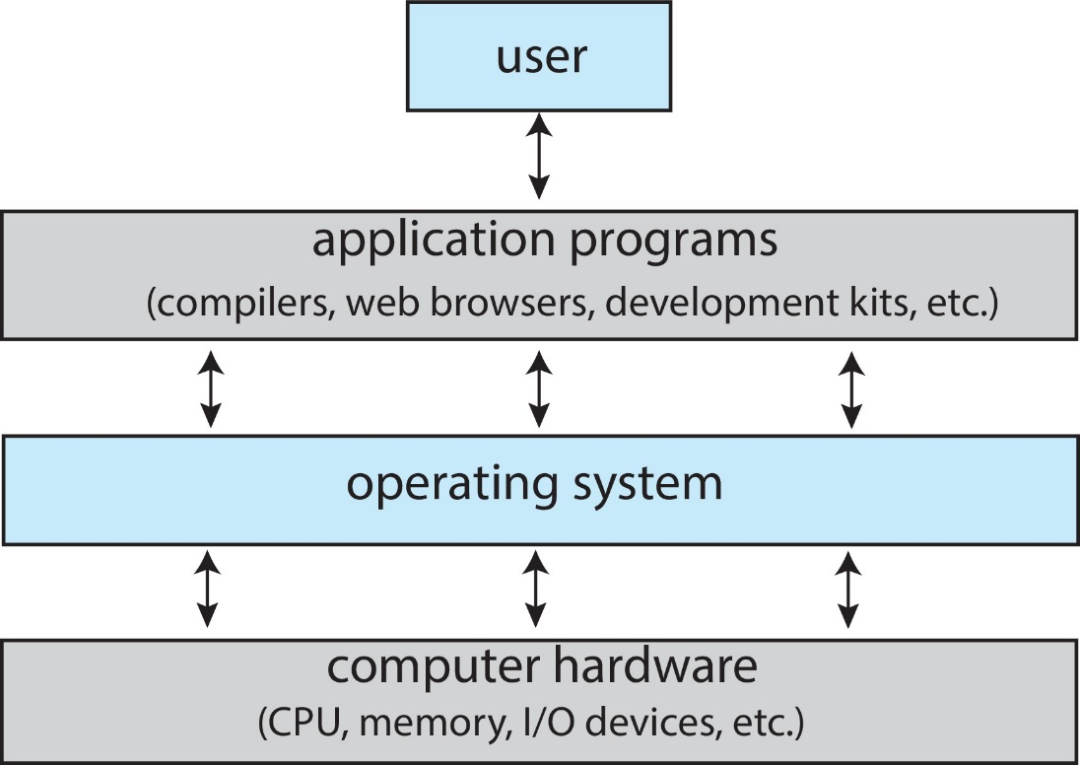
What is an Operating System?
An Operating System is a program that acts as an intermediary/interface between a user of a computer and the computer hardware.
Notes:
An operating system is a program. Typically it comprises many parts, some of which are required to be resident in memory, others are loaded upon demand by the operating system or other applications software.
Some components are invoked by the user. The result is a layered series of software sitting on top of the hardware.
The most significant component of the operating system is the kernel. This program contains the components of the operating system that will stay resident in memory.
The kernel handles such tasks as process management, resource management, memory management, and input/output operations.
Other components include services which are executed on demand, device drivers to communicate with hardware devices, tailored user interfaces such as shells, personalized desktops, and so on, and operating system utility programs such as antiviral software, disk defragmentation software, and file backup programs.

Slide 10
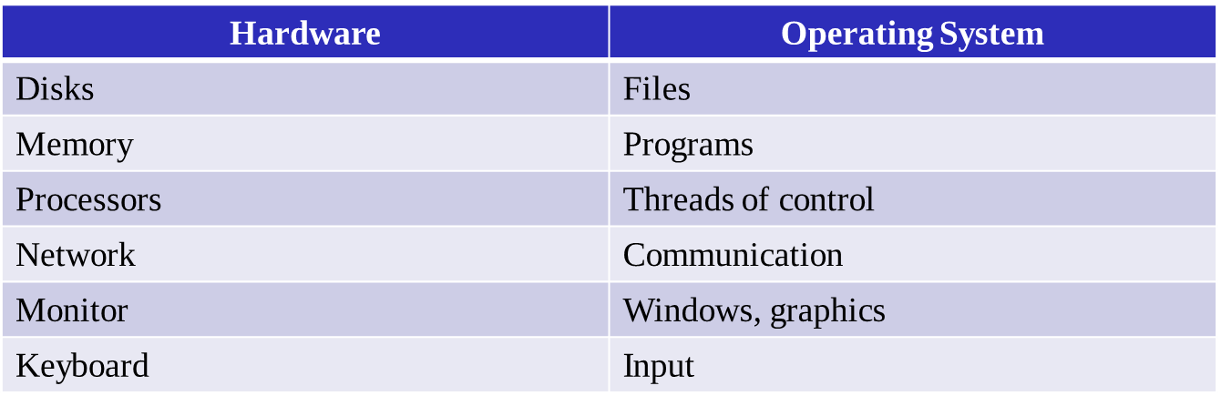
What Operating Systems Do?
Provide abstractions:
Notes:
The operating system abstracts the hardware machine:
The operating system is a software environment which ‘hides’ the hardware from the user environment. Programming the hardware directly is a tedious exercise, which requires a lot of low-level knowledge of the hardware architecture and the various interfaces. The operating system provides the programmer with a simpler environment where the hardware detail becomes more abstract and easier to use. For example, consider the concept of a simple file. A file is an abstraction to represent a collection of bytes stored on a physical disk (usually). To access these data bytes directly through the hardware, knowledge of the disk drive controller design and knowledge of the low-level format details of the disk drive is required. However, the operating system provides the file concept so that a user can simply open a file by using the file name and read and write the file in a simple fashion. The operating system provides the necessary device driver to interface to the disk drive’s hardware and provides the filing system to manage the various files. The programmer accesses the operating system via the API (application programmer’s interface). The API provides a library of system calls which can be used by the high-level language compiler or interpreter. Thus the programmer is ‘talking’ to the API and not to the underlying hardware; we say that a virtual machine is created which abstracts the underlying hardware.
File system provides a simple abstraction of permanent storage, i.e., storage that doesn’t go away when your program terminates or you shut down the computer.
A program is an abstraction that we view as consisting of data and code. Somehow we’ve got to build programs from the pieces of hardware available to us, in particular memory, disks, and processors.
Memory - Using various hardware features, each program is prevented from accessing private portions of other programs. Shared portions can be accessed, but only in a read-only fashion. When the operating system is executing, it can access the user programs. But when user programs are executing, they can access the operating system only to do prescribed requests.

Slide 11
What Operating Systems Do? (2)
Resource management:
Manages and protects multiple computer resources: CPU, Processes, Internal/External memory, Tasks, Applications, Users, Communication channels, etc…
Handles and allocates resources to multiple users or multiple programs running at the same time and space (e.g., processor time, memory, I/O devices).
Decides between conflicting requests for efficient and fair resource use (e.g., maximize throughput, minimize response time).
Notes:
The operating system as a resource manager:
Since multiple processes (tasks) and possibly multiple users can access the operating system at the same time, the management of system resources becomes very important. For example if two processes attempt to access a printer at the same times then the printed output may be garbled with mixed text from both processes. Hence the operating system needs to provide special synchronisation support to help manage the various system resources.
As mentioned already the OS is responsible for controlling the use of a computer’s resources, such as I/O, main and secondary memory, and processor execution time. But this control is exercised in a unusual way.
Like other computer programs, the OS consists of instructions executed by the processor. While executing, the OS decides how processor time is to be allocated and which computer resources are available for use. But in order for the processor to act on these decisions, it must cease executing the OS program and execute other programs. Thus, the OS relinquishes control for the processor to do some “useful” work, then resumes control long enough to prepare the processor to do the next piece of work.
The OS and the memory management hardware (MMU) in the processor jointly control the allocation of main memory, as we shall see. The OS decides when an I/O device can be used by a program in execution, and controls access to and use of files. The processor itself is a resource, and the OS must determine how much processor time is to be devoted to the execution of a particular user program.

Slide 12
Operating System as a VM
An interface between the user and hardware that hides the details of the hardware (e.g., I/O).
Constructs higher-level (virtual) resources out of lower-level (physical) resources (e.g., files).
Definition: OS is a collection of software enhancements, executed on the bare hardware, culminating in a high-level virtual machine that serves as an advanced programming environment.
virtual machine = software enhancement = extended machine = abstract machine = layer = level = ring.

Slide 13
Operating System Types
Mainframe Operating Systems – still found in major corporate data centers.
Server Operating Systems – multiple users are served at once over a network. Users are allowed to share hardware and software resources.
Multiprocessor Operating Systems – multiple CPUs are installed on the system.
Personal Computer Operating Systems – focused on a single user experience.
Handheld Computer Operating Systems – smart phones, tablets etc.
Embedded Operating Systems – used on TVs, cars, DVD players, microwave ovens etc.
Real-Time Operating Systems – hard and soft real-time systems
Notes:
Mainframe: are also making something of a comeback as high-end Web servers, servers for large-scale electronic commerce sites, and servers for business-to-business transactions. The operating systems for mainframes are heavily oriented toward processing many jobs at once, most of which need prodigious amounts of I/O. They typically offer three kinds of services: batch, transaction processing, and timesharing.
Server: Internet providers run many server machines to support their customers and Websites use servers to store the Web pages and handle the incoming requests. Typical server operating systems are Solaris, FreeBSD, Linux (Red Hat) and Windows Server 201x.
Multi: They need special operating systems, but often these are variations on the server operating systems, with special features for communication, connectivity, and consistency. With the recent advent of multicore chips for personal computers, even conventional desktop and notebook operating systems are starting to deal with at least small-scale multiprocessors and the number of cores is likely to grow over time.
Personal: The next category is the personal computer operating system. Modern ones all support multiprogramming, often with dozens of programs started up at boot time. Their job is to provide good support to a single user. They are widely used for word processing, spreadsheets, games, and Internet access. Common examples are Linux, FreeBSD, Windows 7, Windows 8, and Apple’s OS X.
Handheld: Smartphones and tablets are the best-known examples. As we have already seen, this market is currently dominated by Google’s Android and Apple’s iOS, but they have many competitors. Most of these devices boast multicore CPUs, GPS, cameras and other sensors, copious amounts of memory, and sophisticated operating systems.
Embedded: The main property which distinguishes embedded systems from handhelds is the certainty that no untrusted software will ever run on it. You cannot download new applications to your microwave oven all the software is in ROM. This means that there is no need for protection between applications, leading to design simplification. Systems such as Embedded Linux, QNX and VxWorks are popular in this domain.
Real: If the action absolutely must occur at a certain moment (or within a certain range), we have a hard real-time system. Many of these are found in industrial process control, avionics, military, and similar application areas. These systems must provide absolute guarantees that a certain action will occur by a certain time. A soft real-time system, is one where missing an occasional deadline, while not desirable, is acceptable and does not cause any permanent damage. Digital audio or multimedia systems fall in this category. Smartphones are also soft real-time systems.

Slide 14
Summary of OSs services
User Interface
Program Development & Execution
Input / Output Operations
File System Manipulation
Error Detection & Response
Resource Allocation
Accounting
Protection
Application Binary Interface (ABI)
Application Programming Interface (API)
Notes:
The operating system provides certain services to programs and to the users of those programs. The operating system functions provided for the convenience of the programmer to make the programming task easier are as follows:
1. UI: Almost all operating systems have a user interface (UI). This interface can take several forms. One is a command-line interface (CLI), which uses text commands and a method for entering them (say, a keyboard for typing in commands in a speciﬁc format with speciﬁc options).
2. Program D&E: The OS provides a variety of facilities and services, such as editors and debuggers, to assist the programmer in creating programs. Typically, these services are in the form of utility programs that, while not strictly part of the core of the OS, are supplied with the OS, and are referred to as application program development tools. Users will also want to execute programs. The system must be able to load a program into memory and run it. The program must be able to end its execution either normally or abnormally.
3. Input/output operations: A running program may require input and output. This I/O may involve a file or an I/O device. Since a user program cannot execute I/O operations directly, the operating system must provide some means to do so. Each I/O device requires its own peculiar set of instructions or control signals for operation. The OS provides a uniform interface that hides these details so programmers can access such devices with ease.
4. File system manipulation: It should be obvious that user want to read and write files, also want to create and delete files by name, operating system provides all the file manipulation operations like create a file, read a file, write to a file, delete a file. In the case of a system with multiple users, the OS may provide protection mechanisms to control access to the files.
5. Error detection: The operating system constantly needs to be aware of possible errors. Errors may occur in the CPU and memory hardware such as a memory error or power failure and in Input/output devices such as a printer out of paper or in the user program such as an
arithmetic overflow or access to illegal memory location. In each case, the OS must provide a response that clears the error condition with the least impact on running applications. The response may range from ending the program that caused the error, to retrying the operation, or simply reporting the error to the application.
6. Resource allocation: When there are multiple users or multiple jobs running at the same time, resources must be allocated to each of them. Many different types of resources are managed by the operating system.
7. Accounting: In multi-user system, operating system keep track of which user uses how many and which kind of computer resources. A good OS will collect usage statistics for various resources and monitor performance parameters such as response time. On any system, this information is useful in anticipating the need for future enhancements and in
tuning the system to improve performance.
8. Protection: In multi-user system, when jobs of more than one user executed simultaneously, it should not be possible for one job to interfere
with the other.
9. ABI: The ABI defines a standard for binary portability across programs. The ABI defines the system call interface to the operating system, and the hardware resources and services available in a system
through the user Instruction Set Architecture (ISA.)
10. API: The API gives a program access to the hardware resources and services available in a system through the user ISA supplemented with high-level language (HLL) library calls. Any system calls are usually performed through libraries. Using an API enables application software to be ported easily, through recompilation, to other systems that support the same API.

Slide 15
A View of OS Services
Users & other system programs
User 1
User 2
User 3
User N
Operating System
User interfaces
GUI
Touchscreen
CLI
System Calls
OS Services
Program
Execution
I/O
Operations
File System
Manipulations
Error
Detection
Resource
Allocation
Accounting
Protection & Security
Application Binary Interface (ABI)
Application Programming Interface (API)
Computer Hardware

Slide 16
Some Definitions
PROGRAM:
An executable sequence of instructions which resides in the computer storage area. It is a static entity.
PROCESS:
A program in execution. Consists of the executable program, data, stack, registers etc. It is a dynamic entity.
TASK & THREAD:
Task is an ambiguous term but generally the same definition as a Process. Thread is the basic unit of execution
within the context of one task. Any number of threads may execute within a single task.
PROCESSOR:
The agent which executes the program to realise a process. This is usually a hardware device, normally
the system CPU.

Slide 17
Some Definitions … continued
JOB:
A program or a set of programs which are to be processed in a specific environment to perform a system
or a user function.
BATCH SYSTEM:
A job or jobs are submitted to the system for automated processing. A user does not interact.
INTERACTIVE SYSTEM:
Jobs or individual processes are initiated and controlled from the user console.
MULTIPROCESSOR (PARALLEL) SYSTEM:
There is more than one processor in the system available for processing.
MULTITASKING SYSTEM:
Several programs can be executed on the system at the same time.

Slide 18
OS Definition recap
The Operating System abstracts the hardware on the machine
2) The Operating System is a resource manager
3) The Operating System as a Virtual Machine (VM)

Slide 19
Process & Process Management
Process is a key concept in the design of all Operating Systems. It can be defined as:
A program in execution.
An instance of a program running on a computer.
The entity that can be assigned to and executed on a processor.
A unit of activity characterized by a single sequential thread of execution, a current state, and an associated set of system resources.
The OS is responsible for the following activities in connection with process management:
Creating and deleting both user & system processes
Suspending and resuming processes
Providing mechanism for process synchronisation & communication (IPC)
Notes:
A Process needs resources to accomplish its task:
CPU, memory, I/O devices, files & Initialization data
Process termination requires reclaim of any reusable resources.
Typically a system has many processes, some user, some operating system running concurrently on one or more CPUs.

Slide 20
Process Creation
When a program executable is loaded into memory and dispatched to the CPU, it becomes a process.
The memory occupied by a process can be divided into four sections – stack, heap, text and data. The image below shows simplified layout of a process in memory.
Stack
Stack: The process Stack contains the temporary data such as method/function parameters, return address and local variables.
Heap: This is dynamically allocated memory to a process during its run time.
Data: This section contains the global and static variables.
Text: This includes the current activity represented by the value of Program Counter and the contents of the processor’s registers.
Heap
Data
Text
Notes:
Associated with each process is its address space, a list of memory locations from 0 to some maximum, which the process can read and write. The address space contains the executable program, the program’s data, and its stack. Also associated with each process is a set of resources, commonly including registers (including the program counter and stack pointer), a list of open files, outstanding alarms, lists of related processes, and all the other information needed to run the program. A process is fundamentally a container that holds all the information needed to run a program.

Slide 21
Process Creation (1)
A process is created with a name and an initial priority level. A Process Control Block (PCB) is generated and inserted in the process table. The process resources are allocated.
Processes are most often created by one process spawning another process. An identical copy of the calling process is thus created. The calling process is referred to as the parent process and the newly created process is referred to as the child process. A child process can spawn new processes. In this manner a whole tree of processes can be created. Each process will have only one parent but any process can have a number of child processes.

Slide 22
Process Creation (2)
P1
(systemd)
P3
P2
P9
P5
P4
P11
P7
P6
P10
P8
P…
P…
P…

Slide 23
Process Control Block (PCB)
Associated with each process is a data structure referred to as a process control block (PCB) or a process descriptor.
The PCB is an abstract representation of the process.
The PCB contains all the process status information necessary so that any process can leave the CPU (quantum-time-out or block) and can later resume execution without losing control.
All process status information must be retained following a context switch. In some systems the PCB is known as a TCB (Task Control Block).
Notes:
To implement the process model, the operating system maintains a table (an array of structures), called the process table, with one entry per process. (Some authors call these entries process control blocks.) This entry contains important information about the process’ state, including its program counter, stack pointer,
memory allocation, the status of its open files, its accounting and scheduling information, and everything else about the process that must be saved when the process is switched from running to ready or blocked state so that it can be restarted later as if it had never been stopped.

Slide 24
PCB continued
Process ID
PID: Unique identification for each of the process in the operating system.
Process State
Process State: The current state of the process i.e., ready, running, waiting, or whatever..
Priority
Process Priority: The current priority of a process.
I/O Status Info
I/O Status: This includes a list of I/O devices allocated to the process.
Process Privileges
Process Privileges: This is required to allow/disallow access to system resources.
Queue Pointer
Queue Pointer: This includes a list of I/O devices allocated to the process.
Pointer to Parent
Pointer to Parent: Pointer to parent process.
Pointer to Children
Pointer to Children: Pointer to children processes.
Resources
Program Counter
Program Counter: Program Counter is a pointer to the address of the next
instruction to be executed for this process.
Stack Pointer
Machine Registers
Memory Management Info
Process Context:
the VOLATILE
environment
Machine Registers: Various CPU registers where process need to be stored for execution for running state.
Open file status
CPU time used
Memory Management Info: This includes the information of page table, memory limits and a segment table depending on memory usage.
Various flags
Notes:
The process control block is the most important data structure in an OS. Each process control block contains all of
the information about a process that is needed by the OS. The blocks are read and/or modified by virtually every module in the OS, including those involved with scheduling, resource allocation, interrupt processing, and performance monitoring and analysis. One can say that the set of process control blocks defines the state of the OS.

Slide 25
Processes States
RUNNING - The process has been selected by the dispatcher and is now the active process on the CPU
READY - The process is runnable and is available for selection to run by the dispatcher when the CPU becomes available
BLOCKED - The process is unable to run as it is awaiting some event to happen (possibly waiting for an I/O device to become ready). This state is often referred to as the ASLEEP/BLOCKED state.
Notes:
A process known as the dispatcher ( the dispatcher is part of the scheduler operation, described later) is responsible assigning the CPU to a process for a selected time period. At any one instant in time one process is running on the CPU.
Processes often need to interact with one another. A running process may become blocked if it reaches a point where it awaits input from another process or awaits a response from a relatively slow peripheral device.
At a point in time a process may be ready to run but may have not yet been selected to the running state by the dispatcher.
These names are arbitrary, and they vary across operating systems. The states that they represent are found on all systems, however. Certain operating systems also more ﬁnely delineate process states. It is important to realize that only one process can be running on any processor at any instant. Many processes may be ready and waiting, however. The state diagram corresponding to these states is presented on the next slide.

Slide 26
Processes States continued
process
finished
RUNNING
a dispatch
b pre-empt
(quantum time-out
c block
READY
new
process
d wake-up
BLOCKED
(ASLEEP)
Notes:
Processes can move between states, they are said to make state transitions. The diagram shows a directed graph. Nodes represent possible process states. The CPU can execute only one process at a time so only one process at most can be in the running state at a given time.
There are four possible state transitions described as follows:
a. Dispatcher selects the process for running (dispatch).
b. The running process is stopped and put back to the ready state so that another process can run. This happens after the quantum time expires (quantum_time_out).
c. Process voluntarily gives up the CPU (blocks). This normally happens after the process initiates an I/O operation and has to wait for an event.
d. The process is no longer blocked as the event upon which it was waiting has occurred. The process goes to the ready state (wakeup).
Note, when a process is finished it exits the system from the running state.

Slide 27
Context Switching
The context defines the environment for the CPU while it is running one particular process.
The CPU is said to operate in the context of a process.
When the CPU runs another process it executes in the context of the other process.
The operating system must save enough status information for a process so that it can at a future time switch back to an earlier process and continue execution at the point where it left off. It does this by saving the necessary status information for a process in the context section of the process’s PCB (see diagram, slide 25).
Consider a two process model (Process_A) in a RUNNING state & (Process_B) in a READY state.

Slide 28
Context Switching continued
On receipt of an interrupt the processor will save the machine status to Process_A's PCB.
Other status information (e.g. open files) is stored to Process_A's PCB.
The dispatcher will select the next most suitable process to run, process_B in this example.
Process_A’s PCB is put to the READY queue. Process_A’s PCB pointers are updated to set its queue position and the PCB field is updated. (If Process_A had, in fact, finished processing, its PCB would now be freed up).
Process_B’s PCB state field is set to RUNNING. The machine status and other information from Process_B’s PCB is restored (context is switched). Process_B can now continue execution from where it left off at previous context switch.
Notes:
Note, the context switching operation is more than simply swapping out one process and swapping in another.
The kernel takes control of the system during the context switch and performs various updates of scheduler queues, reorganising priorities etc.
Thus the context switch time can be relatively long.
More explanation and example of interrupt service routine on slide 31.

Slide 29
Process Suspension (load balance)
TYPICAL OPERATIONS
WHICH CAN BE
PERFORMED
ON A PROCESS
Create a process ( )
Destroy a process ( )
Set priority for a process ( )
Dispatch a process ( )
Block a process ( )
Wakeup a process ( )
Suspend a process ( )
Resume a process ( )
Notes:
The operating system can temporarily suspend a process, usually for just a short period of time. This is usually done to reduce system loading at peak times. The operations SUSPEND and RESUME are used. Two new states are introduced, the SUSPENDED_BLOCKED state and the SUSPENDED_READY state. See diagram. The technique of shedding some processes to the suspended states is referred to as LOAD BALANCING where the scheduler protects a busy system from being overloaded with active processes. The additional state transitions to support the suspended states are as follows:
e A running process may suspend itself (in a multi-processor system a running process may be suspended by a running process on another processor). The process makes a state transition to the suspend_ready state. It is more usual not to support this transition in real implementations.
f A process in the ready state may be suspended by the running process. The process makes a state transition to the suspended_ready state.
g A suspended_ready process can transition to the ready state following a resume operation.
h A blocked process may be suspended by the running process. The process makes a state transition to the suspended_blocked state.
i When a suspended_blocked process becomes unblocked it makes a state transition to the suspended_ready state.
j A resume operation can be used to transition a suspended_blocked process back to the blocked state.

Slide 30
Process Queues
Notes:
Consider a ‘snapshot’ of a system that is the following state as shown in the pictorial diagram.
The operating system will maintain a list of all existing processes in a central process table, consisting of process’s PCB entries.
Using pointers a number of separate queues can be established within this table.
Only one process may be in the running state at one time.
A number of processes may be in the ready state and a number of processes may be in the blocked state at any given time.
The processes in the ready state are maintained in a ready-to-run list. The processes in this list are ordered by priority (assuming priority is supported – will be explained later) so that the process at the head of the list is always the next process to run.
Where there is more than one blocked process awaiting the same event, the blocked processes may also be maintained in some priority order although it is common to queue blocked processes on a first-come-first-served basis. The can be several blocked queues, each queue corresponding to an event being waited upon.

Slide 31
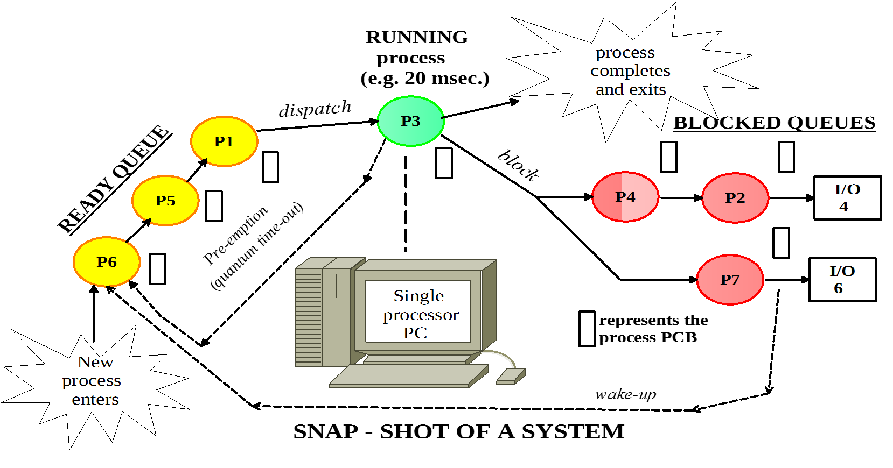
Process Logical Queues
P3
Running
P6
P5
P1
Ready
P4
P2
Blocked on I/O #4
P7
Blocked on I/O #6
Notes:
This is a diagram of the same system ‘snapshot’ but this time the illustration shows just simple logical queues.
Now that we have looked at the process table, it is possible to explain a little more about how the illusion of multiple sequential processes is maintained on one (or each) CPU. Associated with each I/O class is a location (typically at a fixed location near the bottom of memory) called the interrupt vector. It contains the address of the interrupt service procedure. Suppose that user process 3 is running when a disk interrupt happens. User process 3’s program counter, program status word, and sometimes one or more registers are pushed onto the (current) stack by the interrupt hardware. The computer then jumps to the address specified in the interrupt vector. That is all the hardware does.
From here on, it is up to the software, in particular, the interrupt service procedure.
Actions such as saving the registers and setting the stack pointer cannot even be expressed in high-level languages such as C, so they are performed by a small assembly-language routine, usually the same one for all interrupts since the work of saving the registers is identical, no matter what the cause of the interrupt is.
When this routine is finished, it calls a C procedure to do the rest of the work for this specific interrupt type. (We assume the operating system is written in C, the usual choice for all real operating systems.)
A process may be interrupted thousands of times during its execution, but the key idea is that after each interrupt the interrupted process returns to precisely the same state it was in before the interrupt occurred.

Slide 32
Process Termination
Normal exit (voluntary) – Most processes terminate when job is done.
Error exit (voluntary) – Process discovers a bug or an error and then exits.
Time overrun – Process has waited longer than allowed for some I/O to occur.
Invalid instruction – Process attempts to execute invalid instruction.
Fatal error (involuntary):
Memory unavailable – Process requires more memory than the system can provide.
Bounds violation – Process tries to access memory location without permission.
Protection error – Process attempts to use a resource in an improper fashion (write to read-only).
Killed by another process – When a parent process exits, the OS may automatically terminate all children processes created by the parent process.
Notes:
NORMAL: Most processes terminate because they have done their work.

Slide 33
Questions?

