Slide 1
ED5502 Embedded Software
Lecture 11:
STM32 Timer Modes,
Output Setting using Output Compare
Ciaran MacNamee

Slide 2
What we will cover today
We look at the Compare/Capture features of STM32 Timers
We look at how to set up a Timer using Output Compare (OC) to generate a periodic output signal

Slide 3
After these lectures you should be able to:
Explain the use of the Capture/Compare features of the STM32 timers
Explain how the HAL libraries describe the Timer Registers
Initialise and use Timer Interrupts starting with ST32CubeMX

Slide 4
Output Compare using MCU Timers
Given a free running counter set a value in the Compare Register, so that when the current counter value matches the Compare Register an event will occur – usually driving a change on an output pin
If you change the Compare Register value and reset the compare event, then you can create a periodic (or non-periodic) set of signals on the output pin
A variation on this technique is called Pulse Width Modulation (PWM)

Slide 5
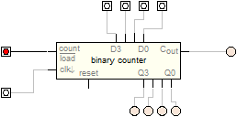
Four Bit Up Counter Output Generation
Compare Value
Clock Signal
Connect the Clock Input to a clock input of known frequency
Start at zero
Compare with a known preset value
When they match you have made your delay or tick
Comparator
Delay Generated or Event Occurrence
The Event Occurrence can be sent to an output pin
You can generate an output signal this way
E,g. for motor control (PWM)

Slide 6
STM32 Timers
STM32 has four types of Timer:
Advanced-Control Timers (TIM1/TIM8)
16-bit timers with master-slave and break features
General-Purpose Timers (TIM2/TIM3/TIM4/TIM5)
TIM2 and TIM5 are 32-bit timers
TIM3 and TIM4 are 16-bit timers
Basic Timers (TIM6/TIM7)
No connection to IO pins (Channels)
Low Power Timer (LPTIM)

Slide 7
General Purpose Timers
These timers may be used for time delays or for output (compare) signal generation or for input capture
Output Compare (including PWM) changes the state of an output pin (Channel in STM32)
Input Capture detects an edge on an inout pin (or channel)
These timers support 4 channels

Slide 8
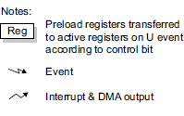
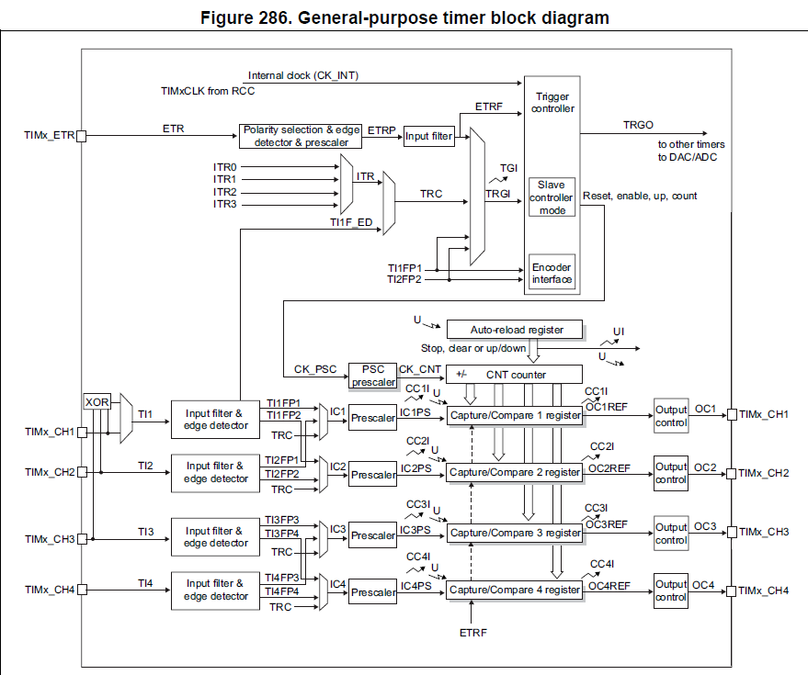
This time we’re looking at the output signal generation
Note that the same registers are used for capture and compare

Slide 9
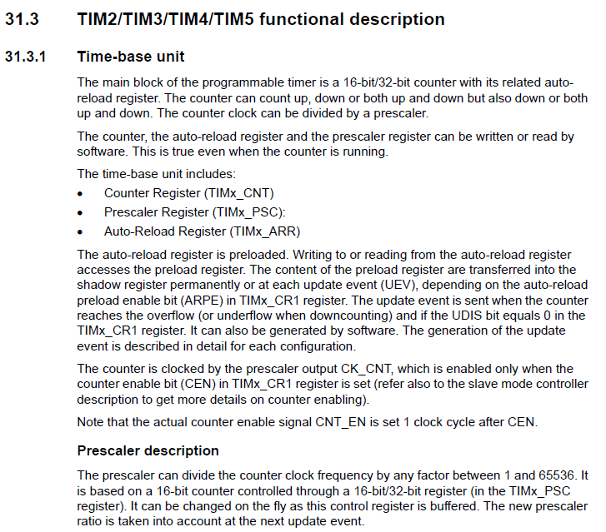

Slide 10
Time Base Unit
No matter what mode we use for the Timer/Counter, we have to set up options to control the Time Base Unit
These options must be setup to enable Input Capture too
Clock and Prescaler affect timing resolution

Slide 11
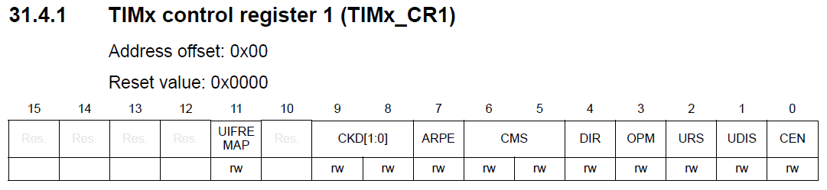
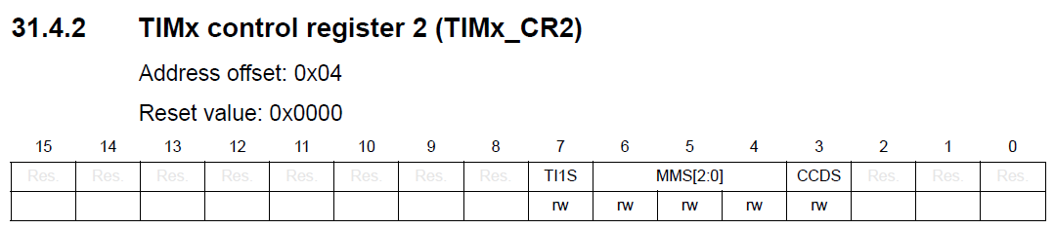
Control Registers
We will see how these registers map to STM32CubeMX and to HAL TypeDefs
Sets Direction, ARR Source, whether an Update Event updates the counter etc
CCDS enables DMA mode

Slide 12
Example: TIM2 CH2 Output Compare
We will configure TIM2 CH2 for Output Compare
First, what pin does this map onto?
See STM32L476RG Data Sheet, Alternate Functions

Slide 13
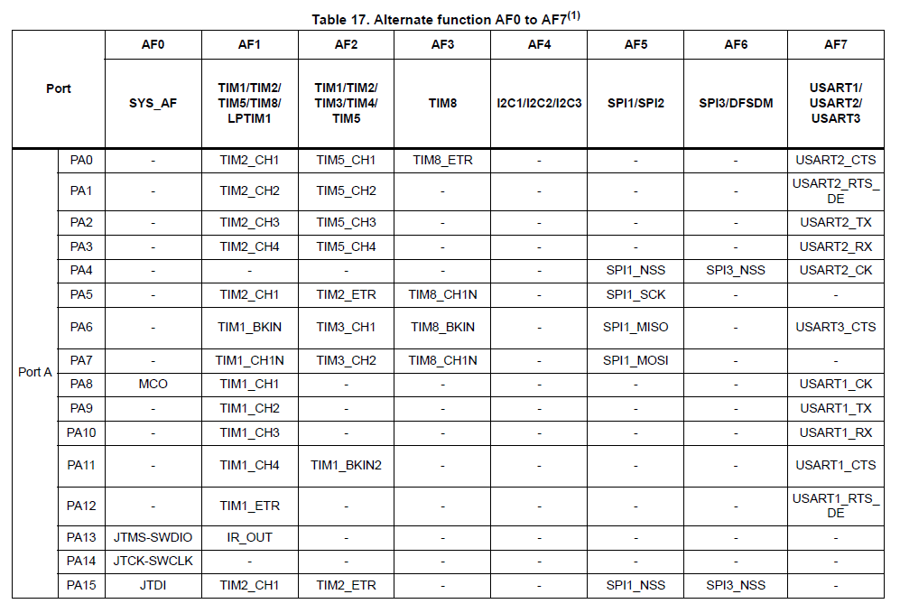
We must use PA1, which is on the Arduino Header

Slide 14
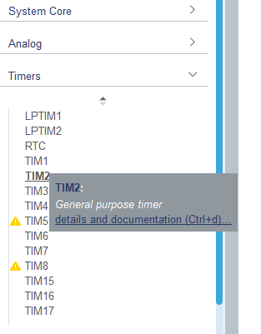
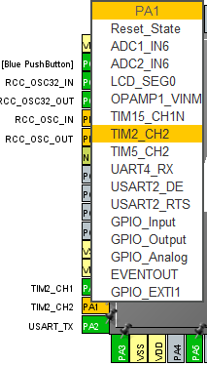
STM32CubeMX: PA1
Next select TIM2 under Timers
We see its list of Alternative Functions here

Slide 15
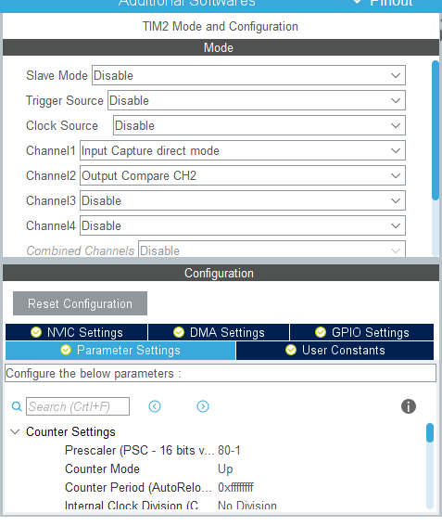
STM32CubeMX: PA1, TIM2 CH2
Channel 2, Select Output Compare CH2
Opens up the Configuration and Parameter Settings
(Same as IC example)

Slide 16
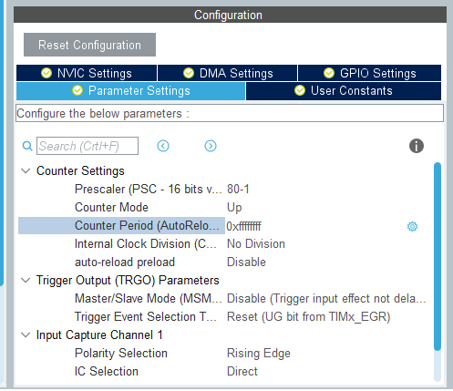
STM32CubeMX: TIM2
The Clock Frequency is 80MHz
Divide by 80 will give a TIM2 Clock frequency of 1 MHz, Period = 1 us
Select 0xffffffff (8 f’s – max count for a 32 bit counter)
Up counter
No division of the internal clock
(These TIM2 Clock Settings are the same as those we used for Input Capture)

Slide 17
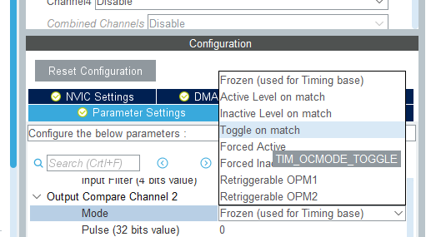
STM32CubeMX: TIM2 CH2, OC
Select Toggle On match
But note that the other options allow for more flexible output signals

Slide 18
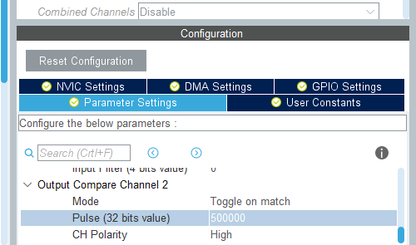
STM32CubeMX: TIM2 CH2, OC
Select Toggle On match
Set First Pulse Value – in this case 500000 gives 0.5s delay

Slide 19
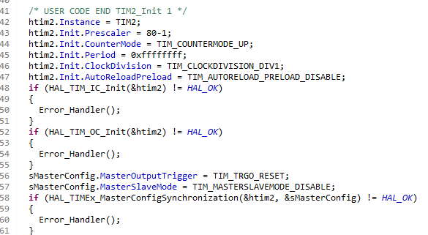
STM32CubeMX Generated Code
Calls HAL_TIM_OC_Init(&htim2);
OC – Output Compare
MX generated code includes Trigger Out/In initialisation
(You can just keep the defaults – disabled)
Note that this example also initialised Input Capture on TIM2 CH1
Indicates that TIM2 can simultaneously support both modes on different channels

Slide 20
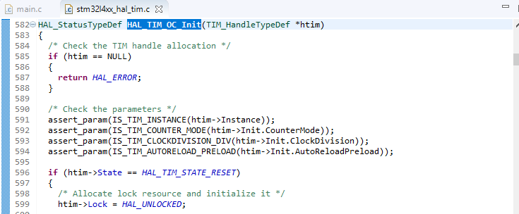
HAL_TIM_OC_Init()
Like HAL_TIM_ICInit(), this is found in stm32l4xx_hal_tim.c

Slide 21
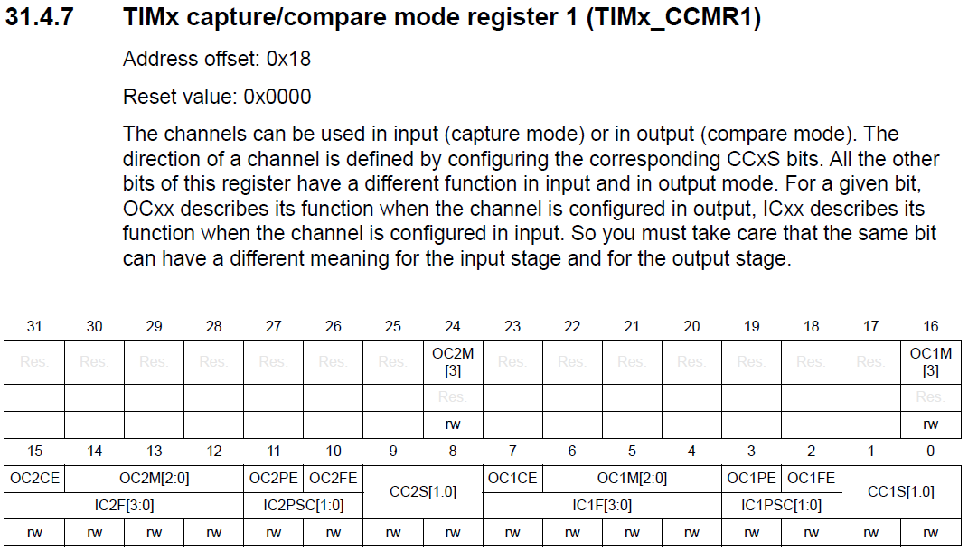
TIMx_CCMRy Registers
This register applies to CH1 & CH2
CCMR2 applies to CH3 & CH4
Depending on the setting of these fields, the upper or lower rows determine what’s enabled
The upper row applies to Output Compare

Slide 22
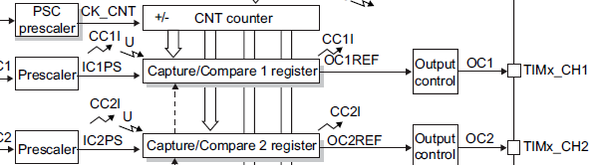
TIMx_CCMRy Registers
We need to program Output Control
Setting these bits to Zero sets Output Compare Mode

Slide 23
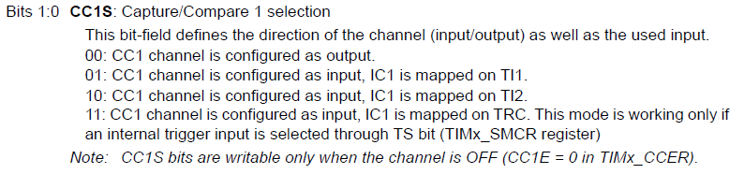
TIMx_CCMRy Registers

Slide 24
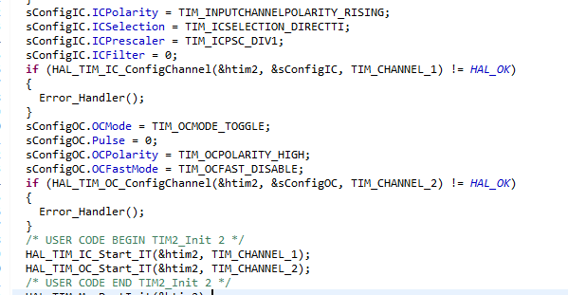
CCMRx Registers: CubeMX code
This code sets the bit of the upper row of CCMR1 when OC Mode is in use

Slide 25
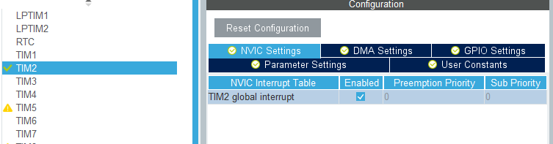
CubeMX TIM2 CH2 NVIC Settings
Enable TIM2 Interrupt and set priorities (if using)
TIM2 uses the same global interrupt for IC and OC interrupts

Slide 26
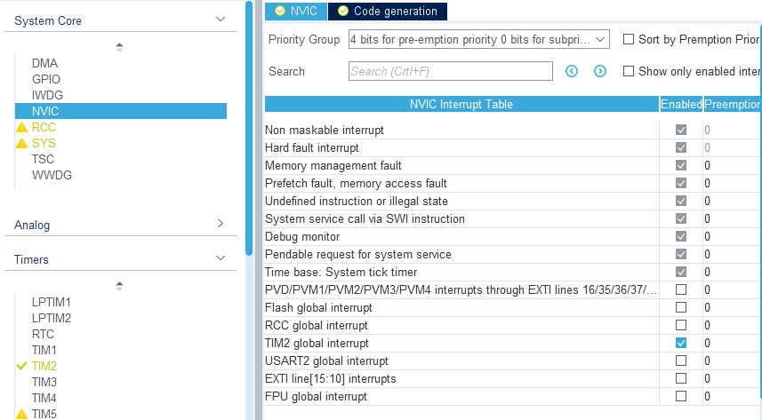
CubeMX TIM2 CH2 NVIC Settings
Enable TIM2 Interrupt and set priorities (if using)
Appears here because we set it in the TIM2 NVIC field

Slide 27
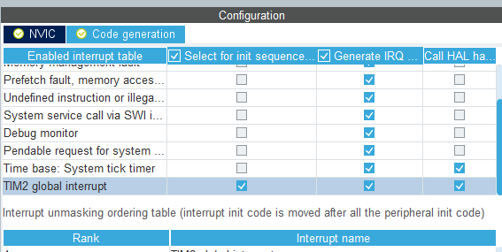
CubeMX TIM2 CH2 NVIC Settings
Make sure that Interrupt handler code is generated and that initialisation code is generated

Slide 28
Output Compare Interrupt Handler (ISR)
Very similar to the IC case we looked at previously
A callback function is used, with a __weak version in the Timer HAL, stm32l4xx_hal_tim.c

Slide 29
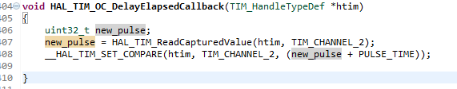
Compare Callback
We read the current compare register (remember it’s the same register that is used for capture purposes) and we rewrite it using a macro
The updated version is the current time + the time till the next pulse
In my case, at 80MHz with prescale of 80 (80-1) to give a clock period of 1us, I set PULSE_TIME to 500000 for 0.5 seconds

Slide 30
Summary
Worked example using CubeMX and the HAL libraries to implement a measurement of a periodic signal using the STM32 bit counter in input capture mode

